Slide 1
Georgia Alternate Assessment
Aligning Assessment Tasks
for the GAA 2016-2017 Session 4

Slide 2
2016-2017 GAA Purpose:
The 2016-2017 webinars (Sessions 1-5) explain how to prepare and submit GAA portfolios.
http://www.gadoe.org/Curriculum-Instruction-and-Assessment/Assessment/Pages/GAA-Presentations.aspx
Information pertaining to the GAA can also be found in the 2016-2017 GAA Examiner’s Manual.
http://www.gadoe.org/Curriculum-Instruction-and-Assessment/Assessment/Pages/GAA-Resources.aspx
Notes:
As a reminder, when the PPT is open you may highlight the link and right click in order to “Open Hyperlink” and gain access to the links and websites.

Slide 3
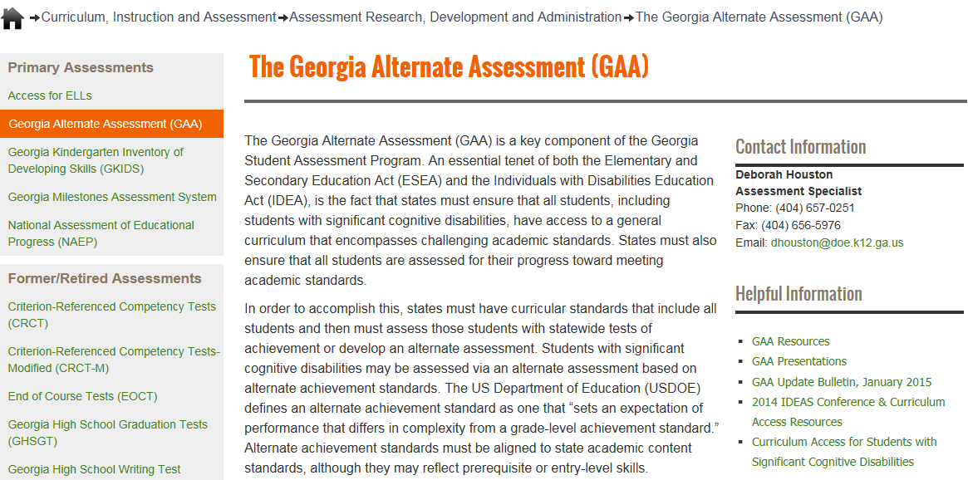
Links to Presentations are on the GaDOE website (shown below)
http://www.gadoe.org/Curriculum-Instruction-and-Assessment/Assessment/Pages/GAA.aspx
Notes:
All Fall Training presentations will be posted on the GaDOE website at:
http://www.gadoe.org/Curriculum-Instruction-and-Assessment/Assessment/Pages/GAA-Presentations.aspx
The GAA Resources link will bring you to Manuals, Electronic Forms (such as the Entry Sheet), Score Interpretation Guides, and other ancillary documents.
The GAA Presentations link will bring you to Pre-Admin Training Presentations (past and present), Mid-Admin and Post-Admin presentations, and other presentations such as “Unpacking the Standards.”

Slide 4
Questions & Answers
You are invited to submit questions you may have using the “Questions” feature of the GoToWebinar anytime throughout each session.
The “Questions” feature will be monitored throughout the session and questions will be addressed.

Slide 5
GAA 2016-2017 Key Dates
August 30 – September 2, 2016:
Manuals, Administration forms, and binders arrive
September 6, 2016 – March 24, 2017:
Administration Window

Slide 6
Topics in this Presentation
It is designed to inform:
All teachers who administer the GAA
Peer reviewers and designated trainers
Special education directors
Test coordinators
Building administrators
Topics in this training session:
Alignment
Unpacking the Standards
Sample Tasks
Prerequisite Skills
Aligning to the Characteristics of Science (CoS)

Slide 7
Table of Contents
Slides
8-10 Alignment to State-Mandated Content Standards
11-14 Alignment – Identifying the Skills and Grade 4 example
15-17 Essential Skills / Unpacking the Standards
19-21 Grade 5 ELA Entry 1 (Reading Literary) example
22-24 Grade 6 ELA Entry 2 (Writing) example
25-30 Guidance for Writing tasks in all grades
32-35 Grade 5 Math Entry 2 example (G.3)
36-38 Grade 8 Math Entry 1 example (EE.2)
39-42 Grade 8 Math Entry 2 example (SP.1)
44 Characteristics of Science
45-48 Grade 5 Science example (S5L1a) characteristic of science: compares physical attributes
49-52 Grade 5 Science example (S5L3b) characteristic of science: identifies parts and makes models
53-55 Grade 8 Science example (S8P3c) characteristic of science: records investigations clearly and accurately
56-59 Grade HS Science Entry 1 (Biology) example (SB4b) characteristic of science: organizes data into graphs, tables, and charts
60-63 Grade HS Science Entry 1 (Biology) example (SB3b) characteristic of science: organizes data into graphs, tables, and charts
64-67 Grade HS Science Entry 2 (Physical Science) example (SPS6e) characteristic of science: records investigations clearly and accurately
69-71 Grade 5 Social Studies (Geographic Understandings) example (SS5G1a)
72-74 Grade 8 Social Studies (Georgia Studies) example (SS8G1b)
75-77 Grade HS Social Studies Entry 1 (U.S. History) example (SSUSH9c)
78-80 Grade HS Social Studies Entry 1 (U.S. History) example (SSUSH16d)
81-83 Grade HS Social Studies Entry 2 (Economics) example (SSEPF1a)
84-86 Grade HS Social Studies Entry 2 (Economics) example (SSEF3a)
87-93 Looking at the skill in the context of the standard / alignment through pre-requisite skills
94-95 Sample Task Resource Guide / Resource Materials
96-98 Contact Information
99 Webinar Survey

Slide 8
Alignment

Slide 9
Alignment to State-Mandated Content Standards
Assessment tasks must align to the grade-level content standard.
Assessment tasks may be simplified to accommodate students with significant cognitive disabilities, but they still must connect to the grade-level standard.
Each of the four assessment tasks must align to the “Big Idea” (intent) of the standard.
The standards-based skill being addressed by the assessment task must connect to the intent of the standard and element/indicator and be taught in the context of the standard.

Slide 10
Alignment to State-Mandated Content Standards
The content standards are the goals for instruction, learning, and assessment.
ELA and Math curricula have standards and indicators while Science and Social Studies curricula have standards and elements. Elements and indicators are the specific concepts and skills within the content standards.
Notes:
When there is no indicator or element, alignment is to the standard.

Slide 11
Alignment Identifying the Skills
GAA students do not need to perform assessment tasks which encompass all aspects of the element/indicator (or the standard, if there in no element or indicator).
It is often more appropriate for a GAA student to focus on just one part of the element/indicator (or standard) in the four assessment tasks, demonstrating a baseline skill in the Collection Period 1 tasks and Achievement/Progress in the same skill in the Collection Period 2 tasks.

Slide 12
Alignment Identifying the Skills
When the standard IS broken down into elements and indicators:
Achievement of the concepts and skills inherent in the element or indicator leads to the achievement of the overall standard.
Although assessment tasks must align to the distinct aspects of the element or indicator, they must do so under the umbrella of the standard.

Slide 13
Alignment Identifying the Skills
Some of the state standards are broad and encompass more skills within a standard.
There can be more than one “Big Idea” and a number of standards-based skills within the same standard.
It is appropriate for teachers to choose one skill around which to design the assessment tasks. This may be more appropriate for many GAA students.
All four of the assessment tasks in an entry must demonstrate a connection to the same standards-based skill.
The same skill(s) must be demonstrated across both collection periods.
Additional skills can be added in the second collection period.
Notes:
It is NOT required that all aspects of a standard or element/indicator be addressed in order for an entry to be aligned and scorable.
In order to receive a 3 in Fidelity to Standard, the student would need to be assessed on all aspects of this standard, and the student’s work would need to address the academic content at or approaching basic grade-level expectations. However, in order to attain alignment to the standard, a student may focus on one or more aspect(s) of the element. The student being assessed could focus on parallel and perpendicular lines ONLY, (e.g., “drawing” them and/or identifying them in two-dimensional figures). These skills should be demonstrated across both collection periods to effectively demonstrate Achievement/Progress.

Slide 14
Alignment Identifying the Skills ELA example – Grade 4
ELAGSE4.L.4 | Demonstrate understanding of figurative language, word relationships, and nuances in word meanings.
c. | Demonstrate understanding of words by relating them to their opposites (antonyms) and to words with similar but not identical meanings (synonyms).
All four assessment tasks must align to the indicator.
If a teacher chooses to assess a student on just a part of the indicator, then all of the assessment tasks must align to the same part of the indicator.
If a teacher chooses to assess a student’s understanding of, for example, synonyms in Collection Period 1, then the student’s work in Collection Period 2 must include synonyms too.
It is acceptable to assess a student on one part of the element (e.g., synonyms) in all four tasks AND to add another part (e.g., antonyms) in Collection Period 2 tasks.
Notes:
It is NOT required that all aspects of a standard or element/indicator be addressed in order for an entry to be aligned and scorable.
In order to receive a 3 in Fidelity to Standard, the student would need to be assessed on all aspects of this indicator, and the student’s work would need to address the academic content at or approaching basic grade-level expectations. However, in order to attain alignment to the indicator, a student may focus on just one aspect of the indicator. It is essential that a common skill be demonstrated across both collection periods so that Achievement/Progress can be judged.

Slide 15
Unpacking the Standards
Essential Skills Task Design Writing the Task Description

Slide 16
Unpacking the Standards
To understand the intent of the standards, look first at the nouns.
Highlight key words and phrases.
Look at the noun: what is the student to know?
Look at the verb: what is the student to do?
Understanding the intent of the standard is necessary to choosing a standards-based skill for assessment.
Notes:
The nouns tell what students are required to know.
The verbs tell how the student will show what is required.

Slide 17
Unpacking the Standards
Unpack the standard
Is there an element or indicator?
What are the essential skills?
Choose the standards-based skill for assessment
Can you identify one standards-based skill to assess in both collection periods?
Design the assessment tasks
Do each of the four assessment tasks in an entry relate to the intent of the standard and the element or indicator?
Notes:
Before choosing assessment tasks, it is critical that the teacher understand the essential skills inherent in the standard and then choose the skill that presents the most appropriate level of challenge for the individual student.

Slide 18
English Language Arts (ELA) Examples

Slide 19
Example from the Grade 5 ELA Standards
English Language Arts – Entry 1 (Reading Literary)
ELAGSE5.RL.3 | Compare and contrast two or more characters, settings, or events in a story or drama, drawing on specific details in the text (e.g., how characters interact).
What are the nouns?
characters, settings, events
What are the verbs?
compare, contrast
Notes:
Grade 5 Standard RL.3 has no indicators.

Slide 20
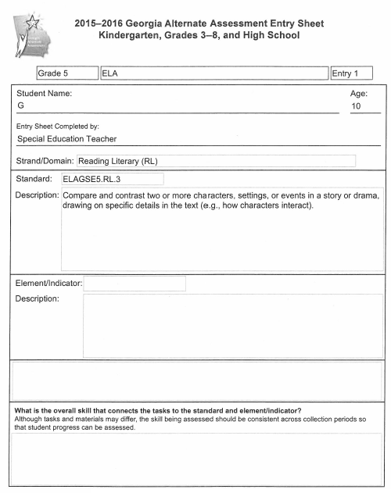
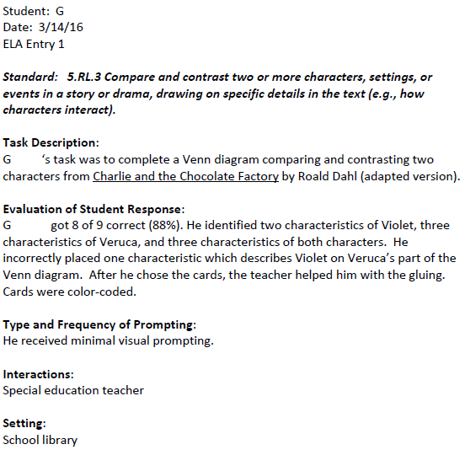

Slide 21
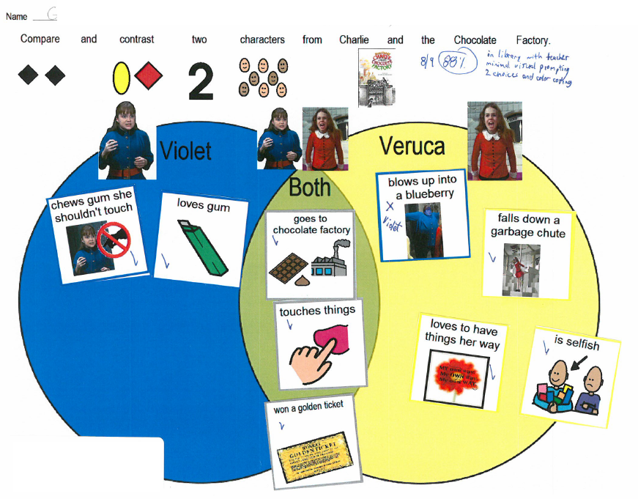
The student’s task is to compare two characters from Charlie and the Chocolate Factory. The student uses picture cards to complete a Venn diagram, showing which traits apply to one character or the other and which traits are common to both characters.

Slide 22
Example from the Grade 6 ELA Standards
English Language Arts – Entry 2 (Writing)
ELAGSE6.W.2 | Write informative/explanatory texts to examine a topic and convey ideas, concepts, and information through the selection, organization, and analysis of relevant content.
b. | Develop the topic with relevant facts, definitions, concrete details, quotations, or other information and examples.
topic, facts, definitions, details, quotations
What are the nouns?
What is the verb?
develop
Notes:
In Writing entries in all grades, students must produce a permanent product which another person can read and understand, whether or not the writer is present. A written permanent product is defined as a sentence, paragraph, essay handwritten or typed by the student, dictation to a scribe, symbols, picture or object representation.
In Writing entries in all grades, students must produce writing which another person can read and make sense of. Here the student has written by pasting a single word to complete a sentence. Sequencing steps in a recipe or daily schedule by pasting strips is acceptable too. Sequencing pictures, with or without text, to tell a story is also acceptable.
It is not acceptable to put numbers in front of sentences (e.g., 2,4,5,1,3) to show the order of sentences in a paragraph. Matching and multiple choice tasks are also considered not to be writing tasks.

Slide 23
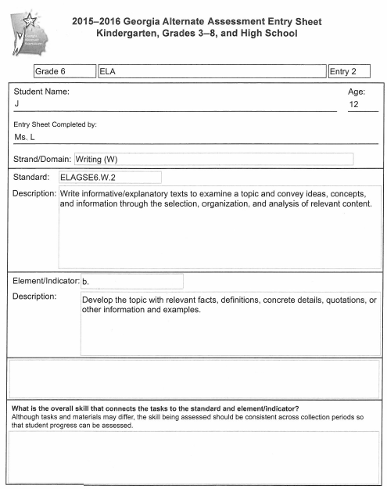
A student with extremely severe cognitive disabilities can be given words, pictures or sentence strips to use to write responses. It is not necessary for a student to be able to print, handwrite or use a keyboard.
Students may construct a written document using words, picture icons or sentence strips that express their thoughts and attaching them to the page themselves or with assistance from a teacher or peer buddy.
The student’s work (seen on the next slide) uses sentence strips to describe Eleanor Roosevelt and Frederick Douglass.

Slide 24
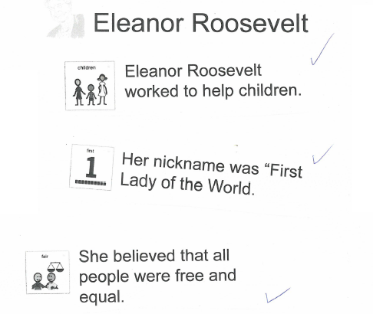
The student was asked to write about two people who were significant in American history. The student developed the topic using relevant facts and details. The student wrote using the sentence strips that expressed facts describing the lives of Eleanor Roosevelt and Frederick Douglass.

Slide 25
Writing tasks in all grades
All Writing tasks in all grades must involve the production of some form of “written” product by the student. A student’s writing must be a visual product that can be interpreted by the reader when the student is not present.
Writing is:
Typing, writing or printing words, phrases or sentences
Dictating words, phrases or sentences which are scribed by another person
Using a computer or speech-to-text assistive technology to produce readable text
Completing a “written” phrase to convey information with a phrase, word, communication symbol(s), pictures or objects in logical order
Telling a story or giving information by appropriately placing phrases, words, sentences, communication symbols, pictures or objects in logical order
Organizing information to be communicated on a graphic organizer such as an outline or Venn diagram
Writing is not completing a worksheet by:
Matching activities
Selecting answers to multiple choice questions
Numbering sentences
Circling words, phrases or sentences

Slide 26
In Writing entries in all grades, students must produce a permanent product which another person can read and understand, whether or not the writer is present. A written permanent product is defined as a sentence, paragraph, essay handwritten or typed by the student, dictation to a scribe, symbols, picture or object representation.
It is not necessary for a student to be able to print, handwrite or use a keyboard. A student with extremely severe cognitive or physical disabilities may utilize words, picture icons, Boardmaker symbols, or sentence strips when writing a response. A teacher or peer buddy may then paste the student-selected items on the page in accordance with the student’s direction. Students may dictate their writing verbally, by using American Sign Language (ASL), or by using an augmentative communication device. Another person may act as a student’s scribe and type or print the student’s work.
Writing a recipe or daily schedule by indicating the information that is to be included and in the correct order is one way for a student to write. Using pictures, with or without text, to write a story is also acceptable.
It is not acceptable to put numbers in front of sentences (e.g., 2,4,5,1,3) to show the order of sentences in a paragraph. Matching and multiple choice tasks are also considered not to be writing tasks.
Examples of tasks which are not Writing tasks are shown on the next four slides.

Slide 27
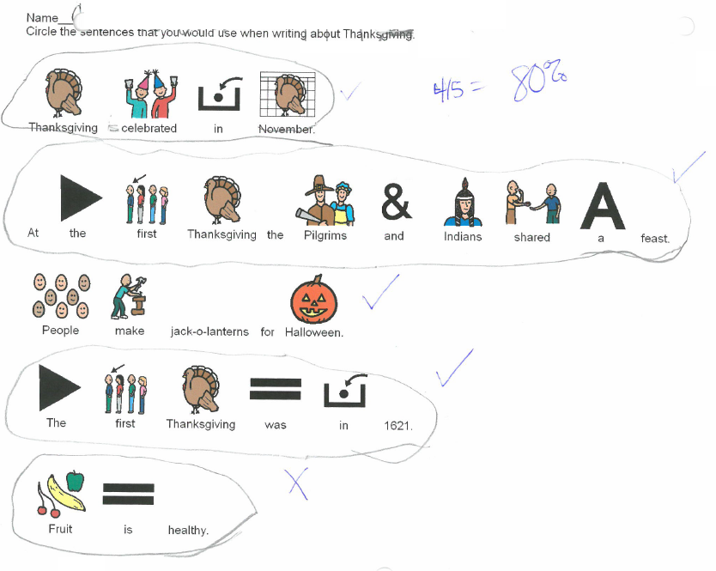
A committee of Georgia educators has determined that circling words or sentences is not a writing task. This task is not aligned to any Writing standard. The Writing entry which included this piece of evidence received a nonscorable code.
Do Not Use

Slide 28
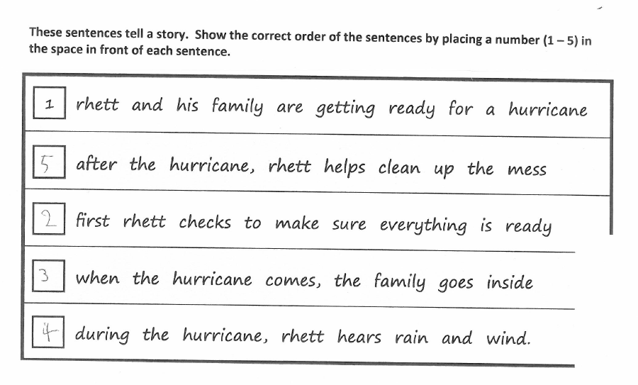
Do Not Use
A committee of Georgia educators has determined that numbering sentences is not a Writing task. This task is not aligned to any Writing standard. The Writing entry which included this piece of evidence received a nonscorable code.

Slide 29
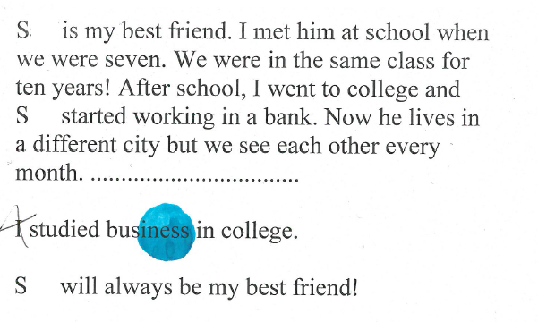
Multiple choice questions are not Writing tasks
A committee of Georgia educators has determined that answering multiple choice questions is not a Writing task. This task is not aligned to any Writing standard. The Writing entry which included this piece of evidence received a nonscorable code.
Do Not Use

Slide 30
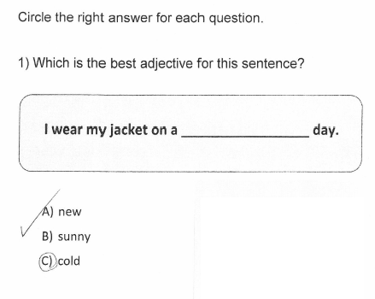
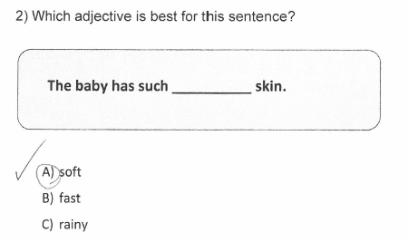
A committee of Georgia educators has determined that answering multiple choice questions is not a Writing task. This task is not aligned to any Writing standard. The Writing entry which included this piece of evidence received a nonscorable code.
Do Not Use

Slide 31
Mathematics Examples
Notes:
Grade 5 Standard RL.3 has no indicators.

Slide 32
Example from the Grade 5 Math Standards
MGSE5.G.3 | Classify two-dimensional figures into categories based on their properties.
 | Understand that attributes belonging to a category of two-dimensional figures also belong to all subcategories of that category. For example, all rectangles have four right angles and squares are rectangles, so all squares have four right angles.
What are the nouns? attributes, two-dimensional figures
What is the verb? understand

Slide 33
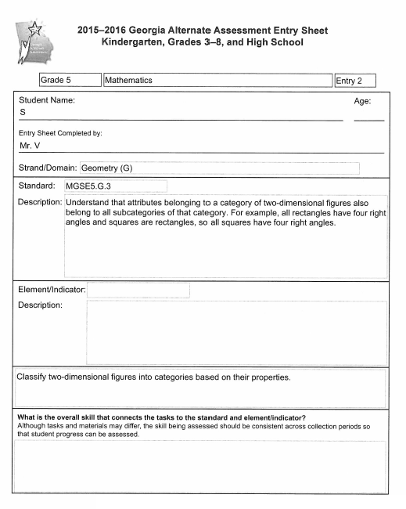
The Entry Sheet is the first page of every entry in every content area. Once the teacher chose MGSE5.G.3 from the drop-down menu, then the text of the standard automatically appeared on the Entry Sheet and the cluster statement associated with that standard (classify two-dimensional figures into categories based on their properties) appeared near the bottom of the page. The teacher opted not to answer the question that appears at the bottom of the Entry Sheet (what is the overall skill that connects the tasks to the standard and element/indicator?).

Slide 34
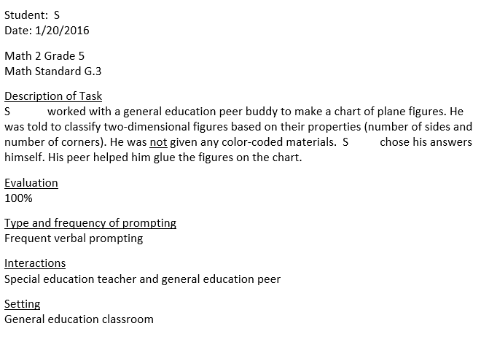
The teacher’s annotation (left) describes what the student was asked to do in this aligned task. The word “corner” is used when it would be more precise to say “angle,” but the meaning is clear. The student’s work is on the next slide.

Slide 35
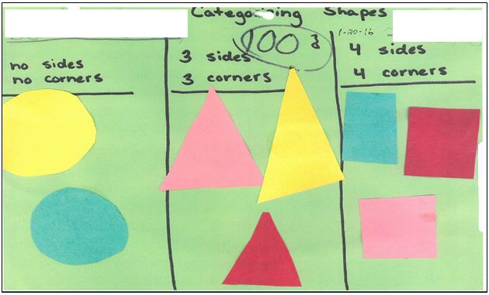
The student used a teacher-made chart to categorize plane figures according to the number of sides and angles (“corners”) each of them has.

Slide 36
Example from the Grade 8 Math Standards
MGSE8.EE.2 | Work with radicals and integer exponents.
 | Use square root and cube root symbols to represent solutions to equations. Recognize that $x^{2}$ = p (where p is a positive rational number and l x l ≤ 25) has 2 solutions and $x^{3}$= p (where p is negative or positive rational number and l x l ≤ 10) has one solution. Evaluate square roots of perfect squares ≤ 625 and cube roots of perfect cubes ≥ -1000 and ≤ 1000.
What are the nouns? square root, cube root
What is the verb? use, recognize, evaluate

Slide 37
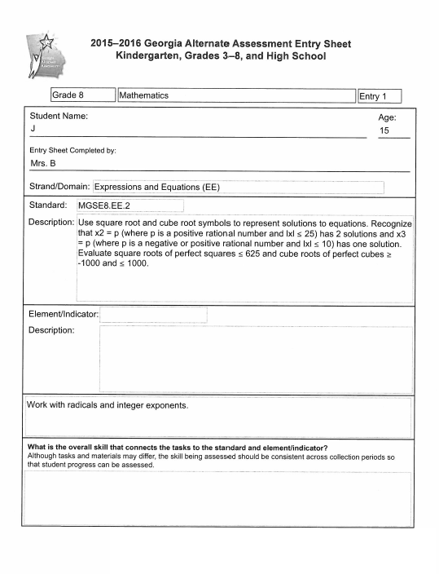
The cluster statement for this Mathematics standard in the Expressions and Equations domain is work with radicals and integer exponents.

Slide 38
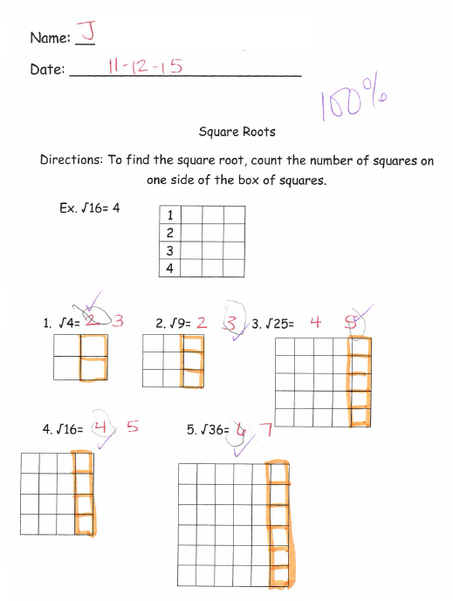
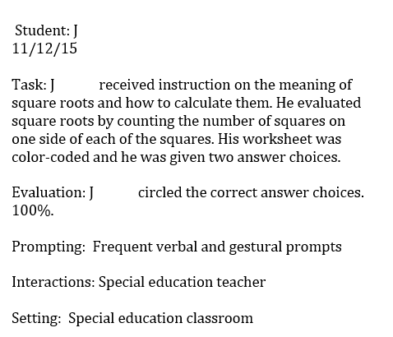

Slide 39
Example from the Grade 8 Math Standards
MGSE8.SP.1 | Investigate patterns of association in bivariate data.
 | Construct and interpret scatter plots for bivariate measurement data to investigate patterns of association between two quantities. Describe patterns such a clustering, outliers, positive or negative associations, linear association, and nonlinear association.
What are the nouns? plots, data, patterns of association
What is the verb? construct, interpret, describe
Notes:
Student work does not need to involve every aspect of a standard. In the task seen on the next two slides, the teacher chose to focus the assessment task only on positive and negative patterns of association. Once the teacher has chosen a part of the content standard to use for a student’s assessment, it is essential that each of the four tasks in the entry focus on the same part of the standard.

Slide 40
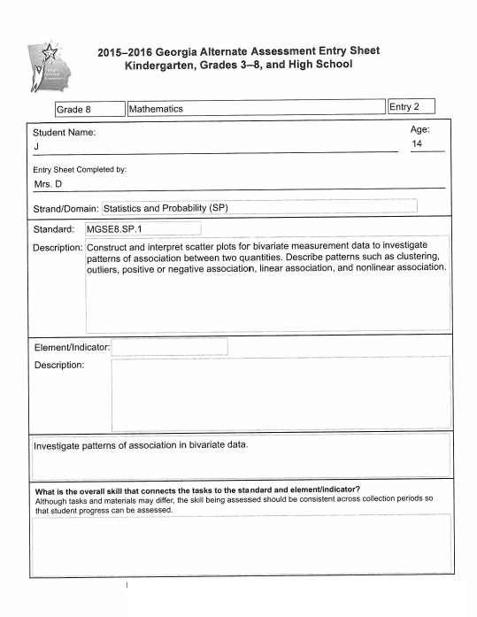

Slide 41
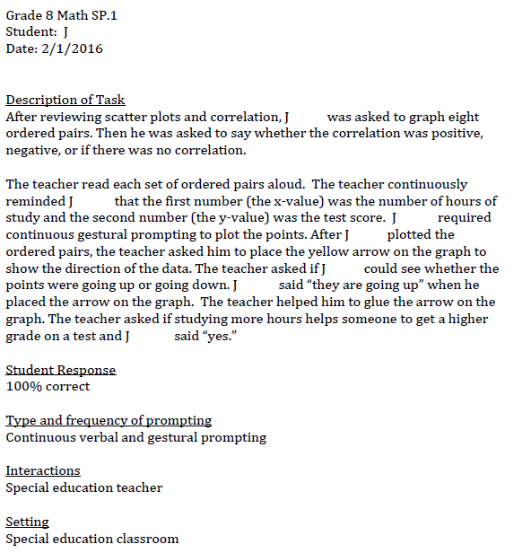
The student’s evidence is on the next slide. In this annotation, the teacher explains in some detail that the student was to plot ordered pairs and to answer interpretation questions about the graph he made.
Notes:
The teacher’s detailed annotation will help scorers understand exactly what the student was asked to do.

Slide 42
The student plotted the eight ordered pairs and then answered an interpretation question about the data. The student also placed the yellow arrow provided by the teacher on the graph to show a positive correlation between study time and test performance.

Slide 43
Science Examples

Slide 44
Science Tasks and the Characteristics of Science
All assessment tasks must align to the content standard and indicator/element, if there is one. Science entries have an additional requirement: at least one task in each Science entry must exemplify the co-requisite Characteristic of Science (CoS) which the teacher has chosen.
Science is assessed in Grades 5, 8 and High School. Teachers should choose a CoS from the drop-down menu on the Science Entry Sheets. The student should exemplify that CoS in at least one of the four Science tasks in each entry.
Science entries which have four aligned tasks but do not show any evidence of the CoS are not scorable.
More information about each CoS is available in the Examiner’s Manual 2016-2017 and on this website:
https://www.georgiastandards.org/Standards/Pages/BrowseStandards/ScienceStandards.aspx

Slide 45
Example from the Grade 5 Science Standards
S5L1 | Students will classify organisms into groups and relate how they determined the groups with how and why scientists use classification.
a. | Demonstrate how animals are sorted into groups (vertebrate and invertebrate) and how vertebrates are sorted into groups (fish, amphibian, reptile, bird, and mammal).
What are the nouns? animals, vertebrate groups, invertebrate groups
What are the verbs? demonstrate, sort
Supplementary concepts: animals in the vertebrate group (fish, amphibians, reptiles, birds, mammals)

Slide 46
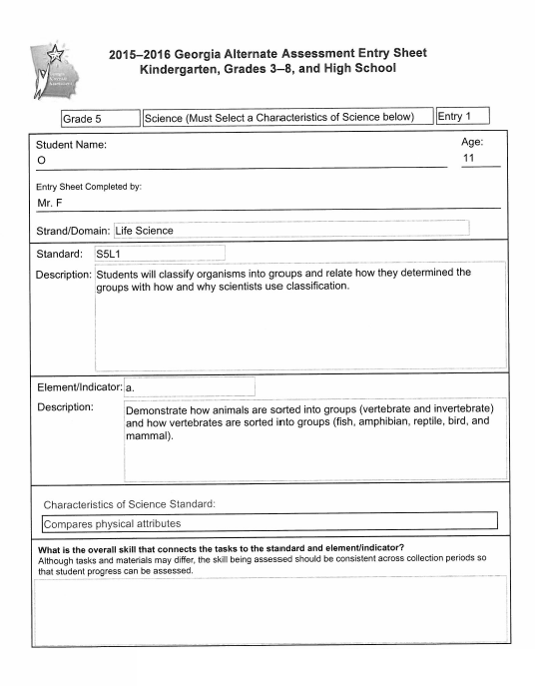
The Characteristic of Science (CoS) is compares physical attributes.

Slide 47
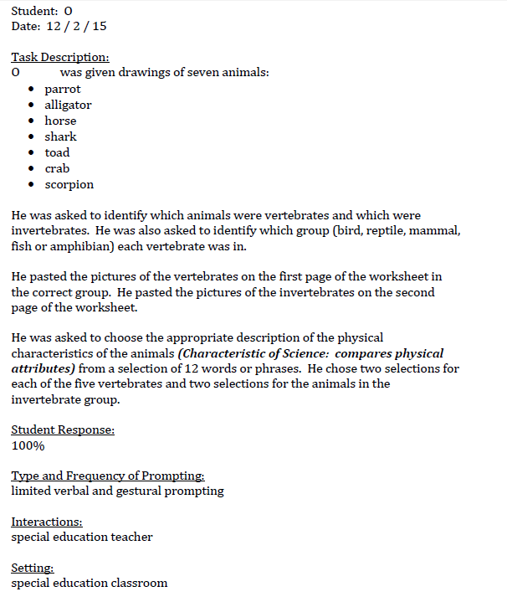
In this Grade 5 Science task, the student performs an aligned task and satisfies the selected Characteristic of Science (compares physical attributes). The student’s two-page worksheet is on the next slide.

Slide 48
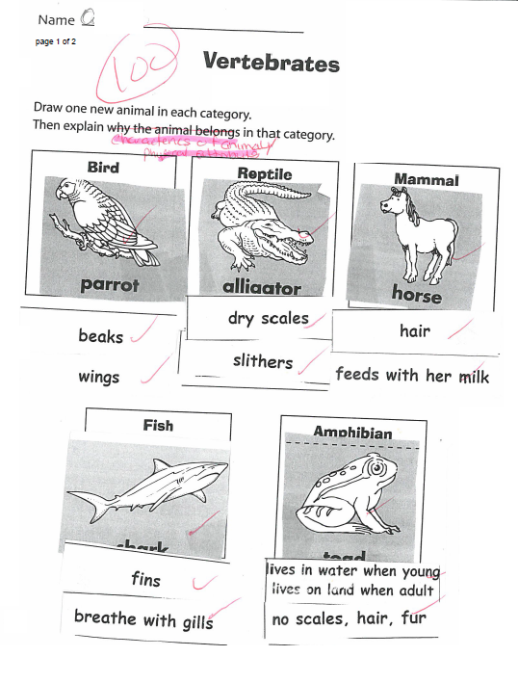
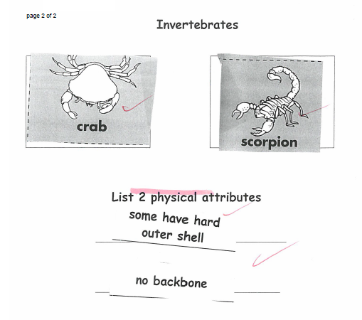

Slide 49
Example from the Grade 5 Science Standards
S5L3 | Students will diagram and label parts of various cells (plant, animal, single-celled, multi-celled).
b. | Identify parts of a plant cell (membrane, wall, cytoplasm, nucleus, chloroplasts) and of an animal cell (membrane, cytoplasm, and nucleus) and determine the function of the parts.
What are the nouns? parts, plant cell, animal cell, function of the parts
What are the verbs? identify, determine

Slide 50
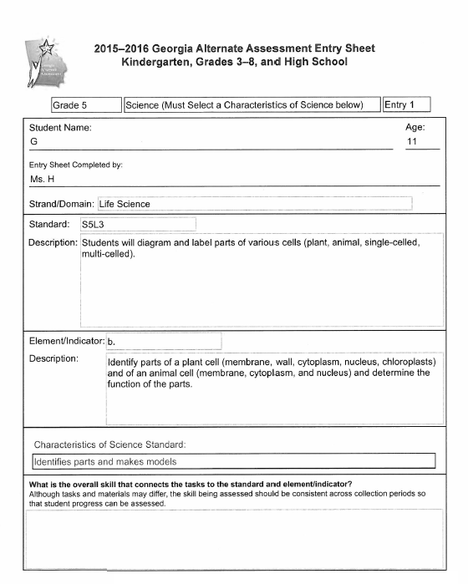
The Characteristic of Science (CoS) is identifies parts and makes models.

Slide 51
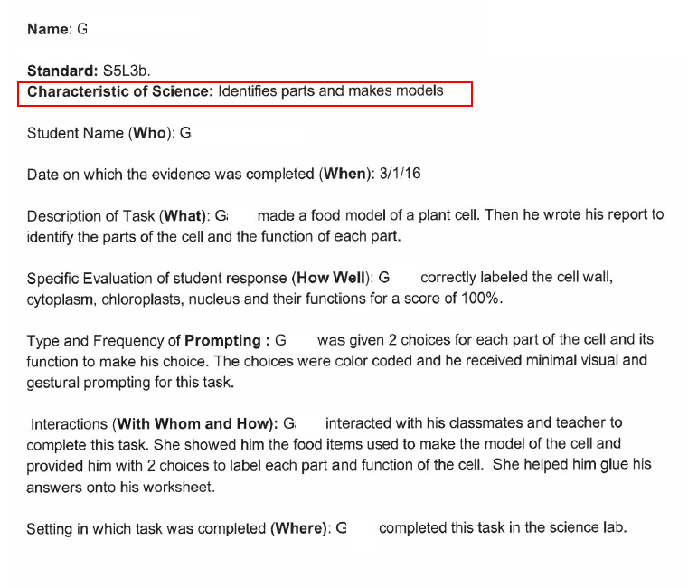
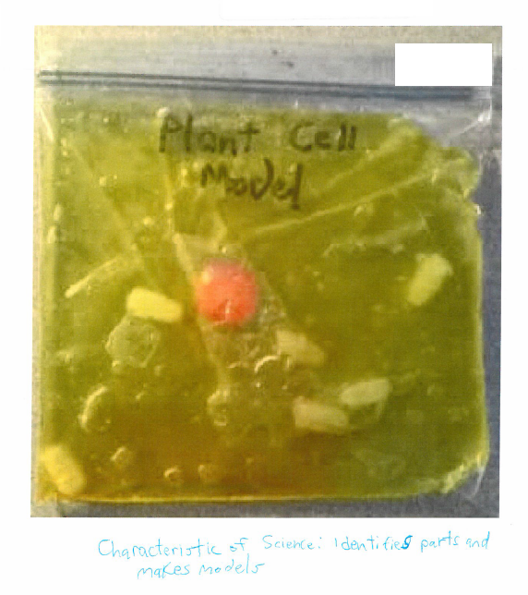
The teacher photographed the model the student made. Lab report is on next slide.

Slide 52
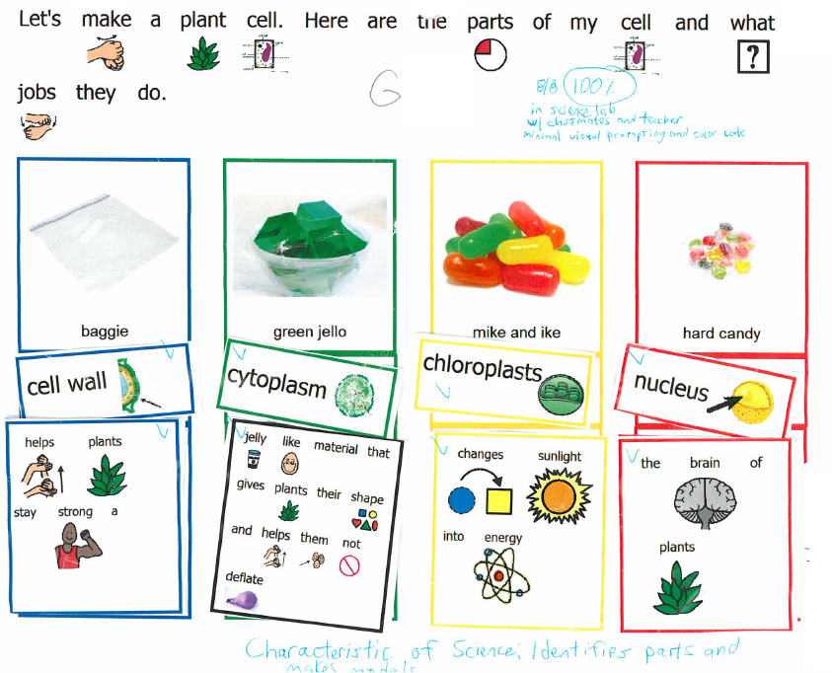

Slide 53
Example from the Grade 8 Science Standards
S8P3 | Students will investigate relationship between force, mass, and the motion of objects.
c. | Demonstrate the effect of simple machines (lever, inclined plane, pulley, wedge, screw, and wheel and axle) on work.
What are the nouns? simple machines, effect on work
What are the verbs? demonstrate

Slide 54
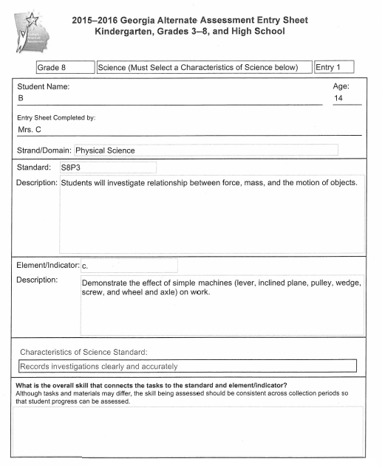
The teacher chose records investigations clearly and accurately as the student’s Characteristics of Science (CoS).
The student performed an investigation (see next slide) by cutting meat and unscrewing the top of a jar. He recorded the results of his investigation on a worksheet.
Notes:
Detailed information about all of the Characteristics of Science for each grade may be found in the Examiner’s Manual 2016-2017. Science is assessed only in Grades 5, 8 and High School.

Slide 55
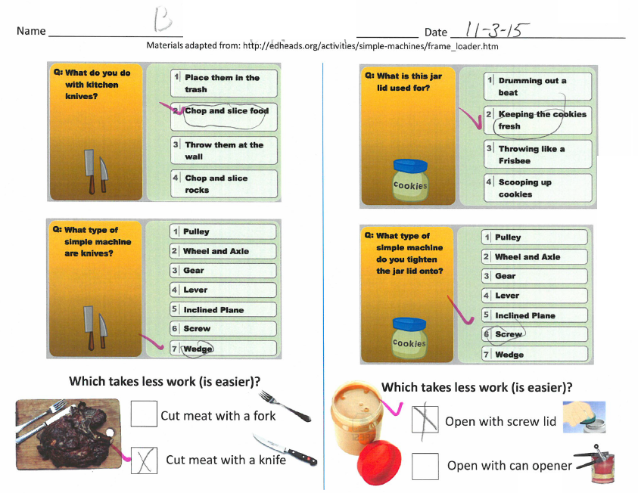
Notes:
The essence of this element is the effect on work of each simple machine. Merely identifying simple machines is not enough.

Slide 56
Example from the Grade HS Science Standards Science 1 (Biology)
SB4 | Students will assess the dependence of all organisms on one another and the flow of energy and matter within their ecosystems..
b. | Explain the flow of matter and energy through ecosystems by: Arranging components of a food chain according to energy flow. Comparing the quantity of energy in the steps of an energy pyramid. Explaining the need for cycling of major nutrients (C,O,H,N,P).
What are the nouns? flow of matter, flow of energy, food chain, energy pyramid, major nutrients
What are the verbs? explain, arrange, compare

Slide 57
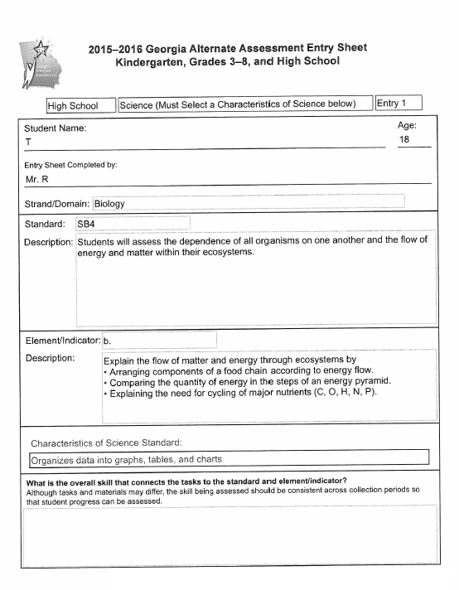
The Characteristic of Science (CoS) is organizes data into graphs, tables, and charts.

Slide 58
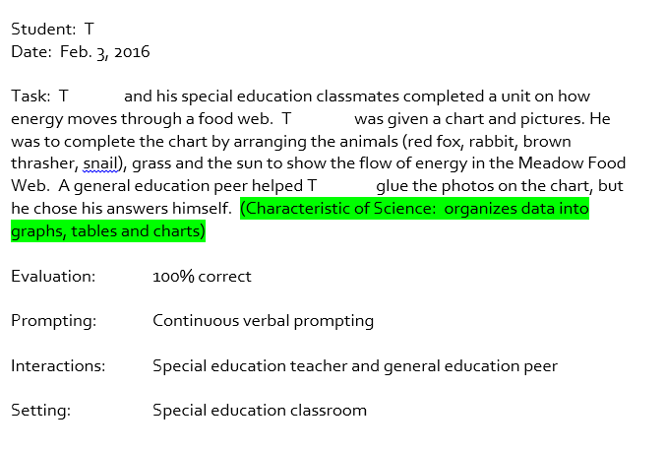
The student’s task is to show the flow of energy in a food web. This task also satisfies the Characteristic of Science organizes data into graphs, tables, and charts.

Slide 59
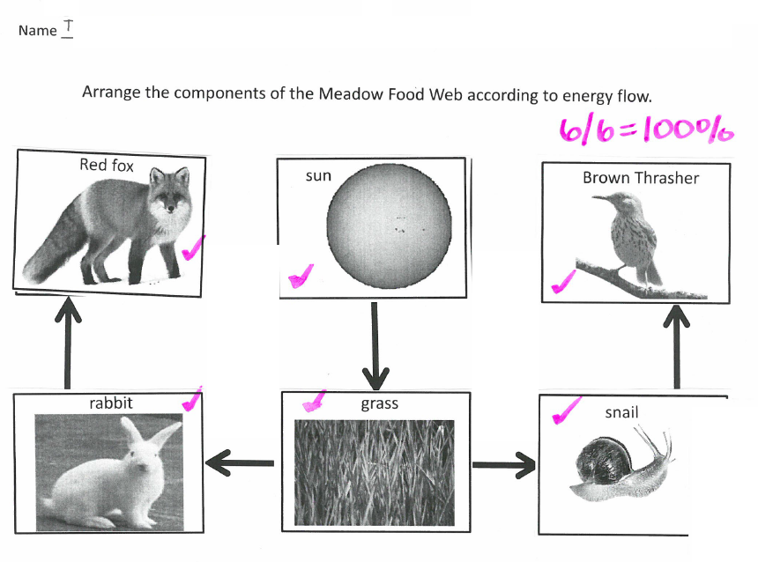
Notes:
This HS Biology task aligns to the first bulletpoint of the element (explain the flow of matter and energy through ecosystems by arranging components of a food chain according to energy flow). The second and third bulletpoints of the element (compare the quantity of energy in the steps of an energy pyramid and explain the need for cycling of major nutrients) are not addressed in this task.
Teachers may choose tasks for their GAA students which focus on just one part of an element or indicator (or the content standard, if there are no elements or indicators). Teachers are the best judges of which part of an element or indicator is most suitable for their students with significant cognitive disabilities.
If only part of the element or indicator is chosen, then it is essential that each of the four tasks in a student’s entry focuses on the same part of the element or indicator. It is not possible to evaluate a student’s achievement/progress if, for example, the tasks in Collection Period 1 involve a food chain but the tasks in Collection Period 2 involve an energy pyramid. If each of the student’s four tasks does not focus on the same part of the element/indicator, then the entry will receive a “1” in Achievement/Progress.

Slide 60
Example from the Grade HS Science Standards Science 1 (Biology)
SB3 | Students will derive the relationship between single-celled and multi-celled organisms and the increasing complexity of systems.
b. | Compare how structures and function vary between the six kingdoms (archaebacterial, eubacteria, protists, fungi, plants, and animals).
What are the nouns? structures, function, six kingdoms
What is the verb? compare

Slide 61
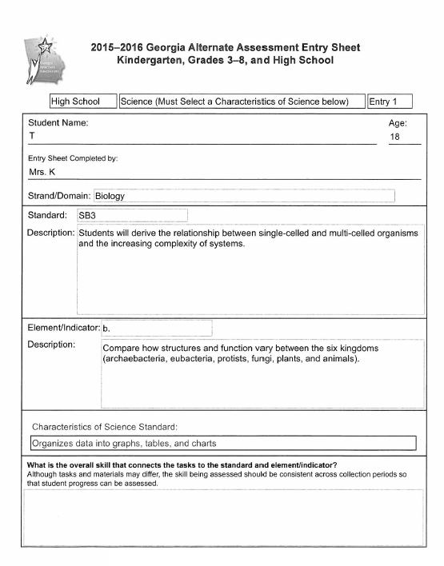
The Characteristic of Science (CoS) is organizes data into graphs, tables, and charts.

Slide 62
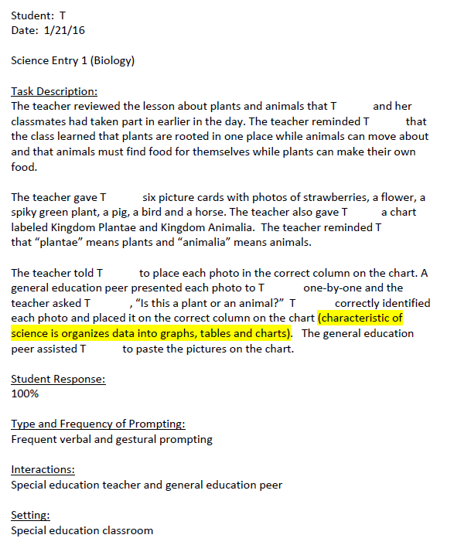
The teacher’s annotation describes the instruction the student received prior to the administration of the assessment task and also the assessment task itself. The student worked with a general education peer to complete the task, but it is clear that the student chose her answers herself. In addition to performing an aligned task, the student also had the opportunity to demonstrate the Characteristic of Science organizes data into graphs, tables and charts.

Slide 63
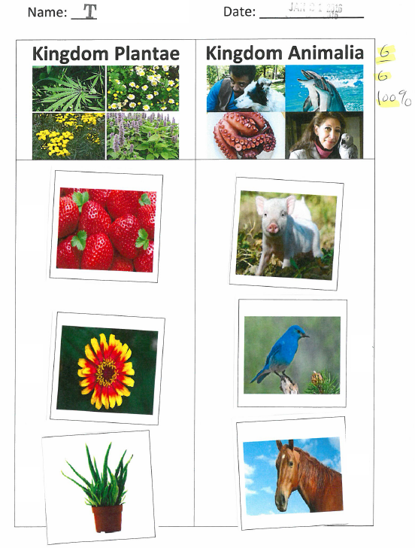
The student’s task was to identify plants and animals. The task does not involve the four other kingdoms (archaebacterial, eubacteria, protists, and fungi) mentioned in the element. That is acceptable because an assessment task may involve only part of an element. All four of a student’s tasks in one entry must involve the same parts of an element.

Slide 64
Example from the Grade HS Science Standards Science 2 (Physical Science)
SPS6 | Students will investigate the properties of solutions.
e. | Determine whether common household substances are acidic, basic, or neutral.
What are the nouns? common household substances
What are the verbs? determine

Slide 65
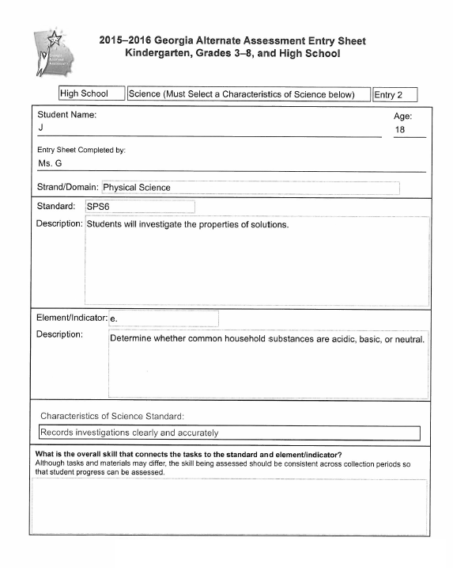
The Characteristic of Science (CoS) is records investigations clearly and accurately.

Slide 66
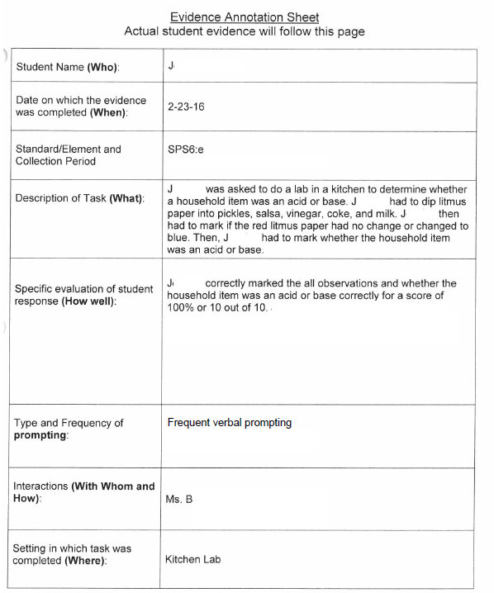
The teacher’s annotation explains that the student will test pickles, salsa, vinegar, Coke and milk with litmus paper. She will record her observations (is it an acid or a base?) on her lab sheet. The student is performing an aligned task and she is also exemplifying the Characteristic of Science records investigations clearly and accurately.

Slide 67
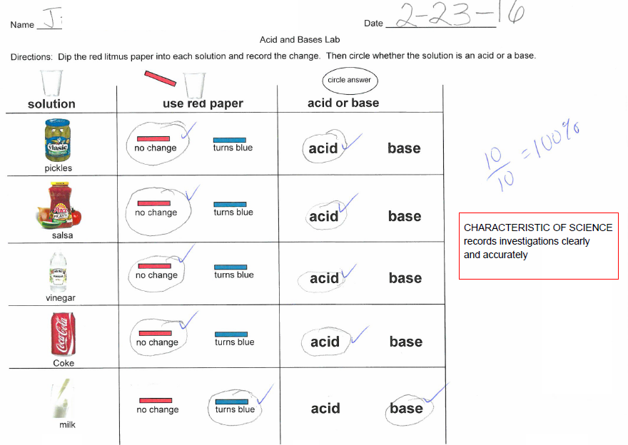
Notes:
The student used litmus paper to test five household items. She recorded her investigations on this lab sheet. She also met the requirements of the chosen Characteristic of Science (CoS) “records investigations clearly and accurately.” The student needs to exemplify the CoS only once in a Science entry. It is fine if a student exemplifies the CoS more than once, but the GAA requirement is just one exemplification of the CoS in any one of the four tasks in the entry.

Slide 68
Social Studies Examples

Slide 69
Example from the Grade 5 Social Studies Standards Geographic Understandings
SS5G1 | The student will locate important places in the United States.
a. | Locate important physical features; include the Grand Canyon, Salton Sea, Great Salt Lake, and Mojave Desert.
What are the nouns? Grand Canyon, Salton Sea, Great Salt Lake, Mojave Desert
What are the verbs? locate

Slide 70
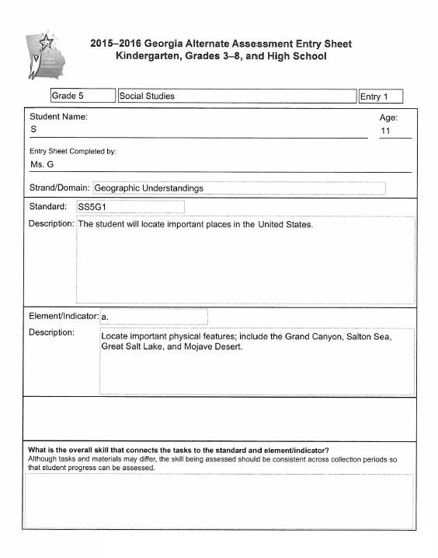
The element says “locate…” so the student should find the Grand Canyon and/or other physical features on a map OR the student should describe where the features are by naming the state or region of the United States where they are located.
If an element says “locate on a map…” then it is necessary for all of the student’s tasks to include maps.

Slide 71
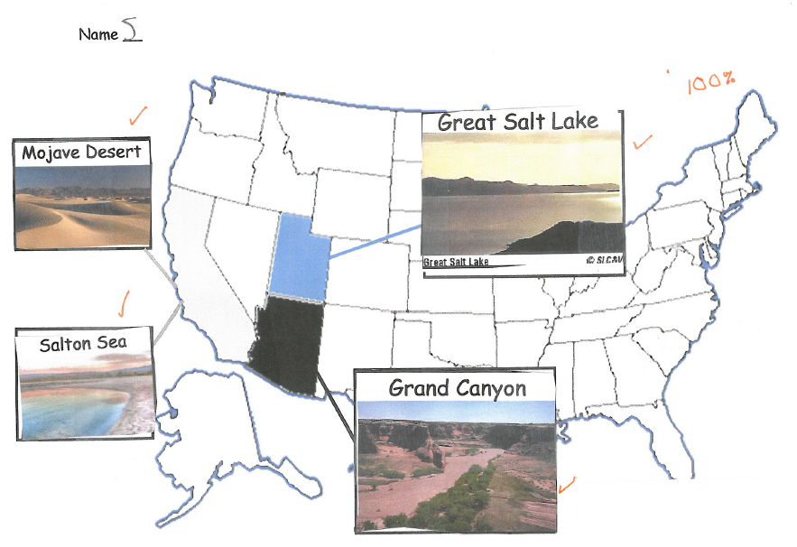
The teacher’s annotation says the student used a map of the United States on the classroom wall to guide him. The student and his classmates had just completed a unit on the geography of the American Southwest.
Notes:
Maps are not required when an element says “locate…” rather than “locate on a map…” but it is always acceptable to use a map when a task involves locating any physical feature.

Slide 72
Example from the Grade 8 Social Studies Standards
Georgia Geographic Understandings
SS8G1 | The student will describe Georgia with regard to physical features and location.
b. | Describe the five geographic regions of Georgia: include the Blue Ridge Mountains, Valley and Ridge, Appalachian Plateau, Piedmont, and Coastal Plain.
What are the nouns? five geographic regions
What is the verb? describe

Slide 73
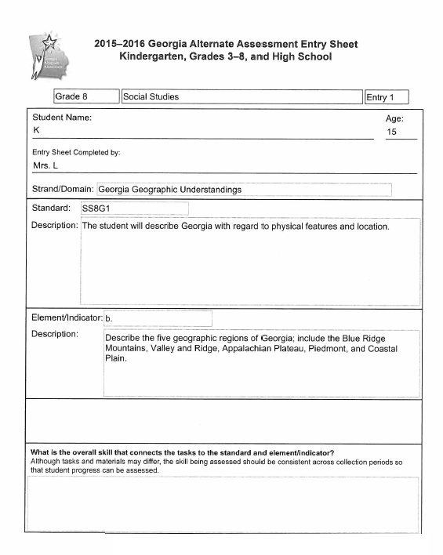
Describing regions of Georgia may include finding the regions on a map as a way of describing their location. Teachers also have the option of asking students to describe a region’s plants, animals, crops, natural resources, terrain or proximity to bodies of water.

Slide 74
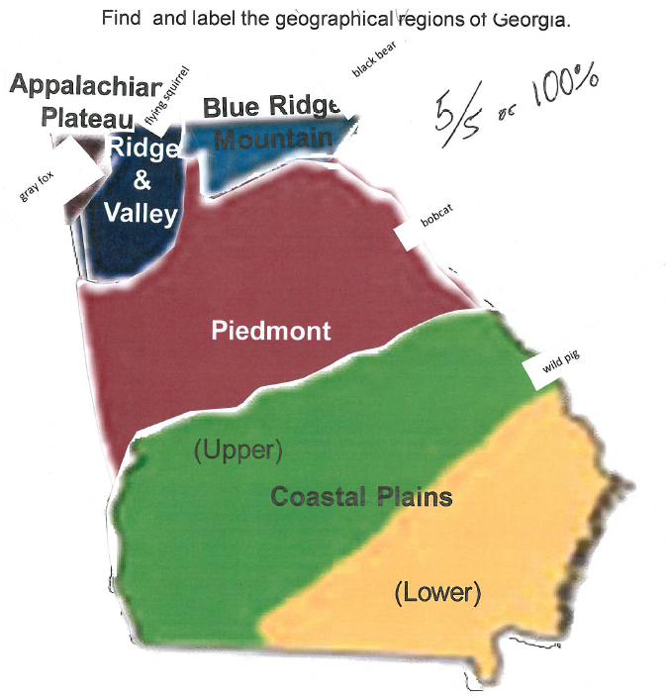
The student pasted the name and shape of each region on the cut-out map of Georgia. The student also identified one animal which is native to each region.
Notes:
Many geography standards in all grades use the phrase “locate on a map…” In those instances, it is necessary for the student to find a particular place on a map. In this Grade 8 standard and element, the text says “Describe the five geographic regions….” A map might be used as a way of describing the location of the region(s), but it is not required. In the task shown on this slide, the student is asked to indicate on a Georgia map where each region is located (one way of describing the region) and to indicate one animal which is native to the region (another way of describing the region).

Slide 75
Example from the Grade HS Social Studies Standards
Social Studies 1 – United States History
SSUSH9 | The student will identify key events, issues, and individuals relating to the causes, course, and consequences of the Civil War.
c. | Describe the roles of Ulysses Grant, Robert E. Lee, “Stonewall” Jackson, William T. Sherman, and Jefferson Davis.
What are the nouns? roles, Grant, Lee, Jackson, Sherman, Davis
What are the verbs? describe
Key Concept: historical significance of five Civil War military leaders

Slide 76
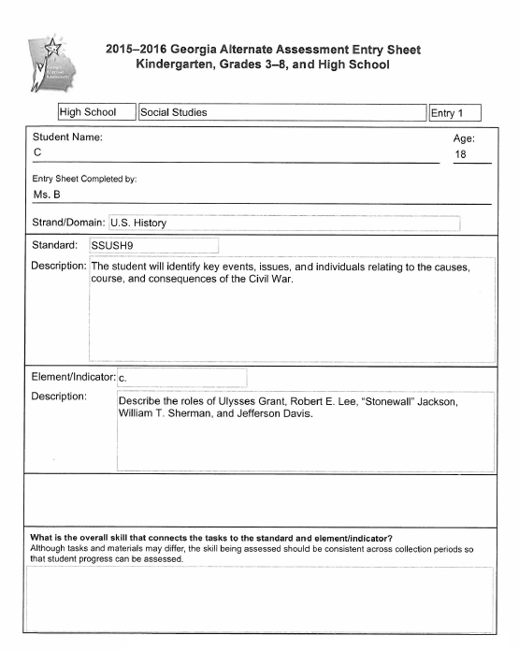

Slide 77
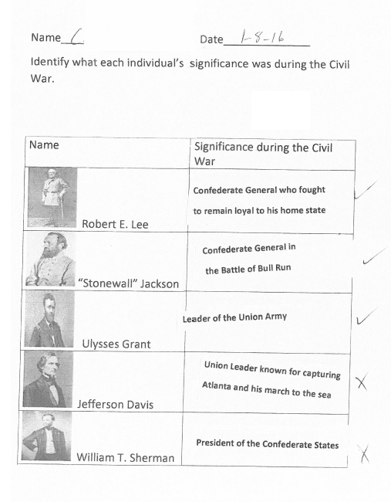
The student was given printed phrases to use to identify each of the five men.

Slide 78
Example from the Grade HS Social Studies Standards Social Studies 1 – United States History
SSUSH16 | The student will identify key developments in the aftermath of WWI.
d. | Describe modern forms of cultural expression; include Louis Armstrong and the origins of jazz, Langston Hughes and the Harlem Renaissance, Irving Berlin, and Tin Pan Alley.
What are the nouns? modern forms of cultural expression
What is the verb? describe

Slide 79
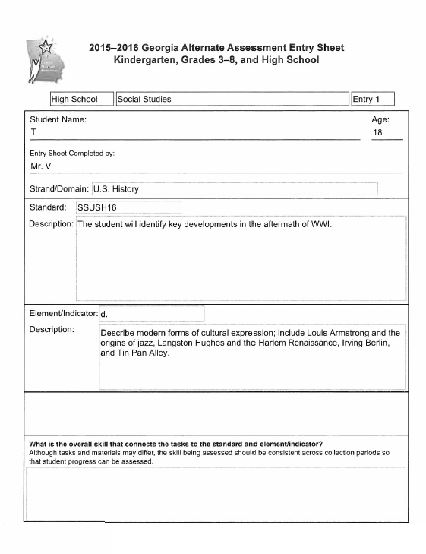
The student’s task involves only Louis Armstrong and the origins of jazz. It does not involve other individuals or historical events cited in the element.

Slide 80
Independent – no prompting
The student used a bingo stamper to answer five multiple-choice questions about Louis Armstrong and the origins of jazz.

Slide 81
Example from the Grade HS Social Studies Standards Social Studies 2 – Personal Finance Economics
SSEPF1 | The student will apply rational decision making to personal spending and saving choices.
b. | Use a rational decision making model to select one option over another.
What is the noun? Rational decision making model
What are the verbs? Use, select
Supporting concept
Choosing to spend and/or save in ways which make sense for an individual

Slide 82
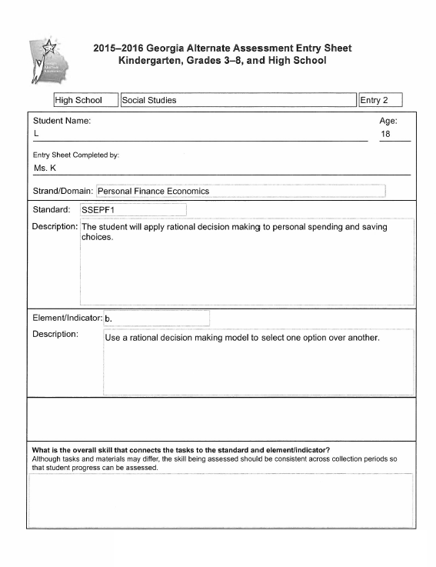

Slide 83
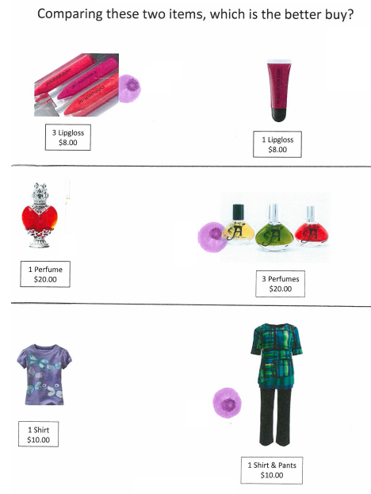
The student was asked to make spending choices based on price. Making a choice based on a single criterion like price satisfies the requirements of the standard and element at an access level.

Slide 84
Example from the Grade HS Social Studies Standards Social Studies 2 – Fundamental Economic Concepts
SSEF3 | The student will explain how specialization and voluntary exchange between buyers and sellers increase satisfaction of both parties.
a. | Give examples of how individuals and businesses specialize.
What is the noun? examples, individuals, businesses
What are the verbs? give
Supporting concept:
Understanding the advantages of specialization in the marketplace

Slide 85
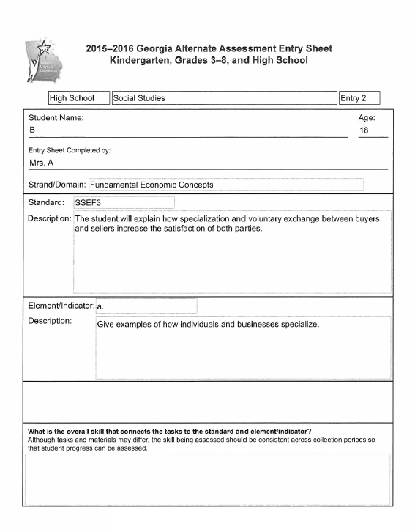

Slide 86
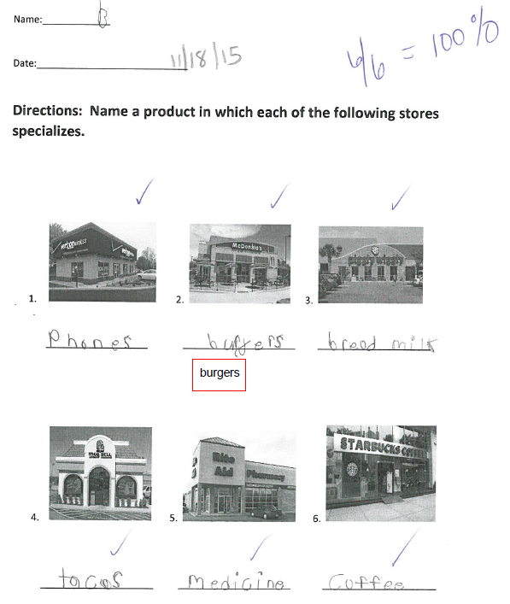
The student’s task is to identify examples of specialization in the marketplace.

Slide 87
Looking at the Skill in the Context of the Standard
Alignment through Prerequisite Skills

Slide 88
Alignment Through Prerequisite Skills
Tasks submitted for the assessment can focus on prerequisite skills that allow the student to be exposed to and assessed on the standard and element/indicator at a level that is meaningful and purposeful for the student.
Prerequisite skills must still focus on the intent of the grade level standard and element/indicator.
When assessing students via prerequisite tasks, it is important that the task be specific to the essence of the standard and demonstrate the student’s knowledge and skills as they relate to the strand being assessed.
Notes:
88
In curriculum training, the focus is on “Big Ideas” – what we are referring to here as the “intent” of the standards.
It is a misunderstanding to say that a student has to be able to identify letters or to decode words in order to access text and to demonstrate reading comprehension. Although it may be an important part of the student’s academic instruction to work on these skills, in and of themselves, they do not represent aligned tasks.

Slide 89
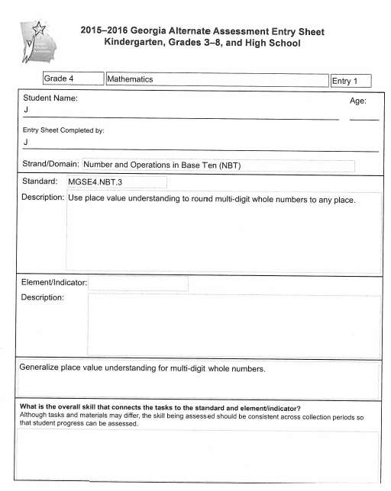
Prerequisite Skills
Prerequisite skill/task
Notes:
In this Grade 4 Math 1 entry, the student’s task in the first piece of evidence is to demonstrate an understanding of when to round “up” and when to round “down.”

Slide 90
Prerequisite Skills
Notes:
Please Note: This is a prerequisite skill because understanding when to round up or down, based on the value of the number in any of the columns, is essential for progressing to the rounding of multi-digit numbers.

Slide 91
Prerequisite Skills
Incorrect marking of CP label – will not affect Scoring.

Slide 92
Prerequisite Skills
A Prerequisite Skill is one that is essential to the acquisition of the standard and element/indicator.
addresses the intent of the standard and element/indicator being assessed
Notes:
A frequent misunderstanding of the concept of a prerequisite skill is the belief that there is a linear hierarchy to learning that must be followed and that anything that comes earlier in that hierarchy is a prerequisite. We think that children should learn to crawl and then to walk and then to run, but that does not make crawling a prerequisite to running. We think that children need to decode letters before they can read and that they need to be able to read before they can demonstrate comprehension of text, but we know that students can demonstrate comprehension without ever being able to identify or decode letters. A student who is a non-reader might listen to a story read aloud and then answer comprehension questions posed verbally by the teacher. That student can demonstrate reading comprehension without being able to identify letters or written words.
Since Mathematics is the science of numbers and their operations, should any task involving numbers be seen as a prerequisite to any and all math standards? Not necessarily.
In order to be considered a prerequisite to a standard, the skill being assessed must be essential to the specific intent of the standard - that is what separates one standard from another.

Slide 93
Is it a Prerequisite Skill?
To determine if a skill is truly a prerequisite to learning the targeted skill, the following questions should be asked:
Is the skill essential to understanding the intent of the standard and element/indicator?
Can working on this skill eventually lead to the standards-based skill targeted by the standard (at a less complex level)?
Notes:
93
If the skill is associated with that task but is not required to show the main concept, it is in itself not aligned when taught in isolation. The skill must be assessed in the context of the standard.
Should acquisition of the skill be part of the instruction that precedes the assessment?
If so, DO NOT submit the task as evidence for the assessment.

Slide 94
Sample Task Resource Guide
A new resource to provide sample tasks (individual entries) that are both aligned to grade-level content standards and accessible to students with a range of significant cognitive disabilities.
Contains sample tasks for all grades and all content areas.
The samples are intended to be used by teachers to inform their creation of assessment tasks which will be suitable for students with varying degrees of cognitive disabilities.

Slide 95
Resource Materials
Sample Task Resource Guide (new)
Individual sample entries
Student Samples Resource Guide
Annotated Student Entries per Content Area
Note: Both resources listed above will be posted to GaDOE Website at: http://www.gadoe.org/Curriculum-Instruction-and-Assessment/Assessment/Pages/GAA-Resources.aspx
Resource Board

Slide 96
Contact Information
Questions About Test Administration
GaDOE Assessment Administration Division
(800) 634-4106
Deborah Houston, Assessment Specialist
(404) 657-0251
dhouston@doe.k12.ga.us

Slide 97
Contact Information
For information about access to the state-mandated content standards for students with significant cognitive disabilities
Kayse Harshaw, Division for Special Education Services
(404) 463-5281
sharshaw@doe.k12.ga.us
kharshaw@doe.k12.ga.us

Slide 98
Contact Information
Questions About Materials, Distribution, or Collection
Questar’s GAA Customer Service
(866) 997-0698
GA@QuestarAI.com

Slide 99
Webinar Survey
We Want your Feedback!
Please use the below link to provide feedback regarding this GAA Training session!
http://gadoe.org/surveys/AsAc-H8PBVZM

