Slide 1
Georgia Alternate Assessment
Understanding the
Basics of the GAA Session 1

Slide 2
2017-2018 GAA
Purpose:
The 2017-2018 pre-administration training sessions explain how to prepare and submit GAA portfolios.
http://www.gadoe.org/Curriculum-Instruction-and-Assessment/Assessment/Pages/GAA-Presentations.aspx
Information pertaining to the GAA can also be found in the 2017-2018 GAA Examiner’s Manual.
http://www.gadoe.org/Curriculum-Instruction-and-Assessment/Assessment/Pages/GAA-Resources.aspx
Notes:
To access websites from a static PPT: Please highlight the web address, right click, and “Open Hyperlink.”
The GAA Presentations link will take you to current year and previous training sessions.

Slide 3
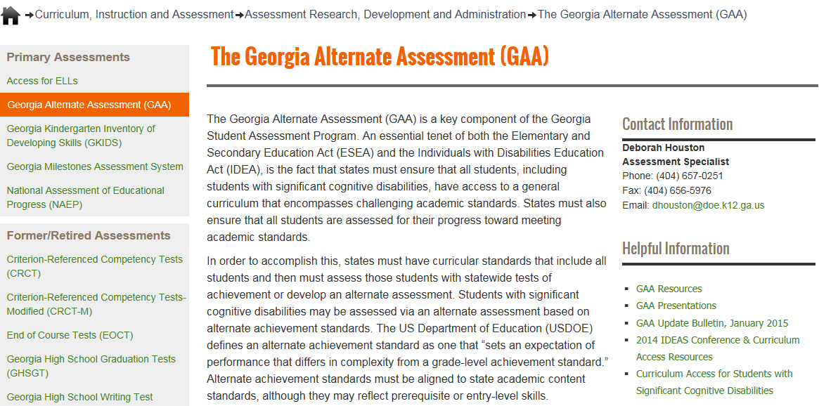
Links to Presentations are on the GaDOE website
http://www.gadoe.org/Curriculum-Instruction-and-Assessment/Assessment/Pages/GAA.aspx
Notes:
All Fall Training presentations will be posted on the GaDOE website at:
http://www.gadoe.org/Curriculum-Instruction-and-Assessment/Assessment/Pages/GAA-Presentations.aspx
The GAA Resources link will take you to Manuals, Electronic Forms (such as the Entry Sheet), Score Interpretation Guides, and other ancillary documents.
The GAA Presentations link will take you to Pre-Administration Training Presentations (past and present), Mid-Administration and Post-Administration presentations.”

Slide 4
Questions & Answers
You are invited to submit questions you may have using the “Questions” feature of the GoToWebinar anytime throughout each session.
The “Questions” feature will be monitored throughout the session and questions will be addressed.

Slide 5
Topics in this presentation
This presentation provides information that will help both new and experienced examiners to prepare portfolios.
Topics in this training session:
Summary of the GAA
GAA Blueprint and Portfolio Components
GAA Terminology
Examples of Primary and Secondary Types of Evidence
Alignment and Documentation
Effective Documentation
Completing the Entry Sheet and Demographic Forms
Organizing and Submitting the Portfolio

Slide 6
Summary of the GAA

Slide 7
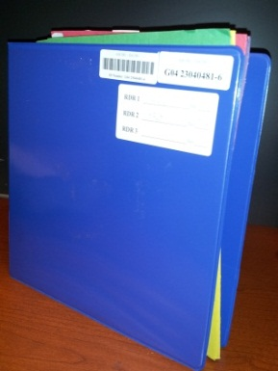
Summary of the GAA
Manuals, administration forms, and binders are delivered to districts August 29 – September 1, 2017.
The GAA administration window for the 2017-2018 school year opens on September 5, 2017 and closes on March 23, 2018.
Students in Grades K, 3-8, and High School must be assessed during this window.
“Early return” of portfolios is encouraged. Portfolios may be submitted to Questar as soon as March 1, 2018.
Notes:
The portfolio is a collection of student work in each content area that is compiled within a 3-ring binder.

Slide 8
Summary of the GAA
The GAA is a portfolio-based assessment.
Tasks submitted for assessment must include student work that is aligned to specific grade-level content standards and is adapted to accommodate the student’s cognitive, communication, physical and/or sensory impairments.
While student work must align to grade-level academic standards, it often does so at a prerequisite or entry level.
The GAA meets the requirements of federal and state laws.

Slide 9
Summary of the GAA
The flexibility of the portfolio system accommodates the diversity of the students participating in the GAA.
Evidence for the portfolio is collected throughout the assessment window (September 5, 2017 – March 23, 2018).
Evidence of an individual student’s task demonstrates what the student can do; all tasks must align to the content standards and indicators the teacher has chosen.
Students will be assessed in the same content areas as their general education peers.
Notes:
Special education students are assessed on the same content standards as their general education peers, but the special education students may access the standards at an entry level. Prerequisite skills may be demonstrated.

Slide 10
Content Standards and Elements/Indicators
Georgia’s content standards are the goals for instruction, learning, and assessment in each of the four content areas, which are English Language Arts, Mathematics, Science, and Social Studies.
Elements/indicators are the concepts and skills that are specific to the state’s content standards.
The content standard and element/indicator descriptions, by grade, can be found in Appendix E of the GAA Examiner's Manual, 2017-2018.
Notes:
*The Blueprint does not give detailed descriptions of the standards, but rather a condensed layout of eligible standards by grade, content area and domain.

Slide 11
Subjects Assessed by Grade
K: English Language Arts, Mathematics
3: English Language Arts, Mathematics
4: English Language Arts, Mathematics
5: English Language Arts, Mathematics, Science, Social Studies
6: English Language Arts, Mathematics
7: English Language Arts, Mathematics
8: English Language Arts, Mathematics, Science, Social Studies
High School: English Language Arts, Mathematics, Science, Social Studies
Notes:
Kindergarten and Grades 3, 4, 6, and 7: ELA & Math will be assessed.
Grades 5, 8, and High School: ELA, Math, Science, and Social Studies will be assessed.
Beginning with the 2017-2018 school year, all Science and Social Studies assessments will be based on the new Science and Social Studies curriculum.

Slide 12
GAA Blueprint and Portfolio Components

Slide 13
2017-2018 GAA Blueprint
The Blueprint outlines the requirements of the 2017-2018 GAA.
The Blueprint identifies the content areas and standards that are eligible for assessment on the GAA
The Blueprint, by grade, can be found in Appendix D of the GAA Examiner’s Manual, 2017-2018.
Note: Do not use Blueprints from previous years!

Slide 14
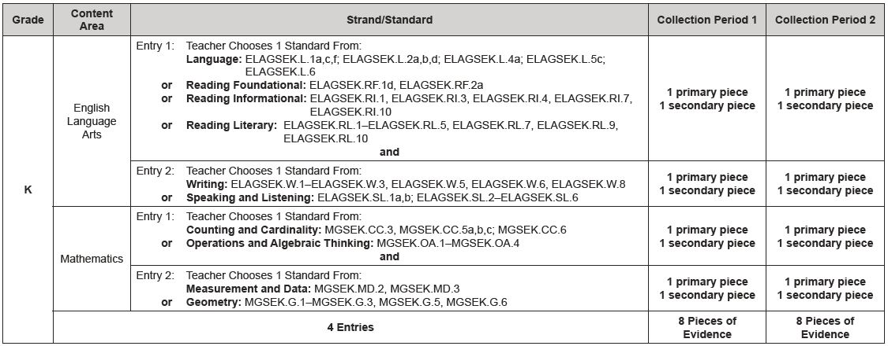
2017-2018 Blueprint
Example: Kindergarten Blueprint
Notes:
Two entries in ELA and two entries in Mathematics must be submitted for Kindergarten students.

Slide 15
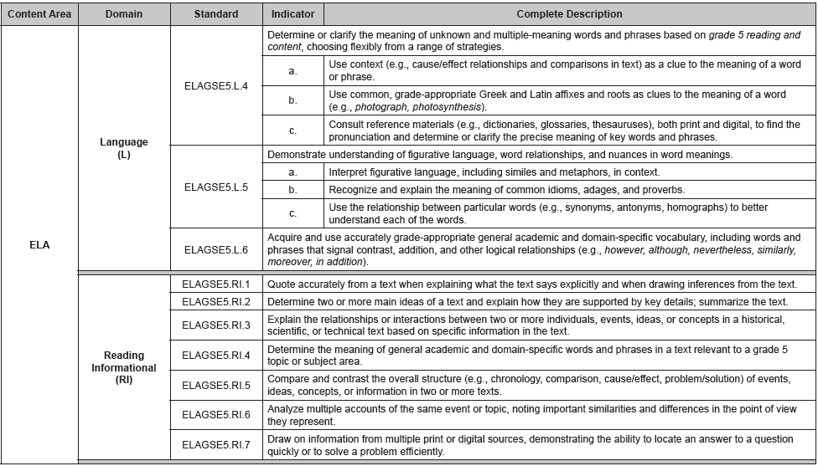
Appendix E–Standards
Example: Grade 5, ELA 1 Entry
Standard description
Standard
Indicators
Domain
Notes:
Standard Descriptions are also included. . . Above elements/indicators.

Slide 16
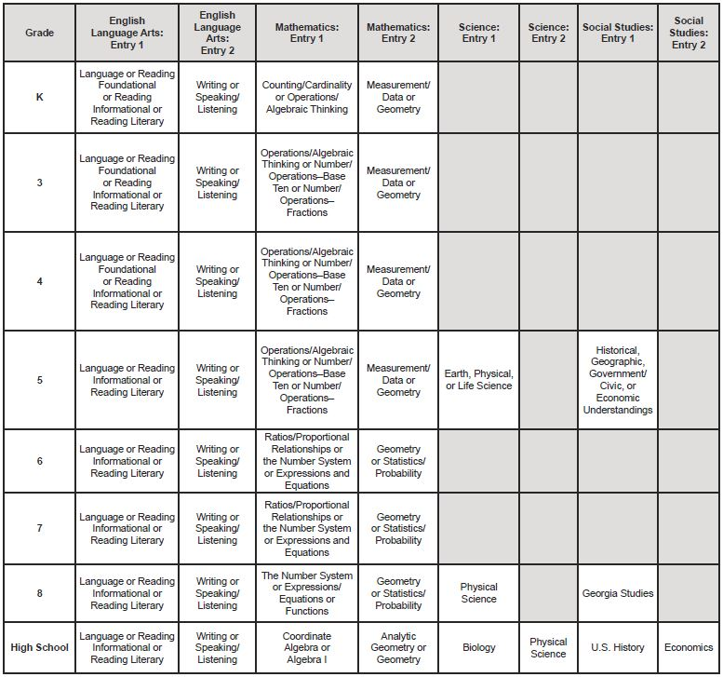
Entry
Grade
Entry 1
Entry 2
Portfolio Components
2017-2018 Examiner’s Manual page 9
Notes:
To read this chart -- Grades are shown on the vertical axis. Content areas, divided by entry, are shown on the horizontal axis. The domains eligible for assessment for each entry are included in the chart and will automatically appear in the electronic Entry Sheet once the grade and content area are selected.
Example: The domains of Language, Reading Foundational, Reading Informational, and Reading Literary are the ELA Entry 1 options for Kindergarten and grades 3 and 4. In Grades 5 and above, there is no Reading Foundational domain. The standard assessed for ELA Entry 2 (all grades) will then be chosen from the Writing or Speaking and Listening domains.

Slide 17
GAA Terminology

Slide 18
GAA terminology
Entry
Entry Sheet
Assessment Task
Evidence
Collection Periods
Collection Period Label
Primary Evidence
Work Sample
Permanent Product
Audio/Video File
Series of Captioned Photos
Secondary Evidence
Observation Form
Interview Form
Data Sheet
Additional piece of Primary Evidence
Alignment
Prerequisite Skills

Slide 19
Entry and Entry Sheet
Entry
An entry includes the Entry Sheet and four pieces of evidence. The first two pieces of evidence, called Collection Period 1, show the student's baseline skill. The last two pieces of evidence, called Collection Period 2, show the student's progress.
Entry Sheet
An Entry Sheet is a 2-page document that is placed in front of the evidence in each entry.
It serves as a table of contents for the entry.
Notes:
Please remember that the task descriptions on the second page of the Entry Sheet should be brief summaries of the assessment activity in each of the four pieces of evidence. Scoring criteria such as dates, settings and interactions, student’s grades, and prompting must be annotated on the evidence itself. Scorers cannot use statements made on the Entry Sheet as evidence of the student’s performance. The task descriptions are used to support what the student’s tasks are, but statements written on the Entry Sheets are not by themselves evidence of the student’s performance.
The Entry Sheet is a two-page document. The first page includes information about the student and the entry (student name, content area, standard to be assessed and so on). The second page requires the teacher or administrator to write brief descriptions of each of the student's four assessment tasks. Do not include descriptions of prompting and/or grades in the task descriptions.
The Entry Sheet can be downloaded from the Resources page on the GaDOE Website. Instructions have been provided as well to guide users through the Entry Sheet.

Slide 20
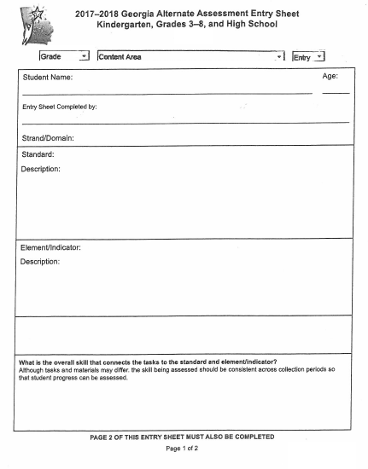
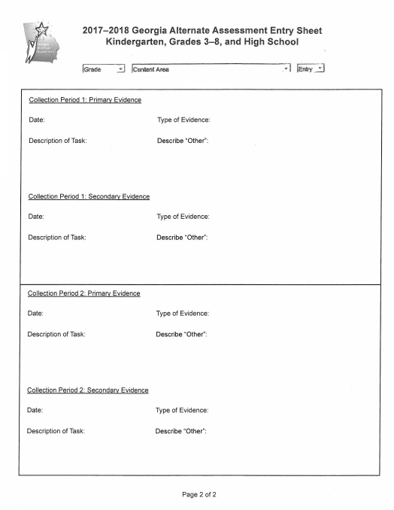
Use drop-down menus to select grade, content areas, strand, standard, etc.
“Table of Contents” part of the Entry Sheet

Slide 21
Assessment Task
An assessment task is any standards-based activity that is performed by the student.
Evidence of the student’s performance on the task is submitted in the portfolio.
Tasks must be clearly aligned to the content standard and element/indicator being assessed.
Look at the nouns- what were the standard and element/indicator designed to teach?
Tasks must align to the intent of the element/indicator.
If there are no elements/indicators, alignment goes directly back to the standard.
Notes:
Please keep in mind the GAA structure and flow for alignment: Content Areas/Domains/Standards/Indicators. Each of these categories should have a direct correlation and tie-in to the preceding category. Therefore, when thinking about the concept of aligning assessment tasks to the standard and indicator, also keep in mind the domain and content area. E.g.: In ELA, ELAGSE8.W.2 (e.) calls for students to “Establish and maintain a formal style.” This could pertain to speech or writing. Looking back at the standard language “Write informative/explanatory texts to examine a topic and convey ideas, concepts, and information through the selection, organization, and analysis of relevant content.” It’s clear that this is in the context of Writing and therefore submitted evidence must be student writing. E.g. #2 ELAGSE8.W.7: “Conduct short research projects to answer a question (including a self-generated question), drawing on several sources and generating additional related, focused questions that allow for multiple avenues of exploration.” Research projects or snip-its from such research that are included as evidence should be captured via student writing.

Slide 22
Collection Periods
Each entry has two collection periods.
Collection Period 1 shows the student’s initial skill.
Collection Period 2 shows the student’s progress.
Each collection period requires two pieces of evidence: Primary Evidence and Secondary Evidence.
Therefore, there are four pieces of evidence in each entry.

Slide 23
Collection Periods
The date of the Primary Evidence for Collection Period 2 must be a minimum of 14 calendar days after the date of the Primary Evidence in Collection Period 1.
Both Collection Period 1 tasks must be complete before either piece of Collection Period 2 evidence is collected.
Each of the four pieces of evidence must represent a different, distinct, and complete event.
Notes:
There may not be an overlap of Collection Periods. E.g., Secondary Evidence in CP2 could be completed a day after CP1 ends, but this is not recommended.
Although it is not recommended, it is permissible that both pieces of evidence for a collection period be collected on the same day. In order to be scored as two separate assessment tasks, the evidence must document two completely separate and distinct events. A task that is begun in the morning and completed in the afternoon is not two separate tasks. The assessment tasks must utilize different materials or a different (but related) concept and each must demonstrate a clear beginning and end.

Slide 24
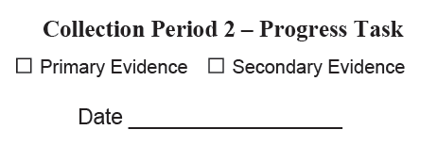
Collection Period Labels
Collection Period Labels are provided in the front pocket of the portfolio. They can help the teacher to organize the portfolio evidence.
Affix a label on each piece of evidence, check the appropriate box, and write the date the evidence was collected.
Notes:
When affixing collection period labels, please do not cover any of the student’s work.

Slide 25
The Anatomy of a GAA Entry
Collection Period 1
Initial/Baseline
Primary Evidence
Secondary Evidence
Entry
14 calendar days (primary to primary)
Primary Evidence
Collection Period 2
Progress
Secondary Evidence
Note: There must be 14 days between Primary Evidence in CP1 and Primary Evidence in CP2.
There must be two distinct collection periods; CP1 must be completed before CP2 begins.

Slide 26
Examples of Primary and Secondary Types of Evidence

Slide 27
Entry Evidence
Evidence
Shows or describes the student’s performance on the aligned tasks.
Primary Evidence
Work sample
Permanent product
Series of captioned photos (minimum of 2)
Media (audio or video) -include a script
Secondary Evidence
Observation form
Interview form
Data sheet
An additional piece of primary evidence
Notes:
Recommend three photos or more for captioned photos. Three photos allow students to be shown beginning the task, amidst the task, and completing the task.

Slide 28
Primary Evidence
Demonstrates knowledge/skills by showing the student’s engagement in tasks
“Primary” refers to the type of evidence; it does not mean that it has to occur earlier than the Secondary Evidence in that collection period.
It is important that the type of evidence used is the appropriate choice to clearly demonstrate the student’s response.

Slide 29
Student Work Sample Primary Evidence
Work samples are items completed or created by the student.
Examples:
Writing samples
Graphic organizers
Worksheets (whether commercial or teacher-made)
Work samples must be annotated to provide the information needed for scoring. Annotations may be written on the evidence or on a separate, labeled page.
Notes:
Annotation sheets are also considered part of the evidence. Annotations should include task descriptions, student performance (grade, score, percentage, or answer key), settings and interactions, and type and frequency of prompting. If the teacher prefers not to submit a separate annotation page, scoring criteria may be written directly on student work.

Slide 30
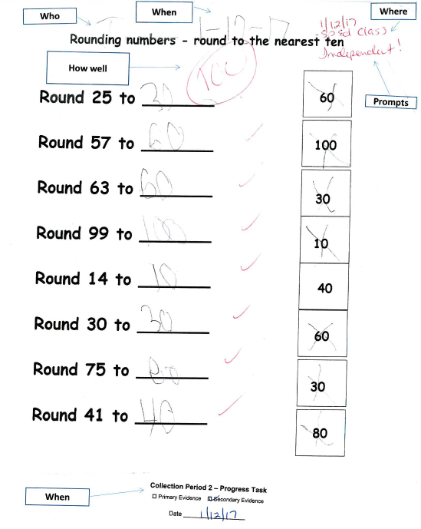
Student Work Sample Primary Evidence
This work sample was submitted as a piece of Primary Evidence and includes all information necessary for scoring. The teacher has provided the student’s name, the Collection Period Label, the date on which it was completed, the grade the student received, and the level of prompting.

Slide 31
Permanent Product Primary Evidence
Permanent products are items created by the student (e.g., murals, drawings, or models).
Often a permanent product is too large or too fragile to be shipped with the student’s portfolio,
In these cases, the teacher should photograph (not photocopy) the student’s work, date it, and label it “permanent product.”
A single photo is acceptable only for permanent products.
Permanent products must be annotated.
Notes:
If a permanent product is too large or too fragile to be shipped with the portfolio, then the teacher should photograph it and include the photo in the entry. A single photo of a permanent product is acceptable, but a series of captioned photos must include at least two photographs.

Slide 32
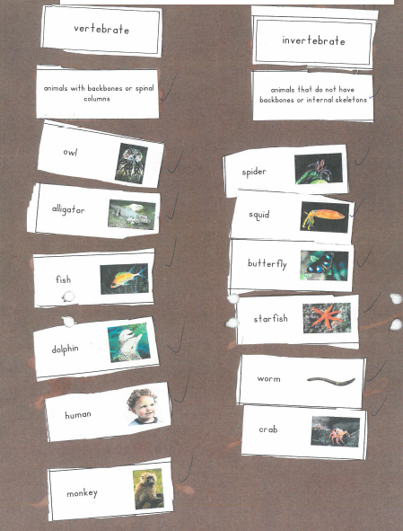
Permanent Product
This photo of a poster was submitted as a permanent product. The task aligns to Grade 5 Science standard and indicator S5L1a (Develop a model that illustrates how animals are sorted into groups (vertebrate and invertebrate)...
The teacher’s annotation (not shown) describes the model the student developed plus the settings, interactions, level of prompting and student’s grade on the task.

Slide 33
Series of Captioned Photos Primary Evidence
A series of captioned photographs means at least two photographs must be submitted (three or more are recommended).
The photos should clearly depict the student doing the task and completing the task.
Captions should state what assessment task the student is performing. If the student is photographed with other people, the captions should say what the student who is being assessed is doing. A group activity, in which the individual student’s task is unclear, is not suitable for assessment.
The caption should include information regarding the activity in which the student is engaged, the student’s level of success, the setting and interactions, and the type and frequency of prompting, if any, that was provided to the student.

Slide 34
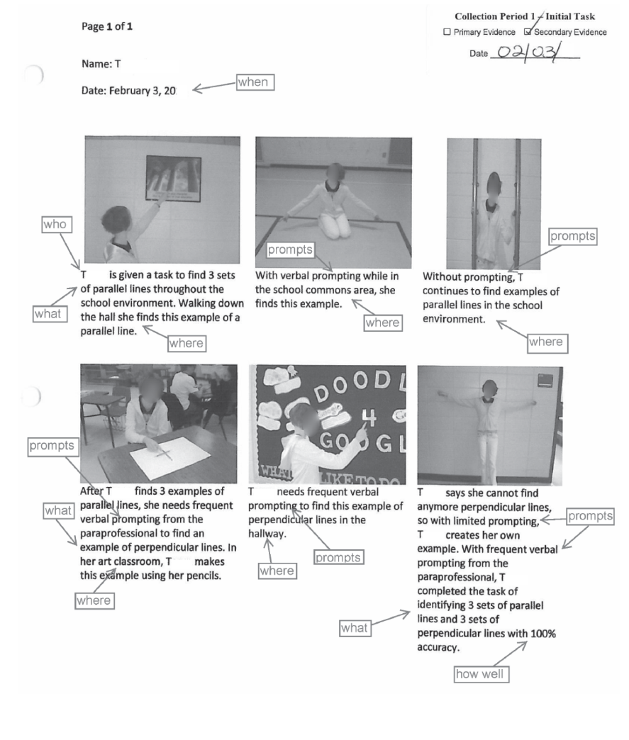
Series of Captioned Photos Primary Evidence
A series of captioned photos was submitted as Secondary Evidence for this student. The photos clearly depict the student in the process of the task and show her response at each phase. The captions describe each step of the task and annotate the student’s success. The teacher has provided information about the setting and interactions with the paraprofessional as well as the level of prompting required for the student.
Notes:
Remember: Any Primary type of evidence can also serve as a Secondary type.

Slide 35
Media–Audio/Video Accompanied by a Script Primary Evidence
Audio, Video, CDs, Flash Drives, and DVDs can be effective ways to demonstrate students’ skills when tasks involve multiple steps, “verbal” responses, or interaction with others.
It is important to provide a script so that, if the media are damaged during shipping, scorers can determine what students were asked to do and how well they did their tasks.
The media must be labeled with the student’s name. If there are multiple students in the video, it must be made clear which student is being assessed.

Slide 36
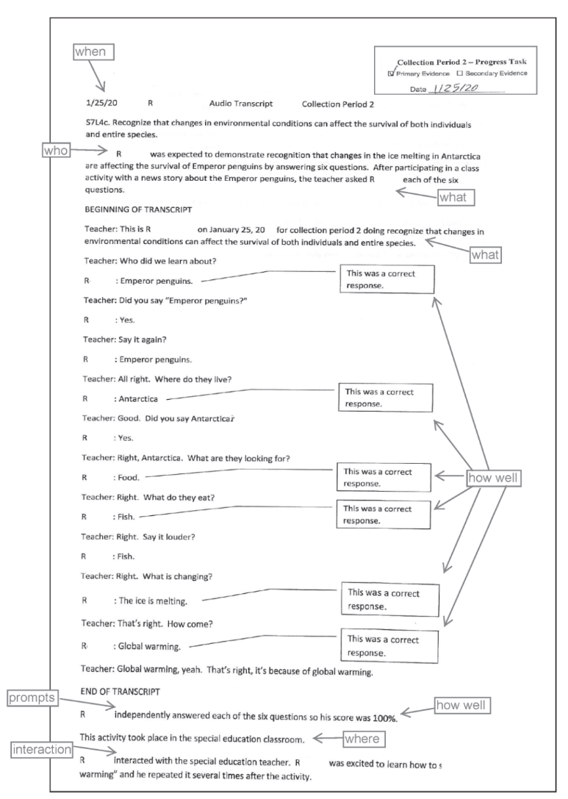
Media–Audio/Video Accompanied by a Script Primary Evidence
A video was submitted as Primary Evidence for this student. The video file was labeled with the student’s name, grade, and school. A script was also included that documented the evidence recorded, the student’s name, the date, and the Collection Period. It also provided a description of the task, the setting and interactions, an evaluation of the student’s level of success, and the level of prompting that was provided.

Slide 37
Secondary Evidence
Reports knowledge/skills by documenting, charting, or interpreting the student’s performance
Secondary Evidence refers to the type of evidence, not to the date or order in which evidence was collected.
Notes:
Secondary Evidence documents, relates, charts, or interprets the student’s performance on assessment tasks and is based on tasks or activities related to but different from those submitted as Primary Evidence. The tasks can differ in terms of the complexity of the activity, the materials used, or the type and frequency of prompting (i.e., the amount of support a student requires and is given to accurately complete a task).

Slide 38
Data Sheet Secondary Evidence
The data sheet should include a clear description of the task, analysis of the student performance, and a key. It should also include information on the setting, interactions with peers (both with and without disabilities) and community members, and the type and frequency of prompting, if any, that was provided.
A minimum of 3 distinct dates on which evidence was collected is required on a data sheet.
Notes:
Please remember that there must be three distinct dates separate from the date on which the Primary Evidence was collected for the same collection period. A data sheet may record what was conducted for the Primary Evidence, but that would mean there would need to be at least 4 distinct dates on the Data Sheet (Secondary Evidence).

Slide 39
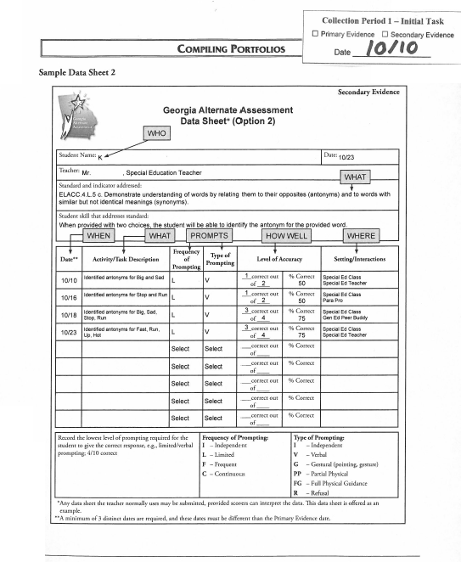
Data Sheet Secondary Evidence
This data sheet was submitted as Secondary Evidence for this student. It includes the student’s name, a description of the task, and the dates on which the tasks were completed. The collection period label has been affixed so as to clearly depict the type of evidence and collection period. A key has been provided for prompting and accuracy so that the student’s achievement/progress can be evaluated.
Notes:
There must be a minimum of 3 discrete dates on which data was collected for the skill being assessed. If the Primary Evidence task is included on the Data Sheet, there must be an additional 3 discrete dates in order for the Data Sheet to be eligible for scoring.

Slide 40
Interview Form Secondary Evidence
Typically, this method of documentation is used when the task occurs in a community or home setting in which the teacher who is assessing the student is not present (e.g., on a work site, at a restaurant, etc.).
The parent, another educator, peer helper, employer, related service staff, or other individual who is in a position to describe the student’s performance is asked a structured set of questions to enable the teacher to document the student’s performance.
Specific information regarding student performance, setting, and interactions with peers (both with and without disabilities) and community members should be included.

Slide 41
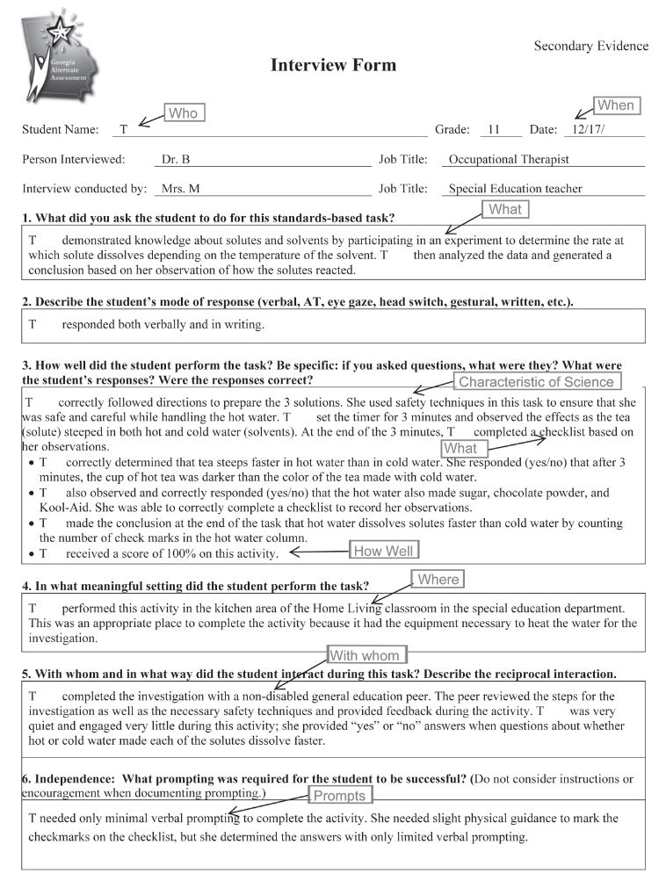
Interview Form Secondary Evidence
All necessary information has been completed for this interview. The teacher described the task and clearly evaluated the student’s performance. Further, the teacher provided the setting in which the task was completed, the interactions that took place, and the type and frequency of prompting necessary for the student to complete the task.

Slide 42
Observation Form Secondary Evidence
The teacher or para-professional uses the observation form to record the student’s performance on an assessment task.
Be sure to include specific information regarding student performance, setting, and interactions with peers (both with and without disabilities) and community members.
Do not include an observation of an event for which Primary Evidence has already been submitted.
Notes:
If an observation form is used to re-document what occurred during the Primary task, the entry will receive a nonscorable code.

Slide 43
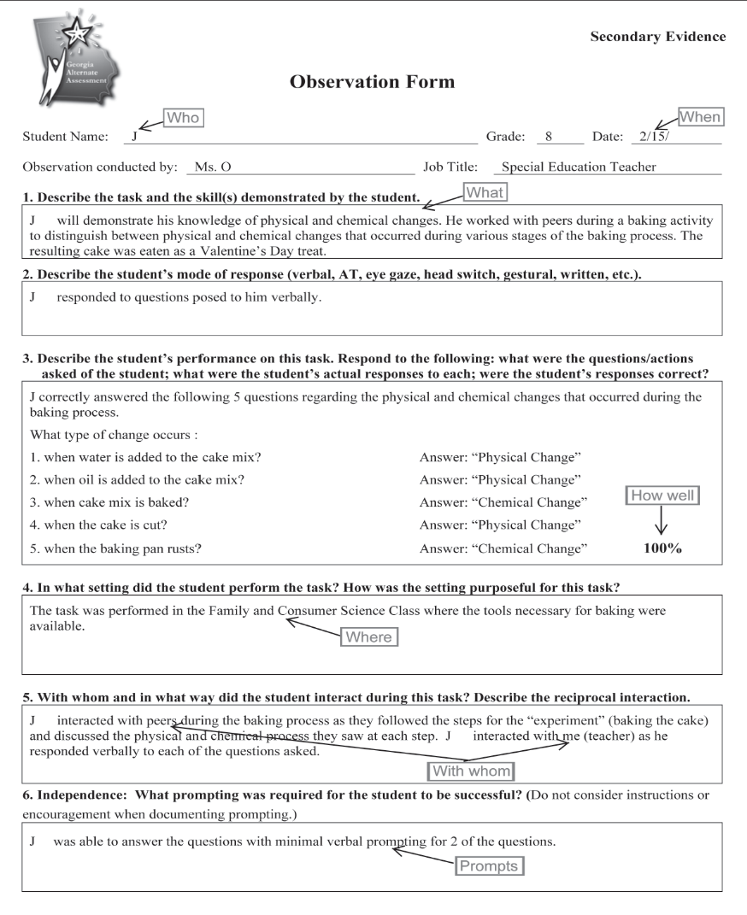
Observation Form Secondary Evidence
All necessary information has been completed for this observation. The teacher described the task and clearly evaluated the student’s performance. Further, the teacher noted the setting in which the task was completed, the interactions that took place, and the type and frequency of prompting necessary for the student to complete the task.

Slide 44
Alignment and Documentation
Choosing the Standard for Assessment /
Aligning to the Intent of the Standard

Slide 45
Alignment
Alignment is the connection between the written, taught, and tested curriculum.
Alignment demonstrates the linkage of the activities (student work) to the intent of the grade-level standard and element/indicator on which the student is being assessed.
Each of the four tasks in every entry must align to the standard and element/indicator.
Assessment tasks should be designed and task descriptions written specifically to address the standards-based skill being evaluated.
Notes:
Intent- what are the standard and element designed to teach?
Consider alignment first when designing assessment tasks.
The task must be true to the standard.
The task must address the distinct aspects of the element (focusing on one aspect of the element/indicator is acceptable).
The task must be appropriately challenging for the individual student.
All four tasks, though distinct events, must provide evidence of what the student knows and can do across the same skill.
A consistent skill must be assessed in both collection periods

Slide 46
Alignment - Prerequisite Skills
A prerequisite skill is one that is essential to the acquisition of the standard and element/indicator.
Tasks submitted for the assessment can focus on prerequisite skills that allow the student to be exposed to and assessed on the standard/element at a level that is meaningful and purposeful for the student.
Prerequisite skills must still focus on the intent of the grade level standard and element.
Can working on this skill eventually lead the student to the skill targeted by the standard and indicator?
Notes:
Access at a prerequisite level must still demonstrate relevance to the intent of the standard -- e.g., Identifying numbers is NOT a prerequisite skill for understanding fractions as parts of a whole.
Identifying letters or decoding words is NOT a prerequisite for understanding character, plot, or setting from a text.

Slide 47
Alignment - Choosing the Best Standard and Indicator for Assessment
Create a plan to develop tasks that align to a grade-level content standard and are appropriate for individual students.
Develop assessment tasks that will allow students to demonstrate progress in skills related to the standard.
Construct assessment tasks that allow students to demonstrate progress in acquiring skills aligned to the content standards.
Planning Sheets are provided in the GAA Examiner’s Manual, 2017-2018.
Notes:
Creating units and activities that can be used for more than one student is acceptable; however, the activities must be tailored to the needs and the abilities of individual students.
Think about the student first when planning tasks that allow access to the standard. What may be appropriate for one student may not be appropriate for another.
Think about the best way to show the student’s skill when deciding the type of evidence to include.

Slide 48
Alignment - the Intent of the Standard and Indicator
The intent of the standard and indicator refers to the “Big Idea”– that which they were designed to teach.
Example: ELAGSE3SL.2 Determine the main ideas and supporting details of a text read aloud or information presented in diverse media and formats, including visually, quantitatively and orally.
The intent of this Grade 3 Speaking and Listening standard is for students to be able to recount the main idea and/or supporting details from text read aloud.

Slide 49
Effective Documentation

Slide 50
Effective Documentation
Every piece of evidence must include this information:
The student's name (Who) and date of tasks (When)
Description of task–documented on Entry Sheet and in the evidence (What)
The setting in which the task was completed (Where)
Specific evaluation of student response (How Well)
Interactions that occurred during the task (With Whom)
Independence–type and frequency of prompting (Prompts)
Notes:
What - The task description should be concise but specific to the standard and indicator.
Where - The setting should be purposeful to the task (e.g., doing a math worksheet in the hallway is NOT allowing the student to generalize the skill in a different setting).
How Well - All student responses should be present in the evidence and must be graded.
With Whom - The nature of the interaction should be documented and relevant to the task as it relates to the standard.
Prompts - Both type and frequency of prompting must be documented. Prompting refers to assistance that leads the student toward the correct answer. DO NOT include information regarding instructions, encouragement, behavioral interventions, or supports as part of your documentation on type and frequency of prompting.

Slide 51
Completing the Entry Sheet and the Student Demographic Information Form (SDIF)

Slide 52
Select Grade, Content Area, Entry # (1 or 2) from Drop-downs. Proceed with selecting the standard and indicator (if applicable).
Notes:
There is one Entry Sheet for all students.
The Entry Sheet should be downloaded and saved to a local drive before completing the form.
Instructions, including a sample entry sheet, are available along with the Entry Sheet.

Slide 53
Completing the Entry Sheet
Select Grade from the drop-down menu
Select Content Area from the drop‐down menu
Select Entry Number from the drop-down menu
Entry 1 or Entry 2 per the GAA Blueprint
Type student’s full name
Type student’s age
Type teacher’s name and position

Slide 54
Completing the Entry Sheet
Select Strand/Domain from drop‐down menu
Select Standard from drop‐down menu
The standard must be chosen from the GAA Blueprint for the student’s recorded grade.
Click on MUST SELECT. The eligible standards will appear on the screen. Select the standard you have chosen for your student.
Once you have chosen the standard by letter and number, the text of the standard will appear automatically on the screen.

Slide 55
Completing the Entry Sheet
Select Element/Indicator from the drop-down menu
The element/indicator must be chosen from the GAA Blueprint for the student’s recorded grade.
Click on MUST SELECT. The eligible elements/indicators will appear on the screen. Select the element/indicator you have chosen for your student .
Once you have chosen the element/indicator, its text will appear automatically on the screen.
If the standard has no elements or indicators, the drop-down menu will be inactive.

Slide 56
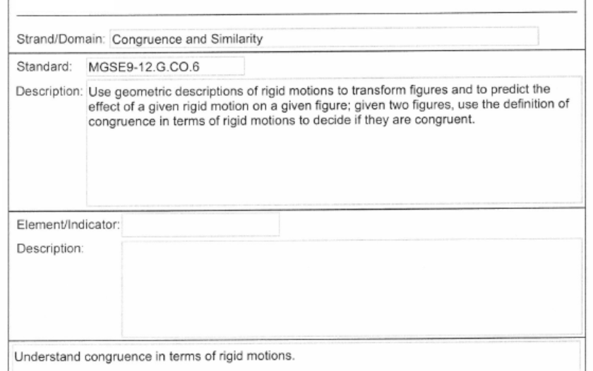
Completing the Entry Sheet
Special Features
When Mathematics is selected on the Entry Sheet, a note will auto-populate with the cluster statement which applies to the selected math standard.

Slide 57
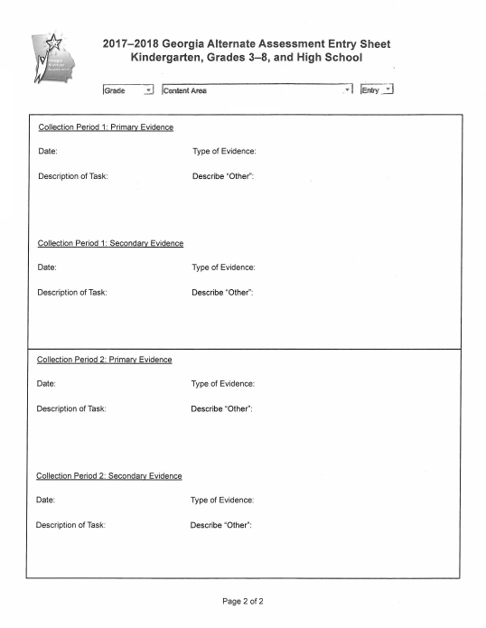
Completing page 2 of the Entry Sheet
Type the date in the “Date” box.
Select the type of evidence being submitted from the “Type of Evidence” drop-down.
Type the task description into the “Description of Task” box.
The description of the assessment task should relate the task to the specific standard/indicator being assessed.
Do NOT include evaluation of the student’s work, documentation of the type and frequency of prompting, or information about settings or interactions. This documentation must be found within the evidence.
Notes:
Information used for scoring, such as the grade the student received and the type and frequency of prompting, MUST be documented on the evidence and not on the Entry Sheet or Task Sheet.

Slide 58
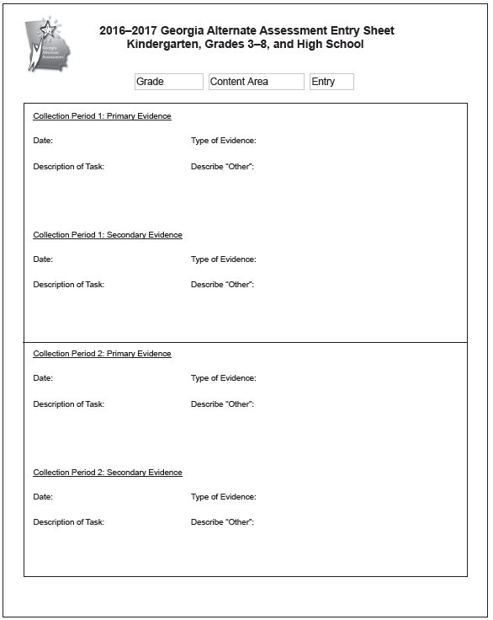
Completing page 2 of the Entry Sheet
These fields auto-populate when chosen on Side 1 of the Entry Sheet.
Please make sure the dates on the evidence match the dates given on the Entry Sheet.
Please make sure the Primary Evidence in CP2 is dated at least 14 calendar days after the date of CP1 Primary Evidence.
Please make sure that all of Collection Period 1 evidence has been completed prior to starting Collection Period 2.
Type in the date; choose the Type of Evidence from the drop-down menu for all four pieces of evidence.
Notes:
Please remember that when entering the date, the Entry Sheet requires a four digit year.

Slide 59
Student Demographic Information Form
Two different SDIFs will be utilized for the 2017-2018 administration of the GAA.
SDIF for grades Kindergarten and 3-8
Form is GREEN
SDIF for High School
Form is ORANGE

Slide 60
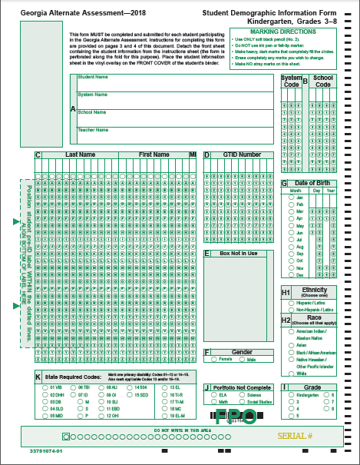
K and 3-8
SDIF for
Kindergarten
and Grades 3-8
Affix the Pre-Id label to the front of the SDIF.
Pre-ID Label
Green Form
Notes:
Complete all necessary fields on both sides as required on the SDIF instruction page.
Place the SDIF under the clear, vinyl overlay on the front of the student’s binder.
Do not 3-hole punch, and do not place it inside the binder.

Slide 61
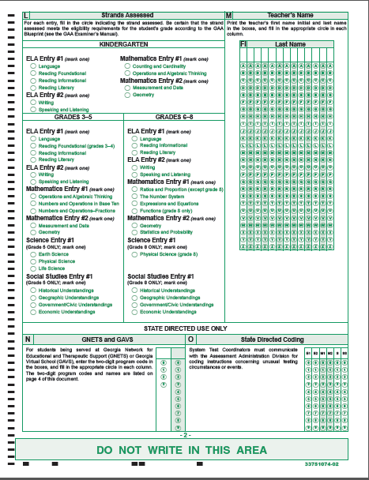
SDIF for Kindergarten and Grades 3-8
Page 2

Slide 62
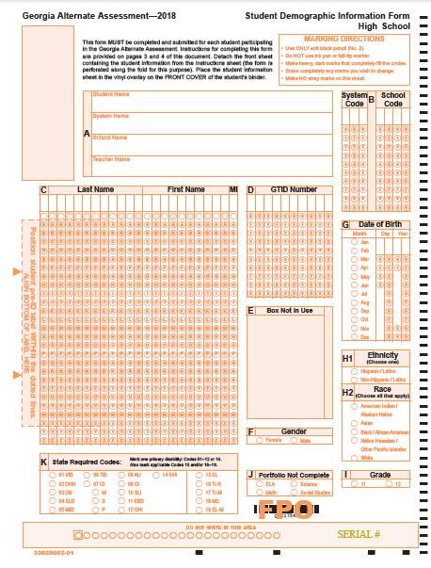
High School
SDIF for
High School
Affix the Pre-Id label to the front of the SDIF.
Pre-ID Label
Orange Form
62
Notes:
Complete all necessary fields on both sides as required on the SDIF instruction page.
Place the SDIF under the clear, vinyl overlay on the front of the student’s binder.
Do not 3-hole punch, and do not place it inside the binder.
Be certain that the SDIF form marked High School is only used for High School students.

Slide 63
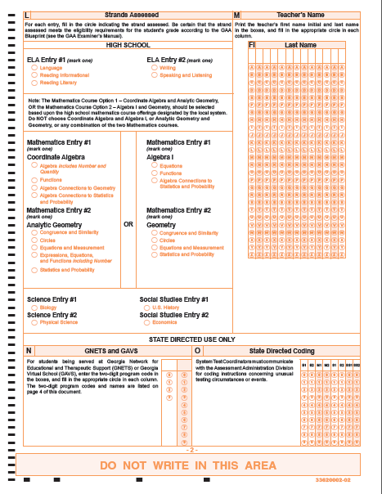
ELA GSE
Mathematics Courses
Science and Social Studies
SDIF for
High School
Page 2

Slide 64
Organizing and Submitting the Portfolio

Slide 65
Organize the Portfolio
Review the evidence to ensure that only grade-appropriate materials have been used and that students have had the opportunity to generalize their skills in different settings and with different people.
Remove and replace any evidence that does not clearly illustrate the student’s initial skill or progress on the tasks.
Affix the appropriate collection period labels (optional) to all evidence being submitted – Primary and Secondary.
There must be at least 14 calendar days between the Primary Evidence for Collection Period 1 and the Primary Evidence for Collection Period 2.
There must be two distinct collection periods; CP1 must be completed before CP2 begins.

Slide 66
Organize the Portfolio
Affix the Pre-ID Label to the Student Demographic Information Form (SDIF) in the correct location.
If a pre-ID label is not available for a student or if the information is not correct, complete all of the student demographic information according to the instructions.
Complete the Validation Form.
Make sure that it is signed by the test administrator and the building administrator.
Place it behind Divider One (Student Information).
Complete the Release to Use Portfolio for Training.
Place it behind Divider One (Student Information).
Notes:
We encourage parents to sign the Release to Use Portfolio for Training form; however, the portfolio will be scored without a parent’s signature.

Slide 67
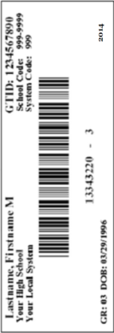
Student Demographic Information Form
Affix the Pre-Id label to the front of the SDIF.
Complete all necessary fields on both sides as required on the SDIF instruction page.
Place the SDIF under the clear, vinyl overlay on the front of the student’s binder.
Do not 3-hole punch, and do not place the SDIF inside the binder.

Slide 68
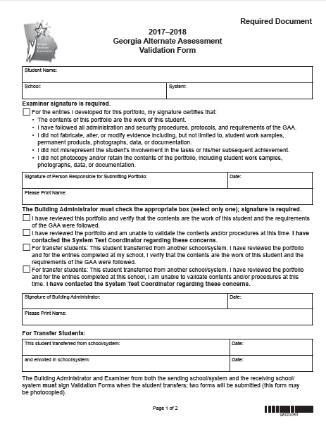
Divider 1 Student Information
Validation Form
Test Administrator Section
Building Administrator Section
Notes:
The Validation Form can be found in the front pocket of the portfolio binder. It is a useful tool to help you ensure that all requirements have been met before you submit the portfolio. After completing the form, place it in the binder behind Divider 1, Student Information. Be certain that signatures have been obtained from both the person submitting the portfolio and the building administrator. This is an important step - the signatures validate the contents of the portfolio and attest that all procedures have been followed and the work is that of the student for whom you are submitting the portfolio.
A signed Validation Form must be submitted or the portfolio cannot be scored.

Slide 69
Divider 1 Student Information
Release to Use Portfolio for Training
Required Signature
Required Signature
Notes:
The Release Form can be found in the front pocket of the portfolio binder. This release form is an important piece that allows portfolios containing photographic evidence to be used to train Georgia teachers. It is not required for scoring.

Slide 70
Divider 2 English Language Arts (Grades K, 3-8, HS)
Entry Sheet 1
English Language Arts
Entry Sheet 2
English Language Arts
Collection Period 1
Primary Evidence
Primary Evidence
Secondary Evidence
Secondary Evidence
Primary Evidence
Primary Evidence
Secondary Evidence
Secondary Evidence
Collection Period 1
Collection Period 2
Collection Period 2
Notes:
Two ELA entries must be submitted for all grades.

Slide 71
Divider 3 Mathematics (Grades K, 3-8, HS)
Entry Sheet 1
Mathematics
Entry Sheet 2
Mathematics
Collection Period 1
Primary Evidence
Primary Evidence
Secondary Evidence
Secondary Evidence
Primary Evidence
Primary Evidence
Secondary Evidence
Secondary Evidence
Collection Period 1
Collection Period 2
Collection Period 2
Notes:
Two mathematics entries must be submitted for all grades.

Slide 72
Divider 4 Science (Grades 5 and 8)
Entry Sheet
Science
Primary Evidence
Secondary Evidence
Primary Evidence
Secondary Evidence
Collection Period 1
Collection Period 2
Notes:
One Science entry is submitted for students in grades 5 and 8.

Slide 73
Divider 4 Science (High School)
Collection Period 1
Entry Sheet 1
Science
Entry Sheet 2
Science
Primary Evidence
Primary Evidence
Secondary Evidence
Secondary Evidence
Primary Evidence
Primary Evidence
Secondary Evidence
Secondary Evidence
Collection Period 1
Collection Period 2
Collection Period 2
Notes:
Two Science entries must be submitted for High School students.
Entry 1 is always BIOLOGY
Entry 2 is always PHYSICAL SCIENCE

Slide 74
Divider 5 Social Studies (Grades 5 and 8)
Entry Sheet
Social Studies
Primary Evidence
Secondary Evidence
Primary Evidence
Collection Period 1
Secondary Evidence
Collection Period 2
Notes:
One Social Studies entry is submitted for students in grades 5 and 8.

Slide 75
Divider 5 Social Studies (High School)
Collection Period 1
Entry Sheet 1
Social Studies
Entry Sheet 2
Social Studies
Primary Evidence
Primary Evidence
Collection Period 1
Secondary Evidence
Secondary Evidence
Primary Evidence
Primary Evidence
Secondary Evidence
Secondary Evidence
Collection Period 2
Collection Period 2
Notes:
Two Social Studies entries must be submitted for High School students.
Entry 1 is always U.S. HISTORY
Entry 2 is always ECONOMICS

Slide 76
Submitting the Portfolio
Review each entry before submitting the portfolio
All four pieces of evidence in each entry must align to the standard and element
Primary and Secondary Evidence must be submitted for each collection period.
Documentation should be clear and concise
Entry Sheets should be filled out correctly
SDIF has been completed correctly and placed under the clear vinyl overlay on the front of the binder
Validation Form and Release to Use Portfolio for Training have been signed and placed behind the Student Information tab.
Notes:
14 calendar days from first Primary evidence to second Primary evidence; Type of evidence is the best choice to clearly demonstrate the student response; Grade-appropriate materials
Would someone else reading the documentation understand what the task was, its connection to the standard, and how well the student performed?

Slide 77
Submitting the Portfolio
Check with your School Test Coordinator for information about portfolio review procedures and schedules within your school/system.
Follow the protocol determined by your system for the Portfolio Review Process.
Submit the binder to your School Test Coordinator by the date specified by your school system.

Slide 78
Contact Information
Questions about how to administer the GAA?
GaDOE Assessment Division
(800) 634-4106
Deborah Houston, Assessment Specialist
(404) 657-0251
dhouston@doe.k12.ga.us

Slide 79
GAA Resources
Student Sample Resource Guide
Examples of annotated student entries for a variety of grades, content areas and access levels
Sample Task Resource Guide
Exemplars of tasks that are aligned to grade-level content standards and accessible to students with a range of significant disabilities
Extended Standards
Through extensions, skills that align are derived (or extended) from the grade-level standards.
http://www.gadoe.org/Curriculum-Instruction-and-Assessment/Assessment/Pages/GAA.aspx

Slide 80
GAA Resources
Student Sample Resource Guide
Examples of annotated student entries for a variety of grades, content areas and access levels
Sample Task Resource Guide
Exemplars of tasks that are aligned to grade-level content standards and accessible to students with a range of significant disabilities
Extended Standards
Through extensions, skills that align are derived (or extended) from the grade-level standards.
http://www.gadoe.org/Curriculum-Instruction-and-Assessment/Assessment/Pages/GAA.aspx

Slide 81
Contact Information
Need information about access to the state-mandated content standards for students with significant cognitive disabilities?
Crystal Callaway, Special Education Services and Supports
(404) 657-9969
ccallaway@doe.k12.ga.us

Slide 82
Contact Information
Teachers of Students with Significant Cognitive Disabilities
The Resource Board
has been moved to the Teacher Resource Link
http://bit.ly/AccessOneNote

Slide 83
Contact Information
Questions About Materials, Distribution, or Collection?
Questar’s GAA Customer Service
(866) 997-0698
GA@QuestarAI.com

Slide 84
Webinar Survey
We Want your Feedback!
Please use the below link to provide feedback regarding this GAA training session.
http://gadoe.org/surveys/AsAc-H8PBVZM

