Slide 1
Georgia Alternate Assessment
Looking Ahead to the 2017-2018 Administration

Slide 2
2017-2018 GAA
Purpose:
The 2017-2018 pre-administration training sessions explain how to prepare and submit GAA portfolios.
http://www.gadoe.org/Curriculum-Instruction-and-Assessment/Assessment/Pages/GAA-Presentations.aspx
Information pertaining to the GAA can also be found in the 2017-2018 GAA Examiner’s Manual.
http://www.gadoe.org/Curriculum-Instruction-and-Assessment/Assessment/Pages/GAA-Resources.aspx
Notes:
When the PPT is open you may highlight the link and right click in order to “Open Hyperlink” and gain access to the links and websites.

Slide 3
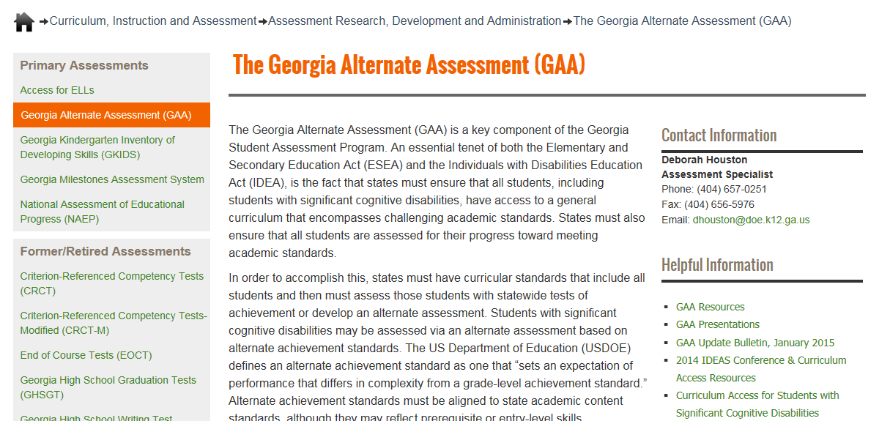
Links to Presentations are on the GaDOE website (shown below)
http://www.gadoe.org/Curriculum-Instruction-and-Assessment/Assessment/Pages/GAA.aspx
Notes:
To access websites from a static PPT: Please highlight the web address, right click, and “Open Hyperlink.”
The GAA Presentations link will take you to Pre-Administration Training presentations (past and present), Mid-Administration and Post-Administration presentations.”

Slide 4
Questions & Answers
You are invited to submit questions you may have using the “Questions” feature of the GoToWebinar anytime throughout each session.
The “Questions” feature will be monitored throughout the session and questions will be addressed.

Slide 5
GAA 2017-2018 Key Dates
August 29 – September 1, 2017:
Manuals, administration forms, and binders arrive
September 5, 2017 – March 23, 2018:
Administration window
Completed portfolios must be shipped to Questar no later than March 23, 2018. They may be shipped as early as March 1, 2018.

Slide 6
Topics in this Presentation
It is designed to inform:
All teachers who administer the GAA
Peer reviewers and designated trainers
Special education directors
System and test coordinators
Building administrators
Topics in this training session:
General Information About the 2017-2018 GAA
Updates and Reminders
Lessons Learned from the 2016-2017 Administration
Test Security and Ethics
Portfolio Review Process / Peer Review

Slide 7
General Information about the 2017-2018 GAA Administration

Slide 8
2017-2018 Review of Standards
Georgia Standards of Excellence (GSE)
The GAA continues in its current form as a portfolio-based assessment.
It is essential that the 2017-2018 Blueprint and Standards be used when assessing GAA students.
Notes:
Refer to Session 1 (“The Basics”) for general information on the GAA. Session 1 includes detailed information on compiling portfolios and it defines GAA terminology.

Slide 9
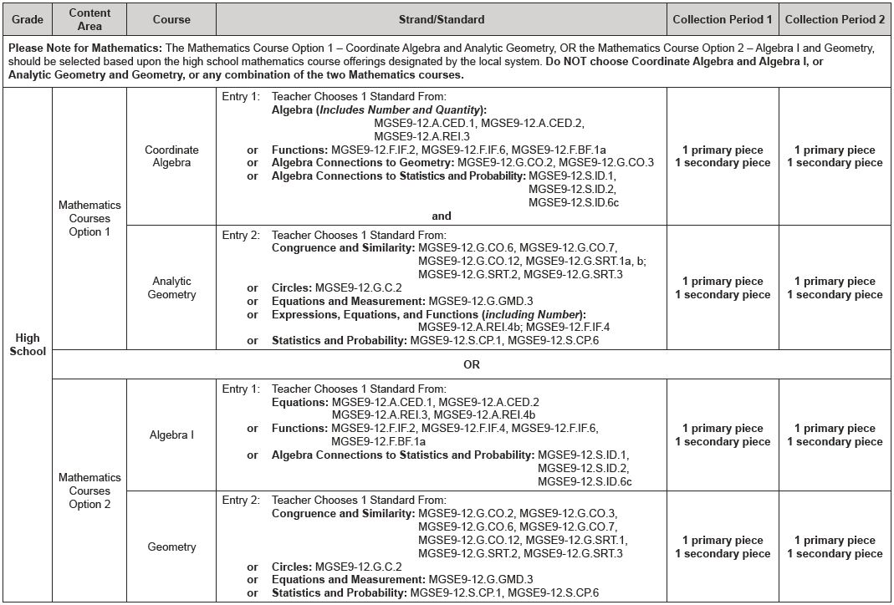
2017-2018 Blueprint
Example: High School Blueprint

Slide 10
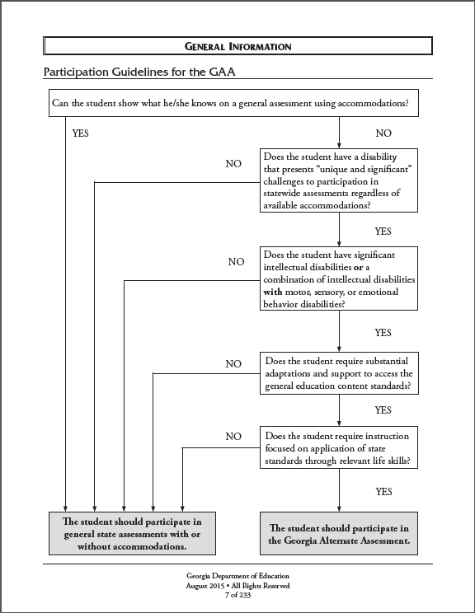
Participation Criteria
The student’s IEP Team determines how the student shall participate in Georgia’s student assessment program(s).
The student may be considered for participation in the GAA only if:
all participation criteria have been met, and
the IEP team determines that a student cannot meaningfully access the general statewide assessments, even with maximum and appropriate accommodations.
Notes:
In general, the GAA is appropriate only for the small number of students who have the most significant cognitive disabilities—those who cannot participate in general assessments, even with maximum accommodations. GAA students have access to state-mandated content standards through the alternate assessment. Teachers may adjust learning expectations to meet the needs and learning styles of the unique and diverse group of students who participate in alternate assessments. Students who are assessed on the GAA often communicate using assistive technology. Students with significant cognitive disabilities generally cannot respond to questions using a bubble sheet. In addition to cognitive disabilities, these students may also have other physical disabilities and may be visually or hearing impaired.
Assessment design and tasks may differ from the general education population in depth, breadth, and complexity. This is the essence of the alternate assessment.

Slide 11
State-Mandated Content Standards
During the 2017-2018 school year students will be assessed on the new Science and Social Studies standards. Science and Social Studies are assessed only in Grade 5, 8 and high school.
The Blueprint for the GAA, including the current state-mandated content standards, is available in Appendix D of the GAA Examiner’s Manual, 2017-2018 and on the GaDOE website.
http://www.gadoe.org/Curriculum-Instruction-and-Assessment/Assessment/Pages/GAA-Resources.aspx

Slide 12
Subjects Assessed by Grade
K: English Language Arts, Mathematics
3: English Language Arts, Mathematics
4: English Language Arts, Mathematics
5: English Language Arts, Mathematics, Science, Social Studies
6: English Language Arts, Mathematics
7: English Language Arts, Mathematics
8: English Language Arts, Mathematics, Science, Social Studies
High School: English Language Arts, Mathematics, Science, Social Studies

Slide 13
Updates and Reminders

Slide 14
Moving Forward
Assessment tasks that aligned to previous GAA standards/elements do not necessarily align to the current content standards. Successful tasks for previously assessed standards may need to be redesigned to align to comparable current standards.
All assessment tasks must align to the content standard and element/indicator that are chosen on the Entry Sheet.

Slide 15
Updates & Reminders
Entry Sheet: there is one Entry Sheet for all students. Drop-down boxes and instructions will guide you through the process of completing the Entry Sheet.
The GAA Examiner’s Manual 2017-2018 will retain its smaller size because the sample entries will remain in the Student Samples Resource Guide. The SSRG will be available on the GaDOE website. Some samples will remain and NEW samples will be added.

Slide 16
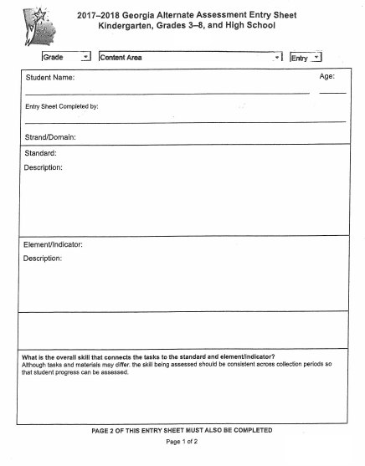
Select Grade, Content Area, Entry # (1 or 2) from Drop-downs. Proceed with selecting the standard and indicator (if applicable).
Notes:
There is one Entry Sheet for all students.
The Entry Sheet should be downloaded and saved to a local drive before completing the form.

Slide 17
Updates for 2017-2018
Reminders:
One Entry Sheet used for all grades:
http://www.gadoe.org/Curriculum-Instruction-and-Assessment/Assessment/Pages/GAA-Resources.aspx
Be sure to discard previous templates and use only the Entry Sheet for 2017-2018!
Use the electronic Entry Sheet to avoid Entry Sheet errors. Please proofread carefully.
Notes:
Please refer to Session 1, ”The Basics,” for an explanation of how to complete the Electronic Entry Sheet.

Slide 18
Lessons Learned from the 2016-2017 GAA Administration

Slide 19
Lessons Learned from the 2016-2017 Administration
Congratulations!
2016-2017 marked the eleventh successful administration of the Georgia Alternate Assessment!
Assessment tasks and the quality of the portfolio entries continue to improve.
Notes:
Please continue to consult general education teachers to understand the intent of each content standard and as a check on the alignment of assessment tasks to the content standards. Peer review of portfolios is also an important step.

Slide 20
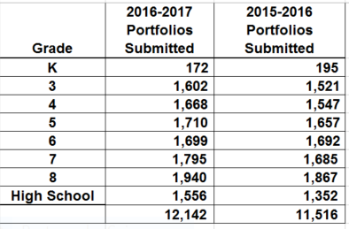
GAA Portfolios Submitted
12,142 portfolios were submitted in 2016-2017, compared with 11,516 submitted in 2015-2016.

Slide 21
Student Proficiency on the 2016-2017 GAA
Across all grades and content areas, the vast majority of students met or exceeded expectations as demonstrated by their Performance Level Indicator.
ELA: ≈ 85% Established or Extending Progress
Mathematics: ≈ 84% Established or Extending Progress
Science: ≈ 95% Established or Extending Progress
Social Studies: ≈ 96% Established or Extending Progress
Notes:
Performance Level indicator is synonymous with “Stage of Progress.”

Slide 22
Test Security and Ethics

Slide 23
Test Security
Maintaining security of all student materials is crucial to obtaining valid and reliable assessment results.
While the GAA materials themselves are not considered secure materials, student work and entries are secure once they have been chosen as assessment evidence and placed in the GAA portfolio binder.
Original student work or photos or videos of original student work (also called permanent products) must be submitted.
GAA evidence may not be photocopied and retained.
Photocopied evidence may not be submitted.
A photograph of a permanent product is acceptable.
Notes:
Given the unique features of the GAA (such as the test window), test security must be considered and attended to throughout the school year and not just during the portfolio submission phase.

Slide 24
Test Security
Once they have been placed in the 3-ring binder, student work and GAA materials must be kept in locked storage within the classroom – except during use.
Access to those materials must be restricted to authorized individuals only.
Notes:
Just as you would not photocopy a Georgia Milestones answer document, photocopying evidence to be used for this assessment is strictly prohibited. Only original student work should be submitted. If the original student work is too large or too fragile to be submitted in the portfolio, a photograph of the original should be submitted. Examples of products appropriate for photographing include three-dimensional models, extremely large posters, or tactile products that do not fit in the binder. In all other cases, original student work must be submitted.

Slide 25
Test Security
The assessment binder should not be removed from the school building, except for the purpose of peer review.
Every school should implement and enforce sign-out protocols.
It is the responsibility of all individuals who administer the assessment to follow security procedures and to protect the integrity of the process.
Notes:
Teachers may want to create folders for all students in which they can collect samples of student work. Materials can be saved until it is time to decide which ones will be used as evidence in students’ portfolios. Remember that the student work becomes secure test material once it has been placed in the 3-ring binder. Follow the instructions regarding Test Security in the GAA Examiner’s Manual.

Slide 26
Test Security
Any action which compromises assessment security or leads to the invalidation of an individual student’s or a group of students’ test scores will be viewed by the Georgia Department of Education (GaDOE) as inappropriate use or handling of tests and will be treated as such.
Any concern regarding test security must be reported to GaDOE immediately.
GaDOE Assessment Division staff members are available to help school system personnel develop and implement assessment security protocols.

Slide 27
2017-2018 Validation Form
The Validation Form was designed to address certain issues that should not occur during the assembly of a student’s portfolio, including:
Fabricating or altering evidence of student work
Making and retaining photocopies of contents
Submitting photocopies of student work
Signatures of the Test Administrator/Examiner and Building Administrator are required on the Validation Form.

Slide 28
2017-2018 Validation Form
The GAA Validation Form was provided in the portfolio binder to verify that all requirements and procedures have been followed and that the contents are the work of the student being assessed.
This is an important step – the signatures validate the contents of the portfolio.
Be certain that signatures have been obtained from both the person submitting the portfolio and the Building Administrator.
For transfer students, two Validation Forms must be submitted – one by the sending school/system and one by the receiving school/system.

Slide 29
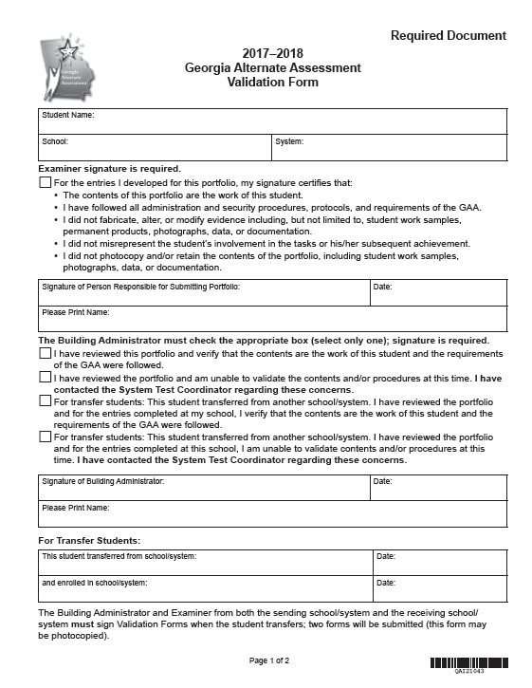
Required signature
Building Administrator
checks one box
Required signature
Notes:
By signing the Validation Form, both the Building Administrator and the person responsible for submitting the portfolio attest:
The contents of the portfolio are the work of the student being assessed.
Original student work has been included; photocopies have not been made, submitted and/or retained.
No evidence was fabricated, altered, or modified.
Portfolio evidence is an accurate depiction of student’s involvement and achievement/progress in tasks.
All procedures and protocols have been followed.
For transfer students, two Validation Forms must be submitted – one by the sending school/system and one by the receiving school/system.

Slide 30
Portfolio Validation
The portfolio validation process authenticates the student work included in the portfolio.
The form is a secure document.
In the case of transfer students, two Validation Forms must be submitted (one from the original school and one from the new school).
Notes:
Reminder: In the case of transfer students, two Validation Forms must be submitted (one from the original school and one from the new school). By signing the Validation Form for a transfer student the teacher certifies that, for all entries that they are responsible for submitting, the work is that of the student.

Slide 31
Portfolio Validation
Violation of any of the requirements for compiling student work for the GAA may result in the portfolio being invalidated and could result in additional actions or consequences.
If the Building Administrator, Portfolio Reviewer, or STC discover any irregularities, the portfolio can be returned to the teacher for correction.
If it is too late in the process or not feasible to return the portfolio to the school/teacher, an Irregularity Form must be completed by the System Test Coordinator alerting the GaDOE to the problem.

Slide 32
Issues Resulting in Invalidation
The vast majority of portfolios submitted for the 2016-2017 GAA were compiled following prescribed policies and procedures, and the evidence submitted represented authentic student work.
Careful attention to validation and evidence requirements is very important.

Slide 33
Ethics
The Georgia Alternate Assessment is a state and federally mandated assessment for students with significant cognitive disabilities who have met the participation guidelines and have been determined appropriate for the assessment by their IEP teams.
This assessment must adhere to all of the protocols and procedures required for the general assessments.
A breach of any of the validation or security policies constitutes both a procedural and an ethical violation, necessitating an investigation and possible consequences.

Slide 34
Portfolio Invalidation
Should an investigation of any of the previously mentioned issues determine that a breach has occurred, one possible consequence is invalidation of the portfolio.
In such a case, the scores for the entry or entries in question are negated, and the student’s assessment is reported as an invalid assessment.

Slide 35
Issues Resulting in Invalidation
Irregularities and questions about evidence authenticity are sometimes discovered and self-reported by schools and/or systems.
brought to light during portfolio review process
noted by Building Administrators during validation process
reported, sometimes anonymously, by various school personnel
If these irregularities are discovered, addressed, and corrected prior to portfolio submission, it is unnecessary to report them to the state as long as they are dealt with at the school/system level.

Slide 36
Issues Resulting in Invalidation
Issues regarding evidence authenticity and possible fabrication can also be discovered during scoring.
Problems most frequently seen include:
Dates changed, erased, and rewritten or covered over with correction fluid or collection period labels
Observation and interview forms with identical information attributed to multiple students
Identical permanent products attributed to multiple students (not group work)
These issues will result in the portfolio being invalidated.

Slide 37
Portfolio Review Process

Slide 38
GAA Portfolio Review
Teachers and other school staff work hard to compile portfolios of student work for the GAA. The portfolio showcases the progress students have made
A great deal of time and effort goes into compiling the portfolio of student work that showcases the progress a student has made in knowledge and skills in the academic content standards.
Portfolio reviewers provide an invaluable service as they work to support teachers before final submission of GAA portfolios by making sure that all requirements have been met.
38

Slide 39
Portfolio Review Prior to Submission
It is critical that the portfolio be reviewed both during the collection of evidence and immediately before it is submitted to be certain that everything is complete, Entry Sheets are completely and correctly filled in, tasks align, and evidence requirements have been met.
To this end, it is essential that portfolio reviewers participate in training and become very familiar with all requirements as outlined in the Examiner’s Manual and the webinar trainings.
Notes:
The importance of peer/portfolio review during and after completion of a portfolio cannot be overstated. It is critical that the review process go beyond counting pieces of evidence and that all portfolio requirements are considered.

Slide 40
Portfolio Review by the Teacher
Portfolio review by the teacher should be an ongoing process throughout evidence collection.
Have I selected the best standard and indicator?
Do students seem engaged?
Are they making progress?
Are the tasks and materials appropriate?
Are students able to demonstrate what they know?
Can students reliably communicate their responses?
Should I replace this evidence and design a task that is more appropriate for the individual student?

Slide 41
Planning a portfolio review
Who should conduct the portfolio review?
Trained GAA administrator
Designated GAA trainer
Other GAA teachers/examiners
School test coordinator
SPED coordinator
Building administrator
Notes:
All portfolio reviewers must participate in training and know the requirements for assessment task design (including alignment), evidence requirements and collection, documentation, and portfolio organization.

Slide 42
Planning a portfolio review
When should reviews be conducted?
First review: mid-administration, after Collection Period 1 evidence has been compiled
Final review: before submission, after all evidence has been compiled and organized in the 3-ring binder
Notes:
Systems have the flexibility to determine the best time to schedule reviews. Some recommendations include staggering reviews so as not to back log the reviewer, providing timely feedback so that teachers can make necessary changes within the collection windows, and returning portfolios quickly after the review is complete.

Slide 43
Portfolio review
1. Carefully review the Entry Sheet. Be sure all of the information is correct:
Student name
Teacher name
Strand/domain, standard, element/indicator
Task Descriptions

Slide 44
Portfolio Review
2. Consider all aspects of the evidence requirements.
All four pieces of evidence must align to standard and element/indicator.
Primary and Secondary Evidence must be included for each collection period.
Original student work, not photocopies, must be submitted.
Collection Period 2 Primary Evidence must be collected at least 14 calendar days after Collection Period 1 Primary Evidence.
Types of evidence are the best choices to clearly demonstrate the student’s responses
Grade-appropriate materials must be used.

Slide 45
Portfolio Review
3. All evidence must be annotated. Annotations may be written on the evidence or on a separate annotation page.
Name of student
Date (when did the task take place?)
Task (what was the student asked to do?)
Setting (where did the task take place?)
Student performance (how well did the student do?)
Interactions (with whom did the student work?)
Independence (what types and frequency of prompting were needed?)
Collection period labels (Optional, but helpful)
Notes:
Scorers make an effort to score the portfolios as presented. E.g., if evidence is out of order, all attempts will be made to correct and connect task descriptions with the evidence. E.g.,#2 If an Observation Form is listed as Primary Evidence and a Work Sample listed as Secondary Evidence, the scorer will flag this for Team Leader review and a Team Leader will make sure that dates of evidence meet GAA requirements (including two distinct Collection Periods). If requirements are met, the entry may still be scorable.

Slide 46
Portfolio Review
4. Checklist for Teachers and Portfolio Reviewers should be signed and dated.
5. Validation Form must be signed by Building Administrator and the person responsible for submitting the portfolio, which is the system test administrator.
6. Release to Use Portfolio for Training has been signed by parent or guardian and included in portfolio. This is not required, but it is helpful for the development of training materials.

Slide 47
Validation Check for Alignment
There were fewer nonscorable entries in 2016-2017 than ever before. Keep up the good work!
The vast majority of nonscorables on the GAA are assigned in the Not Aligned (NA) category.
In the 2016-2017 administration, approximately 83% of all nonscorables were the result of alignment issues.
In a majority of these instances, only one or two of the four tasks did not align.
It is critical that the portfolio reviewers evaluate each task to confirm that all four tasks in each entry align to the content standard and element/indicator.

Slide 48
Validation Check for Alignment
Have opportunities for teaching and learning, aligned to the assessed content, been provided?
When looking at the assessment task in isolation, can you identify the content standard/academic domain?
Could a curriculum content expert link the task back to the specific state standard?
Have the essential components of the standard (element/indicator) been addressed?
Do all four assessment tasks align to the intent of the element as it applies to the specified content standard?

Slide 49
Reviewing Documentation
When reviewing evidence documentation, the teacher/examiner and portfolio reviewer should ask themselves:
What, specifically, was the student asked to do as it aligns to the standard and indicator?
What were the questions that were asked of the student?
What were the student’s answers?
Were the responses correct? Has evaluation of student performance by the teacher been clearly documented? Grades for participation are not sufficient.
What were the type and frequency of prompting required for the student to complete each task?

Slide 50
Reviewing Documentation
Review to ensure that all necessary documentation has been provided.
It is very important that documentation be clear and concise.
Contradictory or unnecessary annotations can lead to lower scores.
Accuracy or correctness of the student response should be documented separately from the type and frequency of prompting that led the student to the correct response.
Notes:
Note: Importance of last bullet point. It benefits the student when accuracy and prompting are separated.

Slide 51
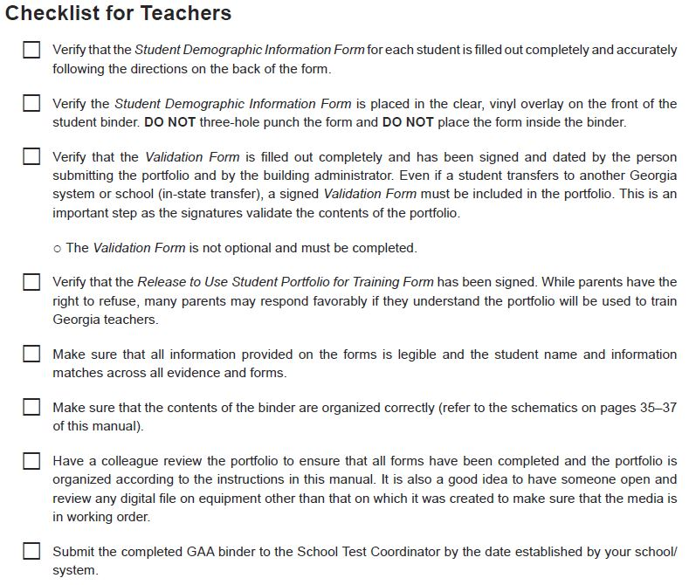
Checklist for Teachers and Portfolio Reviewers

Slide 52
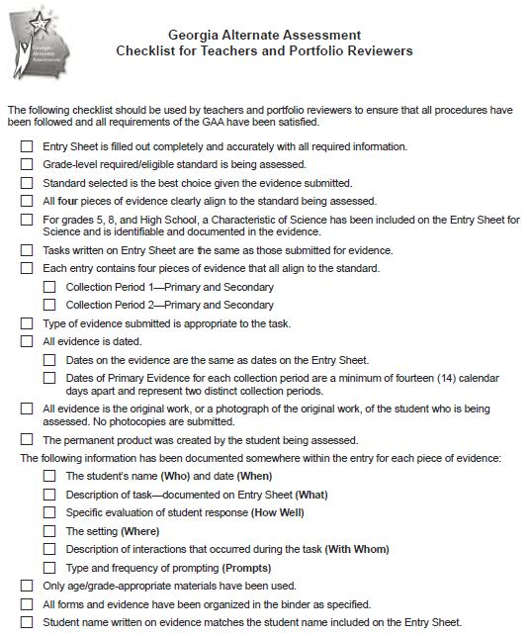
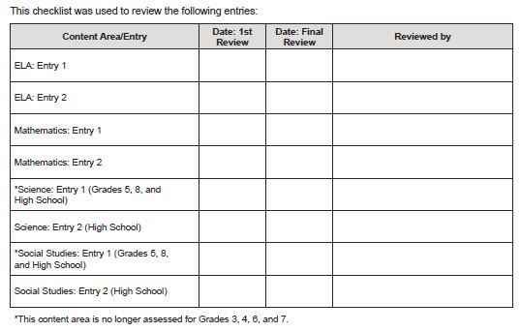
Checklist for Teachers and Portfolio Reviewers

Slide 53
Checklist for Teachers and Portfolio Reviewers
The Checklist for Teachers and Portfolio Reviewers is provided in the portfolio binder to ensure that all procedures and requirements have been satisfied before the portfolio is submitted.
The checklist should be part of the portfolio validation and review process as the reviewer signs and dates the form after each content area entry is checked.
It is recommended that the portfolio be reviewed twice – once after the first collection period has been completed and again before the portfolio is submitted.
The GAA Evidence Checklist, specific to each type of evidence submitted, can be found on pages 52-55 of the GAA Examiner’s Manual, 2017-2018.

Slide 54
Avoiding Invalidations
Reminder:
If irregularities are discovered, addressed, and corrected prior to portfolio submission, it is unnecessary to report them to the state as long as they are dealt with at the school/system level.
Systems can and should attempt to rectify them. However, as with all irregularities, they should be reported to Deborah Houston of the GaDOE. They may or may not require a Portal record.

Slide 55
Ensuring a Successful Administration
Principals are critical!
The GAA must be given the same consideration, resources, and support provided to all programs.
Teachers need support
Planning time needs to be scheduled and substitutes provided.
Collaboration with content experts will assist teachers to understand content standards.
Collaboration with other special educators can help all to discuss and review assessment tasks.
Notes:
Administrators and examiners alike must see the GAA as every bit as important as the Georgia Milestones or any other assessment.

Slide 56
Ensuring a Successful Administration
Training and support will continue to be provided on the state level in the form of:
GAA Fall Workshops via Go-To Webinar presentations.
Webinars focusing on GAA administration as well as access to the curriculum.
GAA portfolio review by peers and building examiners.

Slide 57
Sample Tasks Resource Guide
A resource to provide sample tasks (individual entries) that are both aligned to grade-level content standards and accessible to students with a range of significant cognitive disabilities.
Contains sample tasks for all grades and all content areas.
The samples are intended to be used by teachers to inform their creation of assessment tasks which will be suitable for students with varying degrees of cognitive disabilities.

Slide 58
GAA Resources
Student Sample Resource Guide
Examples of annotated student entries for a variety of grades, content areas and access levels
Sample Task Resource Guide
Exemplars of tasks that are aligned to grade-level content standards and accessible to students with a range of significant disabilities
Extended Standards
Through extensions, skills that align are derived (or extended) from the grade-level standards.
http://www.gadoe.org/Curriculum-Instruction-and-Assessment/Assessment/Pages/GAA.aspx

Slide 59
GAA Resources
The following resources, which include information on the GAA and the state-mandated content standards, are available for local systems and educators.
The website hosts the state-mandated standards
https://www.georgiastandards.org/Georgia-Standards/Pages/default.aspx
The GAA Resources page contains a variety of administration documents, such as:
Examiner’s Manual Score Interpretation Guide
Validation Form Optional Administration Forms
Entry Sheet Parent Brochures
http://www.gadoe.org/Curriculum-Instruction-and-Assessment/Assessment/Pages/GAA.aspx

Slide 60
Contact Information
Questions about how to administer the GAA?
GaDOE Assessment Division
(800) 634-4106
Deborah Houston, Assessment Specialist
(404) 657-0251
dhouston@doe.k12.ga.us

Slide 61
Contact Information
Need information about access to the state-mandated content standards for students with significant cognitive disabilities?
Crystal Callaway, Division for Special Education Services
(404) 657-9969
ccallaway@doe.k12.ga.us

Slide 62
Contact Information
Teachers of Students with Significant Cognitive Disabilities
The Resource Board
has been moved to the Teacher Resource Link
http://bit.ly/AccessOneNote

Slide 63
Contact Information
Questions About Materials, Distribution, or Collection?
Questar’s GAA Customer Service
(866) 997-0698
GA@QuestarAI.com

Slide 64
Webinar Survey
We want your comments!
Please use the below link to provide feedback regarding this GAA Training session!
http://gadoe.org/surveys/AsAc-H8PBVZM

