Slide 1
Georgia Alternate Assessment
Overview of Science and Social Studies
in 2017-2018

Slide 2
2017-2018 GAA Purpose
The 2017-2018 webinars explain how to prepare and submit GAA portfolios.
http://www.gadoe.org/Curriculum-Instruction-and-Assessment/Assessment/Pages/GAA-Presentations.aspx
Information pertaining to the GAA can also be found in the 2017-2018 GAA Examiner’s Manual.
http://www.gadoe.org/Curriculum-Instruction-and-Assessment/Assessment/Pages/GAA-Resources.aspx

Slide 3
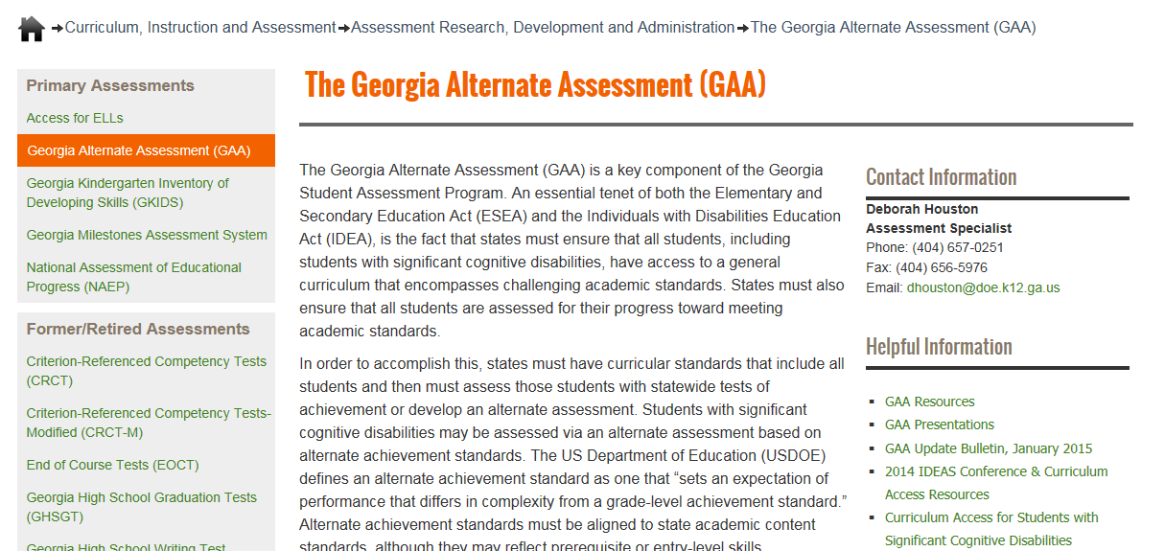
Links to Presentations are on the GaDOE website (shown below)
http://www.gadoe.org/Curriculum-Instruction-and-Assessment/Assessment/Pages/GAA.aspx
Notes:
The GAA Presentations link will take you to Fall Training presentations (past and present), mid-year and post-administration presentations.”

Slide 4
Questions & Answers
You are invited to submit questions you may have using the “Questions” feature of the GoToWebinar anytime throughout each session.
The “Questions” feature will be monitored throughout the session and questions will be addressed.

Slide 5
GAA 2017-2018 Key Dates
August 29 – September 1, 2017:
Manuals, administration forms, and binders arrive
September 5, 2017 – March 23, 2018:
Administration window
Completed portfolios must be shipped to Questar no later than March 23, 2018. They may be shipped as early as March 1, 2018.

Slide 6
Topics in this Presentation
It is designed to inform:
Teachers who administer the GAA
Peer reviewers and designated trainers
Special education directors
Test coordinators
Building administrators
Topics in this training session:
Overview of Science and Social Studies content standards
Science and Social Studies are assessed only in Grades 5, 8 and high school
Sample tasks

Slide 7
Requirements
States must ensure that all students, including students with significant cognitive disabilities, have access to challenging academic standards.
The GAA ensures that all students have the opportunity to learn.
Notes:
GAA meets the requirements of federal and state laws. States must ensure that all students, including students with significant cognitive disabilities, have access to challenging academic standards.

Slide 8
Requirements for all GAA entries
The Georgia Alternate Assessment was designed with the assistance of Georgia general and special educators. It is a portfolio-based assessment which allows students to show their progress in acquiring skills and knowledge aligned to the Georgia content standards in English Language Arts, Mathematics, Science and Social Studies.
Teachers collect evidence of student work during two collection periods. Collection Period 1 represents a student’s baseline skill level. Collection Period 2 provides evidence of a student’s achievement/progress.

Slide 9
Overview of Science and Social Studies Content Standards

Slide 10
2017-2018 GAA Science and Social Studies Blueprint
The Blueprint outlines the requirements of the 2017-2018 GAA.
The Blueprint identifies the content standards that are eligible for assessment on the GAA.
The Blueprint, by grade, can be found in Appendix D of the GAA Examiner’s Manual, 2017-2018.
Text of standards also appears in the GAA Examiner’s Manual, 2017-2018.
Note: Do not use Blueprints from previous years

Slide 11
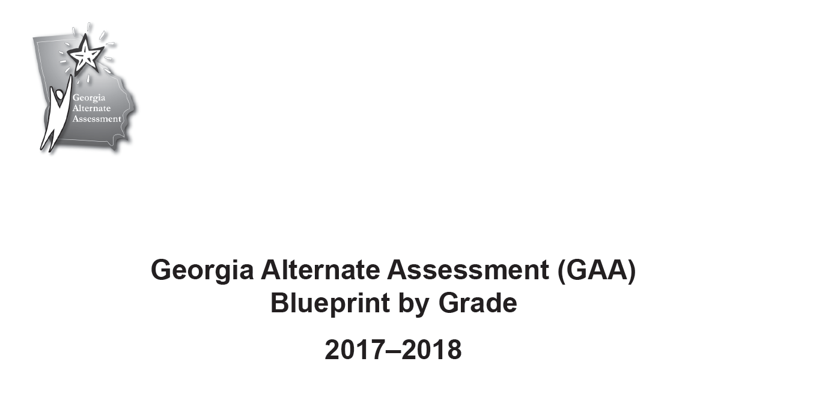
Science and Social Studies Blueprint

Slide 12
2017-2018 Blueprint
Important change in Science standards in all grades:
There are no longer separate Characteristics of Science.

Slide 13
2017-2018 Blueprint
Blueprint, Grade 5 Science
Notes:
The Science and Social Studies standards which were introduced during the 2016-2017 are part of the GAA for the first time in 2017-2018. Students were are assessed on the GAA must perform tasks which align to the new standards.

Slide 14
2017-2018 Blueprint
Blueprint, Grade 5 Social Studies
Notes:
The Science and Social Studies standards which were introduced during the 2016-2017 are part of the GAA for the first time in 2017-2018. Students were are assessed on the GAA must perform tasks which align to the new standards.

Slide 15
2017-2018 Blueprint
Blueprint, Grade 8 Science

Slide 16
2017-2018 Blueprint
Blueprint, Grade 8 Social Studies

Slide 17
2017-2018 Blueprint
Blueprint, Grade HS Science

Slide 18
2017-2018 Blueprint
Blueprint, Grade HS Social Studies

Slide 19
Alignment
Alignment is the connection between the written, taught, and tested curriculum.
Alignment demonstrates the linkage of the activities (student work) to the intent of the grade-level standard and indicator on which the student is being assessed.
Each of the four tasks in an entry must align to the standard and indicator.
Assessment tasks should be designed to address the standards-based skill being evaluated.
Notes:
Intent - what are the standard and indicator designed to teach?
If the standard or element/indicator address multiple skills, the student’s assessment tasks may address only one of those skills. If the teacher chooses to assess a student on just one part of an element/indicator, it is essential that the same part be assessed in each of the four tasks.
Consider alignment first when designing assessment tasks.
The assessment task must be true to the standard.
The task must address the distinct characteristics of the indicator or the standard when there are no indicators.
The task must be appropriately challenging for the individual student.
Both Collection Periods must provide evidence of what the student knows and can do across the same skill(s).

Slide 20
Sample Tasks

Slide 21
Sample Tasks - Science
Slides Grade Standard
21-23 5 S5L1 - Obtain, evaluate, and communicate information to group organisms using scientific classification procedures.
24-25 5 S5P1 - Obtain, evaluate, and communicate information to explain the differences between a physical change and a chemical change.
26-27 8 S8P1 - Obtain, evaluate, and communicate information about the structure and properties of matter.
28-31 8 S8P2 - Obtain, evaluate, and communicate information about the law of conservation of energy to develop arguments that energy can transform from one form to another within a system.
32-34 HS SB4 - Obtain, evaluate, and communicate information to illustrate the organization of interacting systems within single-celled and multi-celled organisms.
35-38 HS SB4 - Obtain, evaluate, and communicate information to illustrate the organization of interacting systems within single-celled and multi-celled organisms.
39-41 HS SPS6 - Obtain, evaluate and communicate information to explain the properties of solutions.

Slide 22
Grade 5 Science Example
 | S5L1 - Obtain, evaluate, and communicate information to group organisms using scientific classification procedures.
 | (a) Develop a model that illustrates how animals are sorted into groups (vertebrate and invertebrate) and how vertebrates are sorted into groups (fish, amphibian, reptile, bird, and mammal) using data from multiple sources.

Slide 23
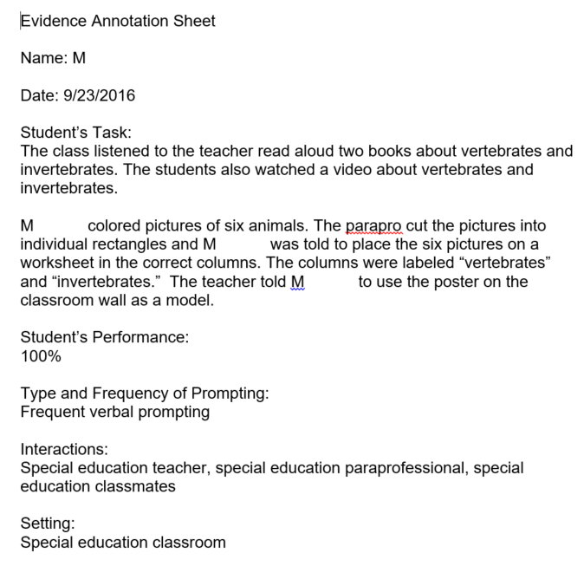
Sample Evidence – Grade 5 Science (S5L1a)
66%
Notes:
The student used the model from the general education classroom to help him perform his assessment task.

Slide 24
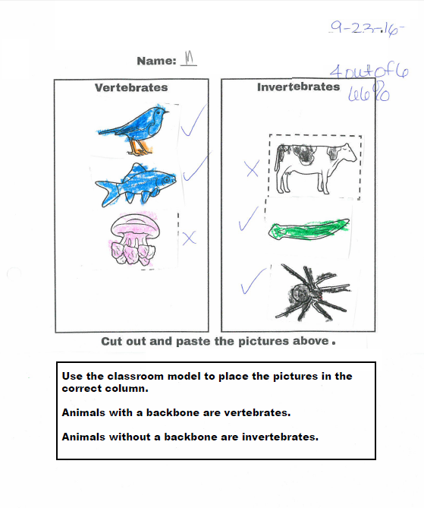
Sample Evidence – Grade 5 Science (S5L1a) continued from previous slide
The student’s task was to use the model from the general education classroom to determine how to categorize six animals. He was given a teacher-made worksheet with columns labeled “vertebrates” and “invertebrates.” The worksheet directions reminded the student to use the model.

Slide 25
Grade 5 Science Example
 | S5P1 - Obtain, evaluate, and communicate information to explain the differences between a physical change and a chemical change.
 | (b) Construct an argument based on observations that the physical changes in the state of water are due to temperature changes, which cause small particles that cannot be seen to move differently.

Slide 26
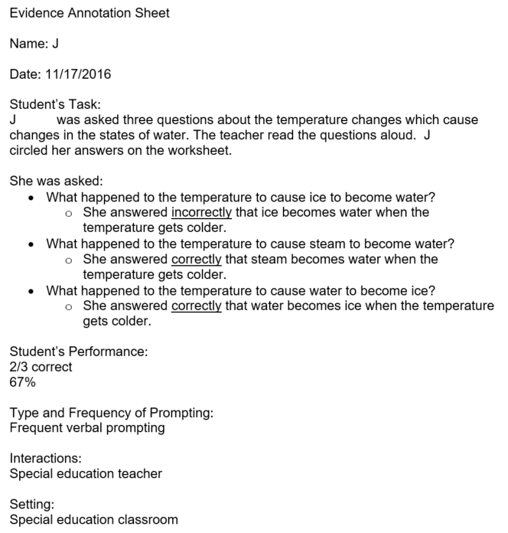
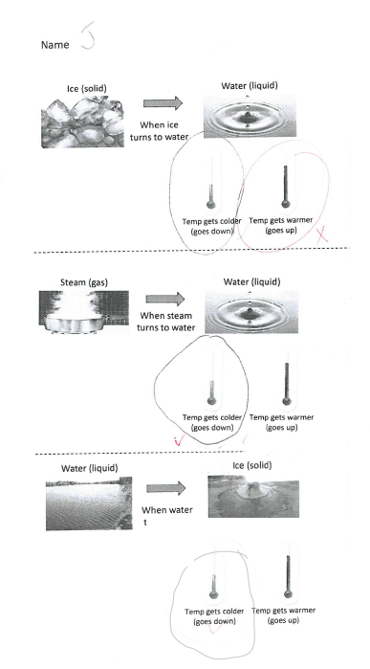
Sample Evidence – Grade 5 Science (S5P1b)

Slide 27
Grade 8 Science Example
 | S8P1 - Obtain, evaluate, and communicate information about the structure and properties of matter.
 | (b) Develop and use models to describe the movement of particles in solids, liquids, gases and plasma states when thermal energy is added or removed.

Slide 28
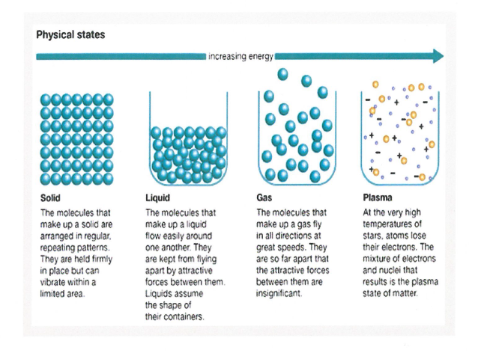
Sample Evidence – Grade 8 Science (S8P1b)
The student used this model to make his chart (see next slide). He was asked to write one phrase to describe the movements of molecules in solids, liquids, gases and plasmas.

Slide 29
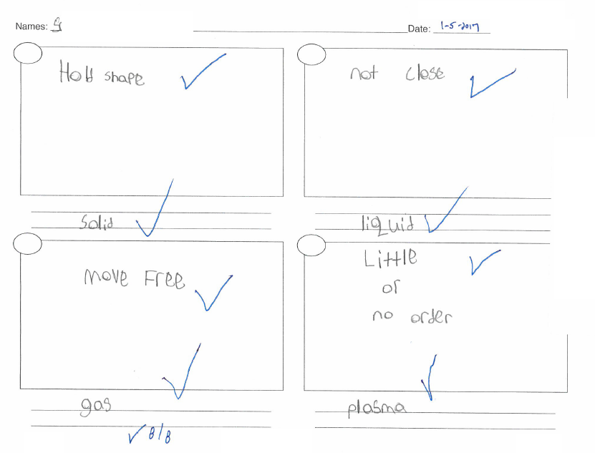
Sample Evidence – Grade 8 Science (S8P1b)

Slide 30
Grade 8 Science Example
 | S8P2 - Obtain, evaluate, and communicate information about the law of conservation of energy to develop arguments that energy can transform from one form to another within a system.
 | (b) Plan and carry out an investigation to explain the transformation between kinetic and potential energy within a system (e.g., roller coasters, pendulums, rubber bands, etc.).

Slide 31
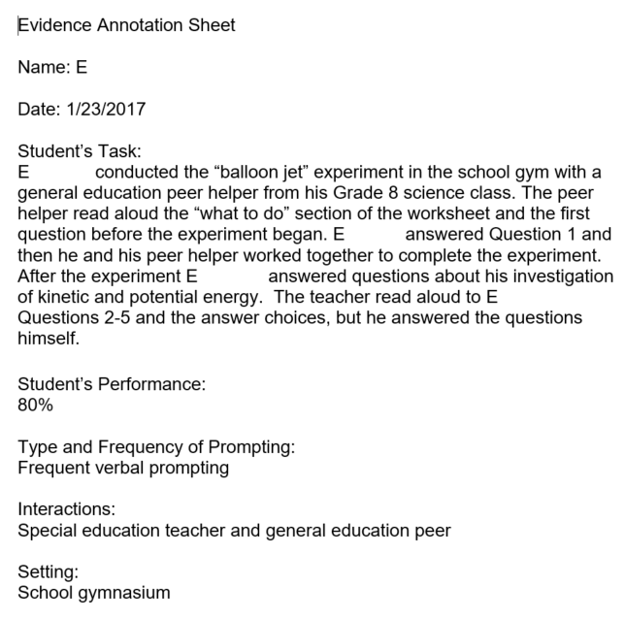
Sample Evidence – Grade 8 Science (S8P2b)
The essence of the standard and indicator is to explain how potential energy becomes kinetic energy. Students may plan and carry out and an investigation or the investigation may be planned by the teacher.

Slide 32
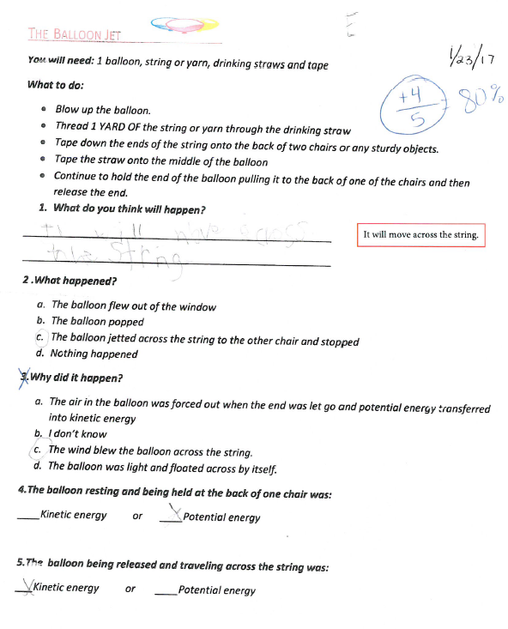
Sample Evidence – Grade 8 Science (S8P2b) continued from previous slide
The student’s task is to show how potential energy becomes kinetic energy.

Slide 33
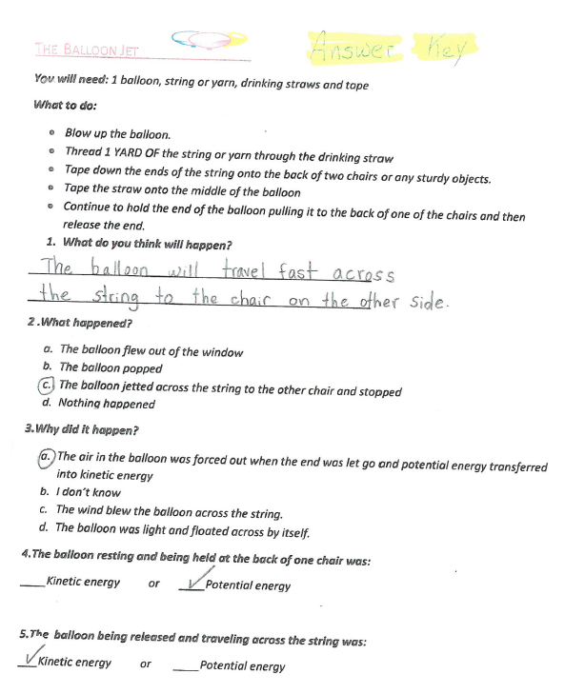
Sample Evidence – Grade 8 Science (S8P2b) continued from previous slide
Teacher’s answer key

Slide 34
Grade HS Science 1 (Biology) Example
 | SB4 - Obtain, evaluate, and communicate information to illustrate the organization of interacting systems within single-celled and multi-celled organisms.
 | (a) Construct an argument supported by scientific information to explain patterns in structures and function among clades of organisms, including the origin of eukaryotes by endosymbiosis. Clades should include: archaea, bacteria, eukaryotes (fungi, plants, animals).

Slide 35
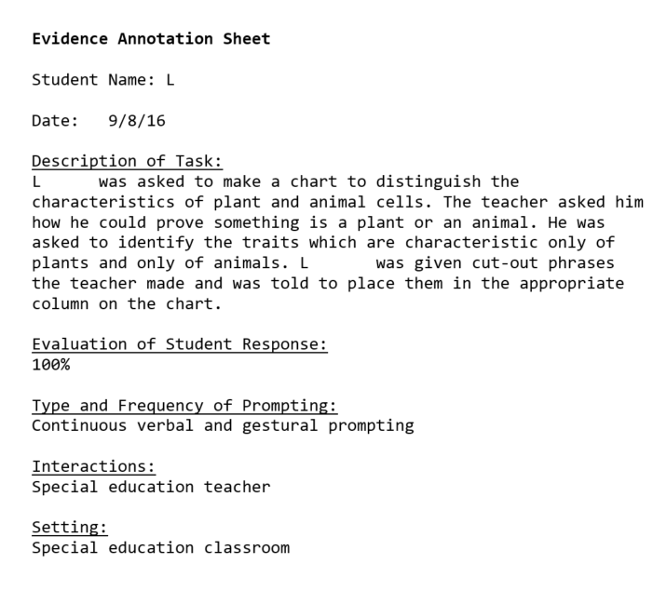
Sample Evidence – Grade HS Science 1 (SB4a)
The student’s task aligns to the part of the element which refers to explaining patterns in structures and functions. The task is limited to plants and animals.

Slide 36
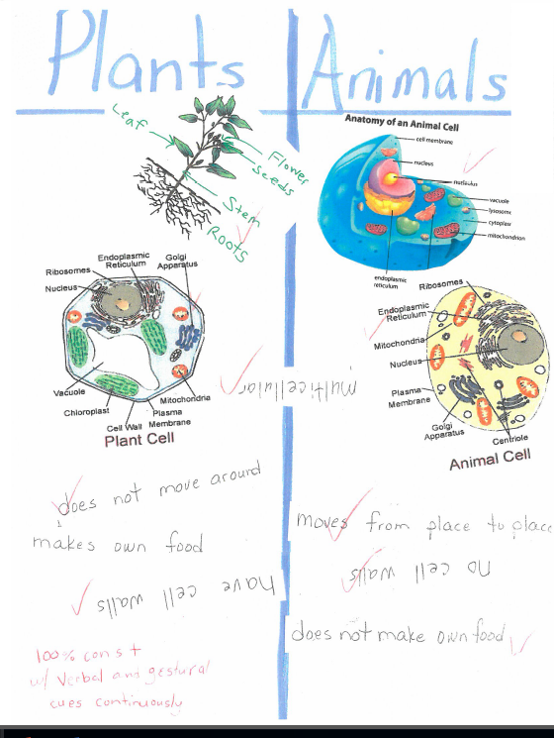
Sample Evidence – Grade HS Science 1 (SB4a) continued from previous slide
The student’s argument is the identification of characteristics which are unique to plants and to animals.

Slide 37
Grade HS Science 1 (Biology) Example
 | SB4 - Obtain, evaluate, and communicate information to illustrate the organization of interacting systems within single-celled and multi-celled organisms.
 | (a) Construct an argument supported by scientific information to explain patterns in structures and function among clades of organisms, including the origin of eukaryotes by endosymbiosis. Clades should include: archaea, bacteria, eukaryotes (fungi, plants, animals).

Slide 38
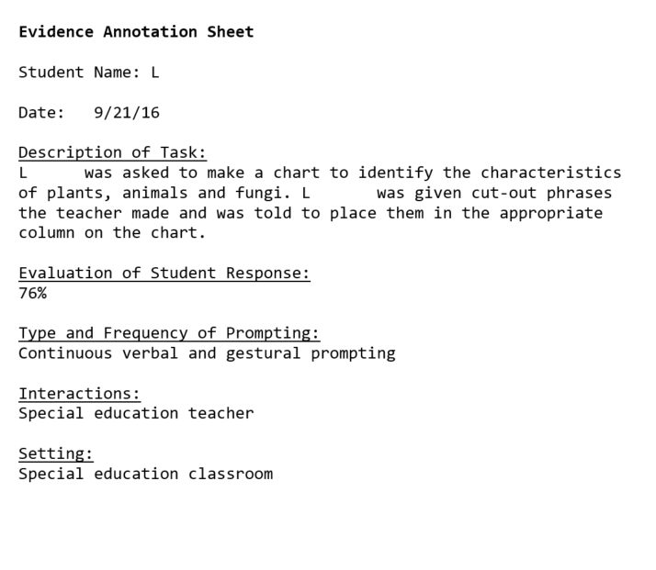
Sample Evidence – Grade HS Science 1 (SB4a)
The teacher’s annotation explains that the student identified the characteristics of plants, animals and fungi.

Slide 39
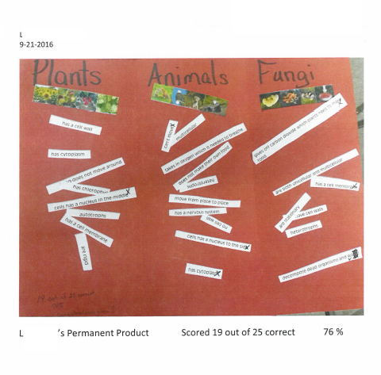
Sample Evidence – Grade HS Science 1 (SB4a) continued from previous slide
The student’s task aligns to the part of the element which refers to making an argument by explaining patterns in structures and functions. The task includes plants, animals and fungi.

Slide 40
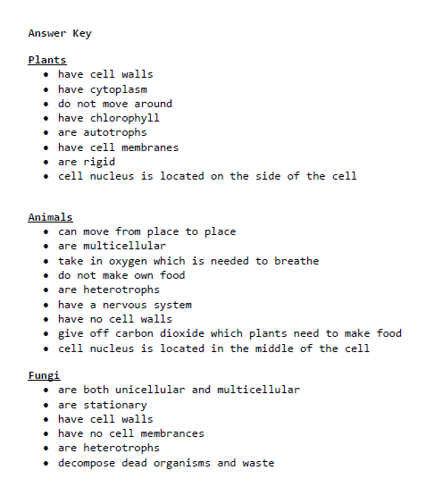
Sample Evidence – Grade HS Science 1 (SB4a) continued from previous slide
Teacher’s answer key

Slide 41
Grade HS Science 2 (Physical Science) Example
 | SPS6 - Obtain, evaluate and communicate information to explain the properties of solutions.
 | (b) Plan and carry out investigations to determine how temperature, surface area, and agitation affect the rate a solute dissolves in a specific solvent.

Slide 42
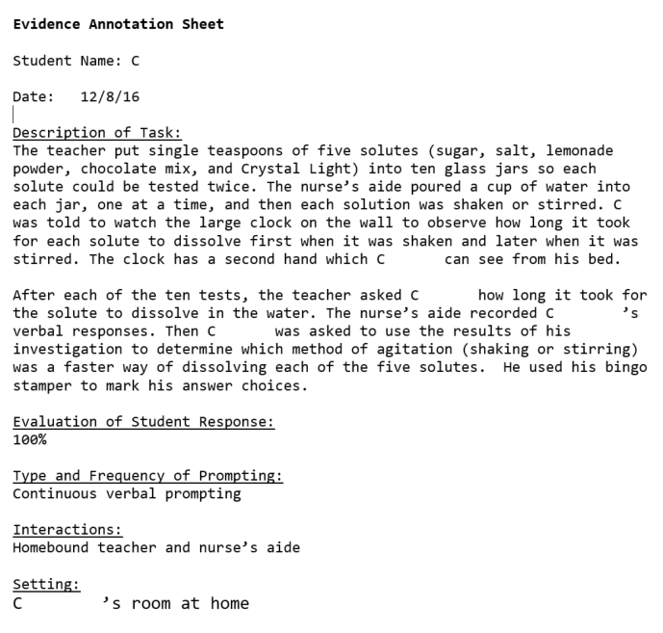
Sample Evidence – Grade HS Science 2 (SPS6b)
The teacher’s annotation explains that the student tested five substances to see if they would dissolve more quickly if they were shaken or stirred. The student’s work aligns to the “how…agitation affect[s] the rate a solute dissolves…”

Slide 43
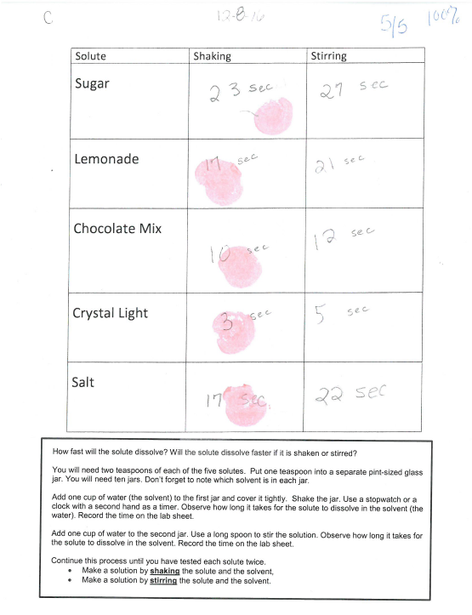
Sample Evidence – Grade HS Science 2 (SPS6b)
The student’s task allowed him to investigate how agitation (shaking or stirring) affected the rate at which a solute dissolves in a solvent. In this task the solvent was always water. The solutes were five commonly available foods with which the student was familiar.
The homebound student who performed this investigation was not able to pour the water into the glass jars or do the shaking or stirring himself. He still was able to perform an aligned task because his verbal answers were scribed and he was able to indicate which method of agitation cause the solute to dissolve faster.

Slide 44
Sample Tasks – Social Studies
Slides Grade Standard
43-46 5 SS5E4 - Identify the elements of a personal budget (income, expenditures, and saving) and explain why personal spending and saving decisions are important.
47-49 8 SS8G1 - Describe Georgia’s geography and climate.
50-52 8 SS8G1 - Describe Georgia’s geography and climate.
53-55 HS SSUSH23 - Assess the political, economic, and technological changes
during the Reagan, Bush Sr., Clinton, Bush, and Obama administrations.
56-59 HS SSUSH10 - Identify legal, political, and social dimensions of Reconstruction.
60-62 HS SSEPF6 - Describe how the earnings of workers are determined in the marketplace.

Slide 45
Grade 5 Social Studies Example
 | SS5E4 - Identify the elements of a personal budget (income, expenditures, and saving) and explain why personal spending and saving decisions are important.
 | This standard has no indicators.

Slide 46
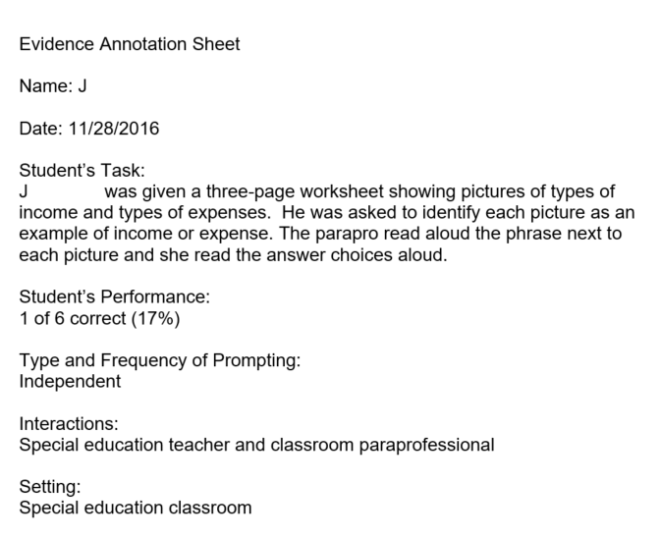
Sample Evidence – Grade 5 Social Studies (SS5E4)
The teacher’s annotation explains that the student was shown photographs of activities which represented either income of expense. He was asked to identify each activity by circling the appropriate description (income or expense).

Slide 47
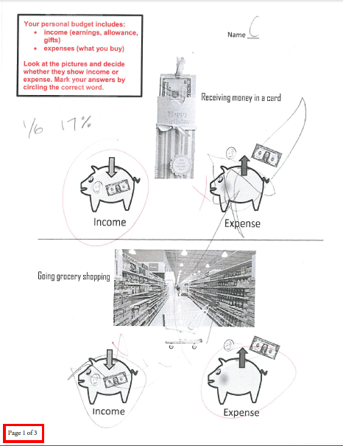
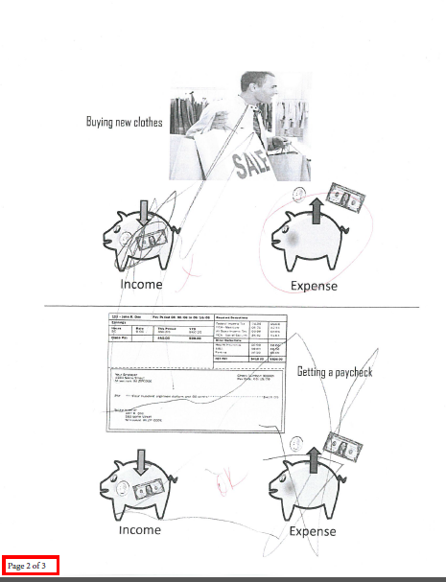
Sample Evidence – Grade 5 Social Studies (SS5E4)

Slide 48
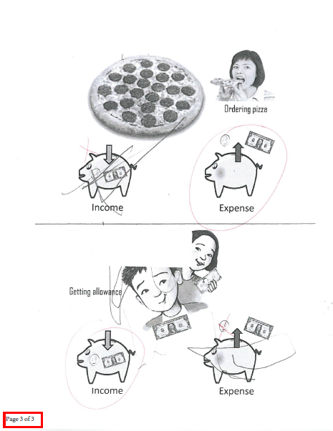
Sample Evidence – Grade 5 Social Studies (SS5E4)

Slide 49
Grade 8 Social Studies Example
 | SS8G1 - Describe Georgia’s geography and climate.
 | (a) Locate Georgia in relation to region, nation, continent, and hemispheres.

Slide 50
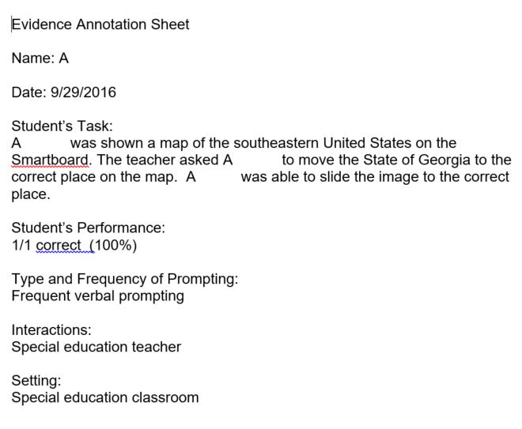
Sample Evidence – Grade 8 Social Studies (SS8G1a)
The teacher’s annotation explains that the student used the Smartboard to place the Georgia map in the correct place on a regional map.

Slide 51
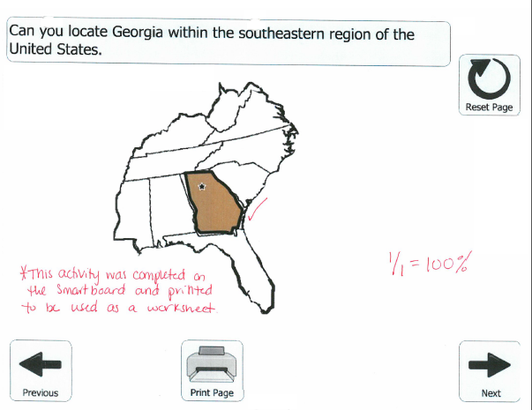
Sample Evidence – Grade 8 Social Studies (SS8G1a)
This task was the student’s Collection Period 1 Primary Evidence. In the three other tasks in this entry she placed the Georgia map on a map of the USA, a map of North America, and a map of the western hemisphere.

Slide 52
Grade 8 Social Studies Example
 | SS8G1 - Describe Georgia’s geography and climate.
 | (b) Distinguish among the five geographic regions of Georgia in terms of location, climate, agriculture, and economic contribution.

Slide 53
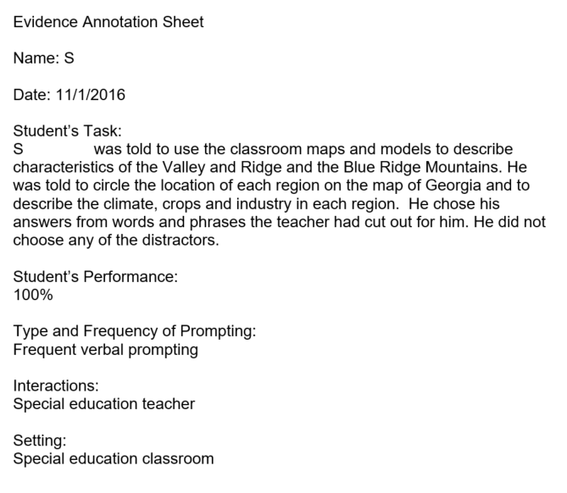
Sample Evidence – Grade 8 Social Studies (SS8G1b)
The student’s work involved two of the five geographic regions of Georgia.

Slide 54
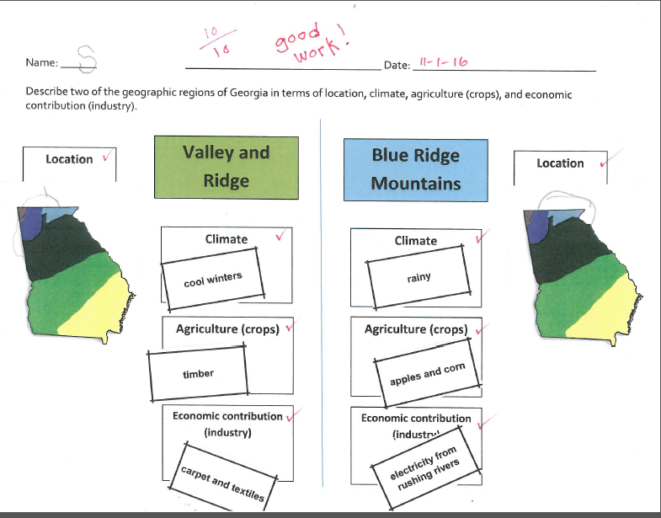
Sample Evidence – Grade 8 Social Studies (SS8G1b)
The student was asked to find each region on a map of Georgia and to describe its climate, agriculture and economic contribution.

Slide 55
Grade HS Social Studies 1 United States History Example
 | SSUSH23 - Assess the political, economic, and technological changes during the Reagan, George H.W. Bush, Clinton, George W. Bush, and Obama administrations.
 | (c) Examine the influences of technological changes on society including the personal computer, the Internet, and social media.

Slide 56
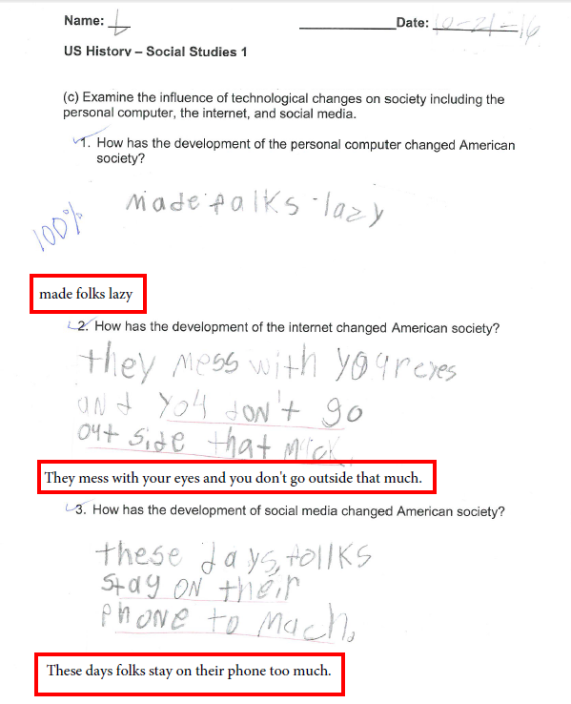
Sample Evidence – Grade HS Social Studies 1 (SSUSH23c)
The student was asked three open-response questions about the influence on society of the personal computer, the Internet, and social media.

Slide 57
Grade HS Social Studies 1 United States History Example
 | SSUSH10 - Identify legal, political, and social dimensions of Reconstruction.
 | (c) Describe the significance of the 13th, 14th, and 15th amendments.

Slide 58
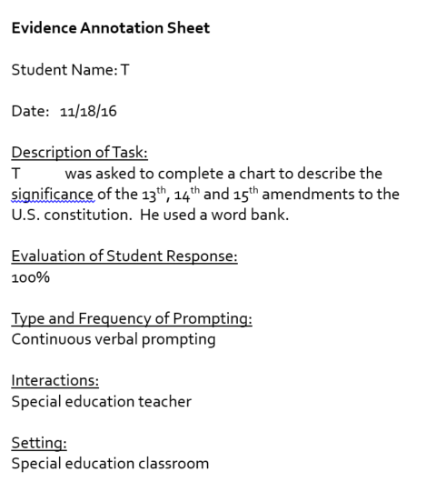
Sample Evidence – Grade HS Social Studies 1 United States History (SSUSH10c)
The teacher’s annotation explains that the student was asked to use a word bank to complete a chart to describe each of the amendments.

Slide 59
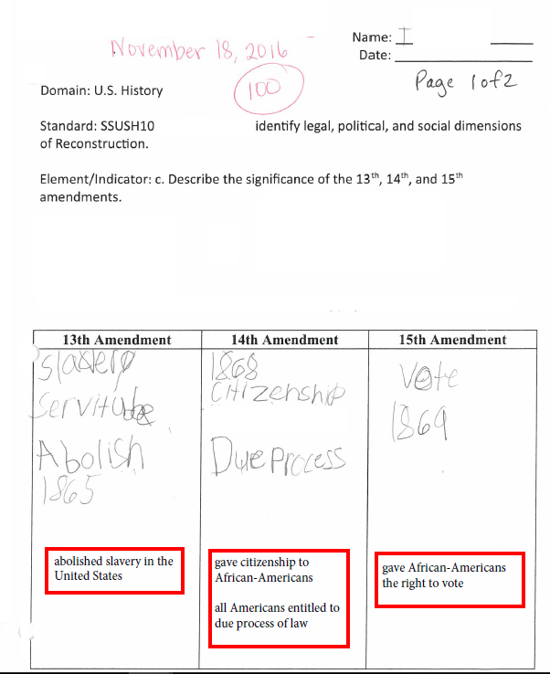
Sample Evidence – Grade HS Social Studies 1 United States History (SSUSH10c)
The student used the words and phrases provided by the teacher (see next slide) to complete this chart.

Slide 60
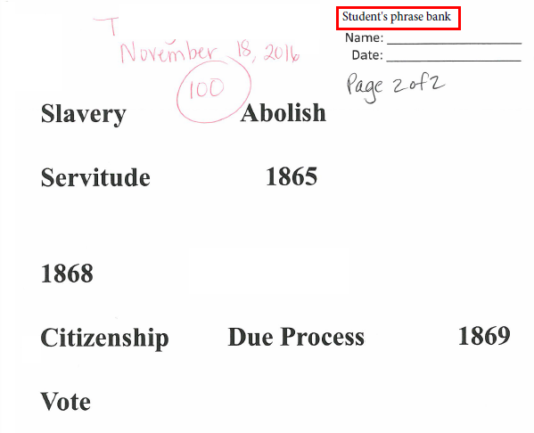
Sample Evidence – Grade HS Social Studies 1 United States History (SSUSH10c)
The student’s answer choices are shown here.

Slide 61
Grade HS Social Studies 2 Economics Example
 | SSEPF6 - Describe how the earnings of workers are determined in the marketplace.
 | (a) Identify skills that are required to be successful in the workplace including positive work ethics, punctuality, time management, teamwork, communication skills, and good character.

Slide 62
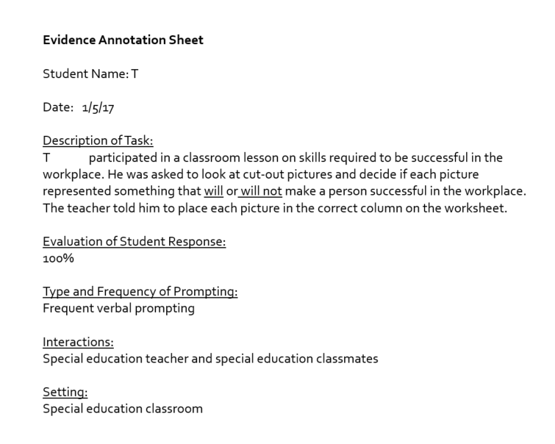
Sample Evidence – Grade HS Social Studies 2 Economics (SSEPF6a)
The student was asked to place pictures on a chart to demonstrate his understanding of what is or is not a skill which will make a person successful in the workplace.

Slide 63
Sample Evidence – Grade HS Social Studies 2 Economics (SSEPF6a)

Slide 64
Contact Information
Questions about how to administer the GAA?
GaDOE Assessment Administration Division
(800) 634-4106
Deborah Houston, Assessment Specialist
(404) 657-0251
dhouston@doe.k12.ga.us

Slide 65
GAA Resources
Student Sample Resource Guide
Examples of annotated student entries for a variety of grades, content areas and access levels
Sample Task Resource Guide
Exemplars of tasks that are aligned to grade-level content standards and accessible to students with a range of significant disabilities
Extended Standards
Through extensions, skills that align are derived (or extended) from the grade-level standards.
http://www.gadoe.org/Curriculum-Instruction-and-Assessment/Assessment/Pages/GAA.aspx

Slide 66
GAA Resources
The following resources, which include information on the GAA and the state-mandated content standards, are available for local systems and educators.
The website hosts the state-mandated standards
https://www.georgiastandards.org/Georgia-Standards/Pages/default.aspx
The GAA Resources page contains a variety of administration documents, such as:
Examiner’s Manual Score Interpretation Guide
Validation Form Optional Administration Forms
Entry Sheet Parent Brochures
http://www.gadoe.org/Curriculum-Instruction-and-Assessment/Assessment/Pages/GAA.aspx

Slide 67
Contact Information
Need information about access to the state-mandated content standards for students with significant cognitive disabilities?
Crystal Callaway, Division for Special Education Services
(404) 657-9969
ccallaway@doe.k12.ga.us

Slide 68
Contact Information
Teachers of Students with Significant Cognitive Disabilities
The Resource Board
has been moved to the Teacher Resource Link
http://bit.ly/AccessOneNote
http://www.gadoe.org/Technology-Services/SLDS/Pages/GAA-Resources-In-TRL.aspx

Slide 69
Contact Information
Questions About Materials, Distribution, or Collection?
Questar’s GAA Customer Service
(866) 997-0698
GA@QuestarAI.com

Slide 70
Webinar Survey
We want your comments!
Please use the below link to provide feedback regarding this GAA training session.
http://gadoe.org/surveys/AsAc-H8PBVZM

