Slide 1
Spring 2015 Pre-Administration Webinar Georgia High School Graduation Test and Georgia High School Writing Test
2015 Retest Administration Dates
GHSWT: February 25, 2015 (Make-up on February 26, 2015)
GHSGT: March 16-27, 2015
GHSWT: June 17, 2015
Webinar Etiquette
Please use the Audio Sound Check Setup on the sidebar to configure and test your audio settings before the presentation begins.
Due to the number of participants, we request that questions be submitted via the Question/Chat box.
The PowerPoint is posted on the GaDOE website at the following links.
http://www.gadoe.org/Curriculum-Instruction-and-Assessment/Assessment/Pages/GHSGT-Resources.aspx
http://www.gadoe.org/Curriculum-Instruction-and-Assessment/Assessment/Pages/WA-High-School-Resources.aspx
A recording link of the webinar will be sent via email to those who registered for the webinar.
We will begin at the scheduled time.

Slide 2
GHSGT Important Reminders and What’s New in 2014-2015
New: In 2014-2015 there are only 3 administrations (Fall, Winter and Spring)
New: Georgia Center for Assessment (GCA) is the new vendor for the GHSGT and booklets will be returned to GCA after each administration.
New: Enrollment counts and additional orders are now managed through TestTime.
New: FTE numbers will not be collected.
Reminder: Students who enrolled in grade 9 for the first time on or after July 1, 2011, SHOULD NOT be assessed the GHSGT. This cohort is not required to pass the GHSGTs for diploma eligibility.
Reminder: Enrollment counts will be prepopulated but the STC may change the number if needed by emailing Stephanie A. Lai, Ph.D. with GCA at slai823@uga.edu and receiving GaDOE approval (see next slide for more details).
Reminder: Material orders are carefully monitored. Only materials needed should be ordered. Materials may be transferred from one high school to another within a system. Please place only one extra order for your system when materials are needed after initial shipment arrives.
Reminder: Rescore and Special Administration costs are $40 per content area, per answer document.

Slide 3
What’s New in 2014-2015
Enrollment counts for the GHSGT are prepopulated based on the number of tests processed during previous assessments. In order for a system to change the number of booklets ordered, the system test coordinator will need to email Stephanie A. Lai, Ph.D., with GCA at slai823@uga.edu and make a request for an enrollment change along with the rationale for the requested change. Any requests for an increased number of materials must be approved by Michael Huneke, GaDOE GHSGT Assessment Specialist.
GPS forms have a 10% overage and then are rounded up to the nearest multiple of five.
Transitional (GPS/QCC) Science, Transitional (GPS/QCC) Social Studies and QCC Math forms have a 10% overage and then are rounded up to the nearest multiple of five.
Transitional (GPS/QCC) ELA forms are sent in singles and no overage is given. (Please note that less than 10 assessments were scored state-wide during the Fall and Winter 2014 administrations. We expect these orders to be very, very minimal.)
* Additional Orders can be made with single numbers as booklets are no longer packaged in multiples of 5.

Slide 4
GHSWT Important Reminders and What’s New in 2014-2015
New: The summer administration is June 17, 2015, earlier than in past years.
New: Enrollment counts and additional orders are now managed through TestTime.
New: FTE numbers will not be collected.
Reminder: Students who enrolled in grade 9 for the first time on or after July 1, 2013, SHOULD NOT be assessed the GHSWT. This cohort is not required to pass the GHSWT for diploma eligibility.
Reminder: Material orders are carefully monitored. Only materials needed should be ordered. Materials may be transferred from one high school to another within a system. Please place only one extra order for your system when materials are needed after initial shipment arrives.
Reminder: Rescore and Special Administration costs are $60 per answer document.

Slide 5
Administration Windows and Deadlines for Answer Documents Spring 2015 GHSWT
Enrollment on TestTime: November 17-28, 2014
Delivery of Materials : Feb. 10-13, 2015
Additional Materials may be ordered: Feb. 10-23, 2015
Testing Dates:
Wednesday, Feb. 25: Main administration
Thursday, Feb. 26: Make-up administration
(for students unavoidably absent on Feb. 25th and it is a different topic)
DOCUMENT DEADLINES
Scorable @ GCA March 4, 2015
Paper reports in systems April 6-10, 2015
Please note that late return of answer documents can impact scoring of the system and potentially other systems. If one system sends in their answer documents late, it could delay results for the entire state.

Slide 6
Administration Windows and Deadlines for Answer Documents Spring 2015 GHSGT
Materials Delivery: March 2-6, 2015
TESTING WINDOW DOCUMENT DEADLINES
March 16-20 Scorables @ GCA March 25, 2015
March 23-27 Scorables @ GCA April 1, 2015
Nonscorables @ GCA April 8, 2015
Paper reports in systems May 4-8, 2015
Please note that late return of answer documents can impact scoring of the system and potentially other systems. If one system sends in their answer documents late, it could delay results for the entire state.

Slide 7
Administration Windows and Deadlines for Answer Documents Summer 2015 GHSWT
Enrollment on TestTime: April 13-24, 2015
Delivery of Materials : June 1-5, 2015
Additional Materials may be ordered: June 1-15, 2015
Testing Dates:
EARLIER DATE: Wednesday, June 17: Main administration
There is NO Make-up administration
DOCUMENT DEADLINES
Scorable @ GCA June 23, 2015
Paper reports in systems July 13-17, 2015
Please note that late return of answer documents can impact scoring of the system and potentially other systems. If one system sends in their answer documents late, it could delay results for the entire state.

Slide 8
2015-2016 Testing Calendar
GHSGT
September 14-18, 2015
November 2-13, 2015 (local system will choose just one week)
March 14-25, 2016 (local system will choose just one week)
GHSWT
September 23, 2015
February 24, 2016
June 15 or 22, 2016 (TBD)

Slide 9
GHSGT

Slide 10
Planning for Time
For planning purposes, students are expected to complete the tests in the following times:
English Language Arts in 60 minutes,
Mathematics in 60 – 90 minutes,
Science in 90 minutes, and
Social Studies in 90 minutes.
However, all students may have up to three (3) hours to complete each GHSGT.
School coordinators may choose to move those students requiring more time to another room. Although most students have been able to complete the GHSGT in the recommended times, it is essential that ALL students be given adequate opportunity to do their best work.

Slide 11
Make-Ups
Make-up days should be scheduled within your system’s test administration week.
The purpose of the make-up days is to administer the tests to students who are unexpectedly absent during the regularly scheduled administration.
Make-up days are not alternate testing dates for students whose activities conflict with the regular test administration dates.
Make-up days should be scheduled within your system’s test administration week. Therefore, any student who cannot take the test(s) during this period will need to take the test(s) at the next scheduled administration.

Slide 12
Who Tests?
All students who entered grade nine for the first time after July 1, 1991 through June 30, 2011, must pass the GHSGT in order to earn a high school diploma. School systems are responsible for notifying students and parents of the requirements for obtaining a high school diploma.
Individuals who have already left school with a Certificate of Performance or a Special Education diploma may present themselves for testing or re-testing. Re-test students must pre-register in advance of the test administration so that the System Test Coordinator will know how many retest materials will be needed. Examiners are responsible for verifying student identity.
Be certain to require photo identification of any “unfamiliar” students.
Please Note: Students who enrolled in grade 9 for the first time on or after July 1, 2011, SHOULD NOT be assessed using the GHSGT. This cohort is not required to pass the GHSGTs for diploma eligibility.

Slide 13
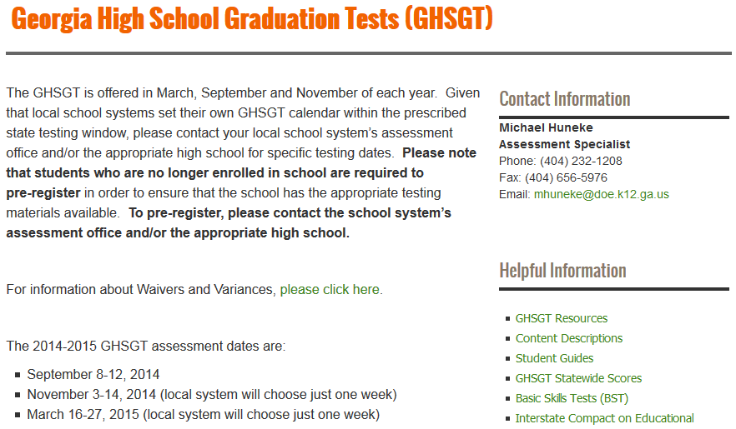
Who Tests?
Please note the GaDOE webpage to help with the pre-registration process in your school system. If your school system has not implemented a pre-registration process, your system should do so as soon as possible.
See pages 8 and 10 in the Coordinator’s Manual
See the GHSGT section in the Student Assessment Handbook
State Board rule (160-3-1-.07) requires that districts/schools have a pre-registration process for the GHSGT and GHSWT for those wanting to retest at the next administration window.

Slide 14
Who Tests? Impact of the Secondary Assessment Transition Plan
Students who entered grade nine for the first time between July 1, 2008 and June 30, 2011
Testing Rule Amendments for this cohort include:
Flexibility – allowing a passing score on one of the two EOCTs in each content area to serve as an alternate demonstration of proficiency and stand in lieu of the requirement to pass the corresponding content area GHSGT.
Retaining the requirement to pass the Georgia High School Writing Test.
Statewide Passing Score Rule amendments include:
Retaining the contribution of the EOCT to the course grade at 15%.

Slide 15
Who Tests?
The 2014-2015 GHSGT Retests should be administered to the following categories of students:
Individuals who are subject to the GHSGT requirement, have exited high school with a Certificate of Performance or Special Education Diploma, and have returned to retest.
Students currently in high school (entered grade nine for the first time prior to July 1, 2008) who have taken but not passed one or more of the GHSGTs.
Students currently in high school (who entered grade nine for the first time between July 1, 2008, and June 30, 2011) who have taken but not passed the GHSGT and who have not achieved a passing score on one of the corresponding content area Georgia EOCTs.
Students who entered grade nine for the first time prior to July 1, 2011, who are enrolled in grade eleven, and who have not yet taken the GHSGT. These students shall test for the first time during the spring administration. These students are only required to test in the GHSGT content area in which they have not achieved a passing score on one of the corresponding content area Georgia EOCTs and they enrolled in grade nine for the first time between July 1, 2008 and June 30, 2011.
Students who enroll in grade twelve (e.g. a move-in from out of state) who have not yet taken the GHSGT and who are subject to the GHSGT requirement. These students may test for the first time at their first opportunity. These students (if enrolled in grade nine for the first time between July 1, 2008 and June 30, 2011) are only required to test in the GHSGT content area in which they have not achieved a passing score on one of the corresponding content area Georgia EOCTs.

Slide 16
Secondary Assessment Transition Plan
 | Ninth Graders | Tenth Graders | Eleventh Graders | Twelfth Graders
2011 / 2012 | EOCT = 20% of course grade Pass the GHSWT | EOCT = 15% of course grade [Pass one EOCT in each of the four content areas or pass the corresponding subject test of GHSGT] Pass GHSWT | EOCT = 15% of course grade [Pass one EOCT in each of the four content areas or pass the corresponding subject test of GHSGT] Pass GHSWT | EOCT = 15% of course grade [Pass one EOCT in each of the four content areas or pass the corresponding subject test of GHSGT] Pass GHSWT
2012 / 2013 | EOCT = 20% of course grade Pass the GHSWT | EOCT = 20% of course grade Pass the GHSWT | EOCT = 15% of course grade [Pass one EOCT in each of the four content areas or pass the corresponding subject test of GHSGT] Pass GHSWT | EOCT = 15% of course grade [Pass one EOCT in each of the four content areas or pass the corresponding subject test of GHSGT] Pass GHSWT
2013 / 2014 | EOCT = 20% of course grade | EOCT = 20% of course grade Pass the GHSWT | EOCT = 20% of course grade Pass the GHSWT | EOCT = 15% of course grade [Pass one EOCT in each of the four content areas or pass the corresponding subject test of GHSGT] Pass GHSWT
2014 / 2015 | EOC/EOCT = 20% of course grade | EOC/EOCT = 20% of course grade | EOC/EOCT = 20% of course grade Pass the GHSWT | EOC/EOCT = 20% of course grade Pass the GHSWT

Slide 17
2014 Fall & Winter GHSGT Documents Scored Approximately 460 high schools
GHSGT Content | ELA | Mathematics | Science | Social Studies
Fall 2014 GHSGT Scored | GPS: 1,297 T: <10 | GPS: 3,248 Q: 78 | GPS: 1,311 T: 147 | GPS: 3,057 T: 110
Winter 2014 GHSGT Scored | GPS: 1,166 T: <10 | GPS: 2,951 Q: 93 | GPS: 1,035 T: 213 | GPS: 2,650 T: 146

Slide 18
Booklet Overages
All booklets are shipped by system and not by school
GPS Booklets
Systems will have a 10% overage and then are rounded up to the nearest multiple of five
QCC and Transitional Booklets
Systems will receive have a 10% overage and then are rounded up to the nearest multiple of five
ELA will not receive an overage, only single booklets will be sent out based on how many students tested in the Fall and Winter administrations (please note: the most one school tested of the <10 students tested during the Fall and Winter 2014 administrations were 2 former students, all other schools tested only 1 student. This has been true for many years of administrations .)
BST Materials
Requests for materials may be made via email to Michael Huneke (mhuneke@doe.k12.ga.us)

Slide 19
QCC Form Phase Out ELA, Science and Social Studies
Effective with the Fall 2011 administration QCC forms will no longer be offered. Students who originally tested using the QCC forms in English/Language Arts, Science, and Social Studies should be tested using the transitional form of the GHSGT (Form T).
As you will recall, the transitional GHSGT forms are developed based on a carefully constructed blueprint built to ensure students have had an opportunity to learn the content and skills assessed regardless of the curriculum under which they were instructed (whether it was the QCC or the Georgia Performance Standards (GPS)). In other words, the transitional forms are dually aligned to both the QCC and the GPS. Importantly, these forms are scored and reported on the QCC scale and are statistically equated (of equivalent difficulty) to the QCC forms.
We are confident that no student will be placed at a disadvantage for the following reasons: (a) the transitional forms are aligned to the QCC; (b) the transitional forms are statistically equated to the QCC forms; and (c) remediation opportunities are likely based on the GPS (as the QCC is no longer used as the basis of instruction in our state).
Please note that QCC forms will continue to be available for the Mathematics GHSGT for those students who received mathematics instruction based on the QCC and who originally tested on the QCC version.

Slide 20
BST, GHSGT and GHSWT Forms Dates are based on when students entered grade 9 for the first time: *Contact Michael Huneke for BST materials at mhuneke@doe.k12.ga.us when needed
Subject | BST * | QCC/Transitional | GPS
English Language Arts | July 1, 1981 – June 30, 1991 | July 1, 1991 – June 30, 2005 (Transitional) | July 1, 2005 – June 30, 2011
Mathematics | July 1, 1981 – June 30, 1991 | July 1, 1991 – June 30, 2008 (QCC) | July 1, 2008 – June 30, 2011
Science | NA | July 1, 1994 – June 30, 2005 (Transitional) | July 1, 2005 – June 30, 2011
Social Studies | NA | July 1, 1993 – June 30, 2007 (Transitional) | July 1, 2007 – June 30, 2011
Writing | July 1, 1987 – June 30, 1991 | July 1, 1991 – June 30, 2005 (QCC) | July 1, 2005 – June 30, 2013

Slide 21
Test Score Ranges and Cut Scores Georgia High School Graduation Test
GPS | Below Proficiency | Basic Proficiency | Advanced Proficiency | Honors
English/Lang. Arts | 100 to 199 | 200 to 234 | 235 to 274 | 275 to 350
Mathematics | 100 to 199 | 200 to 234 | 235 to 284 | 285 to 400
Science | 100 to 199 | 200 to 234 | 235 to 274 | 275 to 370
Social Studies | 100 to 199 | 200 to 234 | 235 to 274 | 275 to 450
Transitional and QCC | Does Not Meet or Fail | Pass (Student Accountability) | Pass Plus (Student Accountability) | Proficient (School Accountability) | Advanced (School Accountability)
English/Lang. Arts (Transitional) | Below 500 | 500 to 537 | 538 or Above | 511 to 537 | 538 or Above
Mathematics (QCC) | Below 500 | 500 to 534 | 535 or Above | 516 to 524 | 525 or Above
Science (Transitional) | Below 500 | 500 to 530 | 531 or Above | -- | --
Social Studies (Transitional) | Below 500 | 500 to 525 | 526 or Above | -- | --

Slide 22
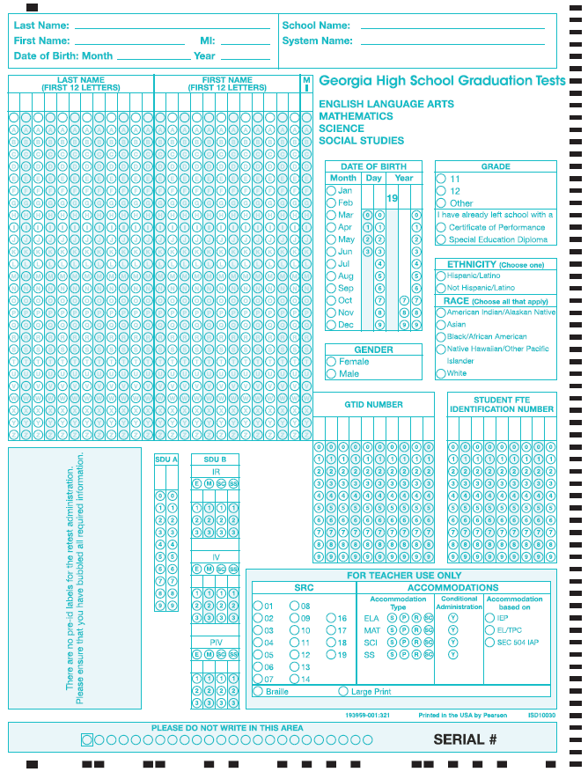
GHSGT
ANSWER DOCUMENT PAGE 1
Complete for all students
Complete when applicable
SDU A: Code as Directed by page 9 in the Coordinator’s Manual
SDU B: Code as Directed by GaDOE
SRC, Accommodations & Participation: Code as Directed in the Coordinator’s Manual starting on page 24
Do Not Bubble FTE
Note: The black timing tracks on the edge must be clean of stray marks to be able to be scanned.
Old answer documents will not scan! The answer document must be BLUE and the pre-id watermark should be absent (see image to the left)!
DO NOT USE OLD ANSWER DOCUMENTS!

Slide 23
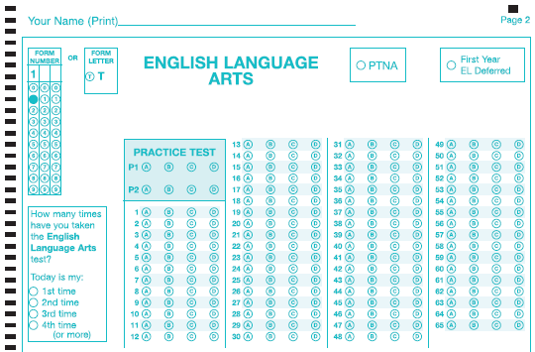
Answer Document – Top of Pg. 2
Marking both Form Number and Form Letter will result in an Invalid Form Number
ELA, Science, and Social Studies are all similar
Mark one! Notice: No “Q”
Examiner or STC Completes
Not on Science Section
Student Marks

Slide 24
Answer Document – Top of Pg. 2
Marking both Form Number and Form Letter will result in an Invalid Form Number
Examiner or STC Completes
Mark one! Notice: No “T”
Mathematics is the only section with “Q”
Student Marks

Slide 25
Invalid Form Codes
Due to the various versions of the GHSGT (GPS, GPS/QCC, QCC), students must code their answer document with the appropriate form number (301, 501, etc.) or letter (T or Q). The scoring vendor, the Georgia Center for Assessment (GCA), will create system level spreadsheets that include students with missing or invalid form numbers or letters. These spreadsheets will be placed on the MyGaDOE Portal for System Test Coordinators to retrieve and complete. When missing/invalid form code spreadsheets are available for download, System Test Coordinators will receive an email message to alert them from PortalSupport@doe.k12.ga.us. The file will be located in the GHSGT folder under DISTRICT ASSESSMENTS and will be named 'Invalid Form Codes'. Please download, complete, and fax back to GCA. If all form numbers or letters are correct for the district, the System Test Coordinator will not receive any spreadsheets on the Portal.
The Georgia Center for Assessment's Fax: 706.542.5364
Please note that delaying the return of this information via fax can impact scoring of the system and potentially other systems. If one system does not fax their form back or is late, it could delay results for the entire state. Please fax your form back within 48 hours or less of its arrival in the MyGaDOE portal.

Slide 26
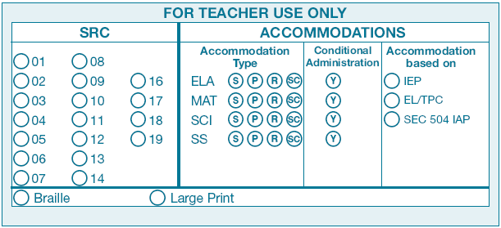
For Teacher Use Only Special Populations
Remember: There are NO APPROVED Conditional Accommodations for the GHSGT – so this bubble should NOT be coded. The only exception would be if the GaDOE has approved a request for an accommodation that does not appear on the chart of state-approved accommodations.

Slide 27
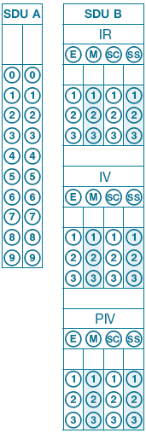
For Teacher Use Only GNETS and Irregularity/Invalidation/Participation Invalidation
GNETS Coding
IR, IV, and PIV Coding
Ensure that these boxes are not coded in error . . . If coded, students may not receive a score. SDU B should be coded only at the direction of the GaDOE.

Slide 28
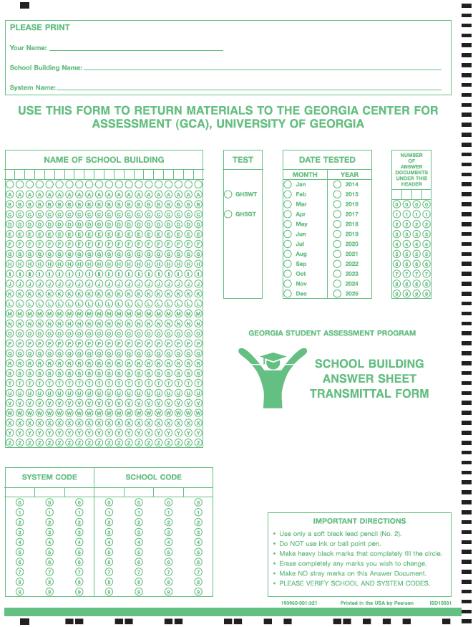
School Building Answer Sheet Transmittal Form for the GHSGT & GHSWT
Print information
Bubble in building Name
Bubble Assessment (GHSGT)
Bubble “Feb”, “Mar”, or “Jun” and “2015”
Bubble number of answer documents sending in and paper banded to transmittal form (right justify)
Bubble in System Code
Bubble in School Code

Slide 29
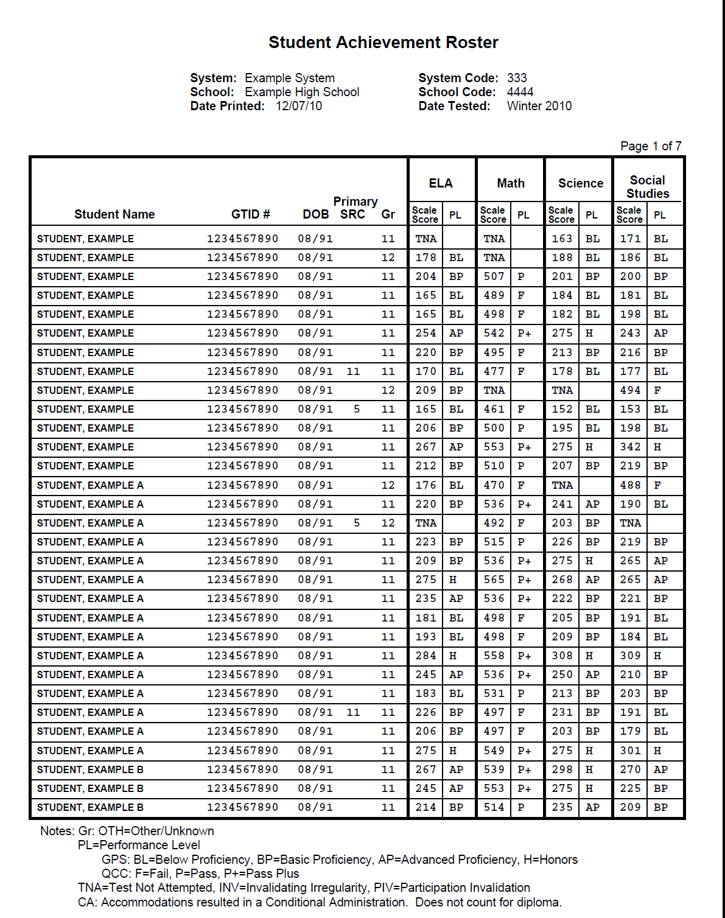
GHSGT PDF Student Achievement Rosters

Slide 30
GHSGT Individual Student Report

Slide 31
GHSWT

Slide 32
Rule Amendment: 160-3-1-.07 Testing Programs – Student Assessment Adopted: August 21, 2014
The GHSWT remains a diploma requirement for those enrolled in grade nine for the first time prior to July 1, 2013 (this year’s juniors and seniors for the most part).
Students enrolled in grade nine for the first time on or after July 1, 2013 no longer must pass the GHSWT and SHOULD NOT be assessed using the GHSWT (this year’s freshmen and sophomores for the most part).
Subject | BST | QCC | GPS
Writing | July 1, 1987 – June 30, 1991 | July 1, 1991 – June 30, 2005 | July 1, 2005 – June 30, 2013* * As a result of amendments to State Board of Education rule 160-3-1-.07 on August 21, 2014

Slide 33
Georgia High School Writing Test (GHSWT)
GHSWT was fully aligned to GPS in fall 2007.
GHSWT Writing Assessment Connections Resource Guide
The guide helps make the connections between the CCGPS and the writing assessment
Includes optional activities for teachers to use for instruction in the classroom
Schools receive Individual Student and Summary Reports.
Scale score
Performance Level
Does Not Meet (DNM), Meets (M), and Exceeds (E)

Slide 34
GHSWT: 2014-2015
The assessment is a test of persuasive writing.
The assessment is scored analytically, using a 5 point rubric evaluating four domains of writing. Each domain contributes a pre-determined weight to the total score.
Ideas (40%) Organization (20%)
Style (20%) Conventions (20%)
Scale scores range from 100 - 350.
100-199 = Does Not Meet
200-249 = Meets the Standard
250-350 = Exceeds the Standard

Slide 35
GHSWT: 2014-2015
Each administration includes GPS and QCC versions. Form numbers indicate which is GPS and which is QCC.
Students who tested for the first time in September 2007 continue to take a GPS version of the writing assessment (entered grade 9 for the first time between July 1, 2005 and June 30, 2013).
Students who tested for the first time prior to September 2007 continue to take the QCC form (entered grade 9 for the first time between July 1, 1991 and June 30, 2005).
The Fall 2014 had <10 students test with the QCC form.

Slide 36
GHSWT – 2014-2015
Examiners must monitor testing to ensure that students receive the correct form.
GPS forms will be scored with the GPS-based rubric and reported on the GPS scale (100 – 350: 200 Pass).
QCC tests will be scored on the QCC-based rubric and reported on the QCC scale (400-600: 500 Pass).
Reports will indicate which version of the test students took.

Slide 37
GHSWT: 2014-2015
Who should take the Spring and Summer administrations?
All 11th grade students (GPS)
Students who have taken but not passed the GHSWT (GPS or QCC)
Twelfth grade students new to the school/system who have not tested (GPS)
Students who have left school with a Certificate or Special Education diploma (GPS or QCC)
From the Retest Manuals (page 4/5)
This administration of the GHSWT is for all 11th grade students, students who have taken but not passed the test, and 12th graders who are new to the school/system who have not tested. Eligible students also include those who are subject to the GHSWT requirement and have left school with a High School Certificate or Special Education Diploma. Students who had not passed the GHSWT as 11th graders in the 2006-2007 school year or earlier must be assigned the QCC prompt. It is expected that the System Test Coordinator will have implemented preregistration procedures for all retesters.

Slide 38
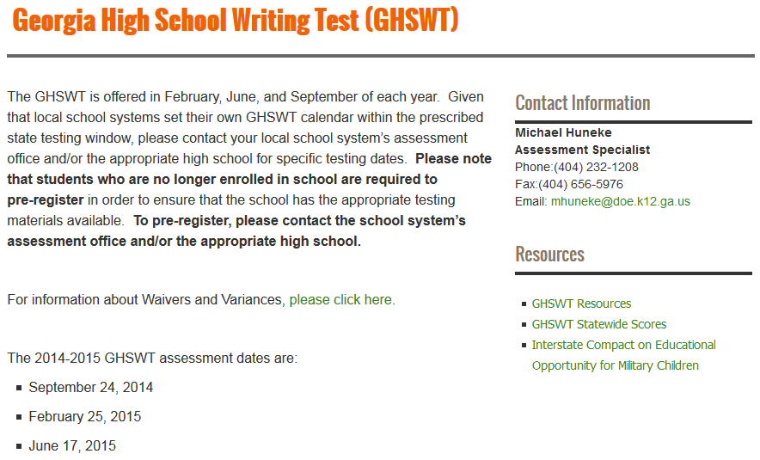
Registration Process
Please note the GaDOE webpage to help with the registration process in your school system. If your system has not implemented a pre-registration process, your system should to do so as soon as possible.
State Board rule (160-3-1-.07) requires that districts/schools have a pre-registration process for the GHSGT and GHSWT for those wanting to retest at the next administration window. (this is not new)

Slide 39
Materials to be Received
Class packs include writing topic pages, planning/prewriting, and drafting pages in shrink wrap packages of 25 and 5.
Answer documents are packaged separately.
Schools will receive a 10% overage and there will be no system overage.
Different colored paper is used to denote forms and administrations (spring 2015 colors)
GPS Main administration prompt (Green)
GPS Make-up prompt (Salmon)
QCC-prompt (White)

Slide 40
Materials to be Received
System/School Coordinator’s Manual*
Examiner’s Manual* (1 manual for every 20 students)
Pre-coded building transmittal forms
Additional materials may be ordered order online via TestTime at https://gcap.tsars.uga.edu/materials/
*All parties involved in test administration must read manuals.

Slide 41
Planning for the GHSWT Administration
Announce the assessment date.
Have School Coordinators prepare rosters of eligible students by form (GPS or QCC).
Include GTID numbers;
Include accommodations for eligible students.
Secure appropriate testing space and proctors.
Arrange testing schedule allowing approximately two hours for administration. (Students have 100 minutes to complete their assessment.)
Account for and secure test materials at all times.

Slide 42
Administration Schedule
Distribute Answer Documents 5-10 minutes
Complete Answer Documents 10 minutes
Distribute Writing Topic Pages 5-10 minutes
Planning/Prewriting 15 minutes
Drafting 35 minutes
Revising and Editing 25 minutes
Final Draft 20 minutes
Proofreading 5 minutes
Above times are suggested times

Slide 43
Administration Schedule
Students unable to test on the established date must wait until the next scheduled administration.
Avoid scheduling the administration after an assembly or special event.
Make certain the school administration is aware of the testing schedule.

Slide 44
Administration
An advanced announcement should be made to students about the date and purpose of the test.
If it is not the usual practice to furnish pencils and pens, students should be instructed to bring two number 2 pencils and a blue or black pen. The final draft must be written in pen.
It is important to give classroom teachers advance notice of the testing date so they may adjust lesson plans and schedules.

Slide 45
Administration
System Test Coordinators must ensure that all school coordinators, examiners, proctors, administrators, and other staff are trained. Documentation shall be kept on file.
Prompts are secure and must be kept under lock and key, with restricted access, until time of administration.
Prompts should not be distributed during trainings!
Examiners must account for all testing materials before dismissing students from the testing site.
Non-scorable materials must be collected, counted, and destroyed by the System Test Coordinator.

Slide 46
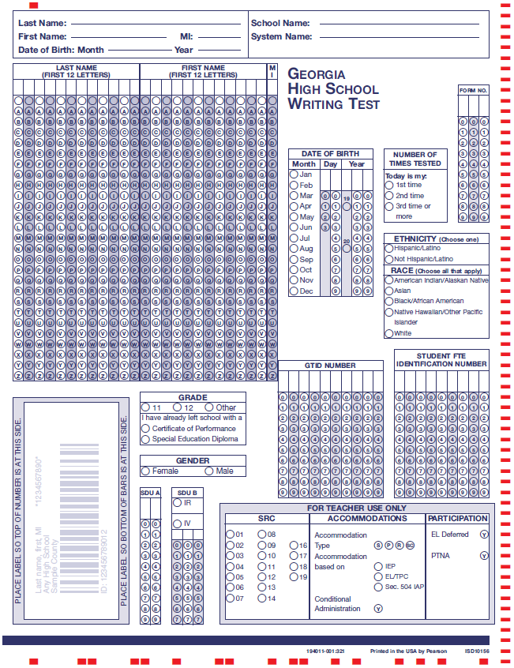
2014-2015 Answer Document
Old answer documents will not scan!
DO NOT USE OLD ANSWER DOCUMENTS!
Complete for all students
Complete when applicable
SDUA: Code as Directed by page 9 in the Coordinator’s Manual
SDUB: Code as Directed by GaDOE
SRC, Accommodations & Participation: Code as Directed in the Coordinator’s Manual starting on page 8
Do Not Bubble FTE
Pre-ID Labels are not supplied.
Note: The black timing tracks on the edge must be clean of stray marks to be able to be scanned.
DO NOT CODE CONDITIONAL UNLESS APPROVED BY THE GADOE!

Slide 47
Student Directions in Answer Document

Slide 48
GHSWT Answer Document
Student GTID numbers must be included on the answer documents. School Test Coordinators should provide examiners with student rosters that include both GTID numbers, Special Education or EL status, and information about accommodations.
Students must enter the form number of the test they take in the correct space on the answer document (page 1 and 3).
Barcode labels are provided only for the Fall administration. They will include GTID.
Students should always write their name, DOB, school name, and system name in the spaces at the top of the answer document.
A script including directions for completing the answer document for students with barcode labels and those without labels appears in the Examiner’s Manual and should be followed exactly.
Students must enter and bubble all demographic information on the answer documents in retest administrations (February and June).

Slide 49
School Building Answer Sheet Transmittal Form for the GHSGT & GHSWT
Print information
Bubble in building Name
Bubble Assessment (GHSGT)
Bubble “Feb”, “Mar”, or “Jun” and “2015”
Bubble number of answer documents sending in and paper banded to transmittal form (right justify)
Bubble in System Code
Bubble in School Code

Slide 50
GHSGT
&
GHSWT

Slide 51
Testing Students With Disabilities, 504 Plans, or EL Test Participation Plans
State required coding (SRC)
Use the SRC section on the Answer Document to code eligible students with disabilities, English Learner (EL) students, Title I students, and migrant students. These codes should be provided by site test coordinator.
The type of accommodation provided should be coded in the Accommodations box: S indicates setting; P indicates presentation; R indicates response; and SC indicates scheduling.
The SRC, Accommodations, and SDU boxes on page 1 of the Answer Document should be filled in by you or the School Coordinator. The State-Directed Use Only (SDU B) section should be used only when instructed by the GaDOE.
If the assessment resulted in a conditional accommodation, code the appropriate box on the answer document. Do not code conditional accommodations unless you have received permission. Doing so could delay scores. Conditional administrations are not eligible for a high school diploma.

Slide 52
Accommodations
For students who require accommodations, Coordinators should consult the Student Assessment Handbook and the Accommodations Manual for Students with Disabilities.
Any accommodations not included in these guides must be approved by the GaDOE at least 4 to 6 weeks prior to the assessment.
This information should be submitted to the Assessment and Accountability Division by calling the main number at (404) 656-2668 or submitting the form by fax at (404) 656-5976.

Slide 53
Accommodations
Eligible students may be provided accommodations based on an emergency Section 504 Plan to allow participation in the assessment.
GHSWT – A word processor may be used with the spell/grammar check function disabled. The printed essay should include the student’s GTID and form number in the upper right hand corner and be placed inside the Answer Document. GCA will score the printout as the final draft. The file must be deleted from the computer.
GHSWT – One other option is the use of a scribe. Scribing instructions are in the Student Assessment Handbook.

Slide 54
Accommodations
Questions, answers, passages and/or prompts may be read aloud to students only if this accommodation is specified in an IEP, IAP/504, or TPC Plan.
GHSWT materials for visually impaired students may be enlarged by the System Test Coordinator in a secure manner, must be accounted for, and returned to the System Test Coordinator.
Questions, answers, passages and/or prompts may be communicated via sign language.
EL students may use word-to-word dictionaries if in their TPC plan.

Slide 55
Braille Availability
Braille versions of the GHSGT and the GHSWT Topic Page and the Testing Directions from page 2 of the Answer Document (Response Folder) will be available upon request.
Systems that require Braille testing materials should have contacted Stephanie A. Lai, Ph.D. (888-392-8977 or slai823@uga.edu) at the Georgia Center for Assessment. Additional orders may still be made.
GHSWT-If requested by February 13, 2015, delivery should occur no later than February 20, 2015.

Slide 56
Word Processor and Enlarged Copies
A word processor is not allowed for the GHSWT unless it is a part of the student’s IEP or IAP/504 and is a part of the regular instructional program accommodations.
If a word processor is used, place the print out inside the answer document with the student’s GTID and form number in the upper right hand corner of the print out.
System Test Coordinators may enlarge a copy of the GHSWT topic for students requiring a large print version as prescribed in a student’s IEP or 504/IAP .
If pages 3 and 4 of the GHSWT Answer Document is enlarged, please place the enlarged copy inside the answer document with the student’s GTID and form number in the upper right hand corner of the enlarged paper.

Slide 57
Irregularities (IR)
Events and circumstances that depart from standardized testing procedures are irregularities.
They may have an impact on student performance that is not possible to define.
They are reported and student scores flagged simply to say, “There is something different about the conditions under which this score was obtained. Use caution in interpreting the score.”

Slide 58
Some Examples of Irregularities
Irregularities in Security:
Irregularity due to content being disclosed, coached, or distributed
Irregularity due to cheating
Irregularity due to someone altering responses during or after testing
Irregularity due to lost test materials
Irregularities in Test Administration:
Irregularity due to materials being distributed inappropriately
Irregularity due to directions not being followed
Irregularity due to accommodations not being given

Slide 59
Invalidations (INV)
Irregularities that significantly affect student performances or compromise the integrity of the testing may result in invalidation of student scores.
Cheating, altering responses, or disclosing content early are examples of irregularities resulting in invalidations.

Slide 60
Reporting Irregularities and Invalidations
Irregularities MUST be handled and reported
promptly.
wrong test version of the test
wrong accommodations
cheating

Slide 61
Reporting Irregularities and Invalidations
Procedures for reporting are in the Student Assessment Handbook.
Examiner provides full report to school coordinator
School Coordinator reports to System Coordinator
System Coordinator contacts GaDOE
Coding is decided
Codes for IR, IV, and PIV will be different
STC reports in the MyGaDOE portal (include statements)

Slide 62
Entering IRs into the MyGaDOE Portal
In the MyGaDOE Portal, find the “Surveys” section and click on “More”
https://portal.doe.k12.ga.us/login.aspx
Click on “View Summary” next to Testing Irregularity Form
Click on “Add New Record”
Click on “Start”

Slide 63
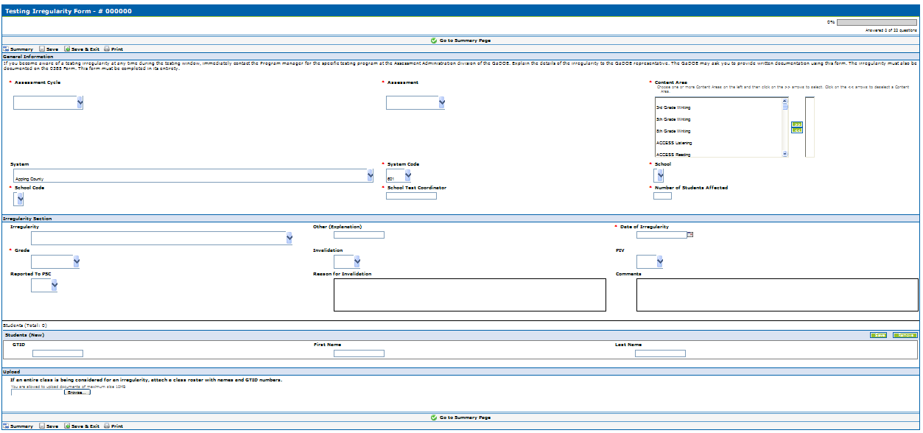
Entering IRs into the MyGaDOE Portal
Pick Assessment Cycle
Pick the Assessment
Pick the Content Area(s)
Pick your system
Pick your system code
Pick the school
Pick the school code
Type the STC
Type the number of students
Select an IR
Explain only if “Other”
Pick date of IR
Select Grade of Student
IV - Yes or No
PIV - Yes or No
PSC - Yes or No
Explain why the IR is an IV
Explain what happened here
Enter student(s) GTID here. First and last name will populate automatically and you may add more students if needed.
Attach a class list and/or statement(s)/evidence by browsing and selecting file on your computer. You may only attach one document so multiple items will need to be zipped or combined into one document..
Fill out the irregularity form and then click on “Save & Exit”
Click on “Submit for Approval”

Slide 64
CODE OF ETHICS FOR GEORGIA EDUCATORS
The Professional Standards Commission (PSC) adopted a new Code of Ethics for Georgia Educators in July 2009.
All educators should review the Code of Ethics prior to testing.
The PSC also adopted a hierarchy of consequences, recommended by System Test Coordinators, that is published on their web site at http://www.gapsc.com/.

Slide 65
PSC Testing Standard
Standard 11: Testing - An educator shall administer state-mandated assessments fairly and ethically.
Unethical conduct includes but is not limited to:
1. committing any act that breaches Test Security;
and
2. compromising the integrity of the assessment.

Slide 66
Breach of Professional Ethics Professional Standards Commission
Gives examinees access to test questions prior to testing;
Copies, reproduces, or uses in any manner inconsistent with test security regulations all or any portion of secure test booklets;
Coaches examinees during testing, or alters or interferes with examinees’ responses in any way;
Makes answers available to examinees;
Fails to follow security regulations for distribution and return of secure test materials as directed, or fails to account for all secure test materials before, during, and after testing;
Uses the secure test booklets for any purpose other than examination; or
Participates in, directs, aids, counsels, assists, encourages, or fails to report any of these prohibited acts.

Slide 67
Characteristics of a Quality Investigation
Examiner should notify Principal and School Test Coordinator of incident.
School Test Coordinator should notify System Test Coordinator.
Request detailed written statements from all parties involved if necessary.
Follow up on details (connect the dots)
Follow district procedures regarding misconduct.
Provide a written summary of incident and investigation findings.
Consult with GaDOE as needed.
System Test Coordinator is responsible for reporting to GaDOE.
Note:
Report to GaDOE immediately, before investigation.
Final documentation should be entered into portal.

Slide 68
Testing Security Requires:
Advanced Planning
Clear and concise communication about roles and responsibilities
Solid logistical procedures
Documented training

Slide 69
Test Security Reminders
Be familiar with the Student Assessment Handbook and test administration manuals
Follow all protocols
Principal’s Certification Form is required for each administration and must be maintained at the system for 5 years
Report problems in a timely manner
Including referrals to PSC

Slide 70
Test Security Reminders
The GHSGT and GHSWT assessment materials are secure test documents.
Tests should be kept under lock and key except during the time materials are being prepared, during actual administration with students, and when completing post-administration tasks required by the manual(s).
During the actual test administration, test materials must remain in the testing room.
Examiners must account for all testing materials BEFORE dismissing students from the testing room each day.
All administered GHSWT prompts are test secure materials.
The GHSWT prompts are not to be shared with anyone or reproduced in any fashion except as already defined in earlier slides by the system test coordinator ONLY.
The GHSWT prompts are not to be used as practice writing assignments for students. Released prompts and sample papers are available for this purpose on the GaDOE website.

Slide 71
Keys To Test Security
Lock tests up!
Count and recount/Sign-in and Sign-out
Material counts must be verified before students leave the test setting
Don’t let them out of your sight
Test booklets must remain in their shrink-wrapped packages as late as possible to avoid security concerns.
Make students put their names on the Test Booklets and sign for them
Students must sign-in . . . including their name and Form Number/Letter
No peeking
Do not copy
Monitor students

Slide 72
PLANNING FOR TEST ADMINISTRATION
Conducive Environment
Seating spaces and writing surfaces are large enough
Seating arranged to prevent cheating.
NO cell phones, PDAs, or other electronic devices in the exam room.
Take any discovered devices away immediately . Return them at a later time
No. 2 Pencils - Each student should be told to bring two No. 2 pencils with erasers on days tests are to be administered. However, there should be a supply of extra pencils and erasers available for students who forget.
GHSWT – Blue or Black ink pen - Each student should be told to bring a pen as responses must be completed in pen (blue or black ink) on pages 3 and 4 of the Answer Document
Keep a timing device visible - You should have a clock or watch to keep track of time during test administration.

Slide 73
PLANNING FOR TEST ADMINISTRATION Roles and Responsibilities
Refer to Student Assessment Handbook for detailed information.
Superintendent has ultimate responsibility for all testing activities within the local school system. The System Test Coordinator shares this responsibility as the Superintendent’s designee.
Principal has ultimate responsibility for all testing activities within the school.
Emphasis: The Principal must complete the Principal’s Certification Form after each administration.

Slide 74
PLANNING FOR TEST ADMINISTRATION Roles and Responsibilities
System Test Coordinator
Liaison between system and GaDOE
Conduct local system trainings of School Coordinators
Coordinate ALL administration activity
Know and enforce responsibilities of all other roles
Adhere to the state testing calendar and local calendars/schedules
Implement plans for ordering and receipt of materials, distribution, test security, administration, collection and return shipments, receipt and dissemination of reports and data
Detailed list of responsibilities in SAH

Slide 75
PLANNING FOR TEST ADMINISTRATION Roles and Responsibilities
School Test Coordinator
Must hold a PSC-issued certificate (per Student Assessment Handbook)
Count and secure all test materials
Materials distribution/return, signing out and signing in materials
Attend and then redeliver training
Plan for all aspects of the school’s test administration, monitor test administration environment
Receive/verify test material counts after testing each day
Collaborate effectively with local system colleagues who have a role in the success of your system’s testing program.
Detailed list of responsibilities in SAH

Slide 76
PLANNING FOR TEST ADMINISTRATION Roles and Responsibilities
Examiner
Must hold a Georgia PSC-issued certificate (teachers, counselors, administrators, paraprofessionals) . . . This is required per SBOE Rule 160-3-1-.07. GaDOE is compelled to invalidate when this does not occur (!).
Security/verification of test materials
Control of testing environment and active monitoring
Accuracy of demographic/student information on answer documents
Correct delivery of assigned accommodations
Follows procedures for testing as given in Examiner’s Manuals, including reading all directions/script to students
Test materials are not to be used for any purpose other than test administration
Detailed list of responsibilities in SAH

Slide 77
PLANNING FOR TEST ADMINISTRATION Roles and Responsibilities
EXAMINERS
Be certain that students’ Answer Documents are prepared correctly.
Be certain that students respond in the appropriate sections of the Answer Document (e.g., that Social Studies items are answered in the section marked SOCIAL STUDIES or start on page 3 of the GHSWT). Marking responses in the wrong content area, even if later erased, can cause scoring errors.
Be certain students code the correct form number/letter on their Answer Documents.
All students may have up to three (3) hours to complete each GHSGT and 100 minutes to complete the GHSWT.

Slide 78
PLANNING FOR TEST ADMINISTRATION Roles and Responsibilities
Proctor
Must be trained
With examiner supervision, ensures that students are managing test materials appropriately
Active monitoring
Detailed list of responsibilities in SAH

Slide 79
PLANNING FOR TEST ADMINISTRATION
PROCTORS
When 30 or more students are to be tested in one room, the assistance of a Proctor is required. At least one Proctor is required for each additional 30 students. If students are tested in groups of less than 30, a Proctor is highly recommended.
Proctors must be trained in appropriate test procedures before testing begins. Tasks which they must perform should be clearly specified. They may help in distributing and collecting materials, assisting students with coding on the Answer Document, observing students from different points in the room while tests are being administered, and answering students’ questions concerning the test directions. To prevent the neglect of any students in large groups, Proctors may be assigned to specific areas of the room during test administration. Proctors must not explain the test items or coach students in any way.

Slide 80
PLANNING FOR TEST ADMINISTRATION
Resources and Aids
NO dictionaries(*), textbooks, or other aids and/or resources that would provide assistance. (*EL Word to Word Dictionaries would be an exception to this if prescribed in an EL-TPC plan)
Any instructional materials that are displayed in the room, such as posters, must be covered or removed during testing.
The following calculator features are NOT allowed:
Graphing calculators
Calculators that store text and/or have QWERTY keyboards or typewriter-like keyboards
Calculators that have programs stored in the memory other than those that are factory installed
Non-calculators such as cell phones, PDAs, laptops, minicomputers, pocket organizers, iPods, etc.
Calculators with beaming capabilities
Calculators with wireless communication technologies and/or Internet access
Calculators with built in Computer Algebra Systems – CAS
Calculators that make noise, have paper tape, or that have voice
Students may use rulers (or another straightedge) for the Social Studies test, if needed.
No scratch paper.

Slide 81
Plan for Accommodations
Know who your SWD, EL, and 504 students are who require accommodations . . . And plan well in advance for their needs
Plan for small groups and the need for the same form number/letter
Know who your visually impaired students are and ensure you have supply
Make provisions (even though all may have up to 3 hours on the GHSGT) for Extended Time students
Plan in advance for any Word to Word (EL) Dictionary needs
Ensure that examiners are familiar with the proper way to deliver the necessary accommodations
Collaborate with others as needed to ensure that “paperwork” (IEP’s, EL-TPC’s, 504 Plans, etc.) is in order
The transfer of student responses to a student answer document (in cases such as Large Print and Braille administrations) must be completed with a witness present . . . The witness must hold a PSC-issued certificate

Slide 82
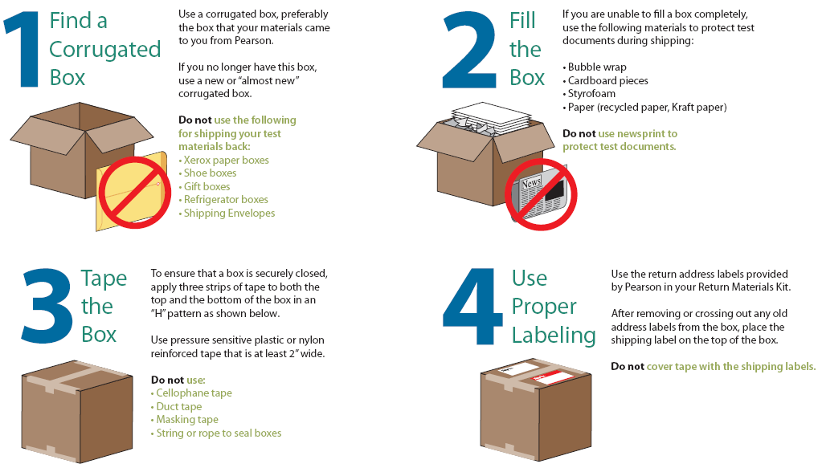
Instructions for Returning Boxed Materials to GCA (scorables and nonscorables)

Slide 83
GHSWT – Reminders
Follow directions and time limits given in manual.
“It is recommended that the GHSWT be administered in the morning beginning about 9:00 on the designated day” (page 9 in the Examiner’s Manual).
Students should read the topic page carefully for directions about the genre and topic.
Students should use the Writing Checklist.
Make certain students are writing final drafts on pages 3 and 4 of answer document.
Be certain to use the main prompt on Day 1 ONLY.
The make-up prompt is for Day 2 ONLY.
Check to make certain students code the form number on their answer document on pages 1 and 3.

Slide 84
Other Important Topics
Manuals are posted on the GaDOE website
Advanced reading aids supplied by GPAT
Large Print and Braille – Contact GCA
Basic Skills Test (BST) – Contact the GaDOE
Test Booklet Pick-up – Security Reports
Update Bulletin and Web Postings
Returning Materials – See Manuals
http://www.gadoe.org/Curriculum-Instruction-and-Assessment/Assessment/Pages/default.aspx

Slide 85
Resources for Administering the GHSGT and GHSWT
Student Assessment Handbook
Accommodations Manual
System/School Coordinator’s Manual
Examiner’s Manual
Presentations
Additional Orders (made via TestTime)
All are posted on the Testing web site:
http://www.gadoe.org/Curriculum-Instruction-and-Assessment/Assessment/Pages/default.aspx

Slide 86
Contact Information
GaDOE
Michael Huneke
404-232-1208
mhuneke@doe.k12.ga.us
GCA
Stephanie A. Lai, Ph.D.
706-542-6606
888-392-8977 (toll free)
slai823@uga.edu

