Slide 1


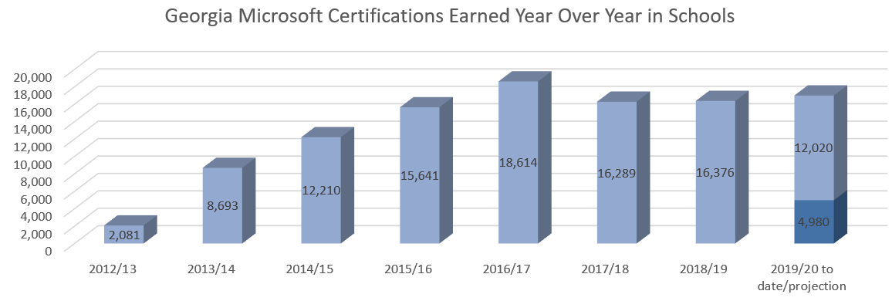
Impact Report 2020:
Microsoft Imagine Academy & Industry Certifications
State of Georgia
The State of Georgia and Microsoft have been making leading industry-recognized certifications accessible to Georgia schools – students, teachers and staff – statewide since 2012-2013, and the program has shown tremendous success over the years. It’s estimated that over 6 million new IT jobs will be created by 2022. There is high-demand for Microsoft skills and certifications in STEM and IT fields and across industry.
Microsoft has added the Computer Science Learning Path to Imagine Academy’s
Productivity, Data Science and IT Infrastructure curriculum. This learning path delivers
computer science and STEM curriculum that Georgia can use to help better prepare
Georgia teachers and students for the increasingly digital economy.
This public-private partnership with Microsoft provides Georgia with significant
cost savings on student, teacher, and staff skills and certifications compared
to industry, commercial costs of training.
Technology Skills Sought | Georgia Open Jobs
Microsoft | 14,358
Python | 1,649
HTML5 | 1,276
Java | 1,849
Google | 1,476
Cisco | 576
Apple | 466
Source: indeed.com, January 2020
$93,862
Average salary for a computing occupation in Georgia, which is significantly higher than the average salary in the state ($48,280)
Source: Microsoft Imagine Aademy program, January 2020
Source: code.org, January 2020
“I was contacted by a Customer Service Manager … three of the students were hired and have all advanced in their primary positions.
… the Industry Certification process has aided in students having the opportunity to receive higher paying and more advanced job placements. During the current academic year, I have been contacted by another manufacturing leader in our community and they are interested in bringing in 10 of our technology students to interview…”
- Robyn Rhodes, Teacher at Southeast Whitfield County High School, Dalton, GA

Slide 2






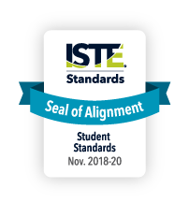
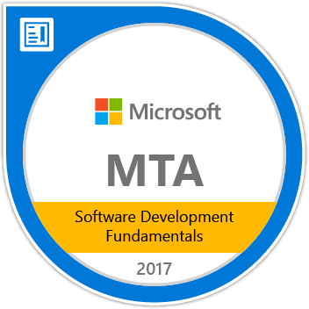


Microsoft Imagine Academy
Today more jobs require technical skills. Microsoft Imagine Academy provides globally recognized technology education, skills, and certifications for educator professional development and content students need to succeed in today’s jobs.
Imagine Academy offers four learning paths to success
“The pathway to new technologies requires a parallel investment in skills development – making sure people have the requisite skills to participate in an increasingly digital society.”
Satya Nadella, CEO, Microsoft
Computer Science
Coding skills based on the latest tools and techniques. Courses like Intro to Python and HTML5 App Dev Fundamentals begin a student’s path to becoming a Python/ Developer and HTML5 Developer which are jobs in high demand.
IT Infrastructure
Skills in IT administration and cloud platform solutions such as the Windows Server Administration and Networking Fundamentals courses that prepare students for a role as a Windows Server or Network Administrator.
Global Education Standards Alignment
Data Science
Introduction to data science concepts and tools. Analyzing and Visualizing Data in Excel is an example of one course preparing students for Data Analyst jobs.
The American Council on Education (ACE) has approved the Microsoft Office Specialist (MOS) Word 2016, Excel 2016, and PowerPoint 2016 certification exams for college credit equivalency in Information Technology. http://www.prweb.com/releases/2017/10/prweb14784139.htm
Productivity
Mastery of the productivity applications broadly used in business. MOS Certified Specialists are in strong demand with over 39,000 US jobs listed on indeed.com (Feb 2019).
The CSTA K–12 Computer Science Standards delineate a core set of learning objectives designed to provide the foundation for a complete computer science curriculum and its implementation at the K–12 level.
The ISTE Seal of Alignment program recognizes EdTech products for their alignment to the ISTE Standards. When you see the seal, you’ll know the resource or tool provides a high-quality, standards-aligned learning experience that enhances students’ digital age skills.
Microsoft Imagine Academy with earned Certifications can be converted to digital display badges and attached to resumes and LinkedIn profiles to help employers conveniently see a candidate’s credentials and strengthen the student pathways to active employment and careers.
+
+
=
Contact: George B. Freiberger, Ed.S Email: gefrei@microsoft.com | Mobile: (678) 577-1142

