Slide 1
IB in Georgia
All data shown in this presentation were gathered from open sources. Permission is granted for Georgia schools and other entities to show these slides and their associated content in any setting with any audience provided that the formatting and CASIE branding are preserved. This PowerPoint presentation may be opened as a read-only file and shown in presentation mode or printed. However, slides should not be altered, rearranged, or copied into another presentation as a safeguard to preserve formatting and CASIE branding. CASIE welcomes questions and ongoing dialogue about this data and its potential implications for IB schools and educational decision-makers in Georgia.

Slide 2
IB Schools Worldwide (September 25, 2018)
518 in Canada and Ecuador

Slide 3
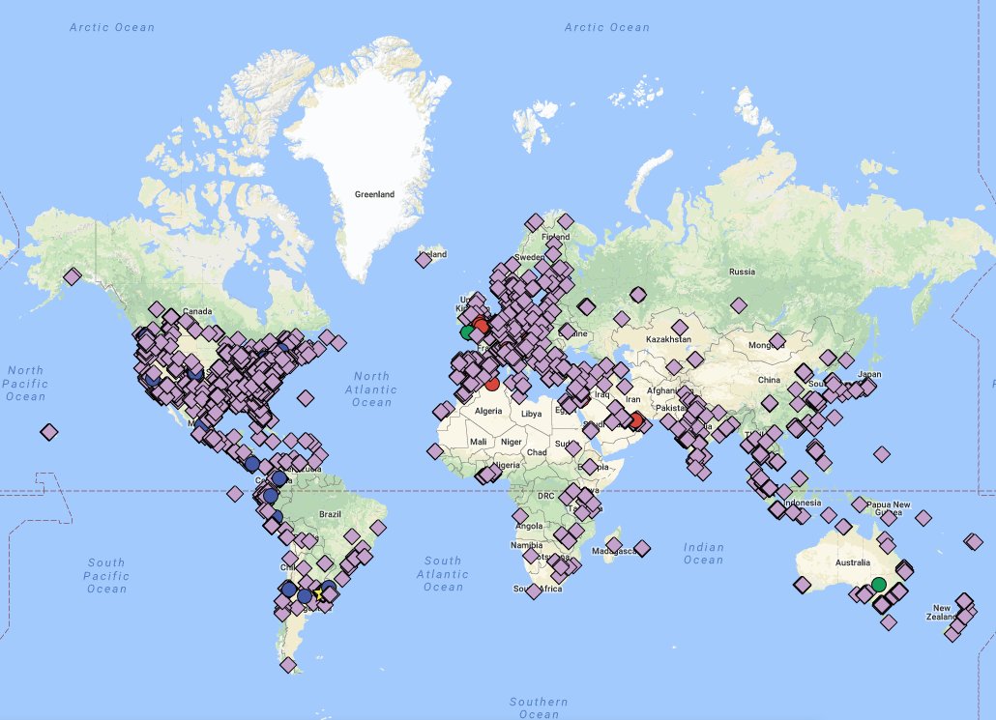
Google Map: Authorized IB Schools (2015)

Slide 4
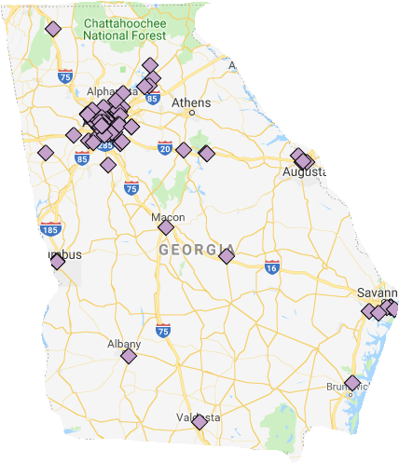
Google Map: Georgia Authorized IB Schools (2018)

Slide 5
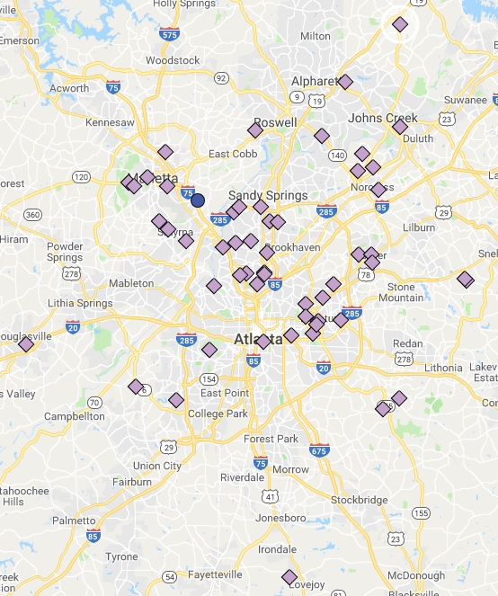
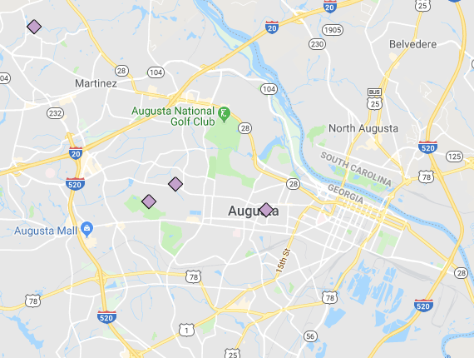
Google Map: Georgia Authorized IB Schools (2018)
Metro Atlanta: 54 IB Schools
Augusta: 4 IB Schools

Slide 6
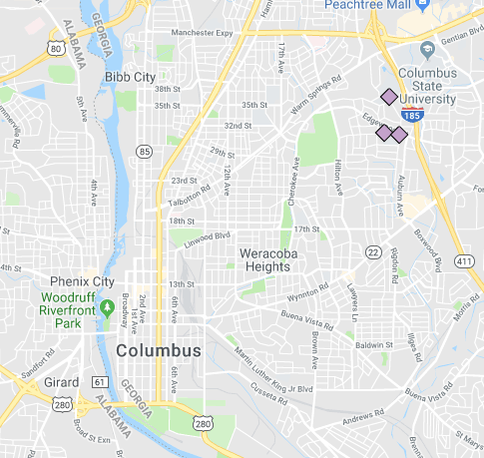
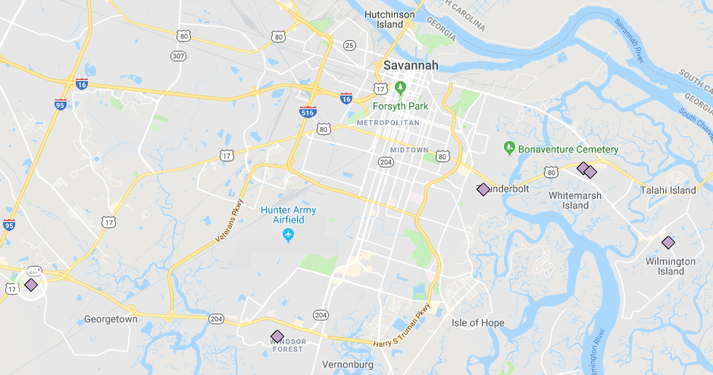
Google Map: Georgia Authorized IB Schools (2018)
Columbus: 3 IB Schools
Savannah: 6 IB Schools

Slide 7
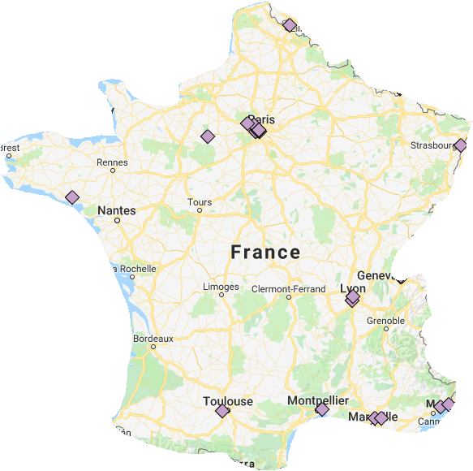
Google Map: Georgia Authorized IB Schools (2018)
Metro Atlanta: 54 IB Schools
France: 19 IB Schools

Slide 8
Growth of Georgia Authorized IB Schools by Year
Data source: www.ibo.org (9/25/18):
Continuously authorized IB schools only

Slide 9
Growth of Georgia Authorized IB Schools Over Time
Data source: www.ibo.org (9/25/18):
Continuously authorized IB schools only

Slide 10
Growth of Georgia Authorized IB Schools Over Time
Data source: www.ibo.org (9/25/18):
Continuously authorized IB schools only

Slide 11
IB in Georgia: Authorized School & Program Data

Slide 12
Authorized IB Programs in Georgia
105 IB Programs
At 80 IB Schools
Data source: www.ibo.org (9/25/18)

Slide 13
Authorized IB Programs in Georgia
Authorized in 2018:
DP: Alpharetta HS, Centennial HS
PYP: Heards Ferry ES, High Point ES, Lake Forest ES
Data source: www.ibo.org (9/25/18)

Slide 14
Authorized IB Programs in Georgia
Data source: www.ibo.org (9/25/18)

Slide 15
2016-2017 Georgia IB Demographics
(Authorized IB Public Schools; n=76)
Data sources: www.ibo.org and https://gosa.georgia.gov/

Slide 16
2016-2017 Georgia IB Demographics
(Authorized IB Public Schools; n=76)
Avg
Min
Max
FRL
5%
60.6%
100%
Avg
SWD
4.1%
10.4%
19.1%
Avg
LEP
0%
10.9%
83.0%
Avg
Gifted
0%
14.3%
39.2%
Avg
Mobility
2.6%
16.1%
43.3%
Data sources: www.ibo.org and https://gosa.georgia.gov/

Slide 17
2016-2017 Georgia IB Demographics
(Authorized IB Public Schools; n=76)
Avg
Min
Max
Black
1%
45.6%
97%
Avg
Hispanic
1%
19.8%
93%
Avg
White
0%
26.9%
85%
Data sources: www.ibo.org and https://gosa.georgia.gov/

Slide 18
2016-2017 Georgia IB Demographics
(Authorized IB Public Schools; n=76)
Data sources: www.ibo.org and https://gosa.georgia.gov/

Slide 19
2016-2017 Georgia IB Demographics
(Authorized IB Public Schools; n=76)
Data sources: www.ibo.org and https://gosa.georgia.gov/

Slide 20
IB in Georgia: Candidate School & Program Data

Slide 21
Candidate IB Programs in Georgia
36 IB Programs
At 35 IB Schools
Data source: Candidacy Self-Reported by Schools (9/25/18)

Slide 22
Candidate IB Programs in Georgia
Data source: Candidacy Self-Reported by Schools (9/25/18)

Slide 23
2016-2017 Georgia IB Demographics
(Candidate IB Public Schools; n=31)
Data sources: Reported by schools and https://gosa.georgia.gov/

Slide 24
2016-2017 Georgia IB Demographics
(Candidate IB Public Schools; n=31)
Avg
Min
Max
FRL
2%
82.4%
100%
Avg
SWD
4%
10.4%
16.3%
Avg
LEP
0%
4.5%
35%
Avg
Gifted
0%
6.6%
22.1%
Avg
Mobility
0.4%
25.7%
49.2%
Data sources: Reported by schools and https://gosa.georgia.gov/

Slide 25
2016-2017 Georgia IB Demographics
(Candidate IB Public Schools; n=31)
Avg
Min
Max
Black
5%
75.3%
99%
Avg
Hispanic
1%
6.5%
41%
Avg
White
0%
13.9%
77%
Data sources: Reported by schools and https://gosa.georgia.gov/

Slide 26
2016-2017 Georgia IB Demographics
(Candidate IB Public Schools; n=31)
Data sources: Reported by schools and https://gosa.georgia.gov/

Slide 27
2016-2017 Georgia IB Demographics
(Candidate IB Public Schools; n=31)
Data sources: Reported by schools and https://gosa.georgia.gov/

Slide 28
Authorized + Candidate IB Programs in Georgia
141 IB Programs
At 115 IB Schools
Data sources: www.ibo.org and reported by schools (9/25/18)

Slide 29
2016-2017 Georgia IB Demographics
(Authorized & Candidate IB Public Schools; n=107)
Data sources: www.ibo.org, https://gosa.georgia.gov/, and reported by schools

Slide 30
IB in Georgia: Public School IB Clusters

Slide 31
20 IB Public School Clusters in Georgia (9/25/2018)
District | Full Clusters (All Schools in Feeder Pattern Authorized) | Partial Clusters (2+ Schools Authorized or Candidate)
Atlanta City | 1 | 3
Fulton | 1 | 1
DeKalb | 0 | 3
Gwinnett | 0 | 2
Richmond | 0 | 2
Savannah-Chatham | 0 | 2
Clayton | 0 | 1
Cobb | 0 | 1
Decatur City | 0 | 1
Greene | 0 | 1
Marietta City | 0 | 1
Muscogee | 0 | 1
Data sources: www.ibo.org, https://gosa.georgia.gov/, and reported by schools

Slide 32
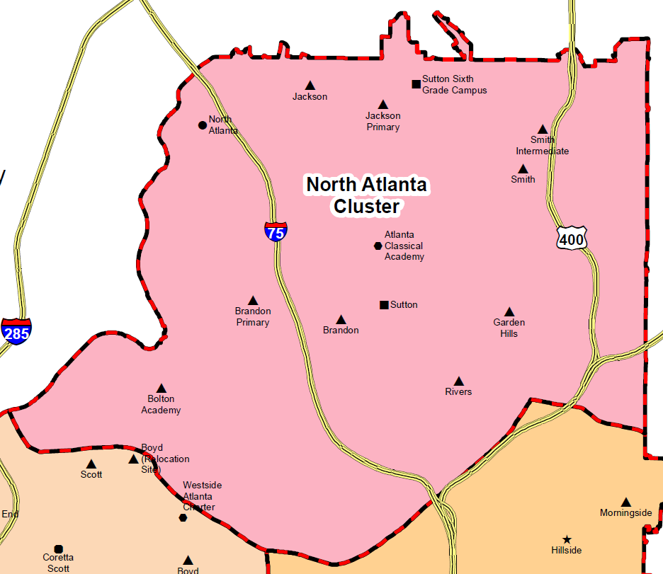
Atlanta Public Schools, North Atlanta Cluster: 8 Authorized IB Schools
PYP
MYP DP CP
PYP
MYP
PYP
PYP
PYP
PYP
Key: Authorized; Candidate

Slide 33
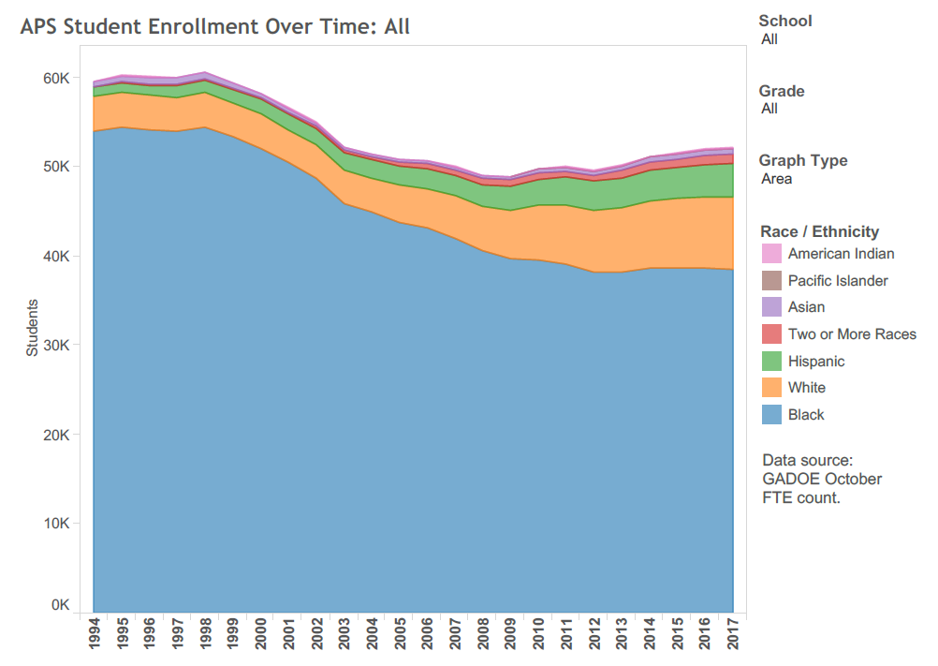

Slide 34
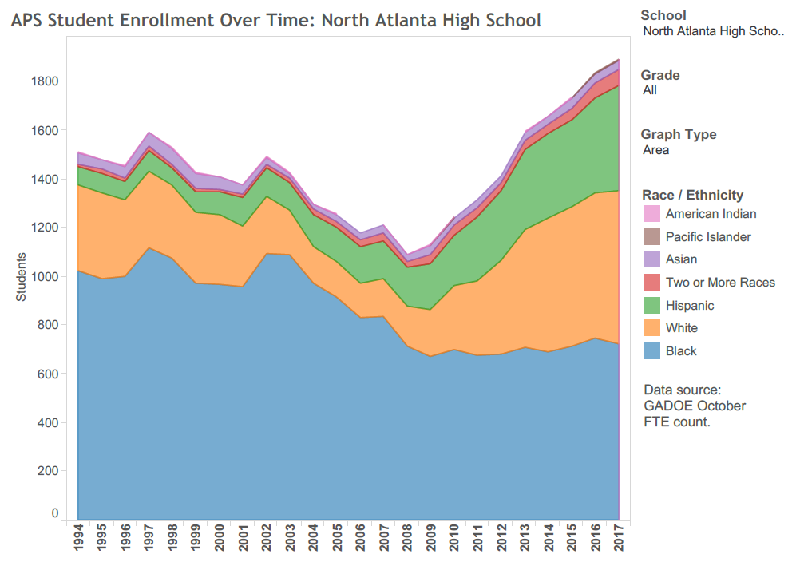
Plan to Form K-12 IB Cluster
Great
Recession
K-12 IB Cluster Complete
New NAHS Building
APS Ends Magnet Programs

Slide 35
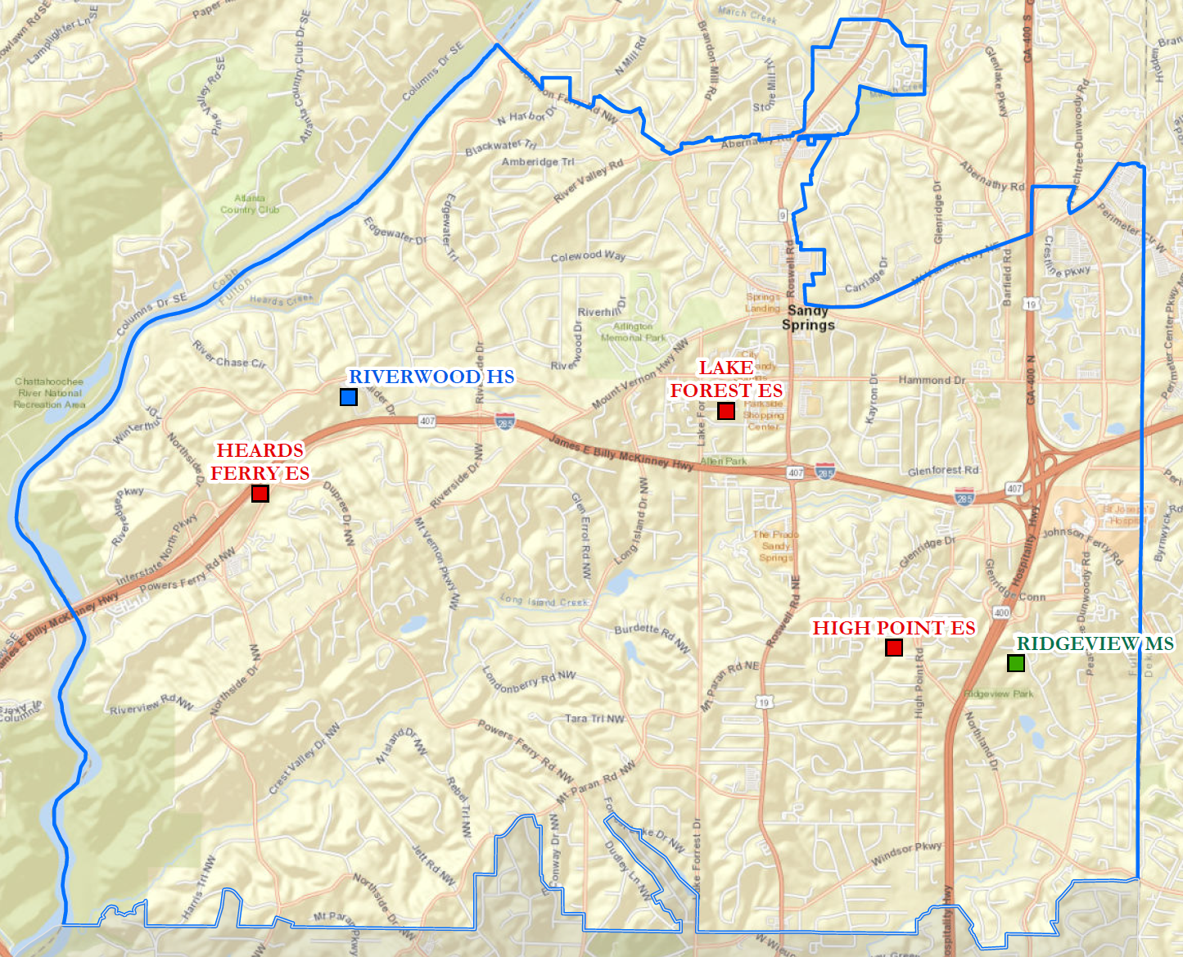
Fulton County Schools, Riverwood Cluster: 5 Authorized IB Schools
MYP DP CP
PYP
PYP
PYP
MYP
Key: Authorized; Candidate

Slide 36
20 IB Public School Clusters in Georgia (9/25/2018)
District | Full Clusters (All Schools in Feeder Pattern Authorized) | Partial Clusters (2+ Schools Authorized or Candidate)
Atlanta City | 1 | 3
Fulton | 1 | 1
DeKalb | 0 | 3
Gwinnett | 0 | 2
Richmond | 0 | 2
Savannah-Chatham | 0 | 2
Clayton | 0 | 1
Cobb | 0 | 1
Decatur City | 0 | 1
Greene | 0 | 1
Marietta City | 0 | 1
Muscogee | 0 | 1
Data sources: www.ibo.org, https://gosa.georgia.gov/, and reported by schools

Slide 37
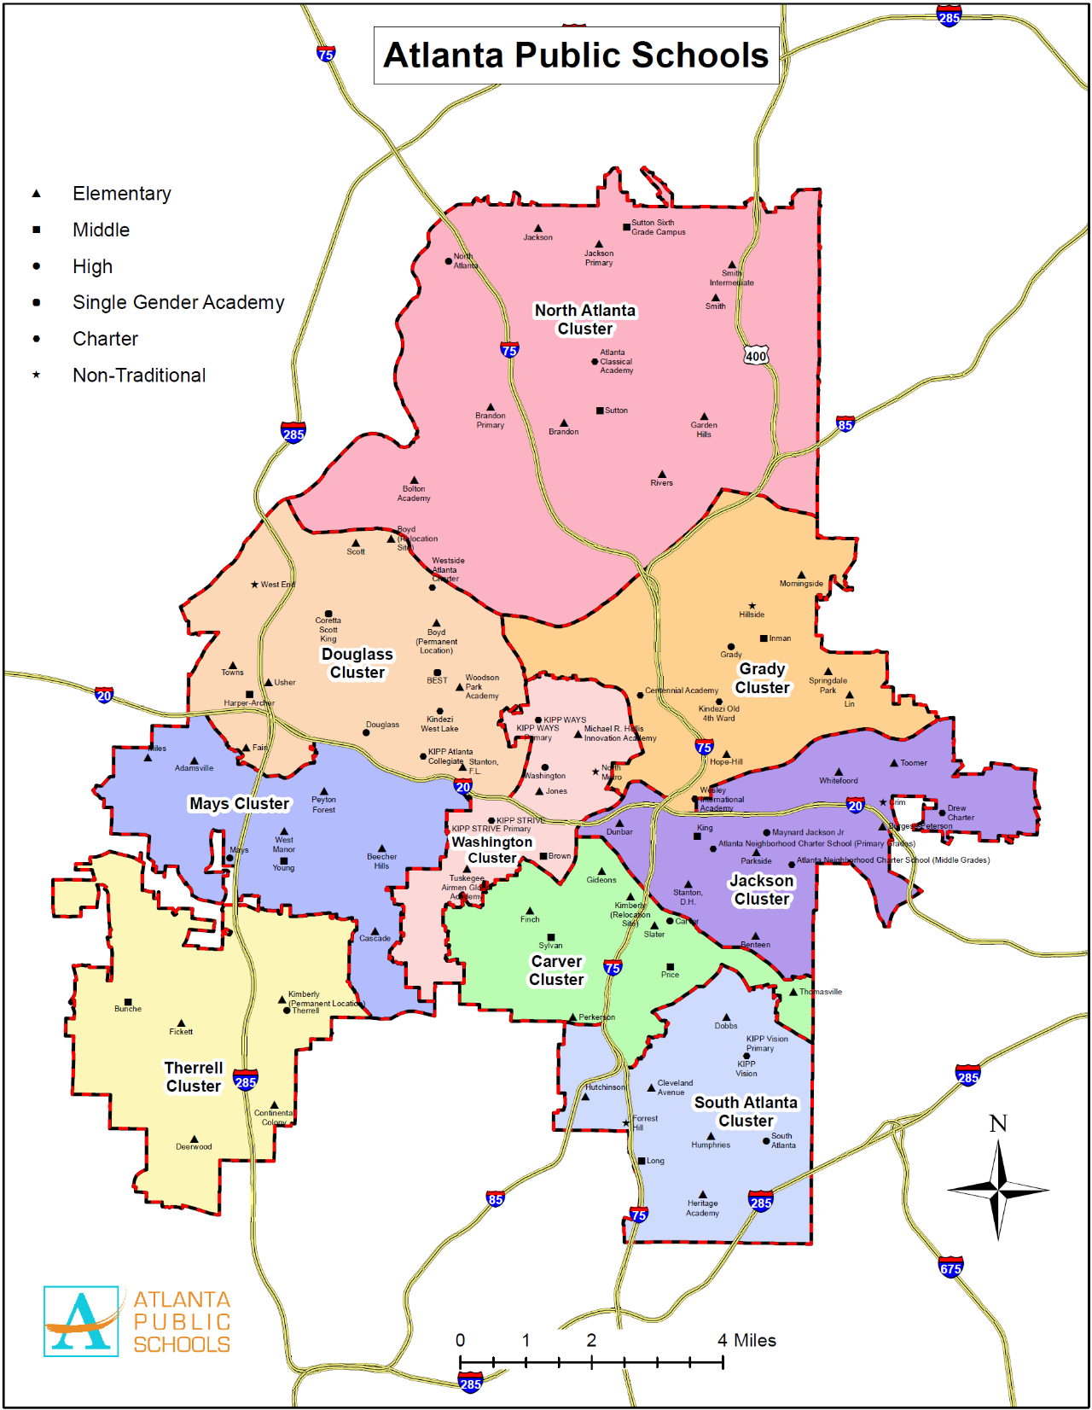
Jackson HS
Mays HS
North Atlanta HS
Therrell HS
Atlanta Public Schools:
4 IB Clusters

Slide 38
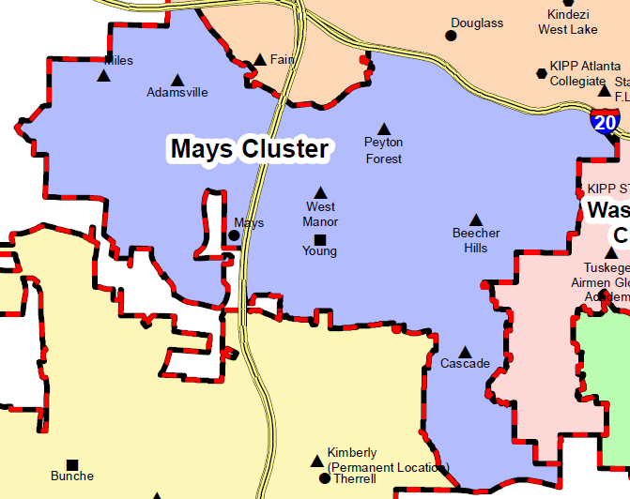
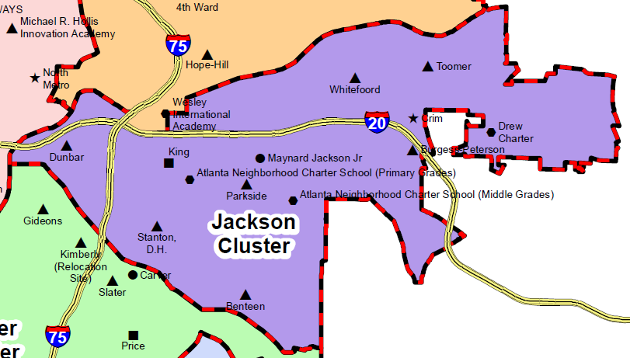
Atlanta Public Schools IB Clusters
PYP
PYP
PYP
MYP PYP
PYP
PYP
DP CP MYP
PYP
CP
PYP
MYP
MYP
PYP
MYP
PYP
PYP
Note: Scales adjusted for fit
Key: Authorized; Candidate

Slide 39
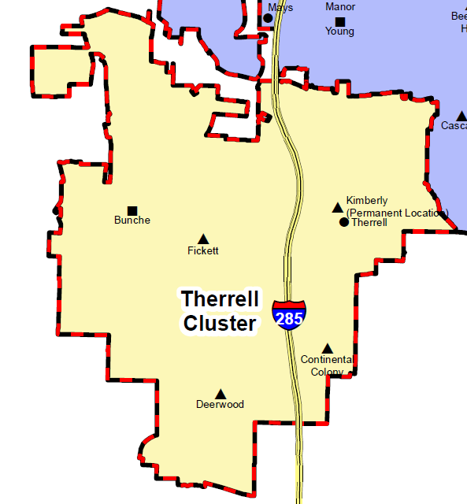
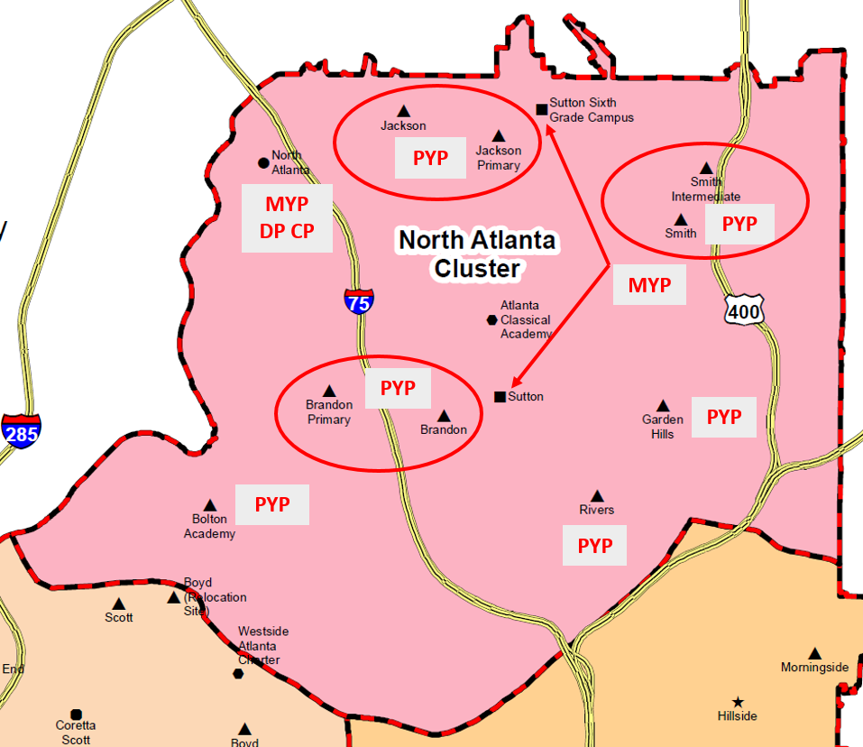
Atlanta Public Schools IB Clusters
PYP
MYP
MYP CP
PYP
PYP
Note: Scales adjusted for fit
Key: Authorized; Candidate

Slide 40
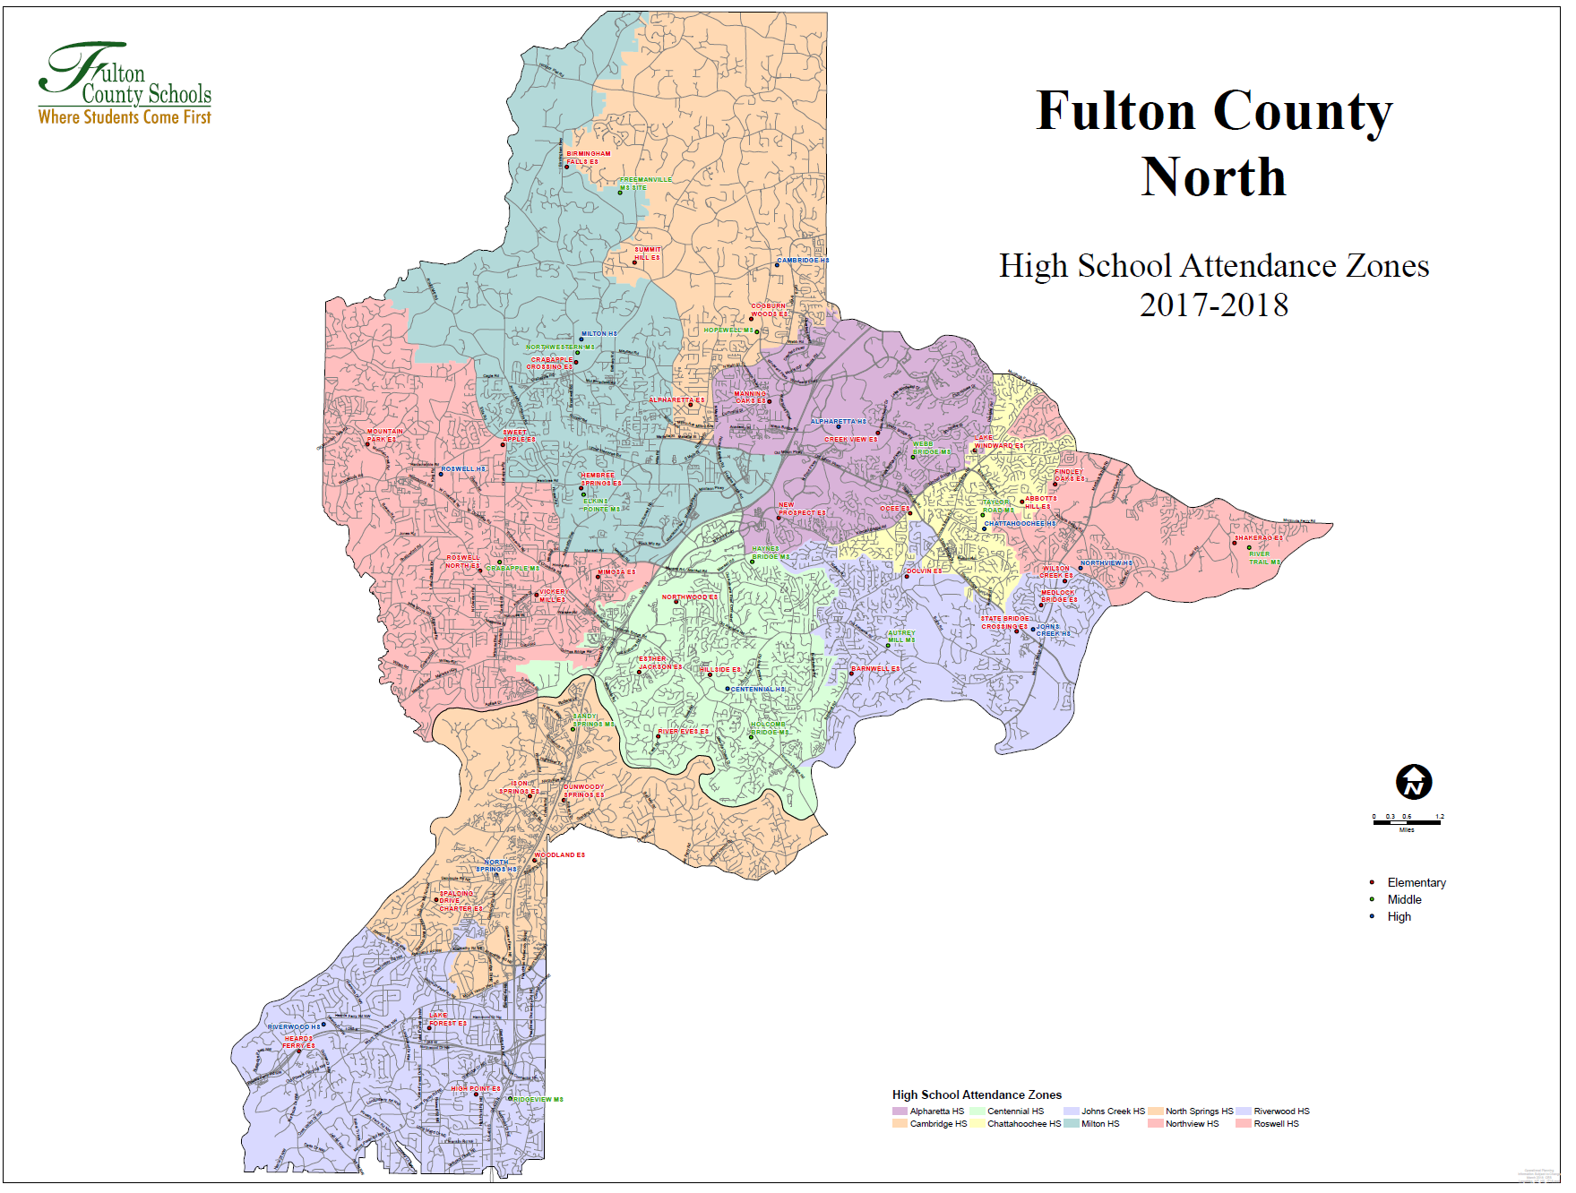
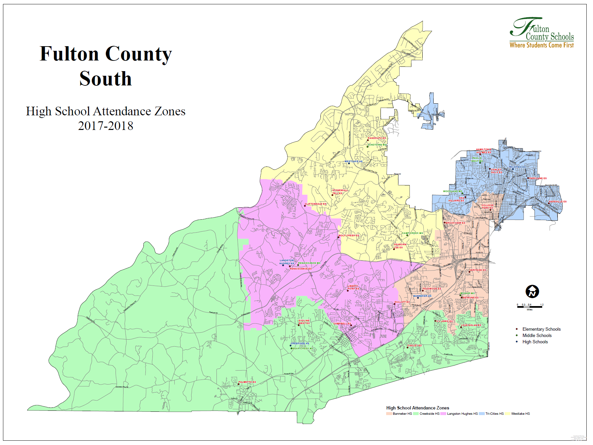
Fulton County:
2 IB Clusters
Riverwood HS
Westlake HS

Slide 41
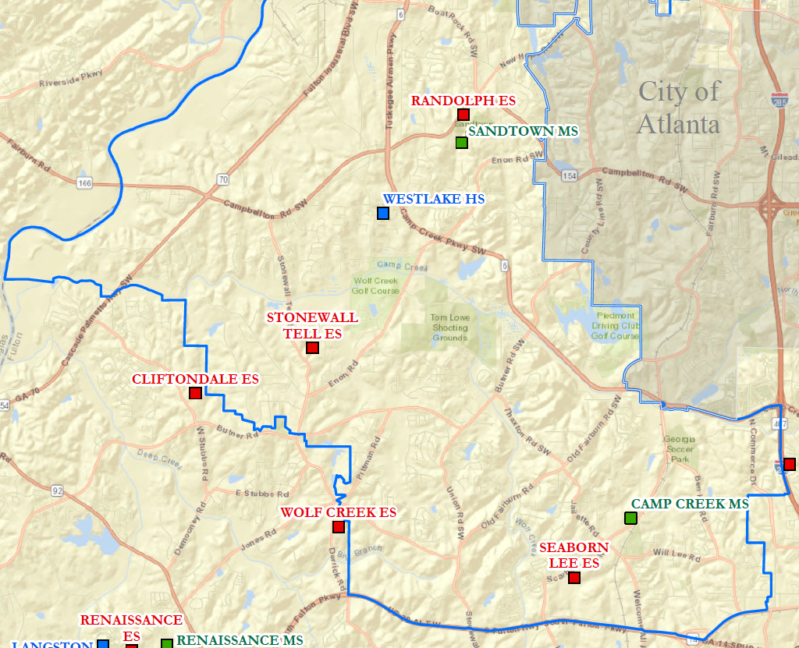
Fulton County IB Clusters
Riverwood HS Cluster
Westlake HS Cluster
PYP
MYP DP CP
MYP DP
PYP
PYP
PYP
PYP
MYP
Note: Scales adjusted for fit
Key: Authorized; Candidate

Slide 42
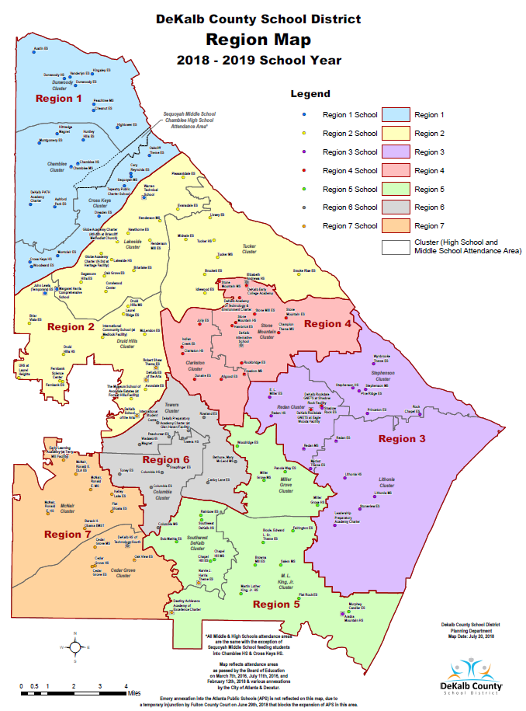
Druid Hills HS
MLK, Jr. HS
Tucker HS
DeKalb County:
3 IB Clusters

Slide 43
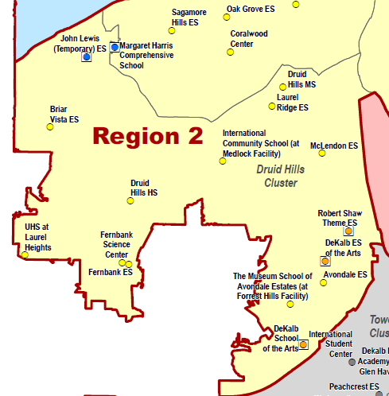
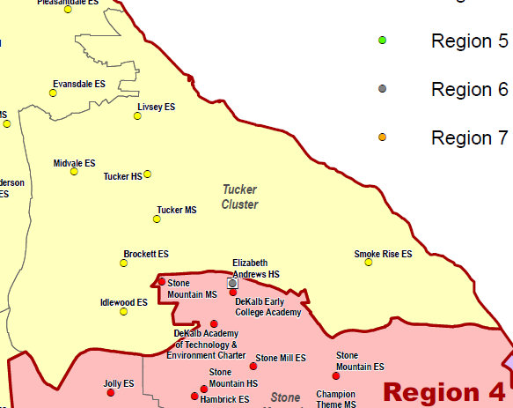
DeKalb County IB Clusters
Tucker HS Cluster
MYP
PYP
DP
DP
PYP
MYP
PYP
PYP
Druid Hills HS Cluster
Note: Scales adjusted for fit
Key: Authorized; Candidate

Slide 44
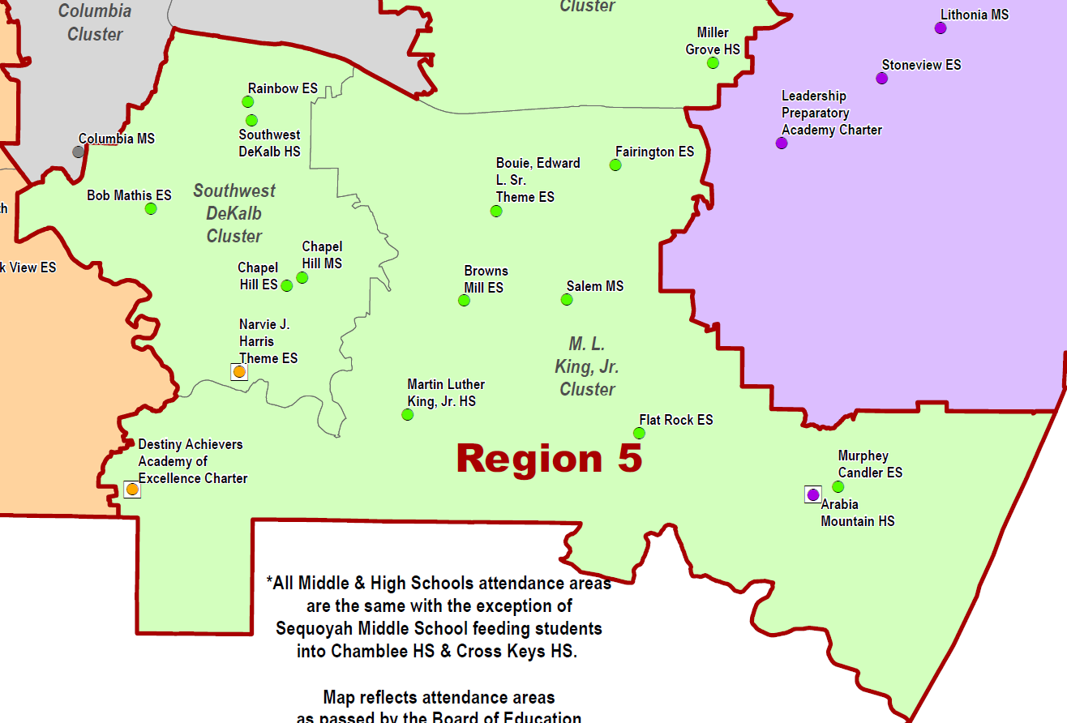
DeKalb County IB Clusters
MYP
DP
Martin Luther King, Jr. HS
Cluster
Key: Authorized; Candidate

Slide 45
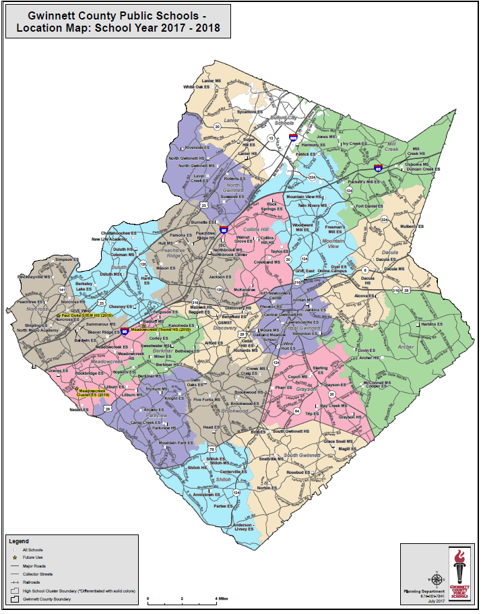
Gwinnett County:
2 IB Clusters
Norcross HS
Shiloh HS

Slide 46
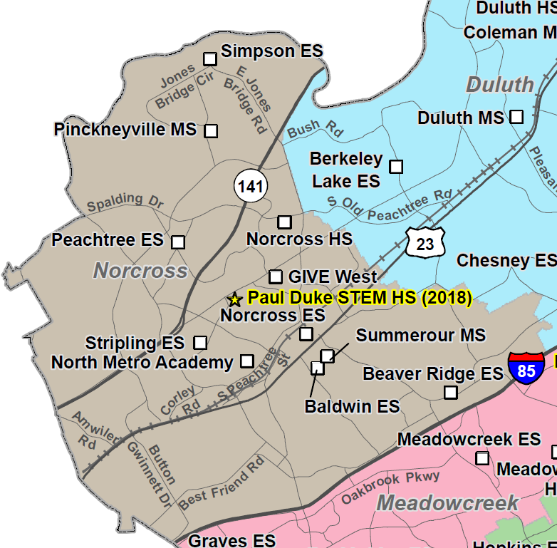
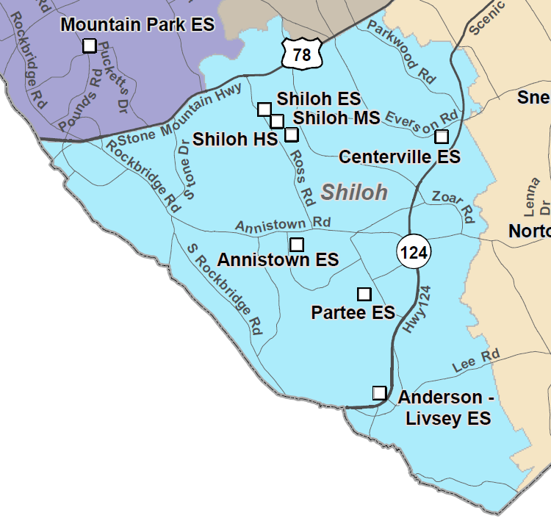
Gwinnett County IB Clusters
Norcross HS Cluster
MYP
MYP
DP
PYP
DP
MYP
Shiloh HS Cluster
Note: Scales adjusted for fit
Key: Authorized; Candidate

Slide 47
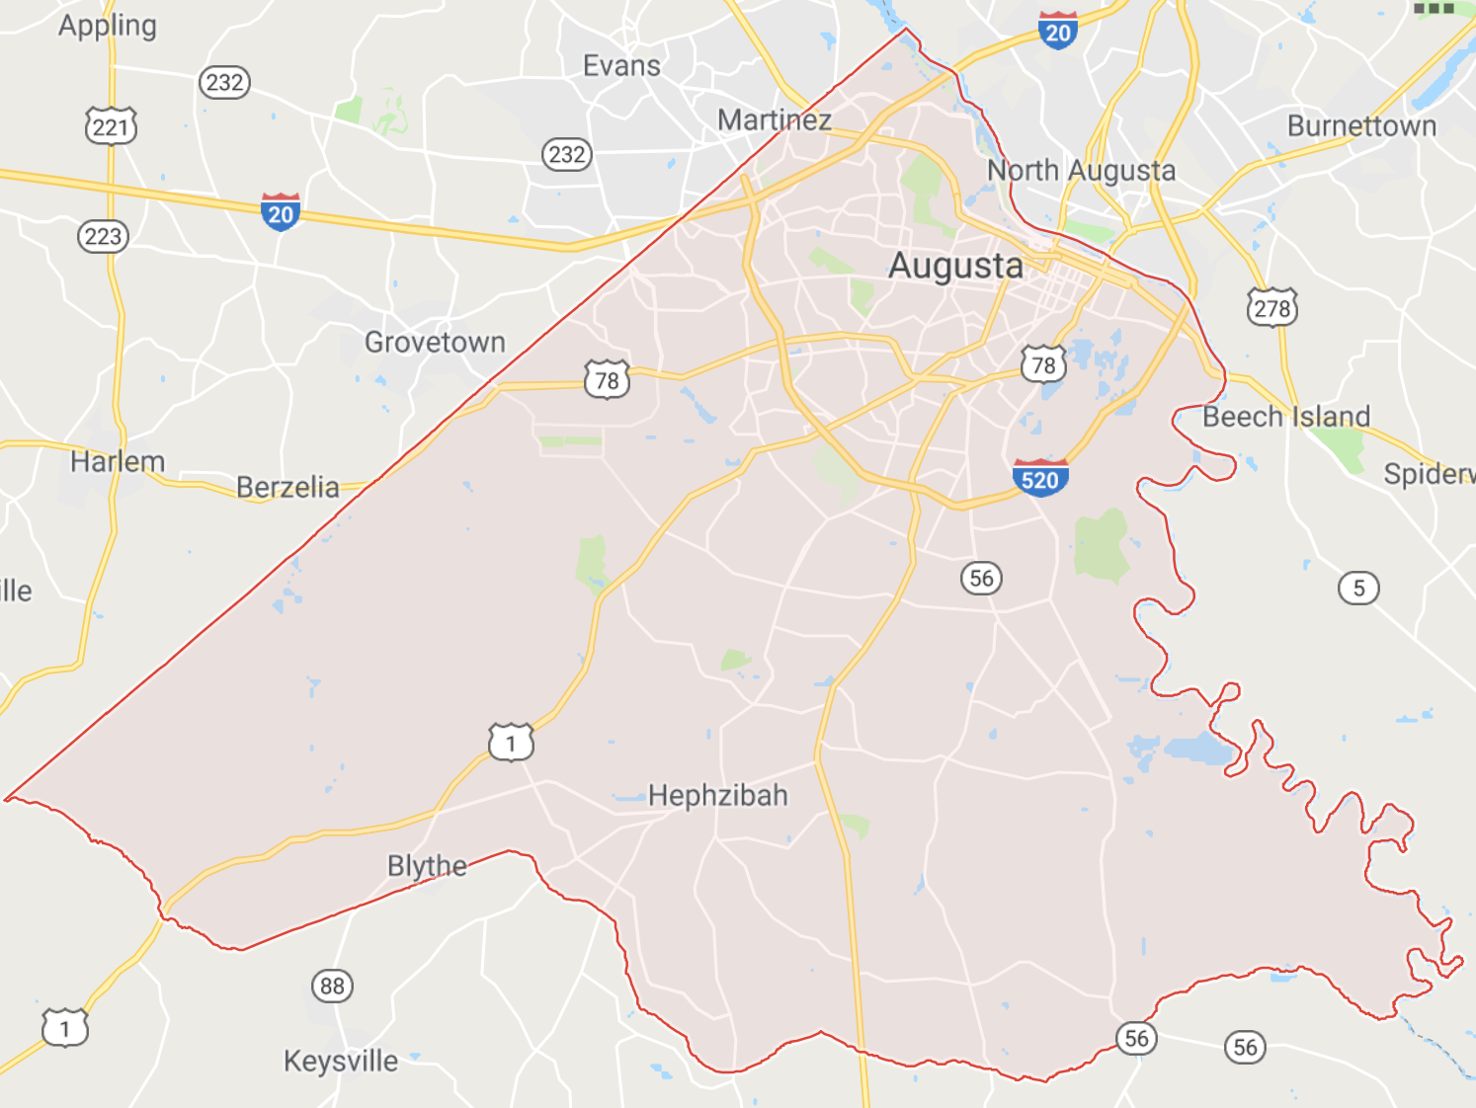
Richmond County:
2 IB Clusters
Academy of Richmond County HS
Hephzibah HS
Key: Authorized; Candidate

Slide 48
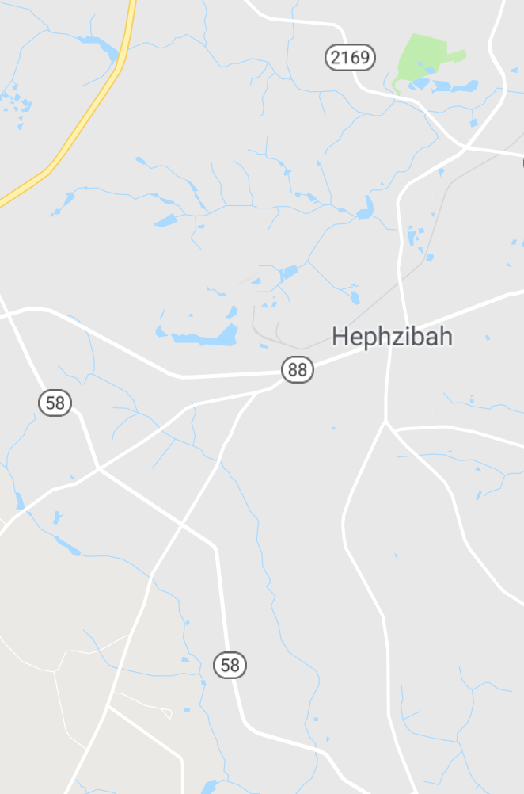
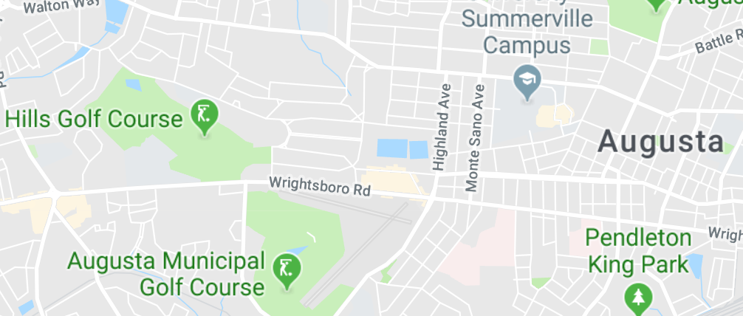
Richmond County IB Clusters
Hephzibah HS Cluster
Academy of Richmond County HS Cluster
Hephzibah
ES
Lake Forest Hills
ES
Academy of Richmond County HS
Hephzibah
MS
Copeland
ES
Langford
MS
Hephzibah
HS
PYP
MYP
MYP
MYP
PYP
DP CP
PYP
Key: Authorized; Candidate

Slide 49
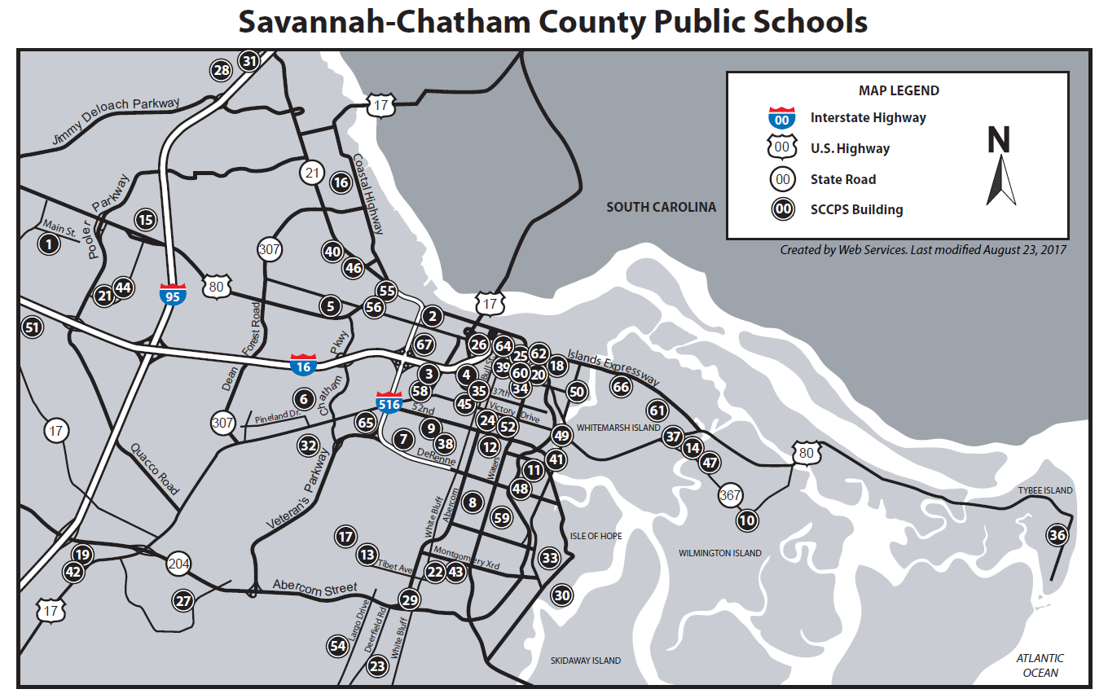
Savannah-Chatham Public Schools:
2 IB Clusters
Johnson HS
Windsor Forest HS

Slide 50
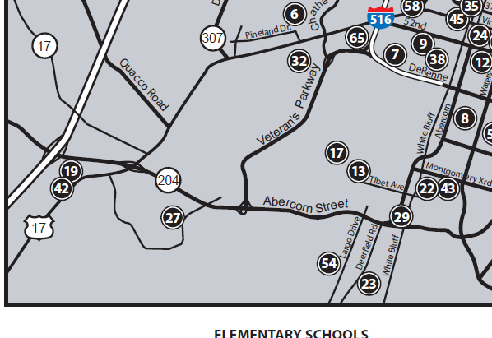
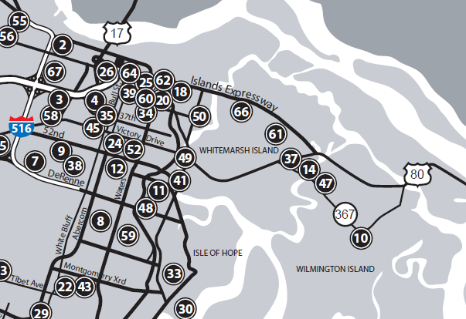
Savannah-Chatham County IB Clusters
Windsor Forest HS Cluster
Sol C Johnson HS Cluster
MYP
PYP
MYP DP CP
PYP
MYP
MYP DP CP
13. Largo-Tibet Elementary School
42. Southwest Middle School
54. Windsor Forest High School
14. Marshpoint Elementary School
37. Coastal Middle School
49. Sol C. Johnson High School
Note: Scales adjusted for fit
Key: Authorized; Candidate

Slide 51
21 IB Public School Clusters in Georgia (9/25/2018)
District | Full Clusters (All Schools in Feeder Pattern Authorized) | Partial Clusters (2+ Schools Authorized or Candidate)
Atlanta City | 1 | 3
Fulton | 1 | 1
DeKalb | 0 | 3
Gwinnett | 0 | 2
Richmond | 0 | 2
Savannah-Chatham | 0 | 2
Clayton | 0 | 1
Cobb | 0 | 1
Decatur City | 0 | 1
Greene | 0 | 1
Marietta City | 0 | 1
Muscogee | 0 | 1
Data sources: www.ibo.org, https://gosa.georgia.gov/, and reported by schools

Slide 52
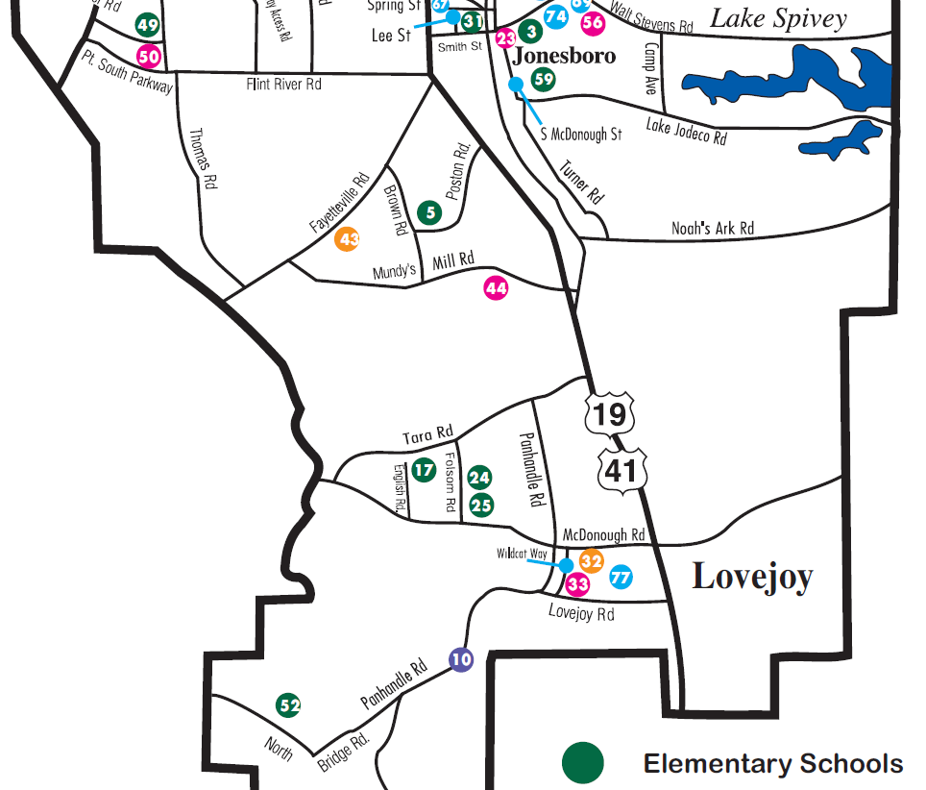
Clayton County, Lovejoy HS IB Cluster
PYP
Lovejoy
HS
Lee Street
ES
DP
Key: Authorized; Candidate

Slide 53
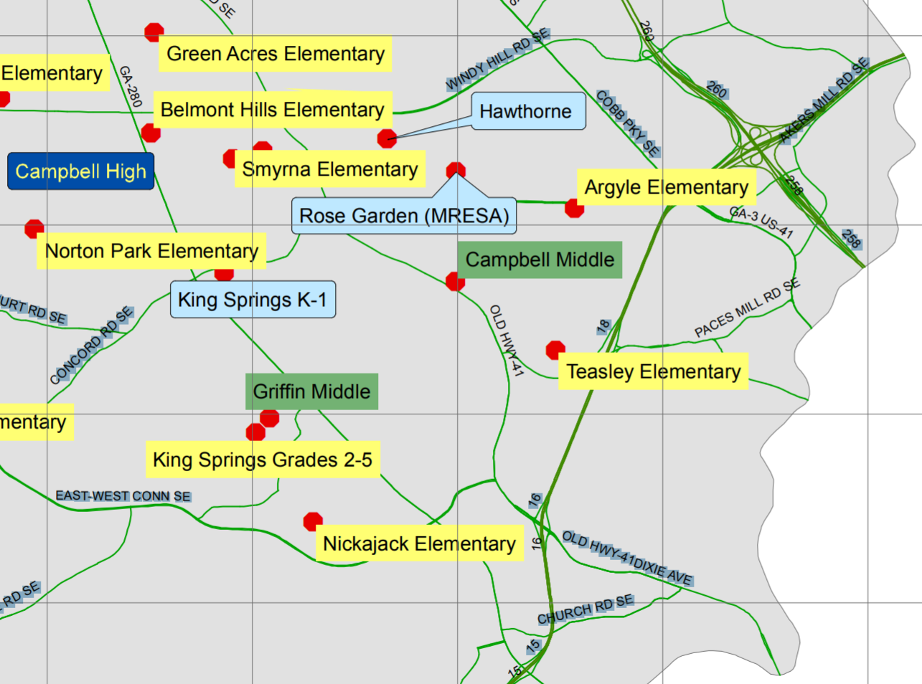
Cobb County, Campbell HS IB Cluster
DP
MYP
PYP
Key: Authorized; Candidate

Slide 54
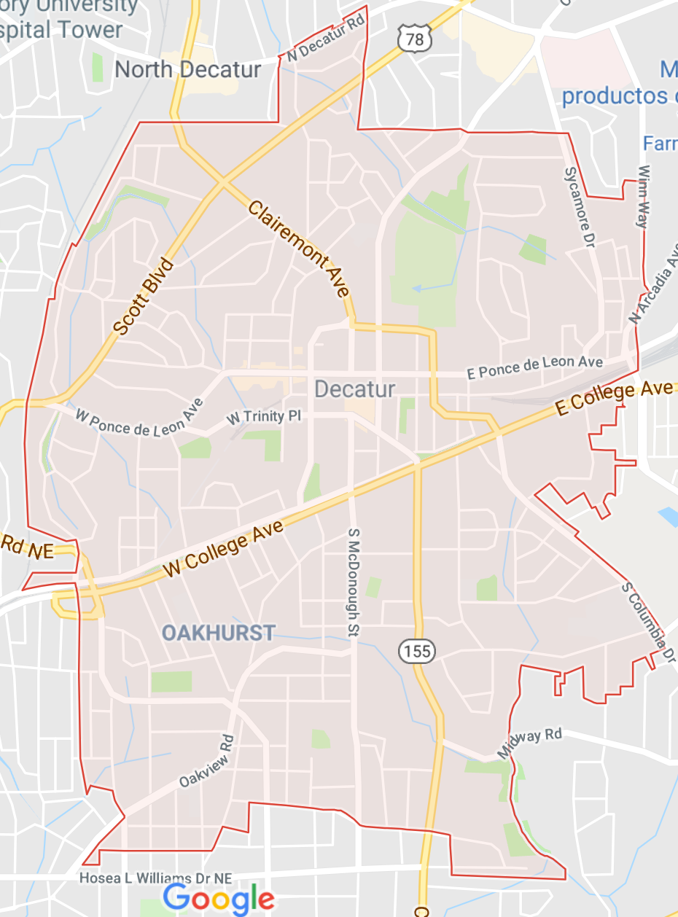
Decatur City IB Cluster
Decatur
HS
MYP DP CP
4/5 Academy
ES
MYP
Renfroe
MS
PYP
Key: Authorized; Candidate

Slide 55
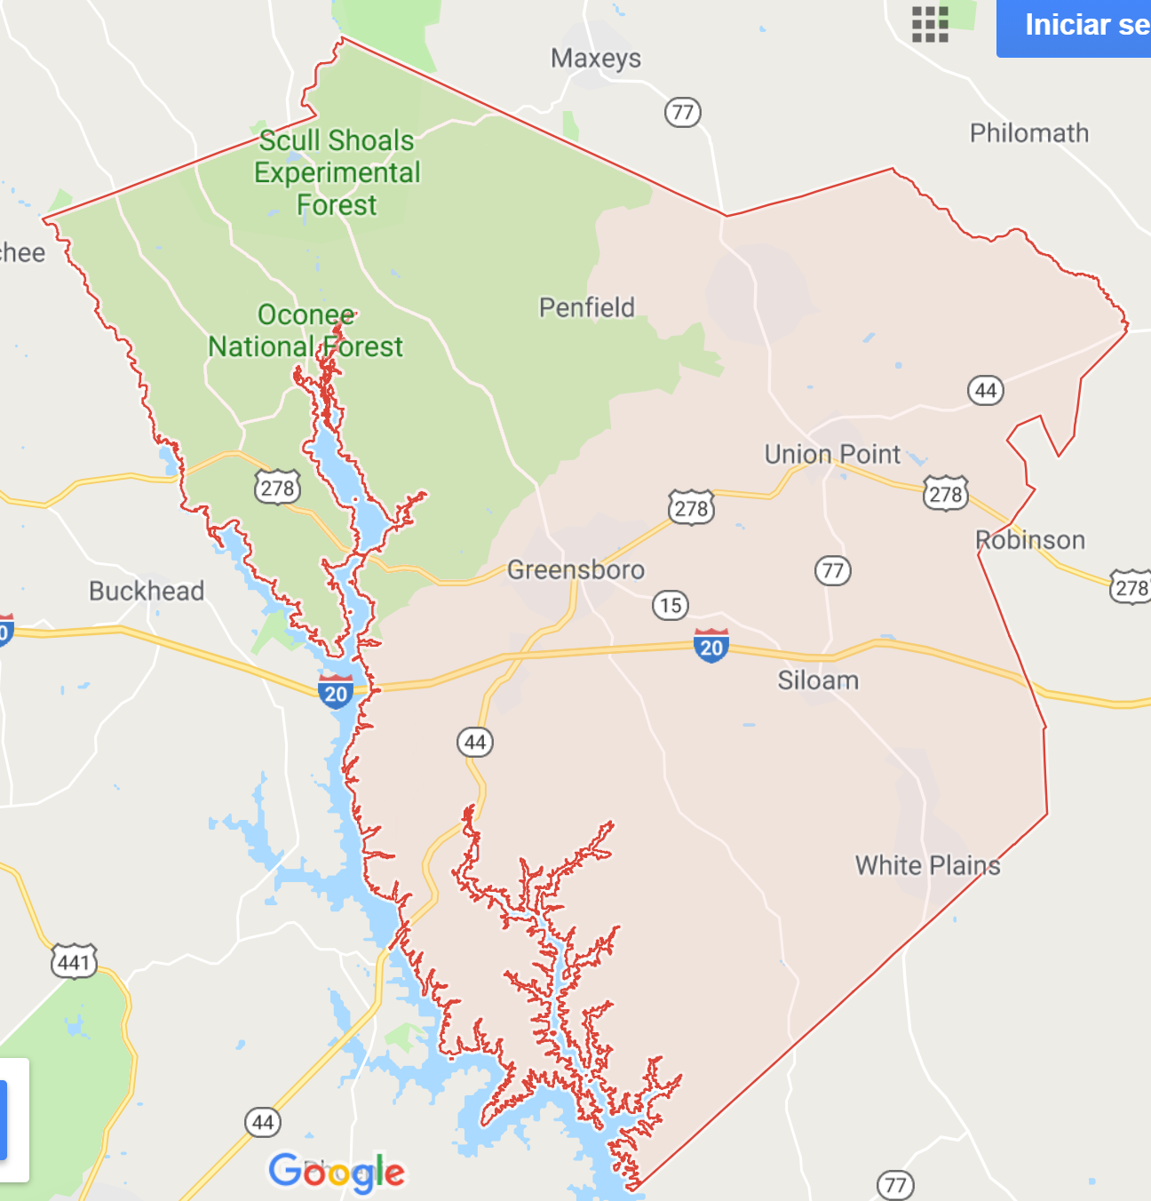
Greene County IB Cluster
Greene County
HS
Anita Carson White MS
MYP
MYP
Key: Authorized; Candidate

Slide 56
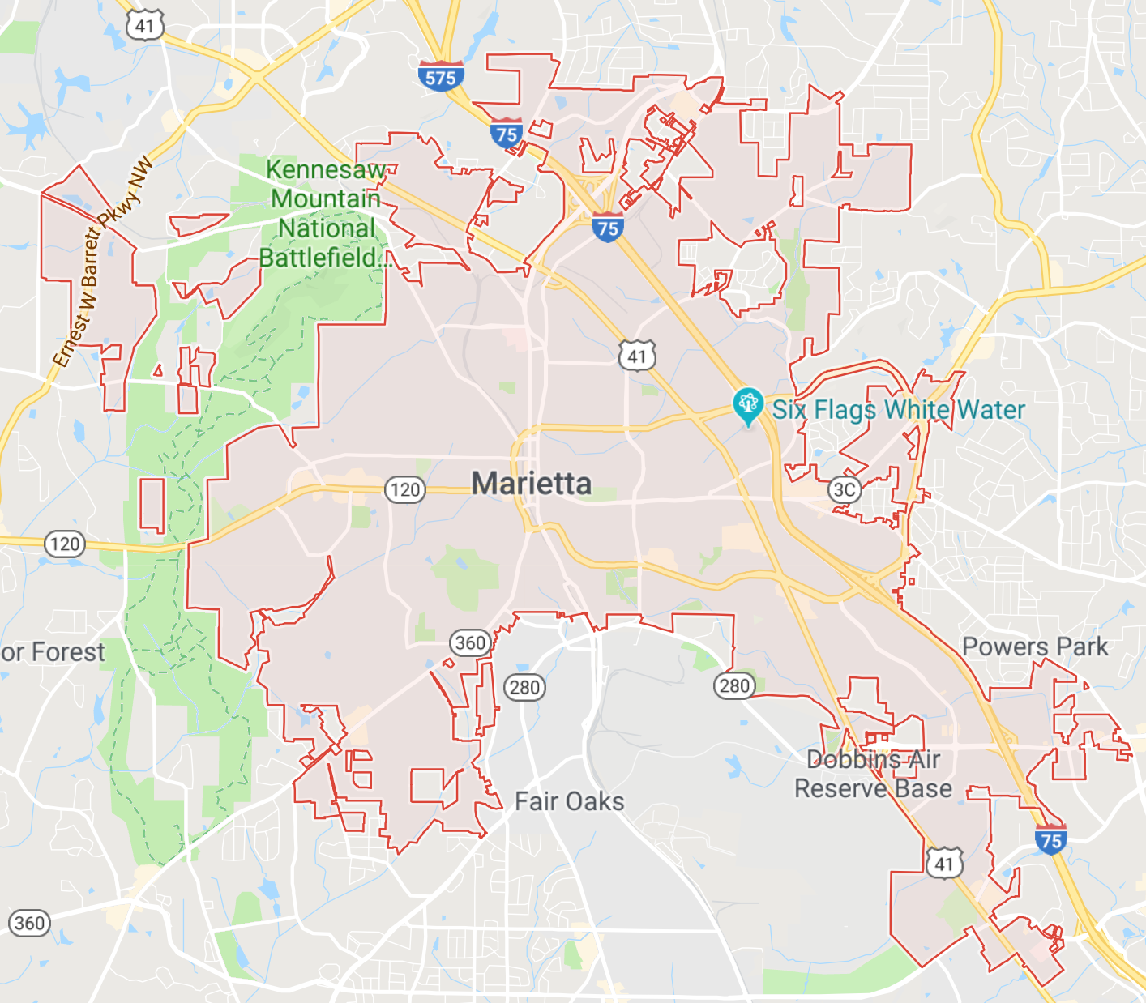
Marietta City IB Cluster
Sawyer Road
ES
Marietta
MS
PYP
MYP DP CP
Marietta
HS
MYP
MYP
PYP
Marietta
6th Grade Academy
Burruss
ES
Key: Authorized; Candidate

Slide 57
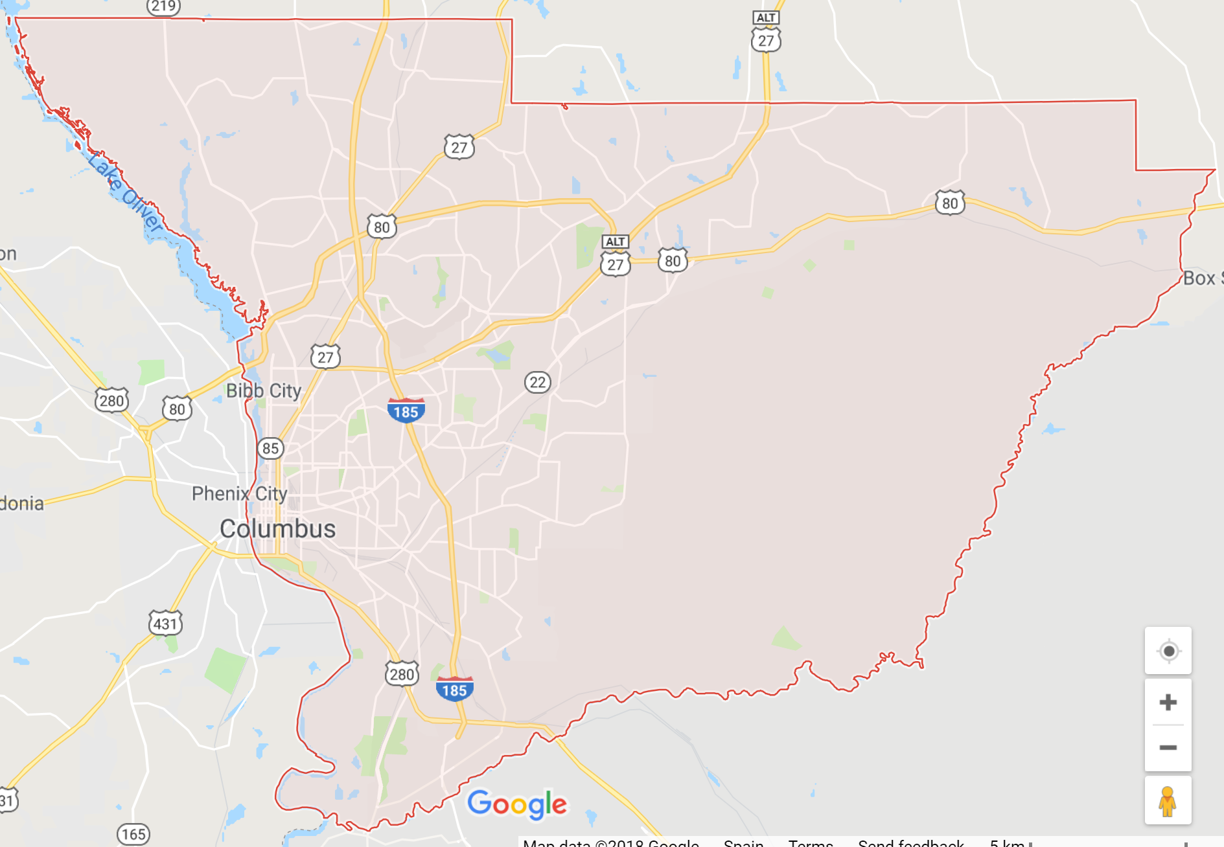
Muscogee County IB Cluster
Hardaway
HS
DP CP
Richards
MS
PYP
MYP
Clubview
ES
Key: Authorized; Candidate

Slide 58
IB in Georgia: Stand-Alone Public School IB Programs

Slide 59
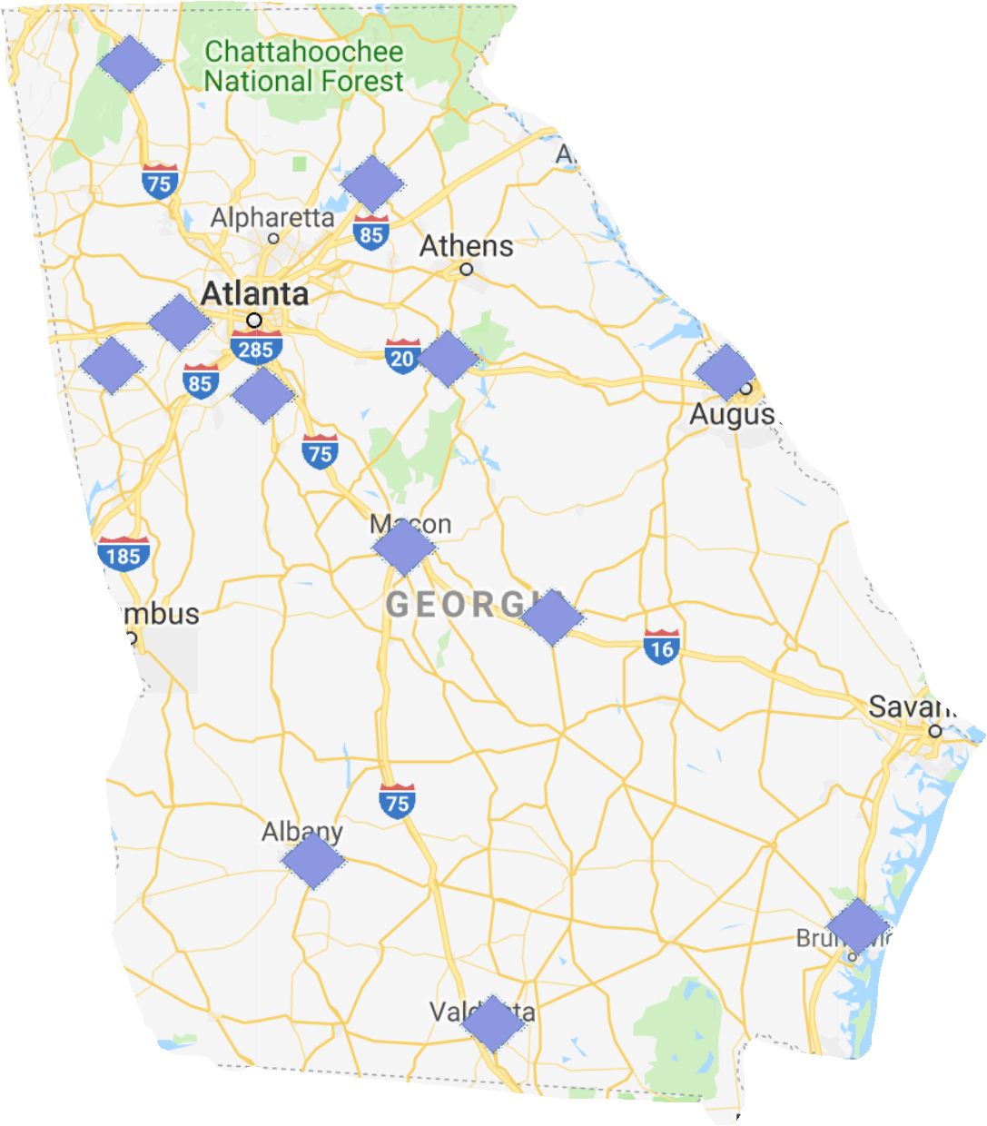
Georgia Authorized Stand-Alone IB Schools (n=11)

Slide 60
Thank You!!
All data shown in this presentation were gathered from open sources. Permission is granted for Georgia schools and other entities to show these slides and their associated content in any setting with any audience provided that the formatting and CASIE branding are preserved. This PowerPoint presentation may be opened as a read-only file and shown in presentation mode or printed. However, slides should not be altered, rearranged, or copied into another presentation as a safeguard to preserve formatting and CASIE branding. CASIE welcomes questions and ongoing dialogue about this data and its potential implications for IB schools and educational decision-makers in Georgia.

