Slide 1
IB in Georgia
"All data shown in this presentation were gathered from open sources. Permission is granted for Georgia schools and other entities to use show these slides and their associated content in any setting with any audience provided that the formatting and CASIE branding are preserved. This PowerPoint presentation may be opened as a read-only file and shown in presentation mode or printed. However, slides cannot be altered, rearranged, or copied into another presentation as a safeguard to preserve formatting and CASIE branding. CASIE welcomes questions and ongoing dialogue about this data and its potential implications for IB schools and educational decision-makers in Georgia."

Slide 2
IB Schools Worldwide (September 25, 2018)
518 in Canada and Ecuador

Slide 3
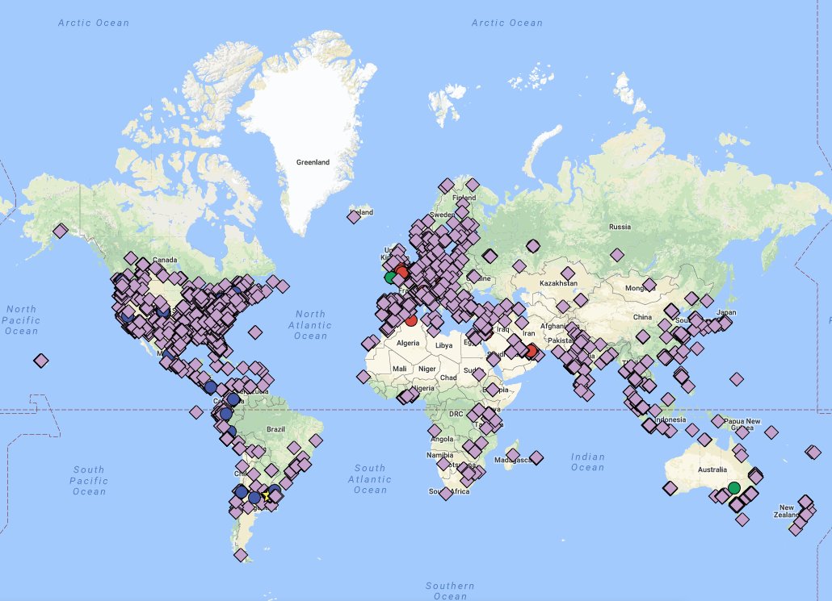
Google Map: Authorized IB Schools (2015)

Slide 4
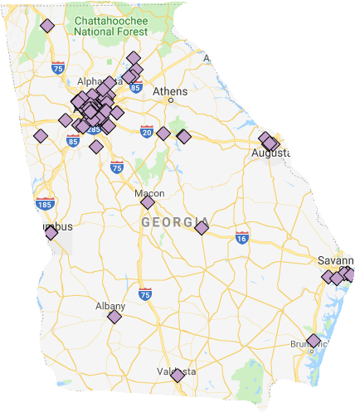
Google Map: Georgia Authorized IB Schools (2018)

Slide 5
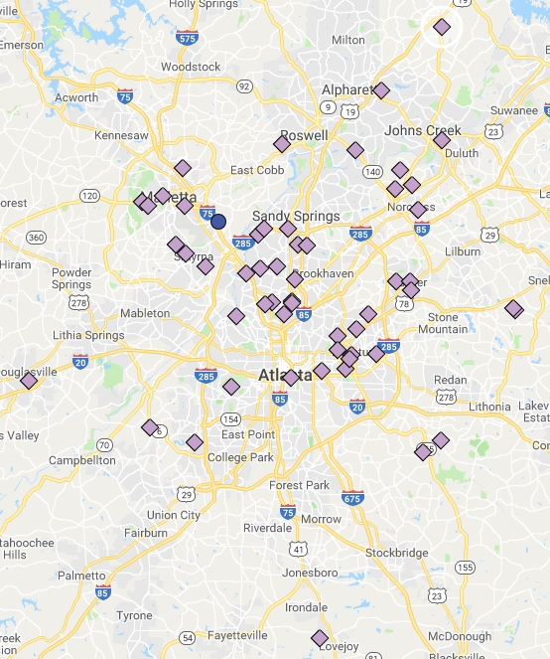
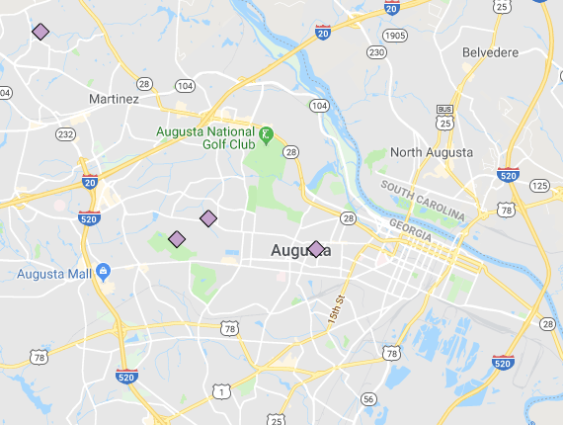
Google Map: Georgia Authorized IB Schools (2018)
Metro Atlanta: 54 IB Schools
Augusta: 4 IB Schools

Slide 6
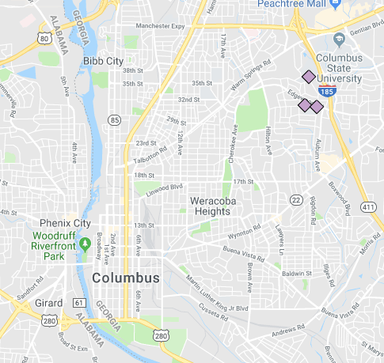
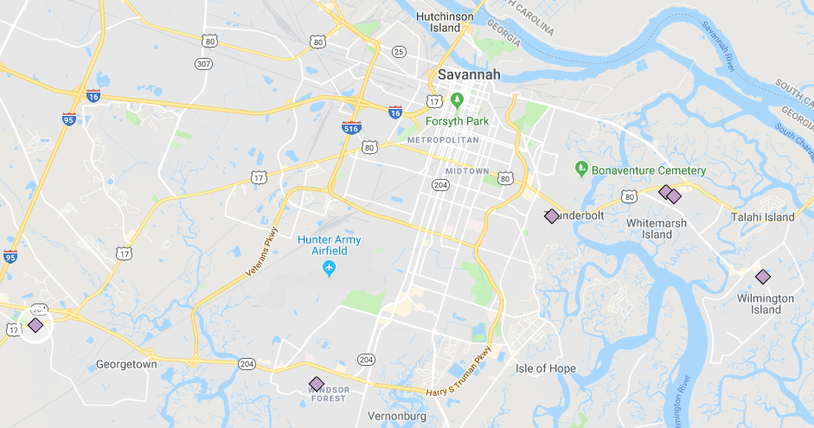
Google Map: Georgia Authorized IB Schools (2018)
Columbus: 3 IB Schools
Savannah: 6 IB Schools

Slide 7
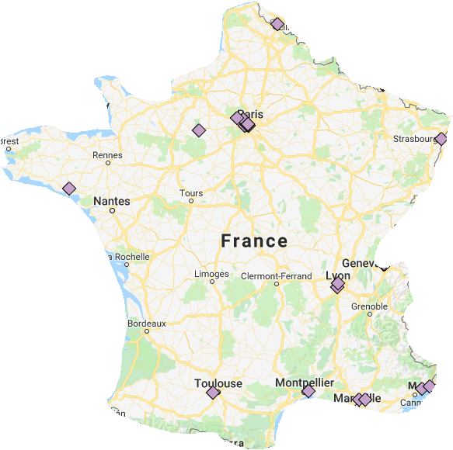
Google Map: Georgia Authorized IB Schools (2018)
Metro Atlanta: 54 IB Schools
France: 19 IB Schools

Slide 8
Growth of Georgia Authorized IB Schools by Year
Data source: www.ibo.org (9/25/18):
Continuously authorized IB schools only

Slide 9
Growth of Georgia Authorized IB Schools Over Time
Data source: www.ibo.org (9/25/18):
Continuously authorized IB schools only

Slide 10
Growth of Georgia Authorized IB Schools Over Time
Data source: www.ibo.org (9/25/18):
Continuously authorized IB schools only

Slide 11
IB in Georgia: Authorized School & Program Data

Slide 12
Authorized IB Programs in Georgia
105 IB Programs
At 80 IB Schools
Data source: www.ibo.org (9/25/18)

Slide 13
Authorized IB Programs in Georgia
Authorized in 2018:
DP: Alpharetta HS, Centennial HS
PYP: Heards Ferry ES, High Point ES, Lake Forest ES
Data source: www.ibo.org (9/25/18)

Slide 14
Authorized IB Programs in Georgia
Data source: www.ibo.org (9/25/18)

Slide 15
2016-2017 Georgia IB Demographics
(Authorized IB Public Schools; n=76)
Data sources: www.ibo.org and https://gosa.georgia.gov/

Slide 16
2016-2017 Georgia IB Demographics
(Authorized IB Public Schools; n=76)
Avg
Min
Max
FRL
5%
60.6%
100%
Avg
SWD
4.1%
10.4%
19.1%
Avg
LEP
0%
10.9%
83.0%
Avg
Gifted
0%
14.3%
39.2%
Avg
Mobility
2.6%
16.1%
43.3%
Data sources: www.ibo.org and https://gosa.georgia.gov/

Slide 17
2016-2017 Georgia IB Demographics
(Authorized IB Public Schools; n=76)
Avg
Min
Max
Black
1%
45.6%
97%
Avg
Hispanic
1%
19.8%
93%
Avg
White
0%
26.9%
85%
Data sources: www.ibo.org and https://gosa.georgia.gov/

Slide 18
2016-2017 Georgia IB Demographics
(Authorized IB Public Schools; n=76)
Data sources: www.ibo.org and https://gosa.georgia.gov/

Slide 19
2016-2017 Georgia IB Demographics
(Authorized IB Public Schools; n=76)
Data sources: www.ibo.org and https://gosa.georgia.gov/

Slide 20
IB in Georgia: Candidate School & Program Data

Slide 21
Candidate IB Programs in Georgia
35 IB Programs
At 34 IB Schools
Data source: Candidacy Self-Reported by Schools (9/25/18)

Slide 22
Candidate IB Programs in Georgia
Data source: Candidacy Self-Reported by Schools (9/25/18)

Slide 23
2016-2017 Georgia IB Demographics
(Candidate IB Public Schools; n=30)
Data sources: Reported by schools and https://gosa.georgia.gov/

Slide 24
2016-2017 Georgia IB Demographics
(Candidate IB Public Schools; n=30)
Avg
Min
Max
FRL
2%
81.9%
100%
Avg
SWD
4%
10.6%
16.3%
Avg
LEP
0%
4.5%
35%
Avg
Gifted
0%
6.7%
22.1%
Avg
Mobility
0.4%
24.9%
41.1%
Data sources: Reported by schools and https://gosa.georgia.gov/

Slide 25
2016-2017 Georgia IB Demographics
(Candidate IB Public Schools; n=30)
Avg
Min
Max
Black
5%
75.2%
99%
Avg
Hispanic
1%
6.5%
41%
Avg
White
0%
14.2%
77%
Data sources: Reported by schools and https://gosa.georgia.gov/

Slide 26
2016-2017 Georgia IB Demographics
(Candidate IB Public Schools; n=30)
Data sources: Reported by schools and https://gosa.georgia.gov/

Slide 27
2016-2017 Georgia IB Demographics
(Candidate IB Public Schools; n=30)
Data sources: Reported by schools and https://gosa.georgia.gov/

Slide 28
Authorized + Candidate IB Programs in Georgia
140 IB Programs
At 114 IB Schools
Data sources: www.ibo.org and reported by schools (9/25/18)

Slide 29
2016-2017 Georgia IB Demographics
(Authorized & Candidate IB Public Schools; n=106 )
Data sources: www.ibo.org, https://gosa.georgia.gov/, and reported by schools

Slide 30
IB in Georgia: Public School IB Clusters

Slide 31
20 IB Public School Clusters in Georgia (9/25/2018)
District | Full Clusters (All Schools in Feeder Pattern Authorized) | Partial Clusters (2+ Schools Authorized or Candidate)
Atlanta City | 1 | 3
Fulton | 1 | 1
DeKalb | 0 | 3
Gwinnett | 0 | 2
Savannah-Chatham | 0 | 2
Clayton | 0 | 1
Cobb | 0 | 1
Decatur City | 0 | 1
Greene | 0 | 1
Marietta City | 0 | 1
Muscogee | 0 | 1
Richmond | 0 | 1
Data sources: www.ibo.org, https://gosa.georgia.gov/, and reported by schools

Slide 32
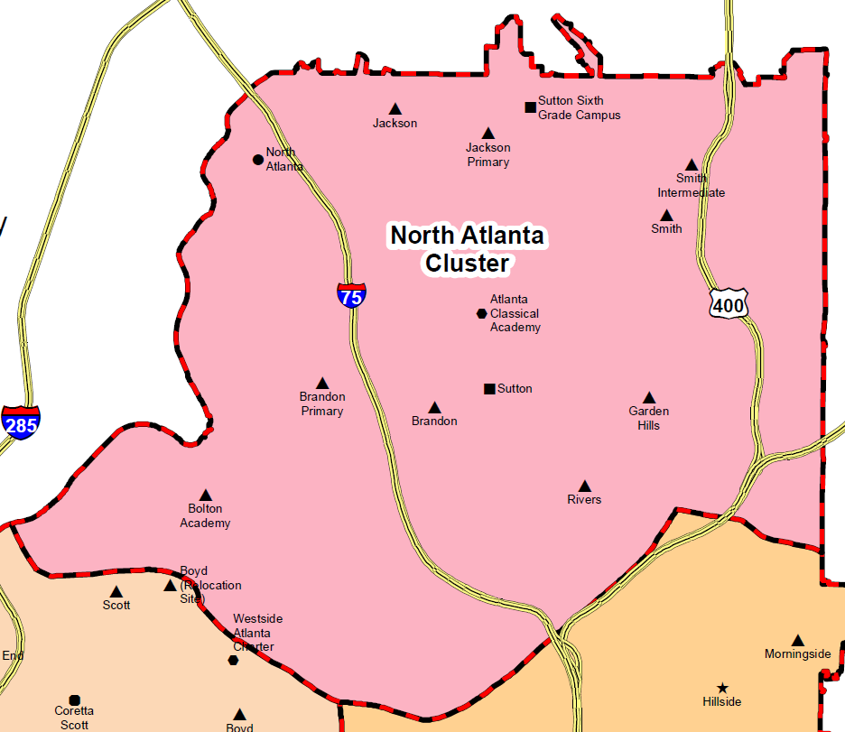
North Atlanta Cluster: 8 Authorized IB Schools
PYP
MYP DP CP
PYP
MYP
PYP
PYP
PYP
PYP
Key: Authorized; Candidate

Slide 33
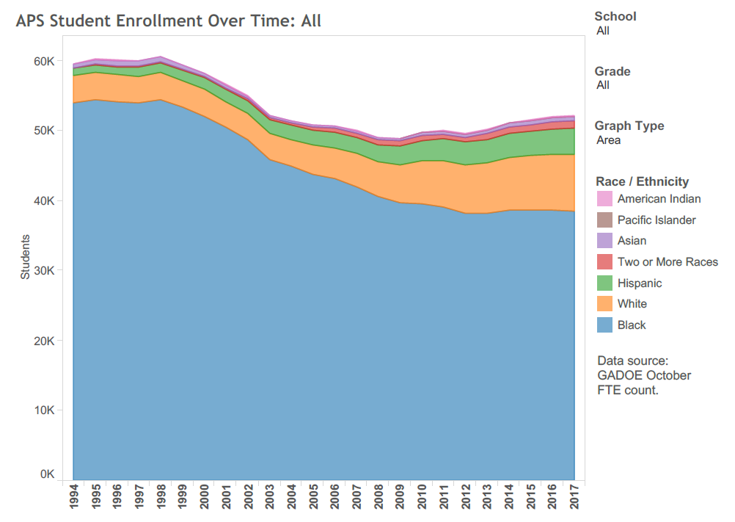

Slide 34
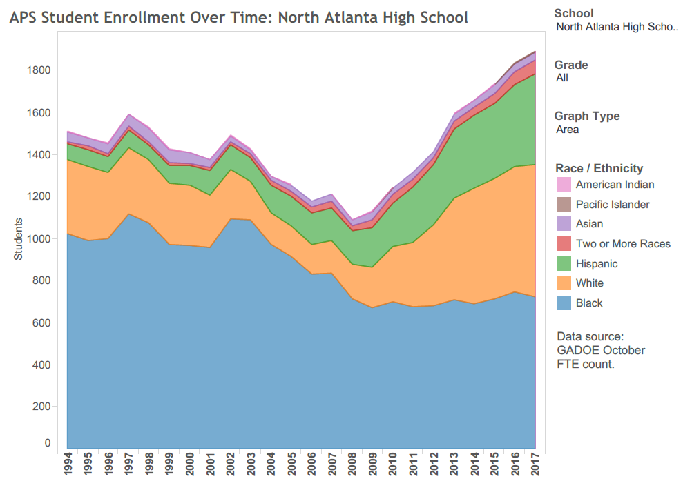
New NAHS Opens
North Corridor Task Force
“Great Recession”
K-12 IB Cluster
Magnets End

Slide 35
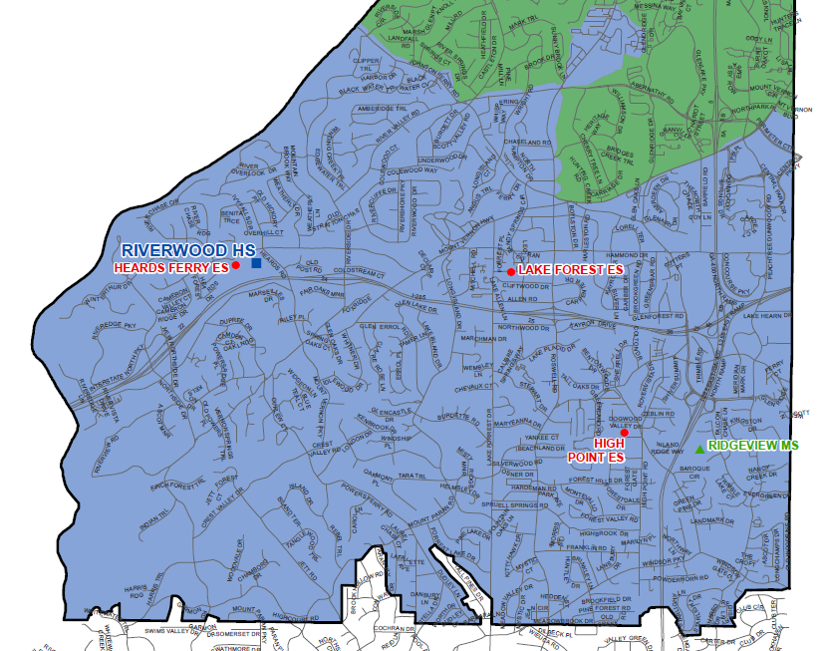
Riverwood Cluster: 5 Authorized IB Schools
MYP DP CP
PYP
PYP
PYP
MYP
Key: Authorized; Candidate

Slide 36
20 IB Public School Clusters in Georgia (9/25/2018)
District | Full Clusters (All Schools in Feeder Pattern Authorized) | Partial Clusters (2+ Schools Authorized or Candidate)
Atlanta City | 1 | 3
Fulton | 1 | 1
DeKalb | 0 | 3
Gwinnett | 0 | 2
Savannah-Chatham | 0 | 2
Clayton | 0 | 1
Cobb | 0 | 1
Decatur City | 0 | 1
Greene | 0 | 1
Marietta City | 0 | 1
Muscogee | 0 | 1
Richmond | 0 | 1
Data sources: www.ibo.org, https://gosa.georgia.gov/, and reported by schools

Slide 37
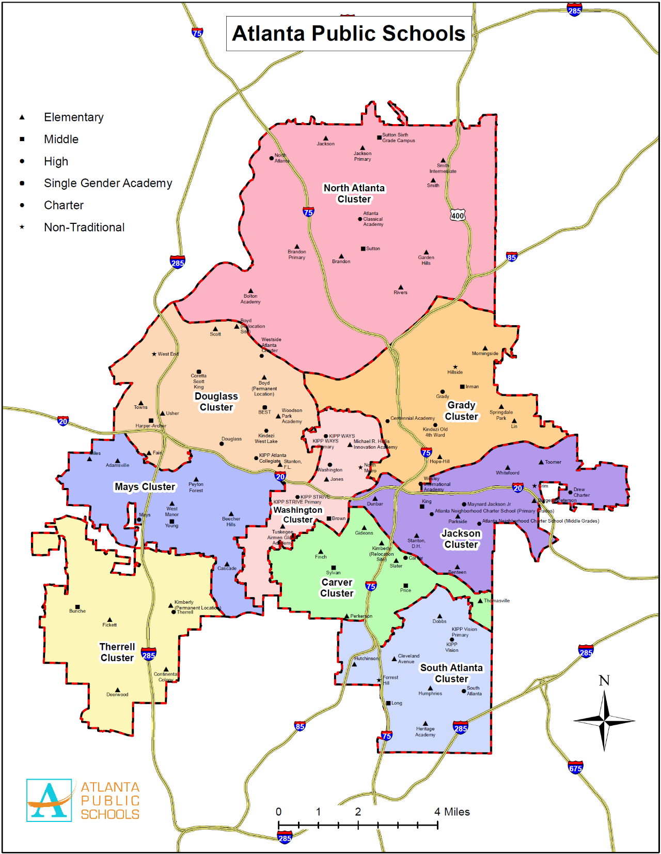

Slide 38
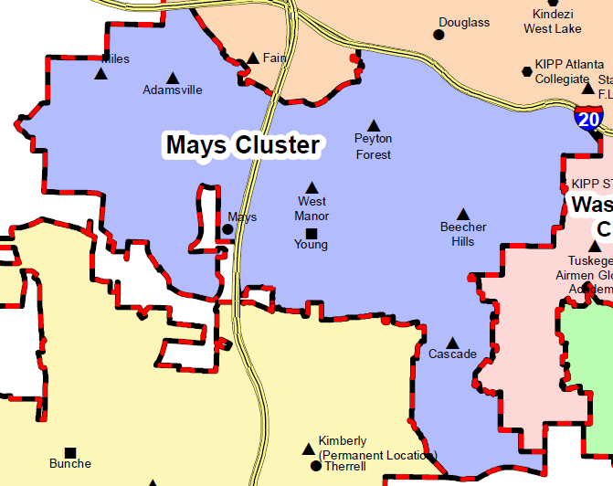
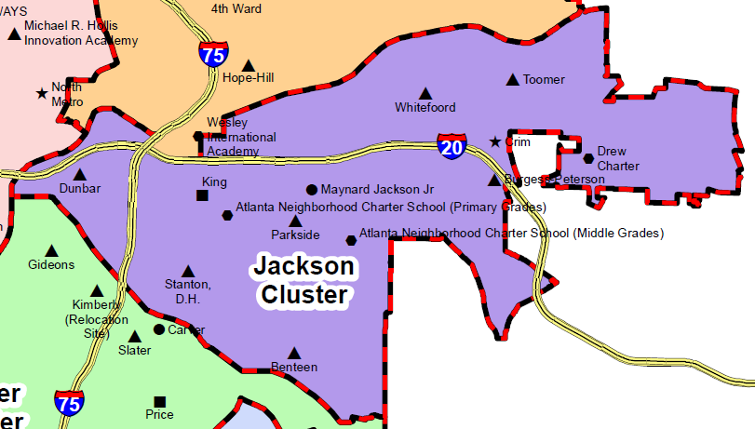
Atlanta Public Schools IB Clusters
PYP
PYP
PYP
MYP PYP
PYP
PYP
DP CP MYP
PYP
CP
PYP
MYP
MYP
PYP
MYP
PYP
PYP
Note: Scales adjusted for fit
Key: Authorized; Candidate

Slide 39
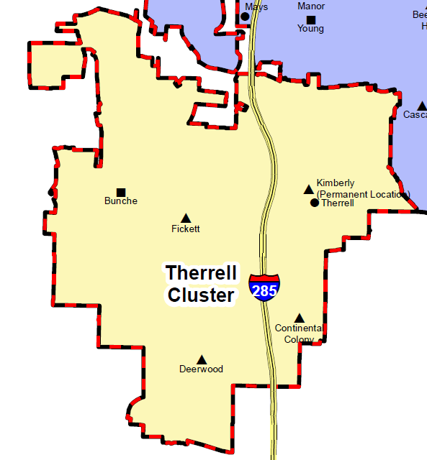
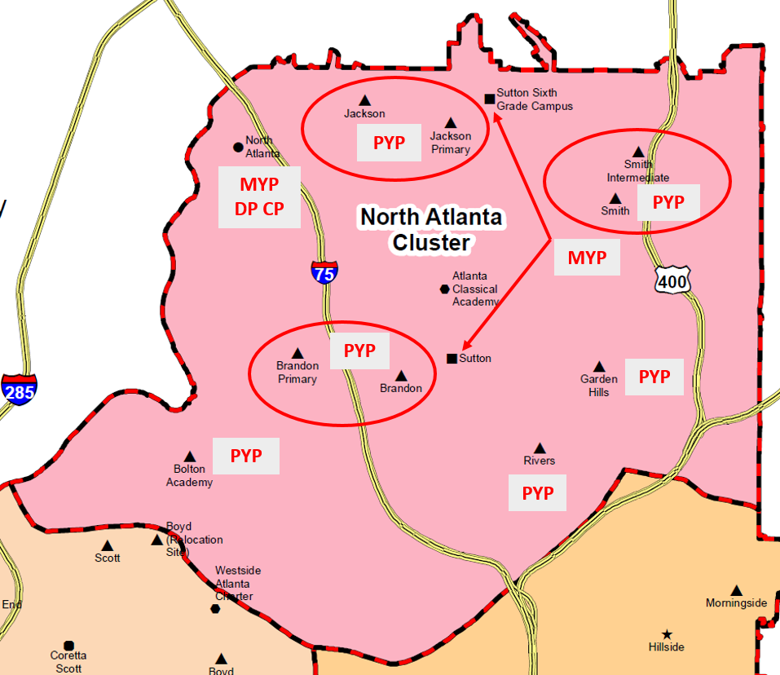
Atlanta Public Schools IB Clusters
PYP
MYP
MYP CP
PYP
PYP
Note: Scales adjusted for fit
Key: Authorized; Candidate

Slide 40
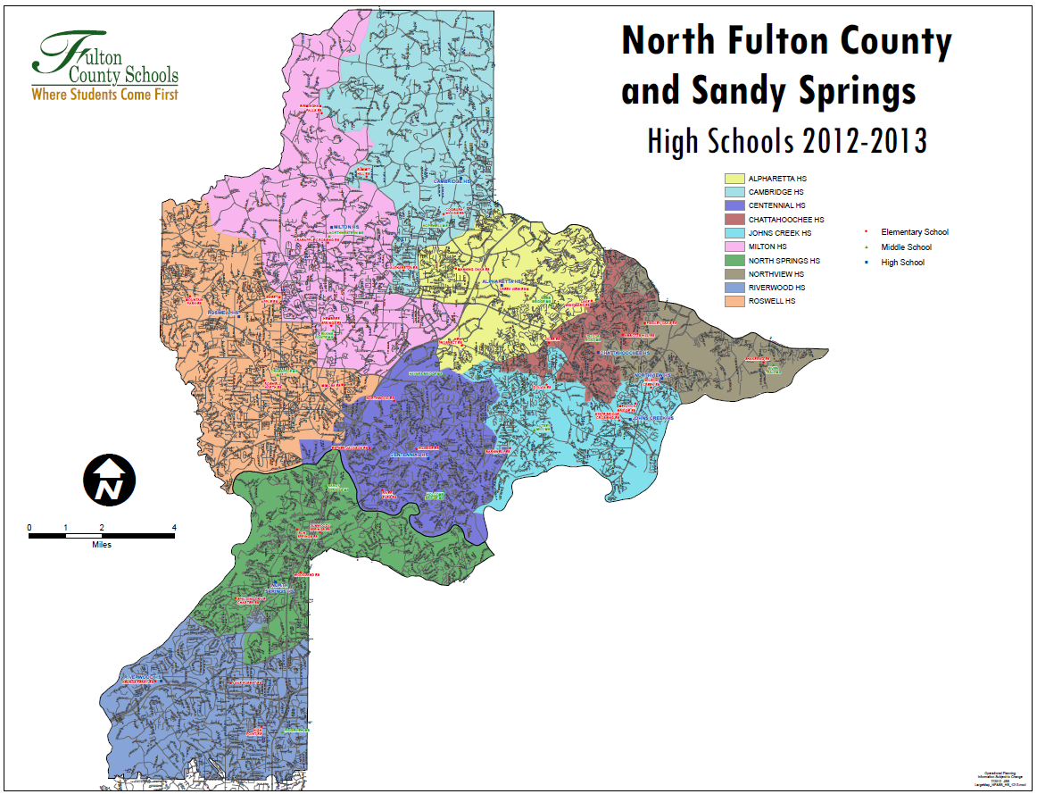
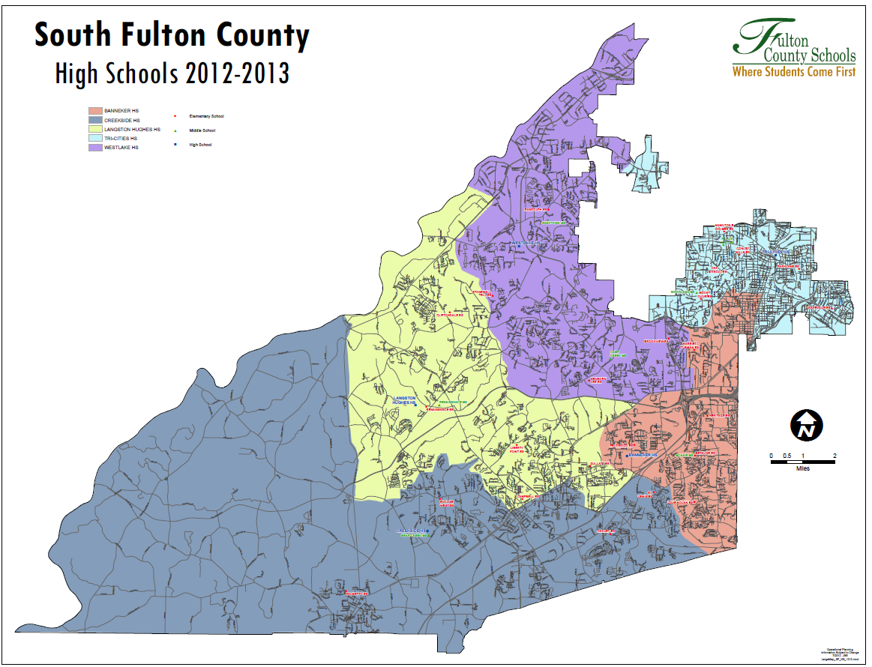
Fulton County IB Clusters

Slide 41
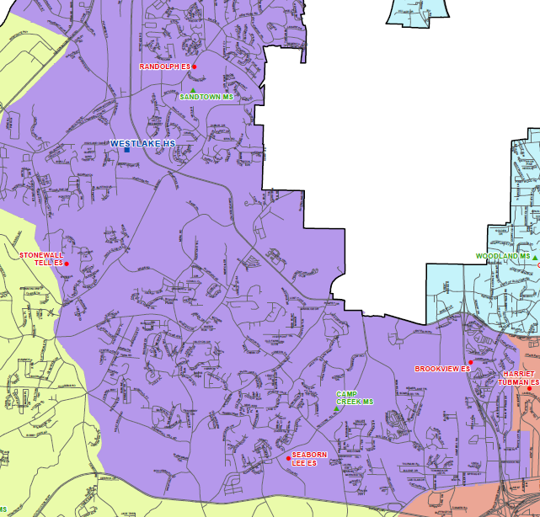
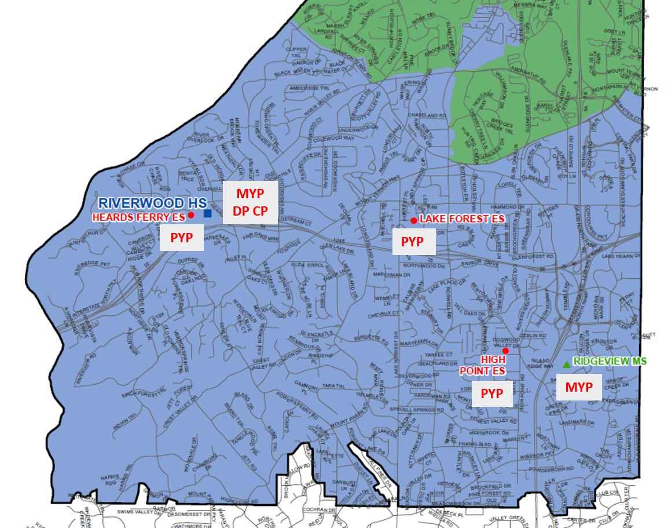
Fulton County IB Clusters
PYP
Riverwood HS Cluster
Westlake HS Cluster
MYP DP
PYP
Note: Scales adjusted for fit
Key: Authorized; Candidate

Slide 42
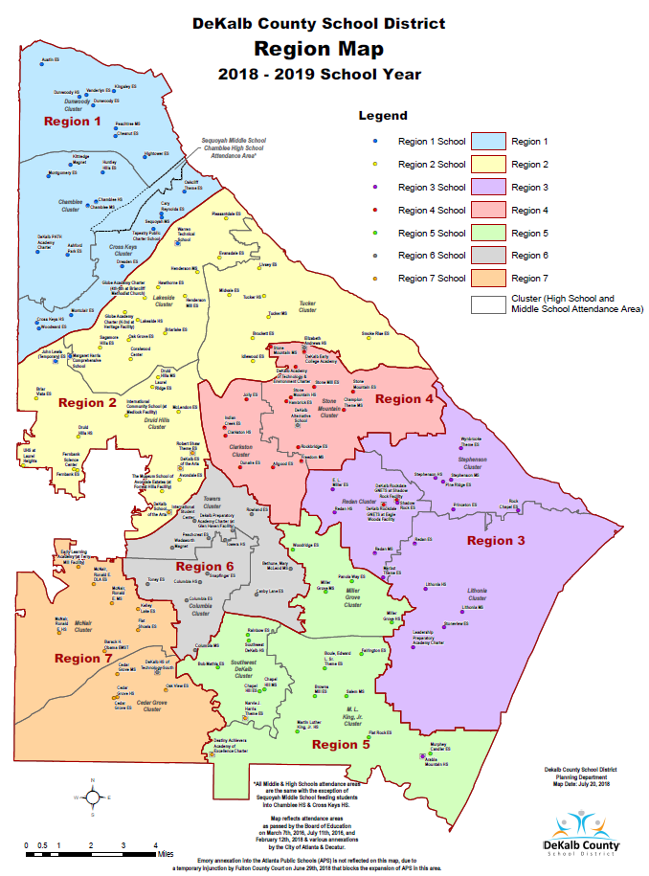

Slide 43
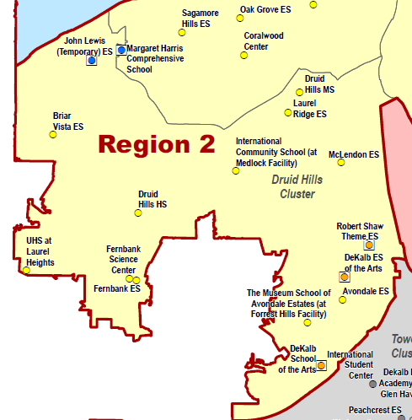
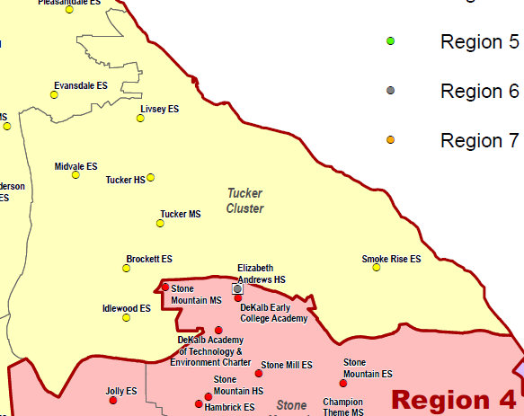
DeKalb County IB Clusters
Tucker HS Cluster
MYP
PYP
DP
DP
PYP
MYP
PYP
PYP
Druid Hills HS Cluster
Note: Scales adjusted for fit
Key: Authorized; Candidate

Slide 44
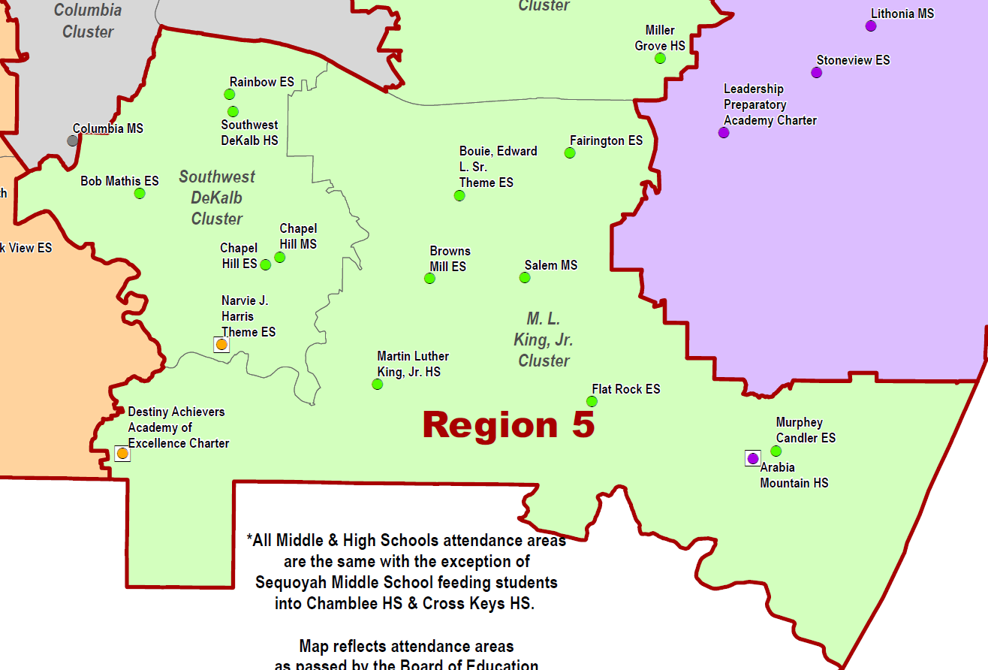
DeKalb County IB Clusters
MYP
DP
Martin Luther King, Jr. HS
Cluster
Key: Authorized; Candidate

Slide 45
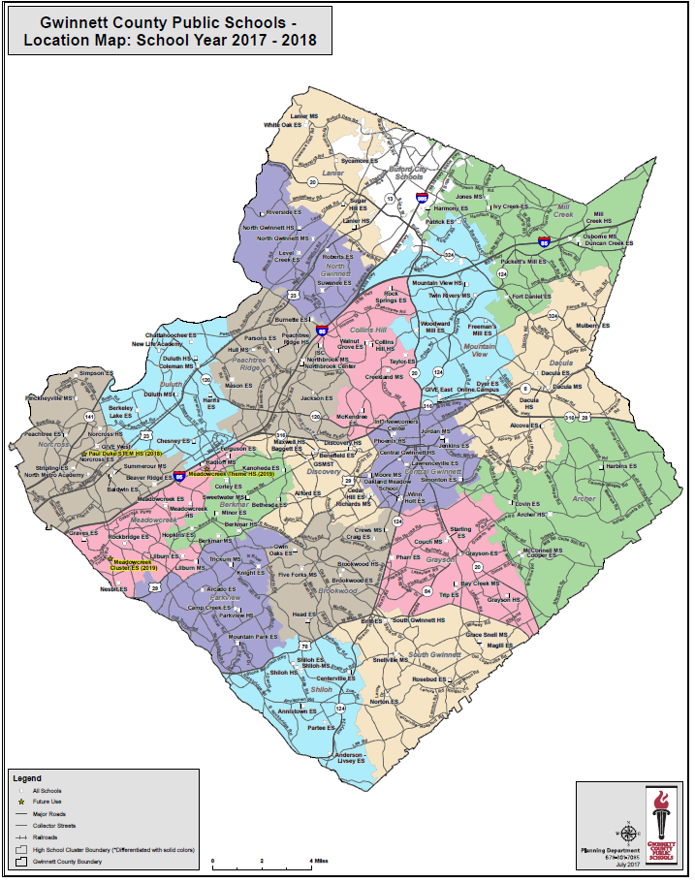

Slide 46
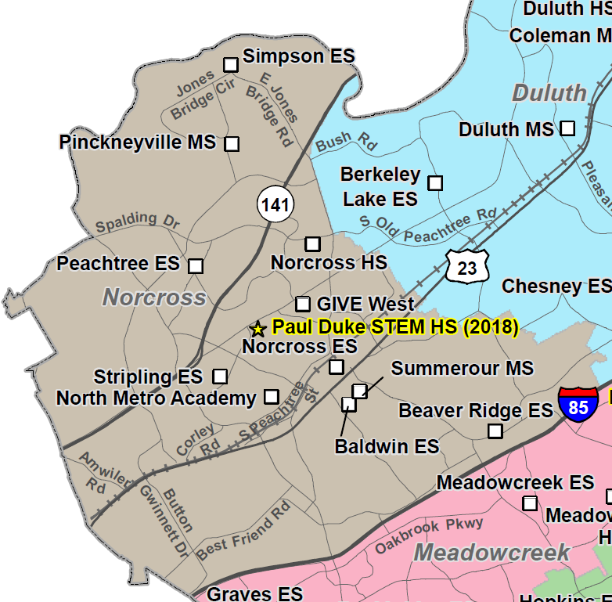
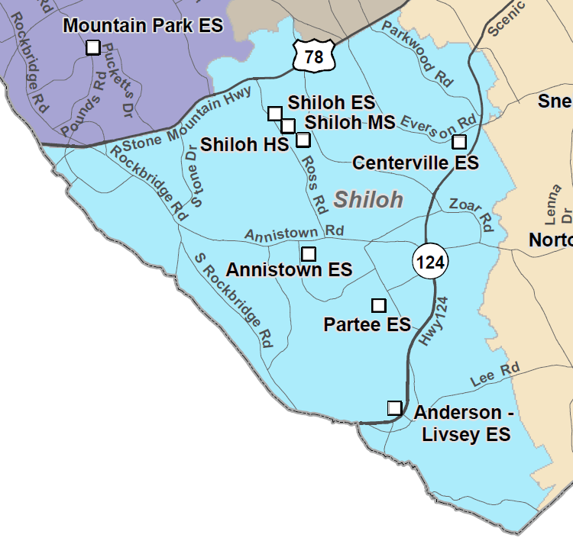
Gwinnett County IB Clusters
Norcross HS Cluster
MYP
MYP
DP
PYP
DP
MYP
Shiloh HS Cluster
Note: Scales adjusted for fit
Key: Authorized; Candidate

Slide 47
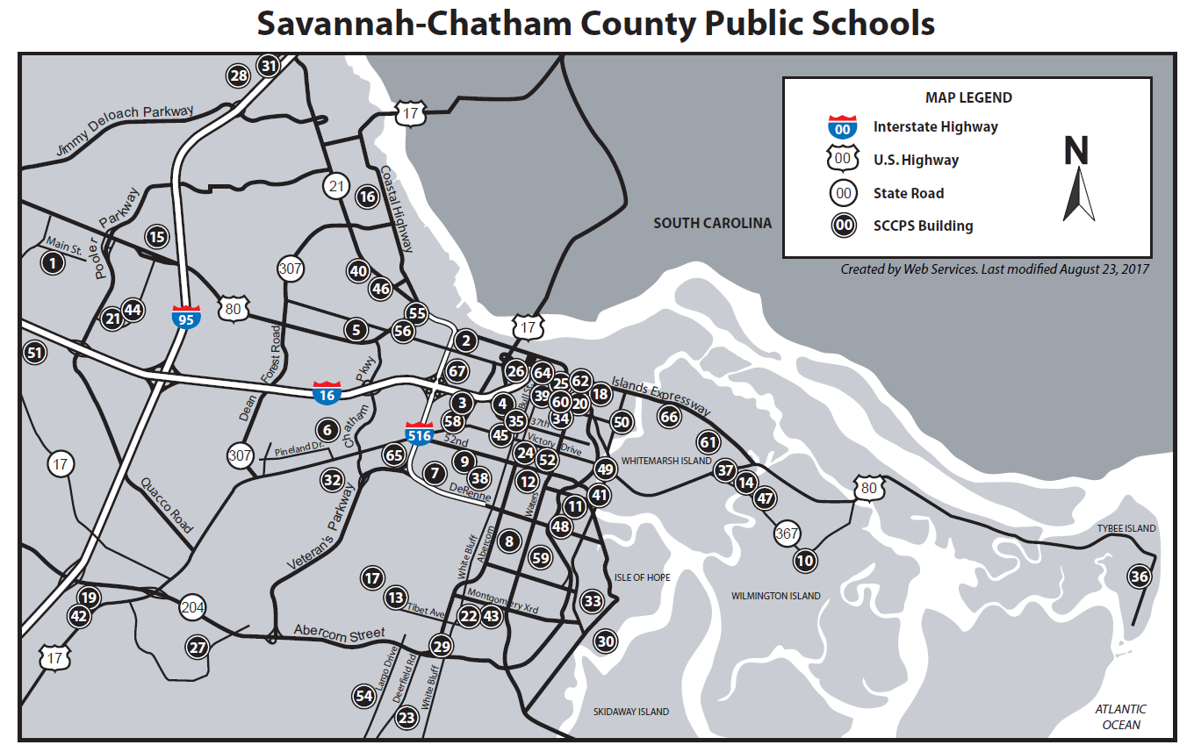

Slide 48
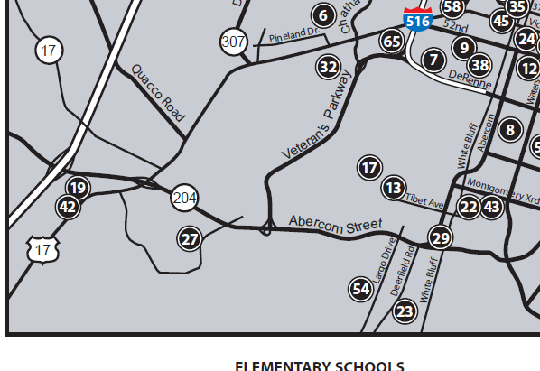
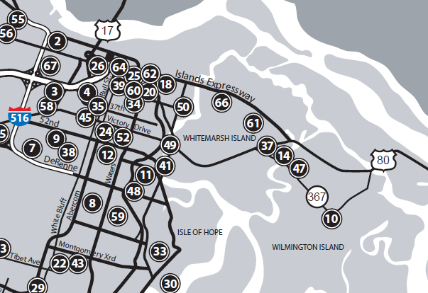
Savannah-Chatham County IB Clusters
Windsor Forest HS Cluster
Sol C Johnson HS Cluster
MYP
PYP
PYP
MYP DP CP
MYP
MYP DP CP
13. Largo-Tibet Elementary School
42. Southwest Middle School
54. Windsor Forest High School
14. Marshpoint Elementary School
37. Coastal Middle School
49. Sol C. Johnson High School
Note: Scales adjusted for fit
Key: Authorized; Candidate

Slide 49
IB in Georgia: Stand-Alone Programs

Slide 50
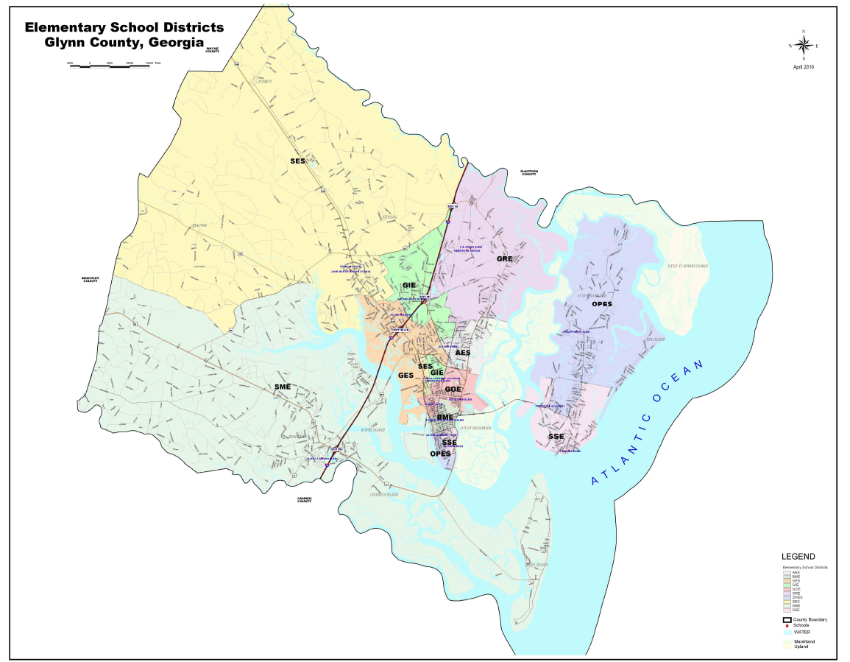
Greer Elementary
(Only IB Program out of 16 schools)
PYP

Slide 51
Thank You!!

