Slide 1
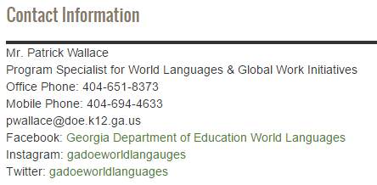
Richard Woods, Georgia’s School Superintendent
“Educating Georgia’s Future”
gadoe.org
Mr. Patrick Wallace
Program Specialist: World Languages &
Global Workforce Initiatives
pwallace@doe.k12.ga.us
Facebook: Georgia Department of Education World Languages
Instagram: gadoeworldlanguages
Twitter: gadoeworldlang
Dual Language Immersion in Georgia

Slide 2
Dual Language Immersion
Intensive early language learning that is transforming proficiency!
A common sense approach with revolutionary results!
What if there was a program that…...
Improved academic performance for all participating students.
Created bilingual and biliterate students before graduation.
Improved proficiency and literacy in English for all students.
Promoted intercultural competency in the community and the workforce.
Improved the cognitive ability of students.
Provided students a competitive advantage in the world.
Provided long term cognitive benefits to students beyond graduation.
Closed the achievement gap for struggling systems/students.
Created opportunities for students beyond our shores.
Attracted international investment and skilled workers to our communities.
Connected to all disciplines and all levels and supported learning in them.
Created a positive attitude about learning and contributed to a positive school climate.
Did all of the above at very low cost and required no additional personnel…..
Dual Language Immersion in Georgia

Slide 3
Goals of this Webinar
To give you an overview of the World Language Landscape here in Georgia so that you can understand the context of how Dual Language Immersion fits into the broader developments.
2) To give you an explanation as to How Dual Language Immersion Programs began in Georgia and an update on where they are now.
3) To explain to you the basic Georgia model for Dual Language Immersion Programs in Georgia.
4) To explain what the research is showing us about Dual Language Immersion Models and the benefits they provide.
5) To explain about this year’s Georgia’s Dual Language Immersion Institute – GADII - the premier Dual Language Immersion Conference in Georgia.
6) To explain the challenges with such programs and to lay out our plans to begin to provide solutions to those challenges.

Slide 4
Framework for Developing Global and Cultural Competencies to Advance Equity, Excellence and Economic Competitiveness
From
Careers
To
Early Learning
Globally and Culturally Competent Individuals
Proficient in at least two languages;
Aware of differences that exist between cultures, open to diverse perspectives, and appreciative of insight gained through open cultural exchange;
Critical and creative thinkers, who can apply understanding of diverse cultures, beliefs, economies, technology and forms of government in order to work effectively in cross-cultural settings to address societal , environmental or entrepreneurial challenges;
Able to operate at a professional level in intercultural and international contexts and to continue to develop new skills and harness technology to support continued growth.
 | Early Learning | Elementary | Secondary | Postsecondary
Collaboration and Communication | Emerging socio-emotional skill-building—focus on empathy, cooperation, and problem solving | Progressive socio-emotional skill-building—focus on empathy, perspective taking and conflict management | Strong socio-emotional and leadership skills—emphasis on multi-cultural understanding and working with diverse groups | Advanced socio-emotional and leadership skills , ability to effectively collaborate and communicate with people in cross- cultural settings
World and Heritage Languages | Developing language skills in English and other languages | Basic proficiency in at least one other language | Proficiency in at least one other language | Advanced proficiency —ability to work or study in at least one other language
Diverse Perspectives | Emerging global awareness through exposure to diverse cultures, histories, languages and perspectives | Deepening global awareness through continued exposure to diverse cultures, histories, languages and perspectives. | Deepening local and global knowledge and understanding, including through classes, projects, study abroad and virtual exchange | Highly developed ability to analyze and reflect on issues from diverse perspectives
Civic and Global Engagement | Growing awareness of community and institutions | Age-appropriate civic engagement and learning | Demonstrated ability to engage in key civic and global issues | Demonstrated ability for meaningful engagement in a wide range of civic and global issues and to be successful in one’s own discipline/specialty in a global context
Foundation of Discipline-Specific
Knowledge and Understanding
January 2017
Source: USDOE

Slide 5
Richard Woods, Georgia’s School Superintendent
“Educating Georgia’s Future”
gadoe.org
Biliteracy Seal
22 states have passed a Seal of Biliteracy.
Rationale:
Help students realize that being biliterate is an asset!
Improve earnings potential for students.
Connect businesses with bilingual employees.
Promote World Language study/interest
Promotes higher academic achievement/participation in IB/AP.
Signal to University system of advanced language learners.

Slide 6
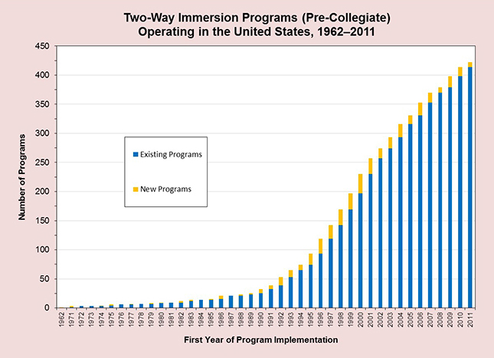
Source: Center for Applied Linguistics, “Growth of TWI Programs, 1962–Present,”

Slide 7
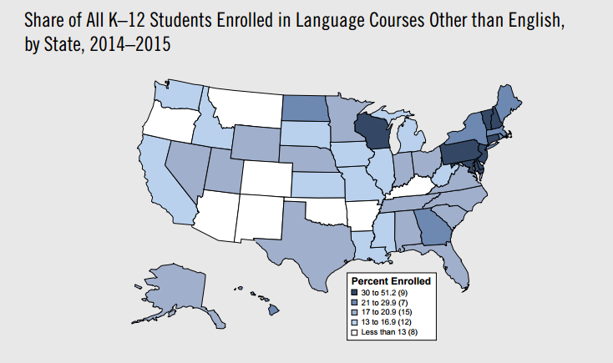
Source: American Academy of Arts and Sciences -The State of Languages in the US 2016

Slide 8
Richard Woods, Georgia’s School Superintendent
“Educating Georgia’s Future”
gadoe.org
World Languages – A critical Need
Total: 524,504
Total Student Population: 1,736,416
Percentage: 30.21%
Students taking an AP WL exam (2013): 3671
Percentage: 0.93% of all WL students in GA (2013)
Source: GaDoE Data and CollegeBoard 2015

Slide 9
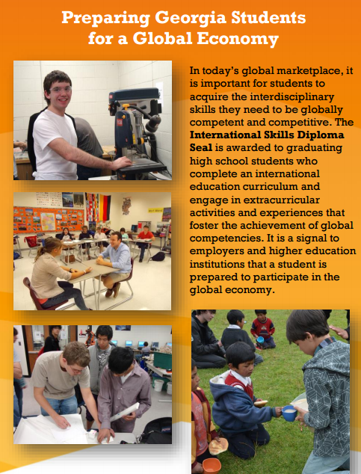
Richard Woods, Georgia’s School Superintendent
“Educating Georgia’s Future”
gadoe.org
The International Skills Diploma Seal

Slide 10
Richard Woods, Georgia’s School Superintendent
“Educating Georgia’s Future”
gadoe.org
Business & World Language Education
Making the connection: How do World Languages fit into Workforce Readiness?
Why Georgia needs a global perspective on
Educating the Workforce of Tomorrow!

Slide 11
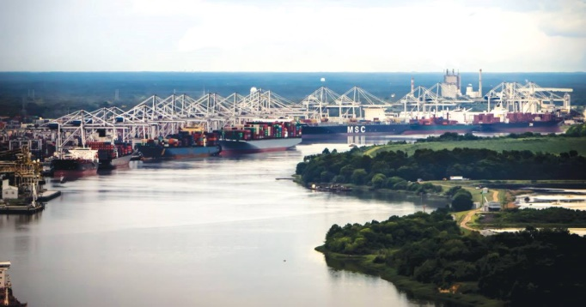
Why Georgia needs a global perspective on
Educating the Workforce of Tomorrow!
If I’m selling to you, I speak your language. If I’m buying, dann müssen Sie Deutsch sprechen! – Willy Brandt
World Language and Cultural Competency is the Competitive Advantage!
Language/Culture Gap
Developing Global Competency
Skills Gap
Developing Workforce Competency
Developing Proficiency in Language Capability!
Developing Cultural Competency!
Developing new markets and enhancing outreach to existing markets!
Developing International Collaboration/Problem solving, Management skills!
Developing Workforce Training models that meet the local and international needs of industry!
Expanding apprenticeships and internship capacity!
Creating greater connectivity and synergy between Workforce partners!
Port of Savannah

Slide 12
World Languages in the Elementary School
FLEX (Foreign Language Exploratory)
FLES (Foreign Language in the Elementary School)
DLI (Dual Language Immersion)

Slide 13
Richard Woods, Georgia’s School Superintendent
“Educating Georgia’s Future”
gadoe.org
Target Goals of Dual Language Immersion
Proficiency in English
Proficiency in a new language
Academic achievement
Intercultural competence

Slide 14
Richard Woods, Georgia’s School Superintendent
“Educating Georgia’s Future”
gadoe.org
Dual Language Immersion Programs
A brief History of DLI Programs in Georgia.
2007 – First DLI Charter School in Georgia is established at Unidos Dual Language School in Clayton County (Charter – now magnet school)
2008 – First non charter public DLI program is established at Beulah ES in Douglas County
- World Language Academy starts in Hall County Georgia (Charter)
2013-2014 = 6 schools
2015- = 19 schools
2016-2017 = 37+ schools
2017-2018 = Increase is certain (How many…???)

Slide 15
Current DLI Programs
Atlanta Public Schools
Bolton Academy ES-Spanish (K)
E Rivers ES-Spanish (K-1)
Garden Hills ES-Spanish (K-1)
Morris Brandon ES-Spanish (K)
Perkerson ES-Spanish (K-3)
Sarah Smith ES - Spanish (K)​
Clarke County
Oglethorpe Avenue ES-Spanish (PreK-K)​
Clayton County
Unidos Magnet School-Spanish (PK-8)​
​Cobb County
Clarkdale ES-Spanish (K)
Dowell ES-Spanish (K)
Fair Oaks ES-Spanish (K)
Hollydale ES-Spanish (K)
Mableton ES-Spanish (K)
Nickajack ES-Spanish (K)
Norton Park ES-Spanish (K)
Riverside Primary-Spanish (K-1)
Russell ES-Spanish (K)
Smyrna ES-Spanish (K-1)​
Dalton Public Schools
Brookwood ES-German (K)​
DeKalb County
Ashford Park ES-German (K-3)
Barack H. Obama Elementary Magnet School of Technology​-Spanish (K)
Evansdale ES-French (K-3)
The GLOBE Academy Charter School - Chinese, French, Spanish (K-8)​
Rockbridge ES-French (K-3)​
Douglas County
Beulah ES-Spanish (K-5)​
Fulton County
International Charter School of Atlanta-Chinese, French, German, Spanish (K-5)
Oakley ES-Chinese (K-1)
Gwinnett County
Annistown ES-Spanish (K-2)
Baldwin ES-Spanish (K)
Bethesda ES-Spanish (K-2)
Camp Creek ES-Spanish (K)
Ivy Creek ES-Spanish (K)
Trip ES-French (K-2)
Hall County
McEver Arts Academy Charter School-Spanish (PK -3)
White Sulphur Elementary – Spanish (PK – K)
World Languages Academy Charter School-Spanish (PK-8)
Henry County
Dutchtown ES-Chinese (K-3)
Rockdale County
C.J. Hicks ES-Spanish (K)

Slide 16
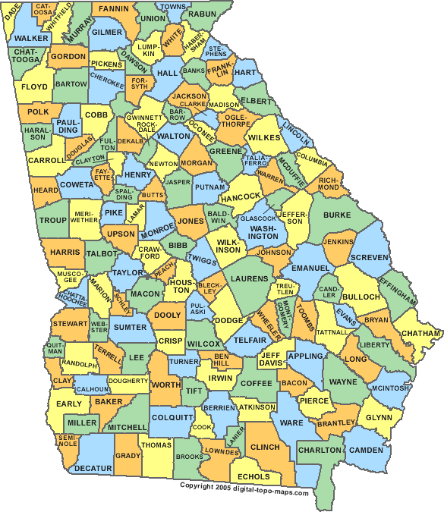
The Georgia Model
50/50
each child =
1 immersion language teacher + 1 English partner teacher
separation of languages

Slide 17
What is DLI?
A form of education in which students are taught literacy and content in two languages.
Two Way | One Way
Two language groups being schooled through their two languages. | One language group being schooled through two languages.

Slide 18
DLI as an ESOL Delivery Model
Rule 160-4-5-.02 (effective August 6, 2015)
(vi) A dual language immersion model – students participating in a dual language immersion program receive their supplemental English language support from the teacher providing instruction during the English portion of the academic day.

Slide 19
Research on DLI
Thomas, W. & Collier, V. (2012). Dual Language Education for a Transformed World.

Slide 20
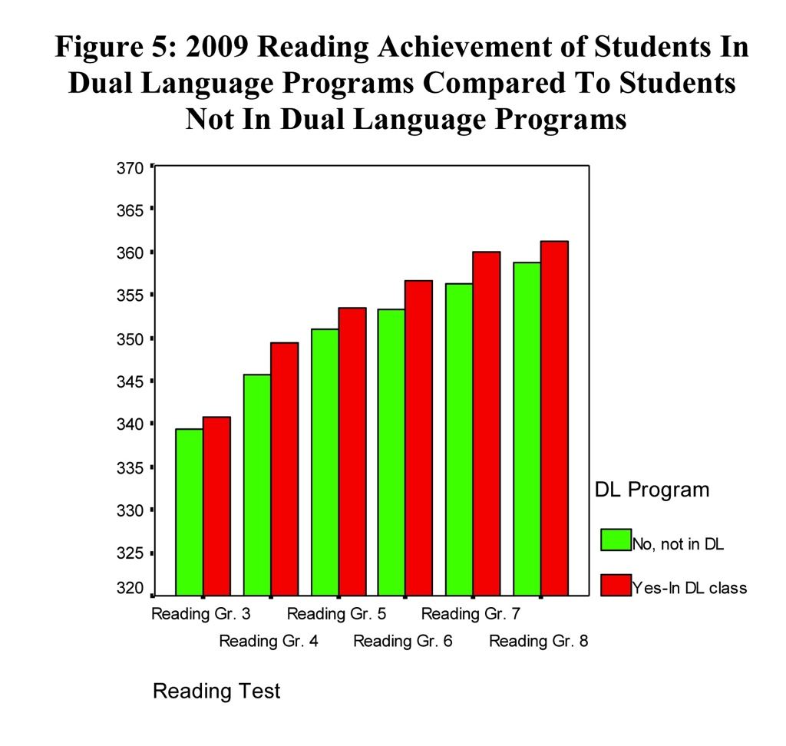

Slide 21
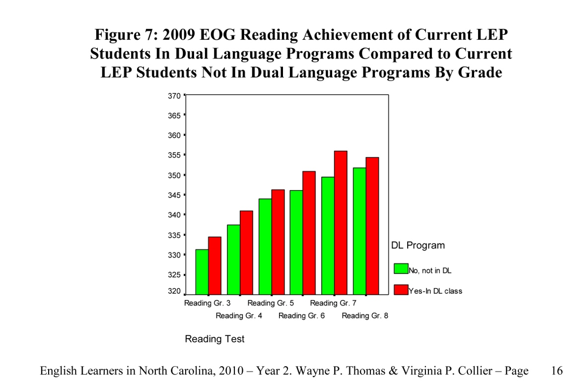

Slide 22
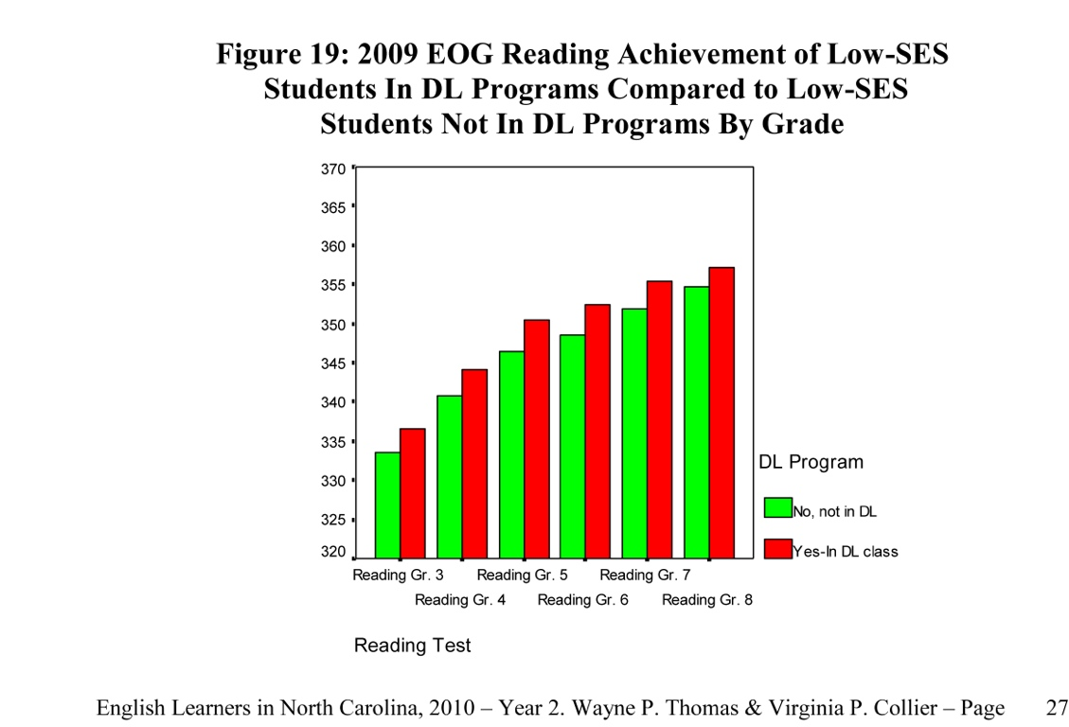

Slide 23
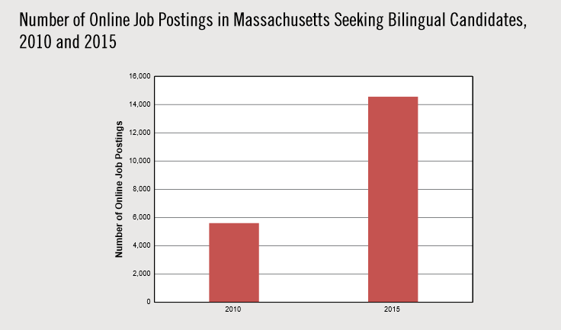
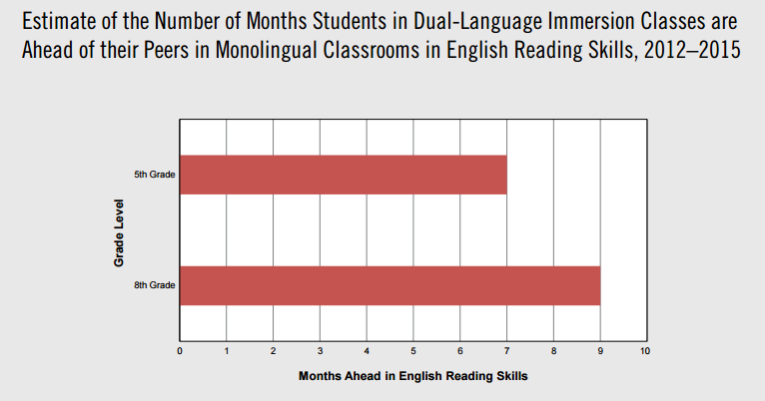
Source: American Academy of Arts and Sciences -The State of Languages in the US 2016

Slide 24
Improved Academic Performance
Immersion students perform as well as or better than non-immersion students on standardized tests of language arts and mathematics, even when these tests are administered in English.
Notes:
Immersion students perform as well as or better than non-immersion students on standardized tests of language arts and mathematics, even when these tests are administered in English.

Slide 25
Enhanced Cognitive Skills
Due to the demands of processing two languages, dual immersion students typically:
Develop greater cognitive flexibility;
Demonstrate increased attention control, better memory, and superior problem solving skills; and
Experience enhanced understanding of their primary language.

Slide 26
Closing or Narrowing of the Achievement Gap
Partially as a result of the cognitive demands placed on students who learn content in two different languages, no other intervention model holds greater promise to narrow the achievement gap more effectively between high and low performing populations than language immersion.

Slide 27
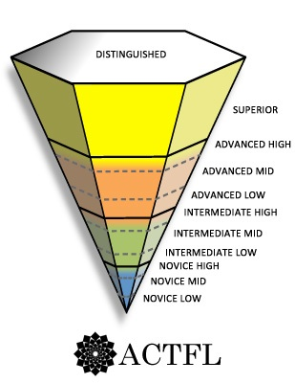
Higher Second Language Proficiency
Biliteracy

Slide 28
Enhanced Global Citizenship
Immersion students are better prepared to collaborate and communicate across linguistic and political boundaries to solve problems as a result of the demands of their learning environments, and they evidence more positive attitudes toward other peoples and other cultures.

Slide 29
Richard Woods, Georgia’s School Superintendent
“Educating Georgia’s Future”
gadoe.org
Benefits of Dual Language Immersion
Second Language Skills: DLI students achieve higher proficiency in the second language than with traditional Foreign Language instruction.
Cognitive Skills: DLI students typically develop greater cognitive flexibility, demonstrating increased attention and memory, superior problem-solving skills as well as an enhanced understanding of their primary language.
Performance on Standardized Tests: DLI students perform as well as or better than English-only students on standardized tests in English, including students from a range of socioeconomic and ethnic backgrounds, as well as with diverse cognitive and linguistic abilities.
Intercultural Competency: DLI students are more aware of and generally show more positive attitudes towards other cultures and an appreciation of other people.
Long-Term Benefits: DLI students are better prepared for the global community and job markets in the 21st century.
Higher Attendance-Rates and Fewer Drop-Outs: Students from DLI programs have higher attendance rates and lower drop-out rates compared to regular programs.

Slide 30
Register to attend the conference by following this link.

Slide 31
Call for Proposals
Deadline for Submissions: April 28, 2017
The Georgia Department of Education, World Languages is soliciting proposals for the 2017 Georgia Dual Language Immersion Institute to be held July 11-13, 2017 at the Atlanta International School and co-hosted by Garden Hills Elementary School. This is an opportunity to share effective models, practices, research and information to provide your colleagues with insights that address the many needs of Dual Language Immersion.
Submission deadline is Friday, April 28, 2017.
The annual Georgia Dual Language Immersion Institute is an interactive experience designed for educators serving students in grades K - 12. With nearly 200 participants registered last year and growing, this conference is the premiere event for developing greater knowledge and skill in working to strengthen achievement for Dual Language Immersion Students in Georgia. This year’s conference will provide professional learning opportunities for new teachers, experienced DLI teachers, administrators and higher education professionals. We are looking for workshops that are specifically targeting ONE of these audiences. You can submit a proposal here.

Slide 32
GADII – focusing on four areas
New Dual Language Immersion Teachers – Classroom management techniques, establishing routines, classroom set up, centers, resources, assigning homework, communicating with parents
Experienced Dual Language Immersion Teachers – Scaffolding Language for Content and materials, collaborating with the English Partner Teacher and/or: effective collaboration between DLI teacher and parapro, collaborative projects, thematic learning, developing social and academic language, oral and written production
Administrators – Recruitment, collaboration and planning, struggling students, difficult conversations with parents
Higher Education – Hands-on teacher education initiatives, Dual Language Immersion Endorsement Programs, connections between schools and academia, lessons learned from former teachers, supporting and educating new DLI teachers and programs

Slide 33
Challenges
1) Teachers – Finding staffing that has the required training and proficiency.
Solutions:
1) Raising awareness to the statewide critical need for WL teachers
2) Working with in-state partners to develop programs to fill that need.
3) Creating opportunities for systems and potential teachers to meet.
4) Support development of Dual Language Immersion Endorsement Programs.
5) Creating State Teacher Recruitment page and State WL Teacher Job fair
6) Promote reciprocity agreements
2) Training & Support – DLI program teachers have an increased work load and need support and training to prevent burnout.
Solutions:
1) Increased Professional Development offerings for DLI (Admin/Teach)
2) Expansion of GADII – Focus on 4 key areas.
3) Creating a webinar/video library for DLI Teachers & Administrators
4) Creating collaboration opportunities in the schools, districts and online.
5) Identifying and developing teacher and Administrative DLI Leaders.
6) Identifying materials that can be used effectively in the DLI programs
7) Recognizing our teachers for the work they do!

Slide 34
Challenges
3) Communication – Informing Stakeholders about DLI and what to expect.
Solutions:
1) Creating a webinar series on DLI to explain what it is and how it works.
2) Reaching out to District Leaders as requested to explain its key elements.
3) Creating in-state structures to facilitate the dissemination of accurate information.
4) Identifying in-state/out of state DLI experts to assist.
5) Creating DLI Open-House days throughout the year.
4) Administrative Needs – Providing support and training for DLI Administration.
Solutions:
1) Professional Development Webinars specifically for DLI Administrators
2) Creating a DLI administrative support group for new DLI Admins.
3) Creating focused learning opportunities for DLI Admins. (DLI Administrative Visitation Program)
4) Recognizing our DLI Administrators and the work they do.

Slide 35
Richard Woods, Georgia’s School Superintendent
“Educating Georgia’s Future”
gadoe.org

