Slide 1
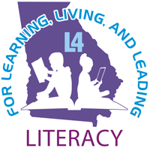
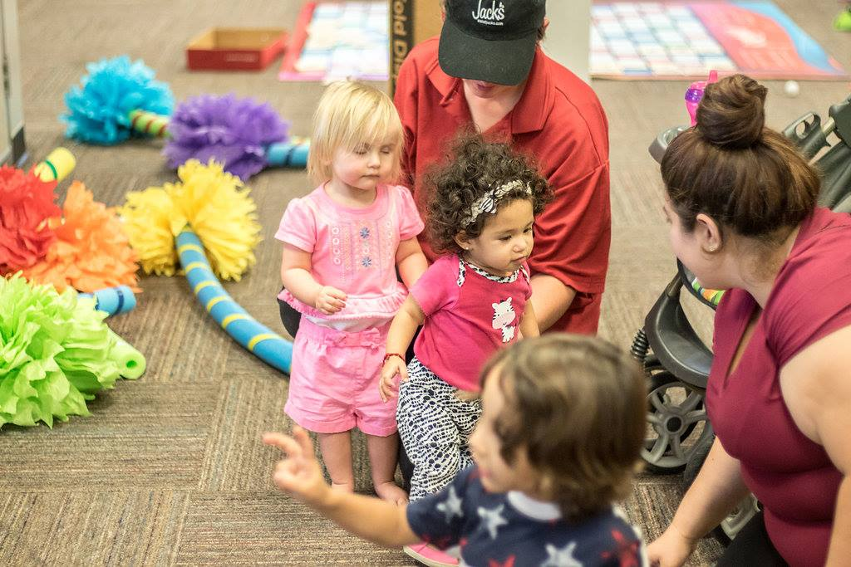
Literacy Focused Community Partnerships
Roberta P. Gardner, Ph.D. Assistant Professor Reading & Literacy Education
Kennesaw State University
Notes:
I am Roberta Gardner Assistant Professor of Reading and Literacy education at Kennesaw State University. I am here to talk about building sustainable literacy focused community partnerships.
I’m joined by two representatives from Whitfield County Georgia. Whitfield is a current L4 community and they will share explicit examples of community partnerships with aparticular focus on B-5, birth-8 efforts. Hoghead of Readers to Leaders. We also have Chris of Seimic at Georgia Tech. You may have already had correspondence with Chris and the team over at Georgia Tech and if you haven’t you will. Chris will share some key information about surveys and xxx

Slide 2
Roberta Price Gardner
Assistant Professor Reading & Literacy Education
rgardn21@Kennesaw.edu
Notes:
Stephanie Hogshead, child development and early learning coordinator Northwest Georgia Healthcare Partnership

Slide 3
Suzanne Harbin
Director of Early Learning Initiatives suzanne.harbin@communityfoundationnwga.org
Notes:
Some of you may remember Suzanne Harbin of the Community Foundation of Northwest Georgia from our Kick-Off held in Athens, Ga. This summer. Suzanne is the

Slide 4
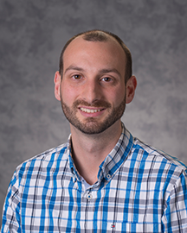
Christopher Cappelli
Research Associate
chris.cappelli@ceismc.gatech.edu

Slide 5
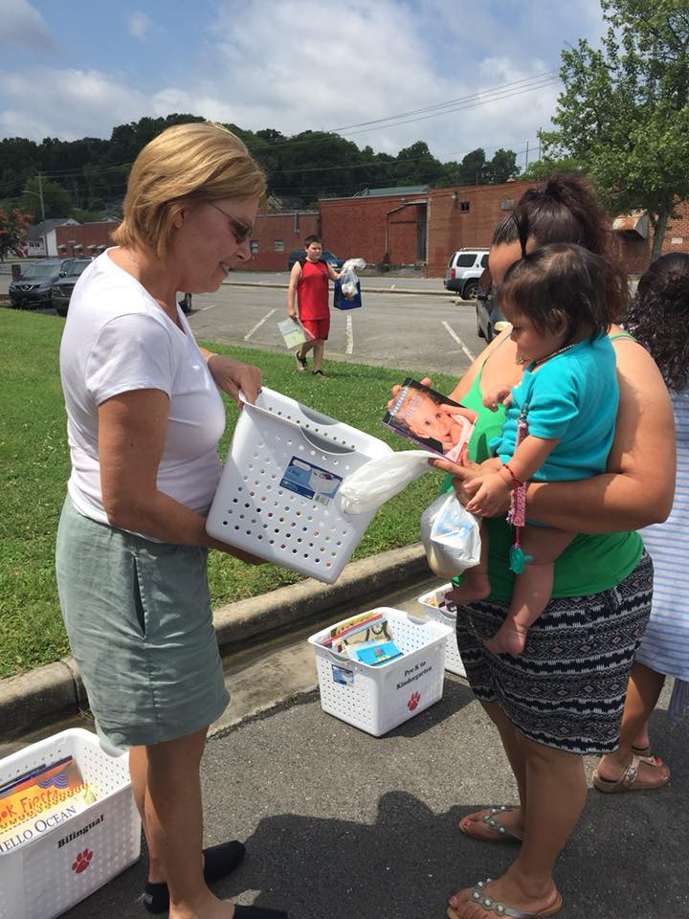
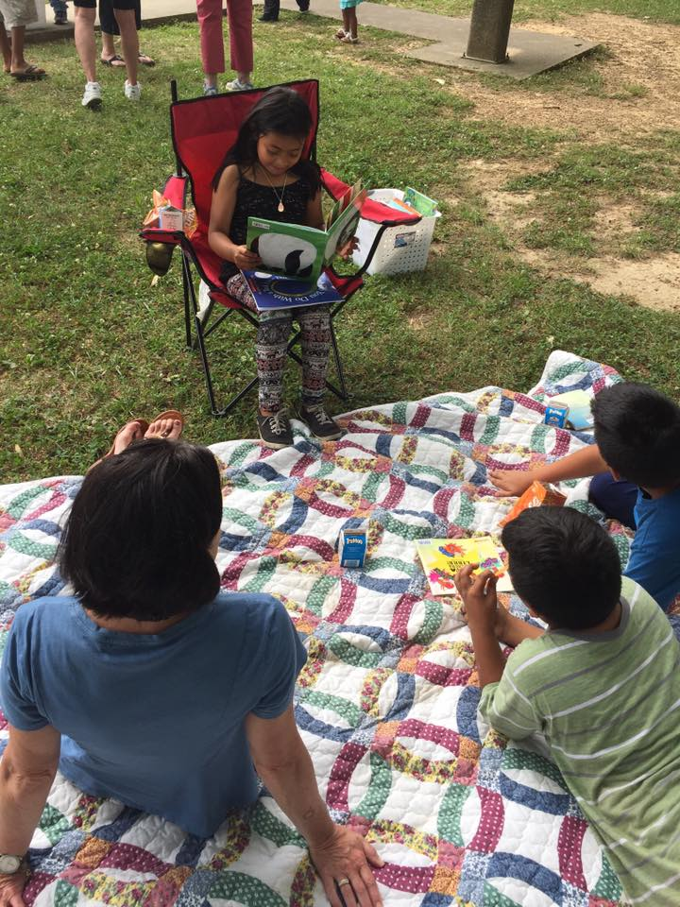
Literacy Focused Community Partnerships
Promising Practices
Family-school-community partnerships academic achievement (Sheldon 2003; Henderson, Mapp, Johnson, & Davies, 2007; Keehne,Waiʻaleʻale Sarsona, Kawakami & Au 2018).
Whitfield County- community of practice, partnership journey, concrete examples
Simplifying dimensions literacy focused community partnership
Notes:
Georgia helping to lead the way in this arena.
Much of the research on community partnerships xxx is scattered across various disciplines. Research has been done in health field and to some extent in education but that data xxx
The varied suggest the need for a more comprehensive theoretical framework to guide partnership development
As you think about your school and community partnerships consider how well your partnership aligns with enriching domains of literacy that you hope to improve .

Slide 6
Addressing the Literacy Needs of Your Community
Examining Your Vision
Aligning Goals
Implementing Strategies
Who has a seat at the table ?
Who is missing that needs to be there?
Examining power dynamics collecting data
and gaining feedback.
Notes:
Access to quality books is a common need across all districts, but perhaps developing a partnership with the library just isn’t enough because transportation is also a barrier. Or perhaps, access to bilingual books or other culturally relevant text? This will help you to determine who to partner with because not just any free book will do. Who do you need to build a relationship with or how can an existing relationship be enriched
Mutually beneficial

Slide 7
Anchor Institutions
Libraries
Health Agencies
P20 Institutions
Housing Agencies
Museums
Statewide Nonprofit Agencies
RESA’s

Slide 8
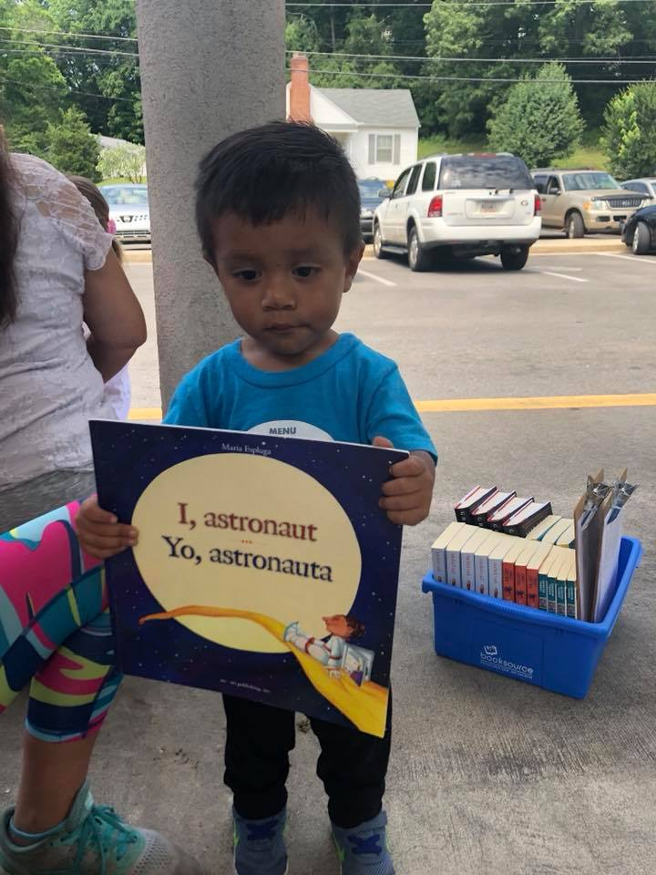
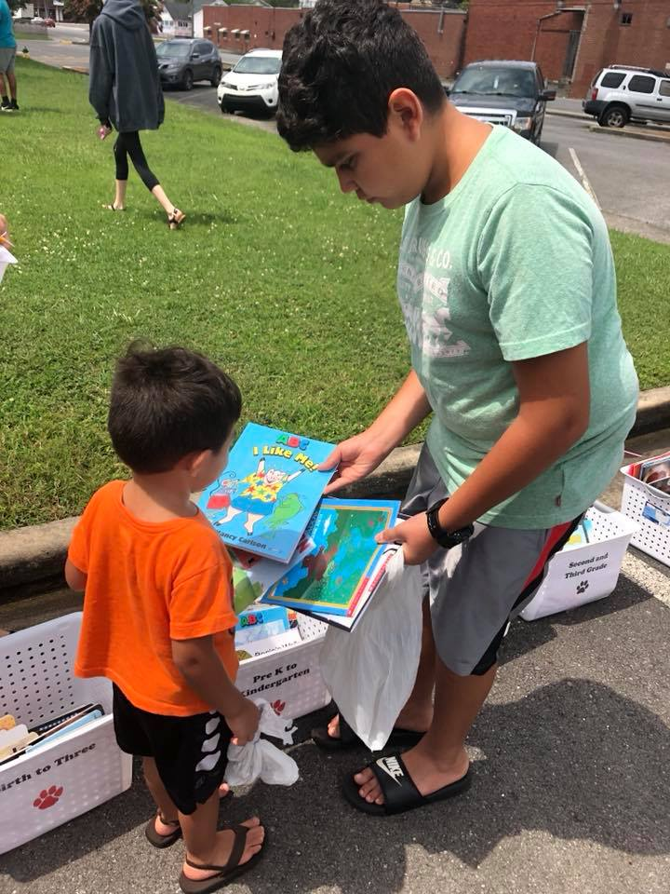
Partnership Alignment
What are the cultural dimensions of literacy that can be expanded through community partnerships?
How strong are the existing partnerships? What’s next?
What are some existing community events/relationships and how can partners collaborate to address goals for supporting literacy needs?
Finding the right fit…
Notes:
Access to quality books is a common need across all districts, but perhaps developing a partnership with the library just isn’t enough because transportation is also a barrier, or maybe the books aren’t culturally congruent.

Slide 9
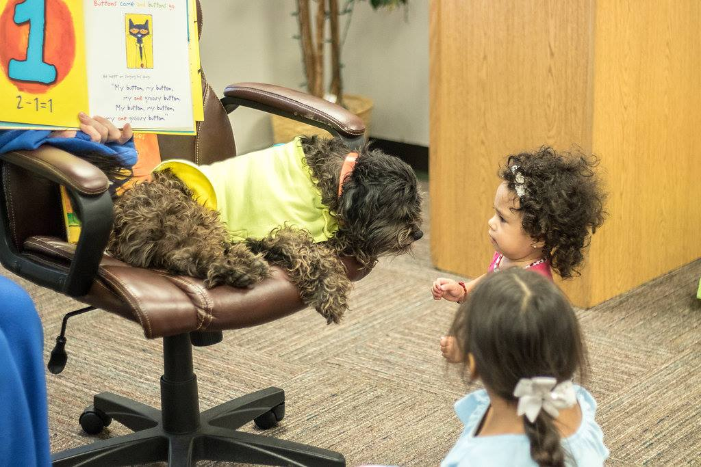
Birth-Eight
Development of B-5 Coalition
Birth-5 / Birth-8
Professional Development
Notes:
Suzanne-Director of Early Learning Initiatives

Slide 10
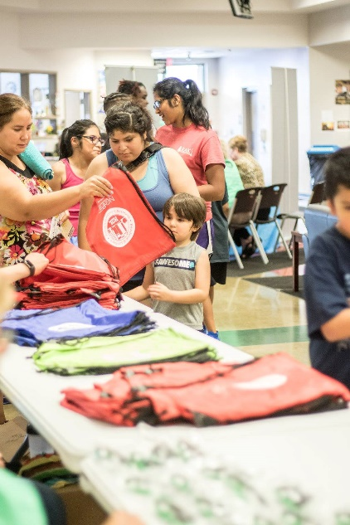
Family Engagement
Access
Engagement
Resources & Support

Slide 11
Community-Wide Literacy: Readers to Leaders
Linking healthcare to literacy
Annual Book Blast
Power Lunch Program Dalton State
Recipes for Success
MyON’s Free digital library.
Notes:
Child development and learning coordinator with the Northwest Georgia Healthcare Partnership
“It started as a fun, back-to-school event to encourage literacy and early literacy with children and families in our community,
Vendor booths from North Georgia EMC, WellCare Health Plans, Right from the Start Medicaid Outreach, Care Sources, Rice Family Chiropractic, Parents as Teachers, Northwest Georgia Regional Library System, Alliant Heath Plans and Chattanooga Allergy Clinic were set up in the gym, and storytelling groups were available as well.

Slide 12
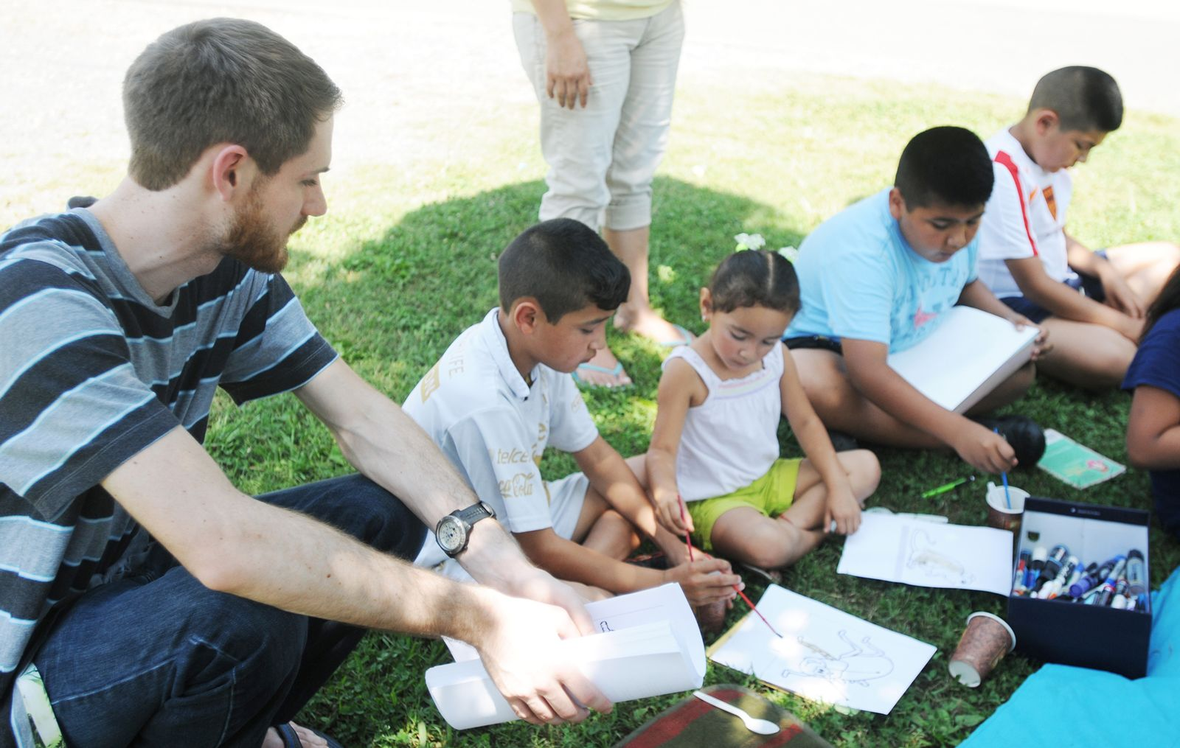
P20 Collaborative Partnership
Readers to Leaders adopted 3 Whitfield County School System sites as Power Lunch sites, where free age-appropriate books are distributed.
Power Lunches
Readers to Leaders.
“We invite the children to take a free book, read with us, and do activities with us that relate back to the book we’ve read.”
Notes:
Reading comprehension
Interactive projects
Moderate evidence based practices

Slide 13
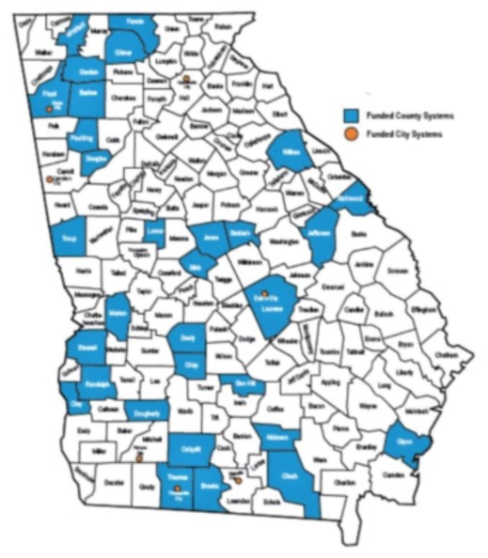
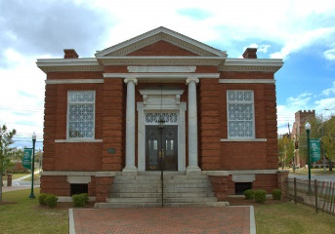
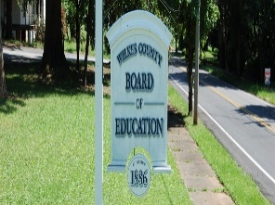
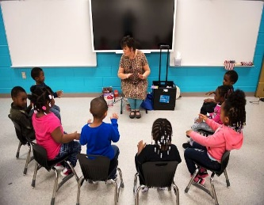
Statewide Networks Peers in other Districts
Dublin City-partnering with public housing developments to provide access to books and tutoring while diminishing transportation gap.
Wilkes coalition includes civic support with plans for enriching and expanding their afterschool program
Early Learning Center Rome . Preparation for 3 year olds operated by Berry College. South Rome Redevelopment Corporation, Rome city government, Rome City Schools, The Rome Rotary Club, the Seven Hills Rotary Club, Georgia Power, Berry College, Atlanta’s Purpose Built Communities and local businesses and community members.
Notes:
Rome’s early learning center includes Kindermus

Slide 14
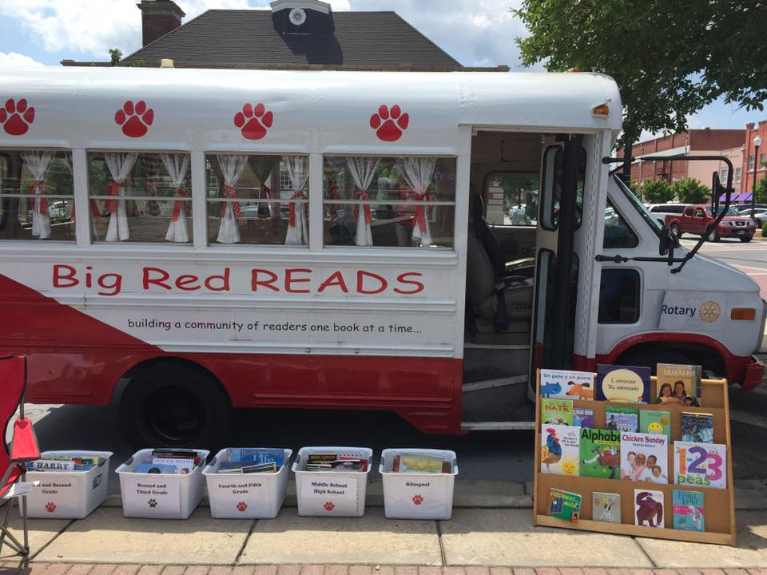
Literacy Focused Partnership Coalitions
Working with other organizations to develop new programs or bolster existing relationships
Leveraging available resources – public and private; federal, state, and local
Collaborative program of activities to support interventions
What opportunities exist for cross-sector partnerships?
What are the existing community events and how can partners collaborate to support literacy achievement?

Slide 15
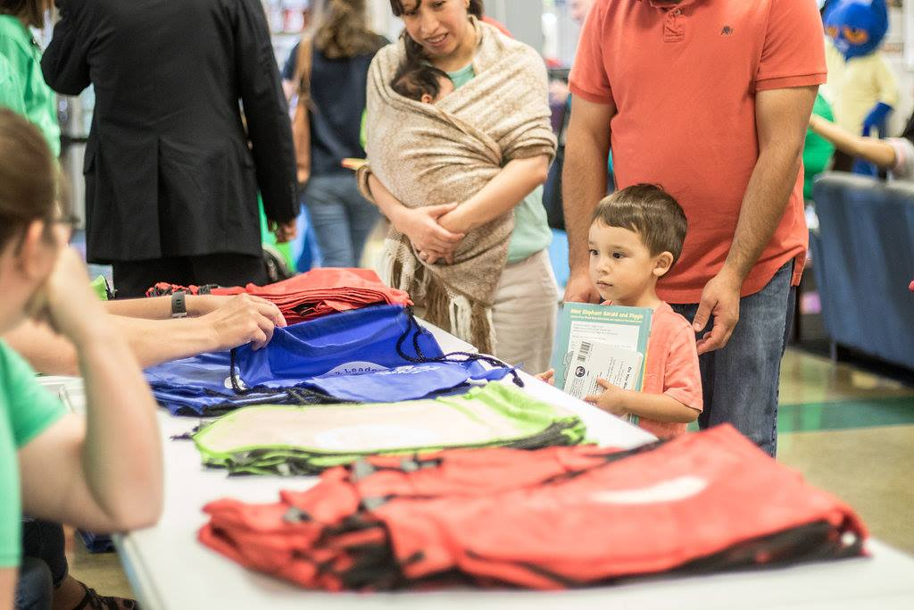
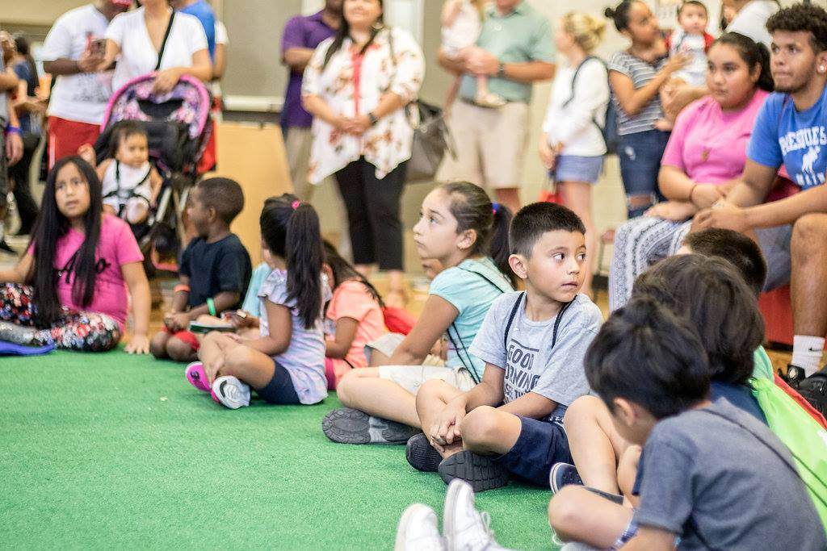
Core Community Partners
Assess, Collect, Connect
Assess relationships, purpose, structures, routines, and timelines
Connect cross-district partnerships
Collect local-level data
Notes:
Define and refine

Slide 16
Next Steps for L4GA
L4GA Partnership Networks
Dr. Lizanne DeStefano
Dr. Meltem Alemdar
Christopher Cappelli
Justina R. Jackson

Slide 17
Action Items
Check email from CEISMC team regarding updating your
Grant Personnel & Community Partner Contacts.
Look out for the Partnership Survey in late September.
Look out for an email from CEISMC team regarding a possible Site Visit in the Fall.

Slide 18
Questions ?

Slide 19
Thank You!
Roberta P. Gardner, Ph.D.
Assistant Professor Reading & Literacy Education
Kennesaw State University
rgardn21@Kennesaw.edu

