Slide 1
Session 4 Strategies for Supporting Students in Reading and Writing

Slide 2
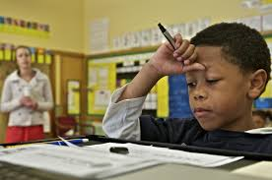
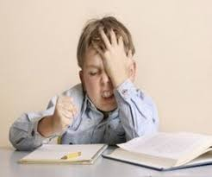
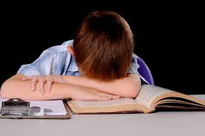
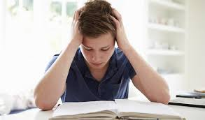
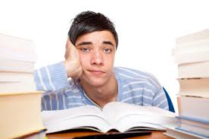

Slide 3
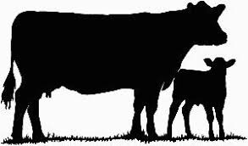
cat
pig
horse
cows

Slide 4
name ___________________
date __________________
1 pat the cat .
2 pat the pig .
3 pat the horse .
4 pat the cat .

Slide 5
Name __________________
Date ___________________
Pat the cat.

Slide 6
Name __________________
Date ___________________
Pat the cat.
Pat the pig.

Slide 7
Name __________________
Date ___________________
Pat the cat.
Pat the pig.
Pat the horse.

Slide 8
Name __________________
Date ___________________
Pat the cat.
Pat the pig.
Pat the horse.
Pat the cat.

Slide 9
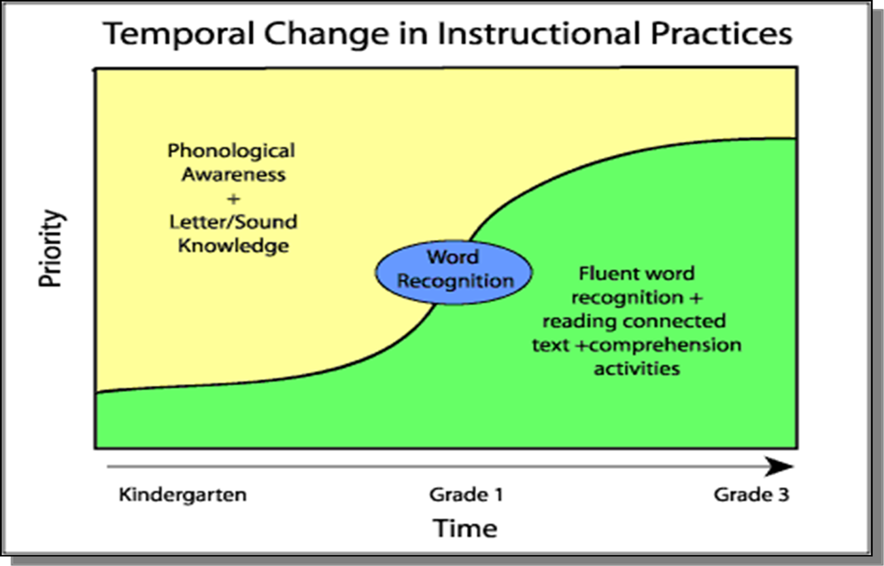

Slide 10
Reading is a Complex Activity
• A skilled reader rapidly and accurately decodes the words,
− attaches the meaning to words and sentences,
− connects text information to relevant background knowledge,
− maintains a mental representation of what he or she has
already read
− forms hypotheses about upcoming information and
− makes decisions based on their purpose for reading
all at the same time.

Slide 11
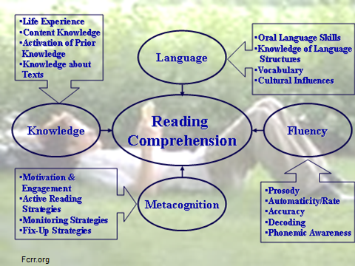

Slide 12
Essential Components of Reading
Component | Elementary | Secondary
Phonemic Awareness | 
Word Study |  |  (Advanced)
Fluency |  | 
Vocabulary |  | 
Comprehension |  | 

Slide 13
Phonological/Phonemic Awareness
Understanding of different ways that oral language can be divided into smaller components and manipulated (an auditory skill)
Creates understanding of internal structure of words
Basic to more complex skills
Rhyming
Sentence Segmentation
Syllable Segmentation/Blending
Onset-rime blending/Segmentation
Blending/Segmenting Individual Phonemes
Phoneme Deletion and Manipulation
Highly predictive of acquisition of beginning reading skills
Related not only to reading but also to spelling

Slide 14
Phonemic Awareness Strategies
Use songs, poetry
Twinkle, twinkle little car; Humpty Dumpty wall on a sat
Create rhyming words and silly rhyming phrases
A cat wearing a _____ (hat); A goat that is sailing a ______ (boat)
“Twinkle, twinkle little car”; “Humpty Dumpty wall on a sat”
Clap the syllables
Develop memory and attention skills
“Clap, clap, snap, fall”
I Spy; I’m Thinking

Slide 15
Phonemic Awareness Strategies
Use blocks to represent each syllable
Read and reread a variety of books with expression, inflection and fluency
Include good, rich discussions about story, author’s intent and relation of the story to the children
Promote activities that help children to understand that print represents spoken language
Calendar
Signs/labels/notes/posters in room
Directions for activities and locations

Slide 16
Word Study Phonics/Decoding
Relationship between phonemes (sounds and graphemes (letters and spellings)
Decoding: Individual letter names and sounds; short & long vowel patterns; blends & digraphs; vowel-consonant-3; r-controlled vowels; vowel teams; prefixes & suffixes; multisyllabic words
Letter-sound association
Consonant, short and long vowels, r-controlled vowels, blends, digraphs
Single syllable words
Multisyllabic words
Structural analysis
Compound Words
Contractions
Structural elements
Prefixes - added before root word (happy – unhappy)
Suffixes - added after root word (amuse – amusement)
Inflectional Endings - boy-boys; look-looked; mean-meaner

Slide 17
Decoding – Why?
Decoding is directly related to comprehension
“There is no comprehension strategy powerful enough to compensate for the fact you can’t read the words.” (Anita L. Archer, Ph.D.)
Poor word recognition skills account for major differences between high performing and low performing readers in upper grades
Inability to decode multisyllabic words is particularly problematic for older struggling readers
Carefully teach the decoding strand of core reading programs in primary grades

Slide 18
Decoding Strategies
Instructional strategies
Provide explicit, systematic instruction
Directly teach letter-sound association and blending of sounds into words
Provide practice decoding single syllable words in lists and decodable passages
Directly teach the pronunciation of structural elements including inflectional endings, prefixes, and suffixes
Give lists of words with similar structure
Deliver instruction that is meaningful, lively and engaging
NOT repetitious drill or mindless completion of worksheets

Slide 19
Decoding Strategies
Provide examples and think-alouds
Track and analyze reading errors and reteach necessary skills
Teach older students a strategy for unlocking the pronunciation of long words
Provide Feedback
Guidance, verbal correction, modeling, questions, reminders, encouragement
Model first (multiple examples), Guided practice, Independent practice

Slide 20
Reading Instruction
Guided Practice
Teacher and Student(s) (“We do”)
Teacher and students do examples
together
Do multiple examples
Continue until instructor feels
comfortable that students are
ready to work independently
Independent
Student (“I Do”)
Student does skill independently
Teacher monitors and provides
support and encouragement
Teacher checks for understanding
Teacher observes and notes skills
that need review and re-teaching
Model/Demonstrate
Teacher (“I do”)
Teacher activates and builds v
student background knowledge
and skills
Teacher models new skills
Teacher provides multiple
examples
Teacher uses think-alouds
Model your thinking and
thought processes
Teacher checks for understanding
Teacher reviews/reteaches skills

Slide 21
Decoding Strategies (cont’d)
Break assignments into manageable proportions
Small parts, chunks
Teach steps in sequence
Start at student’s level and go forward at his/her own pace
Reinforce increasingly greater/more advanced skill
Provide content related vocabulary
Highlight features of the textbook

Slide 22
Decoding Strategies (cont’d)
Build prior knowledge and relevance
Demonstrate how to focus on important information
Examine the structure of words and use roots and affixes to help comprehend new words
Provide a variety of engaging, interesting, student-level independent reading

Slide 23
Fluency
The ability to read connected text accurately with appropriate rate and expression
Fluency is related to reading comprehension
Fluent readers do not have to concentrate on decoding words, but can focus on content
If reading processes are fast and unconscious, the conscious is free to think about the meaning of the text
Fluent readers make the connection between the text and their own personal experiences
An accurate, fluent reader will read more
Fluency is the bridge between recognizing words and comprehension

Slide 24
Take a Deep Breath….
“Is reading comprehension compromised by lack of fluency with decoding?”
Read this passage on your blue handout starting from the bottom of the passage reading backwards. Do your best reading.
.nworb emoceb seye eht ,detisoped si tnemgip elbaredisnoc fI .roloc evitinifed sti semussa siri eht .ecafrus roiretna eht no raeppa ot snigeb tnemgip eht sA .roloc yarg-etals ro hsiulb a fo tceffe eht gnivig yllausu ,eussit tneculsnart eht hguorht swohs reyal tnemgip roiretsop ehT .siri eht fo ecafrus roiretna eht no tnemgip on ro elttil si ereht htrib tA

Slide 25
How much did you understand?
At birth, eye color comes from what layer of the eye?
When does the eye show its definitive color?
What needs to be in place for eyes to become brown?

Slide 26
Lack of Fluency and Decoding
The purpose of this activity was to experience the effect of low decoding skills in students on the comprehension of text.
The Point:
Too much concentration on decoding,
even when you know the words,
takes “brain power” and
deters the comprehension of the passage.
Therefore, fluency and automatic recognition of words is critical to comprehension.

Slide 27
Fluency Strategies
Explicitly teach decoding skills for reading single syllable and multi-syllabic words
Increase the number of words that students recognize immediately (sight vocabulary)
Prepare students for passage reading
Introduce the pronunciation of difficult words
Explicitly teach vocabulary
Introduce background knowledge

Slide 28
Fluency Strategies
Utilize reading procedures that promote reading practice
Choral reading
Group reading where everyone reads the same words at the same time
Partner reading
Partner a higher level reader with a struggling reader (Caution: do not have the gap between levels too wide)
The higher level reads the passage first modeling appropriate reading, the lower level reader follows along and then reads the same passage

Slide 29
Fluency Strategies (cont’d)
Utilize reading procedures that promote reading practice
Guided oral reading (with support and feedback)
Read Aloud (with teacher modeling)
Reader’s Theater
Use of scripts
No costumes, props, or scenery
Multiple opportunities for meaningful practice
Repeated Reading
Taped Reading
- Listening and following along with the text
- Provides students support and a sense of the proper phrasing and
speed of fluent reading

Slide 31
Vocabulary
Ability to understand and use a word effectively and appropriately to foster comprehension
Vocabulary is related to
Reading comprehension
Overall academic success
Ability to learn more vocabulary
Adequate reading comprehension depends on a person knowing between 90 to 95% of the meanings of words in the text

Slide 32
Vocabulary Gap
 | Words heard per hour | Words heard in a 100-hour week | Words heard in a 5,200 hour year | 3 years
Welfare | 620 | 62,000 | 3 million | 10 million
Working Class | 1,250 | 125,000 | 6 million | 20 million
Professional | 2,150 | 215,000 | 11 million | 30 million
Hart & Risley, Meaningful Differences in Cummulative Experiences

Slide 33
Reasons for Vocabulary Difficulties
Lack of exposure to words (through reading, speaking and listening)
Lack of background knowledge related to words
Lack of direct vocabulary instruction

Slide 34
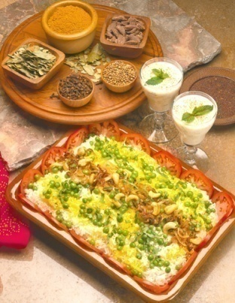
Vocabulary Casserole
Ingredients Needed:
20 words no one has ever heard before in his life
1 dictionary with very confusing definitions
1 matching test to be distributed by Friday
1 teacher who wants students to be quiet on Mondays copying words
Put 20 words on chalkboard. Have students copy then look up in dictionary. Make students write all the definitions. For a little spice, require that students write words in sentences. Leave alone all week. Top with a boring test on Friday.
Perishable. This casserole will be forgotten by Saturday afternoon.
Serves: No one.
Adapted from When Kids Can’t Read, What Teachers Can Do by Kylene Beers
Notes:
Kylene Beers makes an analogy we can all relate to in her book When Kids Can’t Read, What Teachers Can Do. Food! Here we have the “vocabulary casserole” which combines 20 unknown words, a typical dictionary, a weekly matching test and a quiet, structured, teacher-centered classroom.

Slide 35
Some vocabulary practices…
Unreliable Practices
Research-based Practices
Asking students, “Does anyone know what _____ means?”
Numerous independent activities without guidance or immediate feedback
Directing students to “look it up” then use it in a sentence
Relying on context based guessing as a primary strategy
Teacher directed, explicit instruction
Provide opportunities to practice using words
Teach word meanings explicitly and systematically
Teach independent word learning strategies (i.e., contextual strategies & morphemic analysis
Notes:
You’ve had an opportunity to talk about vocabulary instruction. Let’s look at these unreliable and research-based practices.
Traditional vocabulary instruction might include an overuse of asking students who knows what a word means. Typically, some students will respond an confirm or validate their ownership of the word. What about the other students who don’t know the word? Will they learn it from this type of activity? Probably not. Asking this type of question limits the conversation to those who don’t need the help and denies the students who need it most the opportunities they need. Too many students are passive by-standers in the vocabulary learning arena. It is their teachers who spend more time saying and using vocabulary than they do!
Traditional vocabulary instruction has also included a large amount of independent work such as finding words in the dictionary, completing worksheets, using the words in sentences. These practices do not assist most students in acquiring the words they need to know and use. Likewise, relying on context is an ineffective strategy. For example, in content-specific text such as that used in science or history, there are just too many words for guessing.
Now let’s look at some research-based vocabulary practices. What do we mean by “explicit instruction”? Some instructional guidelines for teaching a new term include:
Pronounce the word chorally
Explain vs. define
Provide examples
Deepen understanding
Review and coach use of the new term
It is also very important to teach students how to learn new words independently. We’ll provide some examples of techniques later in the presentation.

Slide 36
Vocabulary Strategies
Select books rich in text
Pre-read text
Choose words for vocabulary instruction carefully
Know your students
Choose words that will be used repeatedly
Pre-teach the chosen words
Pre-teach the chosen words
Use, direct explicit instruction
Develop child friendly definitions
Analyze word relationships
Divisible/division
Compare and contrast words
Antonyms, synonyms
Engage students in active learning with multiple methods
Interesting
Challenging
Playful activities

Slide 37
Vocabulary Strategies (cont’d)
Use repeated multiple exposures and multiple examples in context (spoken and written)
Direct, explicit instruction
Semantic Feature Analysis
Vocabulary Cluster
Definition Mapping
Frayer Model
Drawing
Acting out
Games
Foldables
Thinking Maps

Slide 38
Direct, Explicit Instruction
Teach the meaning of critical, unknown vocabulary words
Step 1 Introduce the word
Write the word on the board
Read the word and have the students repeat the word
“This word is relieved. What word?”
Step 2 Present multiple student-friendly explanations
Tell the students the explanation
”When something that is difficult is over or never happened at all, you feel relieved.”
“So if something that is difficult is over, you would feel _________________.”

Slide 39
Direct, Explicit Instruction
Step 3 Illustrate the word with examples
Concrete examples
Visual representations
Verbal examples
“When the spelling test is over, you feel relieved.”
“When you have finished giving the speech that you dreaded, you feel relieved.”
Step 4 Check students’ understanding
Ask deep processing questions
“When students are lined up for morning recess, Jason said, “I am so relieved that this morning is over.” Why might Jason be relieved?
“When Maria was told that the soccer game had been cancelled, she said, “I am relieved.” Why might Maria be relieved?”

Slide 40
Direct, Explicit Instruction
Step 4 (continued) Check students’ understanding
Have students discern between examples and non-examples
“If you were nervous singing in front of others, would you feel relieved when the concert was over? Why?”
“If you loved singing to audiences, would you feel relieved when the concert was over? Why or why not?”
Have students generate their own examples
“Tell your partner a time when you were relieved.”
Provide students with a “sentence starter”. Have them say the complete sentence.
“Sometimes your mother is relieved. Tell your partner when your mother is relieved. Start your sentence by saying, My mother is relieved when ______________.”

Slide 41
Direct, Explicit Instruction Example #2
Book: Doctor DeSoto (Steig, 1982)
Teacher: “In the story, it said that the DeSotos wouldn’t even treat a timid cat. Timid means “shy, maybe a little scared”. Let’s say the word together.” -- timid
“People can be timid, too. For example, if you walked into a big room full of people you didn’t now you might feel a little timid.”
“Show how you would look if you felt timid.”
“Show how a timid cat might act.”
“Let’s say the word together.” -- timid

Slide 42
Direct, Explicit Instruction
Teacher: “In the story, the fox thought of Dr. DeSoto as a tasty morsel. A morsel is a very small piece of food. Let’s say the word together.” -- morsel
“The fox thought of Dr. DeSoto as a morsel of food because in comparison to a fox a mouse is very tiny.”
“If the food that I name is a very small piece of food, say morsel. If it isn’t a morsel, don’t say anything.”
One Cheerio
A whole pie
A raisin
A turkey dinner
A cake crumb
“Let’s say the word together” -- morsel

Slide 43
Direct, Explicit Instruction
Teacher: “In the story, Dr. and Mrs. DeSoto had to come up with a plan to protect themselves. Protect means “to keep something safe.” Let’s say the word together.” -- protect
You protect your feet from getting wet by wearing boots. A mother cat protects her kittens by keeping them close to her.
“I’ll say some things, and you tell me how they could protect you.”
A pot holder
A smoke alarm
Mittens
Seat belts
“What word are we learning?” -- protect

Slide 44
Direct, Explicit Instruction
Teacher: “Let’s think about all three words: timid, morsel and protect.”
“If a little boy walked out on a stage and saw a lot of people in the audience, would he feel timid or morsel?”
“Would someone wrap a baby in a warm blanket to protect him or timid him?”
“Is a morsel more like a slice of cake or a crumb of cake?”
-Bringing Words to Life: Robust Vocabulary Instruction
Isabel L. Beck, Margaret G. McKeown, Linda Kucan

Slide 45
Semantic Feature Analysis
Term | animal | mammal | fur
dog | + | + | +
cat | + | + | +
snake | + | - | -
 | FDR | JFK | Nixon | Reagan | Clinton
Democrat | + | + | - | - | +
Wartime | + | - | + | - | -
Majority of popular vote | + | - | -/+ | + | -
Re-elected | + | - | + | + | +
Served in Congress | - | + | + | - | -

Slide 46
Vocabulary Cluster
ridiculous
ordinary
silly
usual
preposterous
outrageous
average
Person | Thing | Animal
clown | eggbeater | platypus

Slide 47
Definition Mapping
Mammal used for riding, racing, pulling heavy loads
definition
hohrshhoe
the word
horse
examples

Slide 48
Frayer Model
Definition
A mathematical shape that is closed plane figure bounded by 3 of more line segments
Characteristics
Closed
Plane figure
More than 2 straight sides
2-dimensional
Made of line segments
Word
Polygon
Non-examples
circle
cube
Sphere
cylinder
cone
Examples
hexagon
square
trapezoid
rhombus

Slide 49
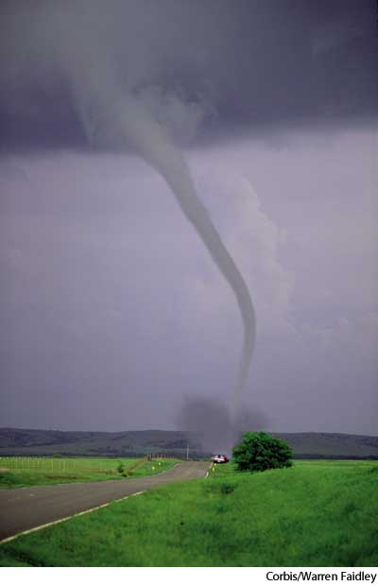
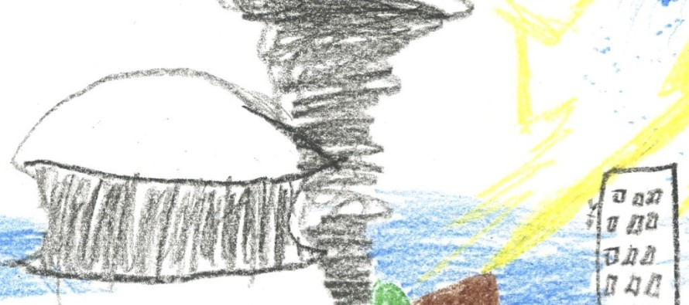
TIP
T | I | P
Term | Information | Picture
volcano | rupture in the Earth's crust where molten lava and gases from escape into the air.
tornado | a twirling, narrow funnel of wind with speeds of 100 to 300 miles per hour that can damage anything in its path
hurricane | a storm with a violent wind, in particular a tropical cyclone in the Caribbean

Slide 50
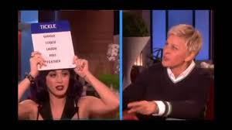
Acting Out
Taboo
Procedure
Concept/words are written on cards
Pair students
One student is Clue detective
One student is Clue giver
Students sit face-to-face
Cards are placed between them
Clue detective places card on forehead so they cannot see it, but clue giver can see it
Clue giver provides clues to clue detective for word
Pairs switch roles

Slide 51
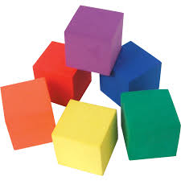
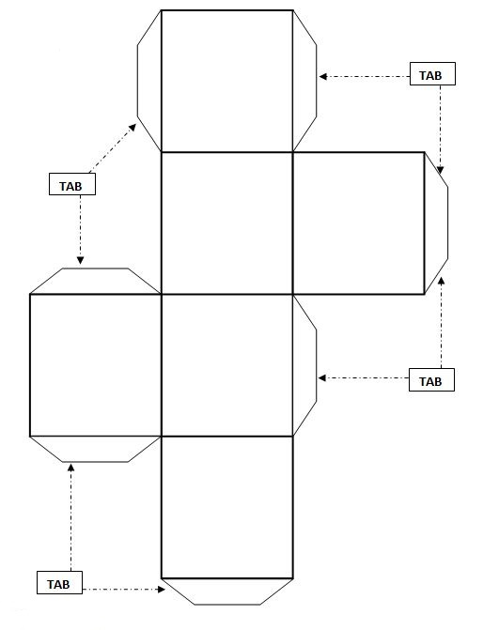
Games
Cubing
Tape a vocabulary word on each side of cube
In groups, roll cube
Give definition for word
Option: Create sentence from word
Option: Draw pictures of words

Slide 52
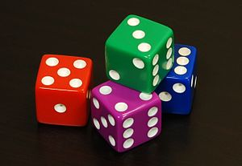
Games
Vocabulary Cubes with Dice
Both partners choose the same 6 words to practice, then write a word on each line of your paper
Do not let your partner see the order of your words.
Your partner should figure out your word from the strategy you use.
Optional Dice Strategies
1 Make a connection to another word
2 Give your definition of the word 3
3 Draw the word
4 Act it out
5 Give a synonym or antonym
6 Use the word in a sentence

Slide 53
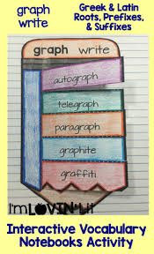
Foldables

Slide 54
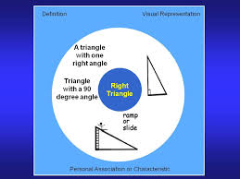
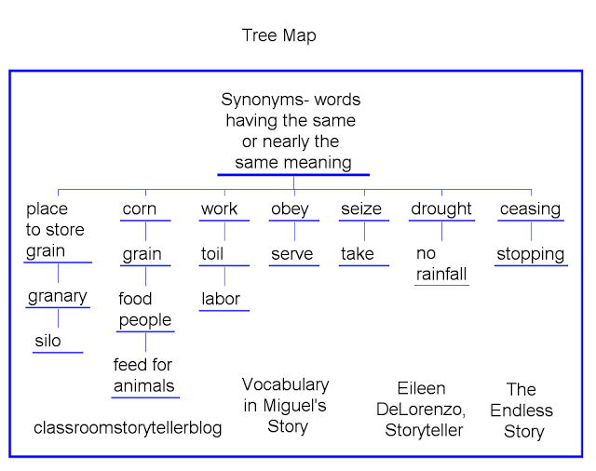
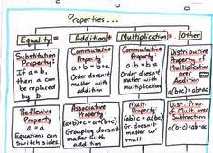
Thinking Maps

Slide 55
Vocabulary Treat
Ingredients Needed:
5-10 great words that you really could use
1 thesaurus
Markers and chart paper
1 game like Jeopardy or BINGO
1 teacher who thinks learning is supposed to be fun
Mix 5 to 10 words into the classroom.
Have students test each word for flavor.
Toss with a thesaurus to find other words that mean the same.
Write definitions on chart paper and let us draw pictures of words to remind us what they mean.
Stir all week by a teacher who thinks learning is supposed to be fun.
Top with a cool game on Fridays like jeopardy or BINGO to see who remembers the most.
Serves: Many
Adapted from When Kids Can’t Read, What Teachers Can Do by Kylene Beers
Notes:
Now let’s have a look at a recipe for a “Vocabulary Treat”. We are taking a smaller amount of words, an active approach to learning and teaching and incorporating user-friendly resources. A thesaurus, or dictionary that provides student-friendly explanations are more appropriate than traditional dictionaries for student vocabulary growth. Actively participating in illustrating the new words involves the use of multiple senses and learning styles which results in greater student learning.

Slide 56
Comprehension
The process of constructing meaning from written texts using a variety of applied strategies
The ultimate purpose of reading
Old, Incorrect New Thinking
Thinking Based on Research
Comprehension occurs naturally • Students must be taught to flexibly
after a student learns to decode, use a repertoire of strategies for
thus comprehension just needs to text comprehension
be tested
Comprehension will improve through
isolated teaching of specific
comprehension skills (e.g. sequence,
cause and effect, main idea)
Adapted from Armbruster, Lehr & Osborn,
Carlisle & Rice

Slide 57
Teaching vs Testing Comprehension Comprehension
Developing
Comprehension
Process-Oriented
Modeling
Guided Practice
Independence
Determining
Comprehension
Product – Oriented
Testing Grading
Evaluating

Slide 58
What Do Good Readers Do?
Make predictions based on background knowledge
Identify key ideas from text they are reading
Are aware of text structures
Monitor their comprehension and know how to employ fix-up strategies
Have a knowledge of and use a variety of reading strategies effectively
Paraphrase, explain and summarize information and construct conclusions

Slide 59
Sources of Comprehension Difficulties
PROCESSES
Decoding (accuracy)
Word Naming Speed
(automaticity and
fluency)
Working Memory
(attention)
Inference Making
(abstract thinking)
Visualization
Comprehension
Monitoring
KNOWLEDGE
Vocabulary
(word meaning)
Oral Language
Prior Knowledge
Comprehension Strategies
Carlisle & Rice, Perfetti, Marron & Foltz

Slide 60
Comprehension Strategies
Teacher Actions for Success
Make explicit connection between strategy and application and text
Model the process for success so students see the mental workings involved (Think-Aloud)
Provide students with multiple opportunities to perform the strategy themselves
Teach strategies with proven success
Promote independence
Apply strategies across curriculum
Use before, during and after reading strategies

Slide 61
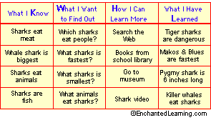
Comprehension Strategies
Before Reading
Teach the pronunciation of difficult to read words
Student can focus energy on comprehension
Focus attention on prefixes, suffixes, root words
Accurate pronunciation of words supports vocabulary acquisition and use of words in discussions/writing
Teach the meaning of critical, unknown vocabulary words
Select limited number of words that are critical to passage understanding
Teach or activate any necessary background knowledge
Ask questions designed to activate knowledge
Have students brainstorm topics in the text by using Think, Pair, Share
Complete a KWHL chart
Connect to prior knowledge
Complete a KWHL chart

Slide 62
Comprehension Strategies
Before Reading (continued)
Preview the text
Preview text structure: title, introduction, headings, subheadings, questions. Emphasize how different genres have different structure – Narrative stories are very different from social studies textbook
Provide key ideas/concepts
Examine visual representations and graphics
Students discover
topics to be covered
information to be emphasized
how the material is activated
Make predictions
I think this title means that _________________ will happen in this story
Revisit predictions during and after reading to confirm or disconfirm

Slide 63
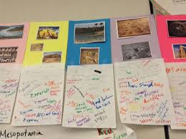
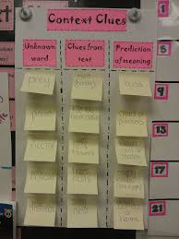
Comprehension Strategies
Before Reading (continued)
Connect to prior knowledge
Image Brainstorm
Show a picture or image and students tell everything they can about the picture
Word Splash
On individual sticky notes write a word or short phrase response to term provided
Categorize the sticky note responses
Determine headings for your categories

Slide 64
Comprehension Strategies
During Reading
Stop periodically and summarize what you have read
Focus on the main idea and supporting details in each paragraph
Ask appropriate questions during passage reading
Have students generate questions
Guide students in passage reading using
Choral reading
Partner reading
Read – Pause – Question
Partner #1 reads. Partner #2 asks questions. Students alternate as reader and listener
Read – Pause – Record
Partner reads. Both students record notes on graphic organizer
Read – Pause – Retell
Partner #1 reads. Partner #2 retells content. Students alternate as reader and the one who retells

Slide 65
Comprehension Strategies
During reading (continued)
Silent reading
Pause periodically to check for understanding
Teacher Generated Questions
Memory Questions (who, what, when, where)
Convergent Thinking Questions (why, how, in what ways)
Divergent Thinking Questions (image, suppose, predict, if/then)
Evaluative Thinking Questions (defend, judge, justify, what do you think)
Scaffold Questions – ask lower order (literal) questions first to establish a foundation for high order responses
Lower order: How did the higher nobles benefit from feudalism? How did the lower nobles benefit from feudalism?
Higher order: Why did the author suggest that the standard of living between the very rich and the very poor was not as great as the difference is today?

Slide 66
Comprehension Strategies
During Reading (continued)
Teach fix-up strategies for when reading doesn’t make sense (Model Strategy – I do it, We do it, You do it)
Reread
Look back
Read ahead
Restate in your own words
Connect to what you already know
Visualization
Read a passage related to the topic
As you read, draw simple pictures that mark the actions, events, or key points
After reading, retell the passage as you point to the pictures in sequence

Slide 67
Visualization Example
Take a clean piece of paper from the back of your handouts
As I read “A New Way of Travel,” draw the simple pictures I describe starting at the top of your page. There will be 8 pictures.
After I finish reading the passage turn to your elbow partner at your table and retell the passage as you point to the sequence of pictures on your paper.
Incorporate important vocabulary into the retelling.

Slide 68
Comprehension Strategies
After Reading
Delete trivial/redundant information
Summarize paragraphs/stories
Graphic organizers/concept maps
Story logs
Sequence of events
Cause/Effect
Compare/Contrast
Problem/Solution
Checklists/observation forms
Role play
Quiz writing
Complete KWHL charts

Slide 69
The Writing Process

Slide 70
Prewriting Stage
Fine Motor Development
Work with play dough or other manipulative objects to build strength and dexterity
Cut play dough in strips with a knife
Use large tweezers to pick up tiny objects such as Cheerios
Tear paper into strips, crumple paper into balls
Letter Formation
Use a pan of pudding, shaving cream, colored sand, finger paint for student to practice writing letters
Use pipe cleaners and have student bend them into letter shapes.
Form letters with play dough
Use paper with raised lines or enlarged lines

Slide 71
Generating Ideas
Use journals for regularly scheduled writings
Have students sequence cards to generate ideas and thoughts
Provide “I like” or similar type of sentence starters
Brainstorming
Provide detailed directions for writing assignments
Deliver one-on-one directions to students or provide a copy of written directions
Select familiar topics or have students generate topics
Model concrete examples before students begin writing
Give list of descriptive words categorized by noun, verb, adjective, etc.
Provide visual organizers and model the use of them

Slide 72
The Writing Process
Focus on development of ideas
Avoid excessive corrections of mechanics when student is beginning to write
Use visual organizers
Provides structure for student
Feeding
Fresh water, dog food special treats bowls dishes morning evening
Training
Class, obedience, leash, chain, training, reward
Dog
Exercise
Run, play, catch a ball, walk daily, leash, kennel
Grooming
Veterinarian, nails, brushing, shedding, bathing, dog soap, dog shampoo

Slide 73
The Writing Process
Provide explicit writing instruction
“Struggling writers, who are likely struggling readers, must have explicit instruction in how to write if we expect them to become better writers and ultimately better readers.”
Model thought processes for developing story ideas
Question student about essential parts of the story
Who is the main character?
Who are the other characters in your story?
What does the main character want to do in the story?
How does your story end?
Teach importance of beginning, middle, and an end
Use mnemonics as support for proofreading writing
Have student read story aloud
Provide technology assistance and support

Slide 75
“Mike’s Poem”
https://www.youtube.com/watch?v=laT8kiS8RPI

Slide 76
Strategies for Struggling Readers

Slide 77
