Slide 1
Strategies for Supporting Students in Math
Session 5

Slide 2
Mathematics is a second language ~ the language of symbols…….

Slide 3
https://www.youtube.com/watch?v=t8XMeocLflc

Slide 4
What is a math learning disability?
Dyscalculia /ˌdɪskælˈkjuːli.ə/ is difficulty in learning or comprehending arithmetic, such as difficulty in understanding numbers, learning how to manipulate numbers, and learning facts in mathematics. It is generally seen as a specific developmental disorder.

Slide 5
Things you should know….
Math involves a sequence of events
Students who have difficulty sequencing, have difficulty with math
Students who reverse letters may also reverse numbers
Students who don’t learn basic math will struggle with more advance math
Manipulatives help because they can be counted, grouped and regrouped
However, sometimes manipulatives are confusing to some students….they don’t make the connection between the problem on the paper and the manipulatives they are using

Slide 6
Where do you begin?
Determine what you need to know to help your students?
Do you need to know more about algebra? Geometry? Etc.
Ask your teacher to help you understand the concepts prior to class.
Schedule time to meet with her to review the lesson
Ask for assignments ahead of time so that you can be sure that you know how to do them
What action do you need to take to insure that you can support the students?
When will you complete the work that you need, so that you can support the students?

Slide 7
Help Students Get Better at Math
Look for student mistakes and identify errors
Procedure – student uses inappropriate procedures to solve the problem
Basic facts – student consistently misses specific fact(s)
Help students identify errors
Help students re-work problems correctly to learn correct processes
***Be sure to let the teacher know of the errors and ask for guidance on how he/she would like for you to help student.

Slide 8
Types of Student Errors
Basic Fact Errors
When the correct steps for solving the problem are used, but the answer is incorrect because of a basic fact error.
Examples: 7 x 3 = 25; 379 x 6 = 2268
Procedure Errors
When the student uses inappropriate procedures to solve the problem or skips a step
Example: 8 + 5 = 3; 10 – 4 = 14

Slide 9
Identify Student Errors Activity

Slide 10
Helping Students Learn Basic Facts
Recognize that more drill and practice will not work
The student needs a strategy
Inventory what each student knows and what he/she doesn’t know
Make a record of the types of mistakes that students are making (i.e. basic facts or procedure)
Determine strengths and weaknesses
What do they do when they encounter a problem they do not know?
Build in success
When reviewing facts, sandwich known and unknown facts so the student experiences success. This builds confidence!
Demonstrate Think-Alouds
Verbalize your mental thought processes in solving the math problems

Slide 11
Strategies for Math
Use real life experiences/situations
Telling time
Ordering at a restaurant
Football game yards
Baseball statistic
Highlight when the operation changes on a math worksheet
Reinforce key math terms from the text
Use colored chalk/markers to represent fact families, algebraic equations, etc.
Model problem solving using manipulatives
Verbally explain each step

Slide 12
Strategies for Math
Create a number-line on the floor using masking tape
Use popsicle sticks, buttons, counters, etc for students who cannot grasp the number-line concept
For students who have difficulty identifying coins, color code them until they can generalize the skill
For word problems, teach students how to:
Read the problem, determine the question
Reread the problem, looking for key words such as altogether, together, in all, are left, spent and remain

Slide 13
Strategies for Math
Teach mnemonic devices for the steps to solve problems:
Long division: Dad (divide), Mom (multiply), Sister (subtract), Brother (bring down)
Dividing fractions: Kids Can Flip(Keep the first fraction, Change the sign to multiply, Flip the last fraction)

Slide 14
Addition Facts Chart

Slide 15
Subtraction Chart

Slide 16
Strategies for Multiplication
Doubles
2 times any number is the same as that number added to itself
Example: 7 x 2 = 14; 7+7 = 14
Fives
5 times any number is the same as counting by 5 that many times
Example: 5 x 5 = 25; 5, 10, 15, 20, 25
Zeros
Illustrate that the number of sets of zero is still zero
Example: (0)(0)(0)(0) = 0; 4 x 0 = 0
Nines
The answer in the ten’s column will always be one less than the other factor (the one other than 9) Example: 6 x 9 = 54; 3 x 9 = 27
When you add the two numbers in the answer together, it will equal 9. Example: 6 x 9 = 54 (5+4=9); 3x9=27 (2+7=9)

Slide 17
Multiplication Chart

Slide 18
Strategies for Division

Slide 19
Division Chart

Slide 20
Helping with Word Problems
Students should have a copy of the strategy posted, so they can refer to it when solving word problems
Color code key words in the problem
Model problem solving for students
Allow them to practice with you
Allow them to tell you what they are to do
Allow them time to practice

Slide 21
Helping with Word Problems
Jane had 6 jacks. She lost 2 jacks. How many jacks does she have left?
STAR Method
Search the word problem
Translate the words into an equation in picture form
Answer the problem
Review the solution
RIDE
FAST DRAW

Slide 22
STAR Strategy

Slide 23
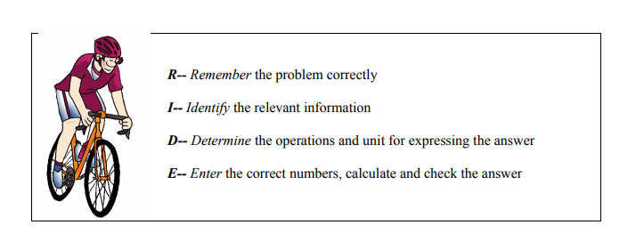
Strategies for Word Problems

Slide 24
Strategies for Word Problems

Slide 25
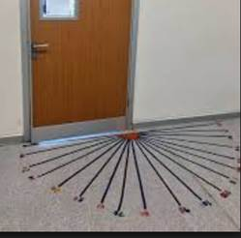
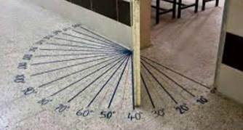
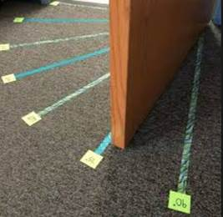
Door Protractor Examples

Slide 26
Accommodations vs Modifications
Accommodations
Modifications
Provide access, but do not significantly change content, expectations or standards
Substantial change or alteration of content, expectation or minimum standard

Slide 27
Making General Accommodations
Re-word directions on worksheets
Terminology posters/sheets
Add +
Subtract –
Multiply x
Give correct examples for students to model

Slide 28
Assistive Technology Review
Assistive technology (AT) is any item, piece of equipment, software program, or product system that is used to increase, maintain, or improve the functional capabilities of persons with disabilities.
AT can be low-tech: communication boards made of cardboard or fuzzy felt.
AT can be high-tech: special-purpose computers.
AT can be hardware: prosthetics, mounting systems, and positioning devices.
AT can be computer hardware: special switches, keyboards, and pointing devices.
AT can be computer software: screen readers and communication programs.
AT can be inclusive or specialized learning materials and curriculum aids.
AT can be specialized curricular software.
AT can be much more—electronic devices, wheelchairs, walkers, braces, educational software, power lifts, pencil holders, eye-gaze and head trackers, and much more.
Assistive technology helps people who have difficulty speaking, typing, writing, remembering, pointing, seeing, hearing, learning, walking, and many other things. Different disabilities require different assistive technologies.

Slide 29
AT for Math
Calculators
Number line
Computer

Slide 31
