Slide 1
JAN Allocations Projections: IRR Teachers
Monday, 11/4
IST
Notes:
Time: 30 seconds
Facilitator Notes: Welcome participants as they enter the room.
Say: "During this session we will be reviewing the new JAN Allocations Projections process. You will see some tweaks to the way we will be doing allocations by taking a true projection model into account."

Slide 2
PHASE I
When:
November 6 - 22
Purpose:
Completion of the Projection Worksheet
Deliverables:
Case Manager Projections Form
School Projection Worksheet
Special Ed Schedule
STEPS:
Train Staff on JAN Allocation Projection Process
Make Student Projections
Complete School Projections Worksheet
Analyze Student Data
Set-up Schedule
Create SEC Schedule
Notes:
Time: 2 minutes
Facilitator Notes: none
Say: "We will be reviewing PHASE I of the JAN Allocations Projections Process. Phase I will take place November 6th through November 11th. The purpose of this phase is to complete the projection worksheet; which is a multi-tier process that includes IRR Teachers completing the Case Manager Projections Form, the IST completing the School Projection Worksheet, and the creation of the special education schedule. Phase I consists of 6 steps. We will be reviewing STEP 2 during our time together.

Slide 3
STEP 2: Make Student Projections
Case Manager reviews Case Manager Guide
Case Manager then completes the Case Manager Projections Form (electronically)
Case Manager sends form to IST
Notes:
Time: 1 minute
Facilitator Notes: none
Say: "Again, the three main components of this phase are the case manager projections form, which I will review in detail today. Once completed, you will e-mail to me. I will then copy and paste the information you provided into the overall school projection worksheet."

Slide 4
STEP 2: Make Student Projections
Task:
Review the Case Manger Guide
Columns A – L
Annual Review Scenarios
Student Progress Scenarios
Notes:
Time: 4 minutes
Facilitator Notes: Handout the Case Manager Projections Guide
Say: "Let's take a look at the Case Manager Projections Guide. The section reviews the information you will be entering into columns A-L. We will look at each of these columns in detail together in a just a moment. The next section provides guidance on whether you use what is it listed in the IEP or need to make a projection. If the Annual Review is completed, you will simply use what is listed in the IEP. If you have not held the Annual Review yet, you will need to go to the next section, which gives guidance on how to make projections. Looking at the next section, as you would if you were holding the Annual Review, make a determination on what type of services the student will need next year based on whether the student is meeting expectations or not. On the back is additional guidance on the types of services as well as a screen shot of the form you will be completing. We will review both of these in depth."

Slide 5
STEP 2: Make Student Projections
Task:
Enter students into Case Manger Projections Form
DO NOT INCLUDE students who are projected to GRADUATE
DO NOT INCLUDE students in IRR with an ACTIVE File Review,
Notes:
Time: 2 minute
Facilitator Notes: During this next section, you may want to have up the actual document to walk them through it live.
Say: "IRR teachers will be filling in a simple sheet for each student on their case load. HIGH SCHOOL: If the student is expected to graduate, DO NOT ENTER him/her on the form. ALL SCHOOLS, if the student is currently in IRR and has an Active File Review open, DO NOT ENTER him/her into the form."

Slide 6
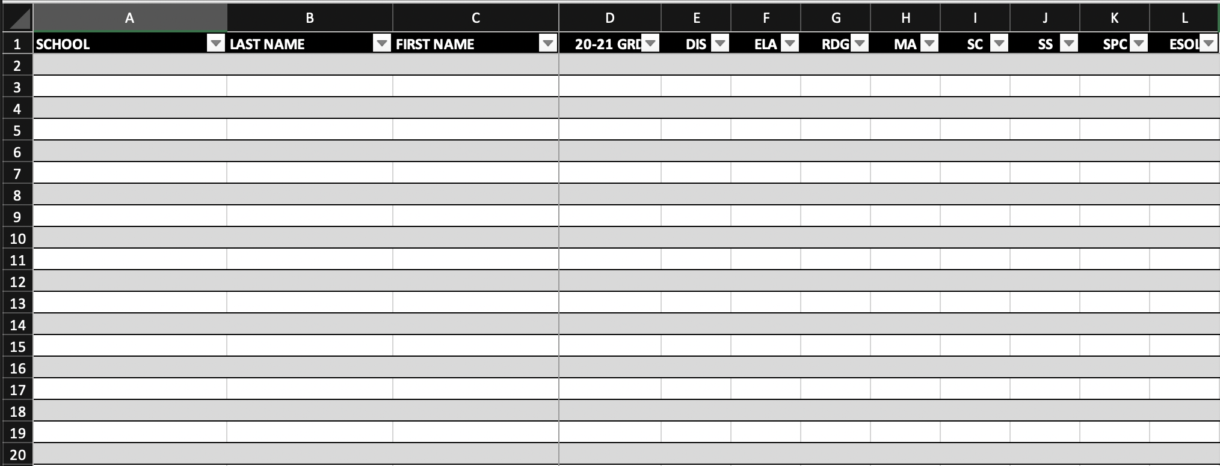
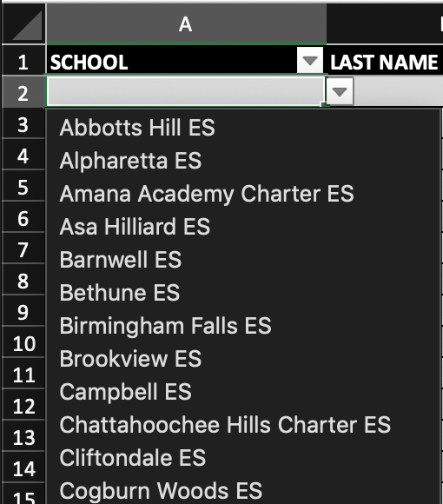
SCHOOL
CHOOSE FROM DROP-DOWN
Student moving to next grade within the SAME school → choose current school
Student is being retained → choose current school
Student is matriculating to K (in another school), MS, or HS --> choose “MATRICULATING”
Student is GRADUATING/FILE REVIEW → DO NOT INCLUDE
Notes:
Time: 1 minute
Facilitator Notes: During this next section, you may want to have up the actual document to walk them through it live.
Say: "In Column A, SCHOOL, you will choose one of two things, either the current school, or Matriculating. Choose the current school if the student is moving from one grade level to another within the school or the student is being retained. Choose MATRICULATING if the student is moving from PK to K in another school, 5th to 6th, or 8th to 9th. Again, do not enter those students that are graduating or in IRR with an Active File Review open."

Slide 7
LAST NAME/FIRST NAME
ENTER STUDENT’S NAME
Enter the student’s last name in column B
Enter the student’s first name in column C
PLEASE BE SURE TO SPELL THE STUDENT’S NAME CORRECTLY
Notes:
Time: 1 minute
Facilitator Notes: During this next section, you may want to have up the actual document to walk them through it live.
Say: "In Columns B an C, enter the student's last name and first name respectively. Please be sure to spell the student's name correctly."

Slide 8
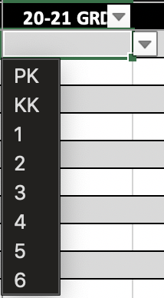
20-21 GRD
CHOOSE FROM DROP-DOWN
Choose the student’s grade level for NEXT year
Notes:
Time: 1 minute
Facilitator Notes: During this next section, you may want to have up the actual document to walk them through it live.
Say: "In column D, from the drop-down, choose the grade level of the student for the 2020-2021 school year. It is very important that this is correct as it will directly impact allocations."

Slide 9
DIS
CHOOSE FROM DROP-DOWN
Choose the student’s PRIMARY disability
Notes:
Time: 1 minute
Facilitator Notes: During this next section, you may want to have up the actual document to walk them through it live.
Say: "in Column E, from the drop-down choose the student's PRIMARY disability."

Slide 10
Instructional Styles
For the next section, you will choose from the following:
Abbr. | Instructional Style | Definition
CON | Consultative | Student is instructed in the General Education with a GE Teacher and support from a SE Teacher less than 50% of the time
SI | Supportive Instruction | Student is instructed in the General Education classroom with a GE Teacher for 100% of the time AND a Para for 100% of the time
COL | Collaborative 1 – 1SET, 1GET | Student is instructed in the General Education classroom with a GE Teacher 100% of the time AND a SE Teacher for 50% of the time
COT | Co-Teaching | Student is instructed in the General Education classroom with a GE Teacher for 100% of the time AND SE Teacher 100% of the time
RES | Resource | Student is instructed in the Special Education classroom with a SE Teacher for 100% of the time
Notes:
Time: 4 minutes
Facilitator Notes: Refer then to the back of their Case Manager Guide.
Say: "There are 5 types of services from which you will choose for columns F-K. [REVIEW each service type]."

Slide 11
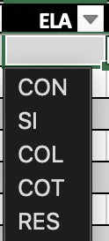
PREPS
CHOOSE FROM THE DROP-DOWN
For each prep that would be listed on the IEP, choose the correct instructional style
If the prep is not listed on the IEP (no special ed services) → LEAVE BLANK
Notes:
Time: 1 minute
Facilitator Notes: During this next section, you may want to have up the actual document to walk them through it live.
Say: "Using the service types we just reviewed, enter the student's projected services for each content area listed on the IEP. If the content area is not listed on the IEP, LEAVE BLANK."

Slide 12
STEP 2: Make Student Projections
When completed, save as follows:
Case Manager Projections Form – Initial.LastName
EX: Case Manager Projections Form - B.McGaha
Send via e-mail to your IST no later than:
Day, XX/XX at XX:XX am/pm
Notes:
Time: 1 minute
Facilitator Notes: UPDATE THE DUE DATE!! You are welcome to change the naming convention as you see fit.
Say: "Once you have entered all your students into the Case Manger Projections Form, please save it using this naming convention. [REVIEW THE NAMING CONVENTION]. Then send me your form via e-mail no later than ….."

Slide 13
Questions/Comments?
Thank you for your time and participation today. If you have any questions or comments please do not hesitate to reach out to us.
NAME, IST (e-mail)
Notes:
Time: 30 seconds
Say: “Thank you for your active participation and engagement in the session. Here is my/our contact information if you have any follow up questions or need additional support.”

