Slide 1
Copyright and Accessibility
How the Marikeesh Treaty is changing access to print materials.
Notes:
Hello everyone. Carson is sorry he can't be with us today. He is currently in Macon at our Department of Corrections Prison Braille Programs' first annual professional learning conference.
Even though, he is not here he wanted to share information that has been confusing for some regarding the Marrakesh Treaty and the definition of Competent Authority.

Slide 2
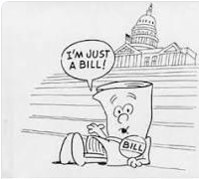
Print Accessibility Law in History
Pratt-Smoot Act of March 3, 1931 (Chap. 400. Sec. 1, 46 Stat. 1487) (original legislation 1931) Establishment of national library program administered by the Library of Congress. Authorizes provision of books for the adult blind
Pub. L. No. 82-446, ch. 566, 66 Stat. 326 (1952) Included Children
Pub. L. No. 89-522 (1966) Authorizes the furnishing of such books and other materials to people with physical disabilities.
Title 36, Code of Federal Regulations, Sec. 701.10(b) (1974) Describes categories of print impaired and competent authorities
The Chafee Amendment: 17 U.S.C. 121 , (1996) Groups producing specialized formats for the blind will no longer have to gain permission from the copyright holder to begin production.
PL 108-446 Individuals with Disabiliteis Education Improvement Act (2004). Established the NIMAC and standardized file code NIMAS
The Marrakesh Treaty Amendment to 17 U.S.C. 121 (2019) Further define certain criteria.
Notes:
Extending exemptions to producers to reproduce materials for blind and visually impaired began in 1931. This act the Pratt-Smoot Act provided money for producers to convert regular print materials into braille with publisher's permission. The Act was assigned to the National Library of Congress to administer under the National Library Service (NLS). The enacted law was amended several times to adjust the amount of money that was provided to produce the materials and add other minor details.
It wasn't until 1952 that a major change was done that expanded the provision of materials to children as well as the adults previously covered under the original act. Another major change was added in 1966 to include people with physical disabilities. Both categories of blind and physically disabled could be assigned to an individual by someone designated as a competent authority. The only caveat was that a competent authority was not clearly defined in the law.
In 1974 the National Library Service of Blind and Physically Disabled offered guidance and through the U.S. Congress created the disability categories of blind and visually impaired, physical disability, and organic dysfunction. The statue also defined a host of competent authorities for blind and visually impaired and for the physically disabled. However, those who were deemed as competent authorities for the organic dysfunction category were doctors of medicine in consolation with others in the medical field. This provided supports for additional groups but would later muddy the water in terms of who qualified as having an organic dysfunction and potentially limited services for the people with an invisible print disability.
The Chafee Amendment to the original Act of 1931 is the most widely know amendment to the law. This amendment was meant to decrease the amount of time that it took for the print impaired to get materials by circumventing the previous requirement of requiring permission from publishers to reproduce books in accessible formats. This cleared the way for different agencies to produce materials and get them in the hands of readers faster. However, a major drawback was that different agencies produced identical titles in many different formats which wasted time and money.
The re-authorization of the Individuals with Disabilities Education Improvement Act of 2004 attempted to resolve the formats issue by creating a repository for a standardized accessible ready file. The American Printing House for the Blind was chosen to "house" the repository know as the National Instructional Materials Accessibility Center (NIMAC). Although participation in the NIMAC was voluntary all 50 states and territories of the U.S. agreed to participate and provided assurances that any curriculum materials purchased from publishers would contractually be submitted by the publisher in the new National Instructional Materials Accessibility Standard (NIMAS) format. This increased the opportunity for accessible curriculum for K-12 students on IEPs but was marred by the former NLS statue defining disability categories and those competent to diagnose them.
Fast-forward to today and the adoption of the Marrakesh Treaty which is the latest amendment to the U.S. copyright laws regarding accessible print. The treaty has existed in many other countries for several years and was initiated to provide international exchange of accessible materials. The treaty was signed into law this year. It has not only opened international exchange of accessible materials but also redefined disability categories.

Slide 3
The Marrakesh Treaty
“Marrakesh Treaty to Facilitate Access to Published Works for Persons Who Are Blind, Visually Impaired or Otherwise Print Disabled,” provides for the exchange of accessible-format books across international borders by organizations that serve people who are blind, visually impaired, and print disabled. The Marrakesh Treaty was adopted in 2013 by the World Intellectual Property Organization (WIPO) to address the widespread problem known as a “book famine,” the situation where few books are published in formats that are accessible to those who are blind or visually impaired. The United States became the fiftieth member to be party to the treaty on February 8, 2019.
Notes:
The Marrakesh Treaty defined print disability categories to those of 1. blind, 2. visually impaired or otherwise print disabled, and 3. physically impaired.

Slide 4
Marrakesh Treaty Changes
Expanded the types of works allowed to be copied from nondramatic literary works to all literary works, plus musical works fixed in the form of text or notation.
Changed the term “specialized formats,” the definition of which was limited to specific technologies, to “accessible formats,” which is defined more broadly as an “alternative manner or format” (includes related illustrations)
Updated the beneficiaries, which were originally termed “blind or other persons with disabilities,” to “eligible person,” which is defined as someone who is either blind, has a “visual impairment or perceptual or reading disability” rendering them unable to read printed works “to substantially the same degree as a person without an impairment or disability,” or has a physical disability making them unable to hold or manipulate a book or focus or move their eyes to read. Note: Additionally, the Senate Report stated that a condition making one an “eligible person” must be “determined by a competent authority possessing experience in making such determinations.”
Notes:
The treaty also expanded the variety of materials covered, removed limiting technology definitions, and updated beneficiaries or disability categories. But as with other past copyright accessibility amendments named but did not define those who are the competent authorities thus leaving the 1974 statute intact.

Slide 5
Beneficiary Changes
1974 statue
Blind and Visually Impaired
Physical Disability
Organic Disfunction
Marrakesh
Blind
Visual or print impairment
Physical Disability
Notes:
This demonstrates the comparison of the 1974 statue beneficiary definition to that of the Marrakesh Treaty emphasizing the change from the label of an organic dysfunction to that of a print impairment.

Slide 6
NLS’s New Identity
National Library Service for the Blind and Physically Handicapped
National Library Service for the Blind and Print Disabled
Notes:
The U.S. Congress authorized a name change of the National Library Service of Blind and Physically Handicapped (NLS) to the
CLICK SLIDE TO CHANGE NAME
National Library Service of Blind and Print Disabled.

Slide 7
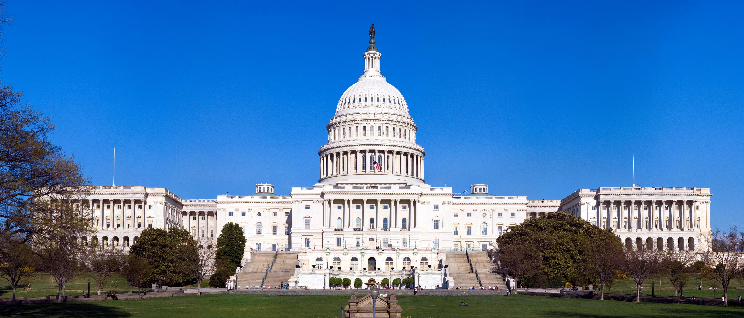
Next Act…
Revision of Title 36, Code of Federal Regulations, Sec. 701.10(b) defining competent authorities…
Expected Fall 2019.
This Photo by Unknown Author is licensed under CC BY-SA
Notes:
The next break through which will increase the opportunities the invisibly print impaired will be the Congressional revision of the 1974 statue to redefine competent authorities. The NLS expects this to happen in the Fall of 2019 but until then has issued a “stay put” on the requirement of a medical doctor as the only professional who is the competent authority for the newly defined print impaired category.

Slide 8
Laws Impacting Accessible Text
IDEA
Rehabilitation Action of 1973 (Section 504)
Title II Americans with Disabilities Act (ADA)
Each of these laws obligate districts “to ensure timely provision of appropriate, accessible instructional materials for all students with disabilities who require such materials because of their disabilities….”
Notes:
Three laws, IDEA, 504, and ADA require accessible materials “who require such” even though there is no change in the law regarding certification by a competent authority for copyright provision for accessible materials. The GaDOE is closely monitoring the situation and will issue an official statement when congressional approval and the change of the definition of a competent authority is modified.

Slide 9
Recommended Resource
Policy Brief Accessible Instructional Materials: Ensuring Access for Student with Learning Disabilities, (2010) National Center for Learning Disabilities, Accessed 06sep2019, https://web.kamihq.com/web/viewer.html?file=https%3A%2F%2Fwww.cleweb.org%2Fsites%2Fcleweb.org%2Ffiles%2Fassets%2FNCLD_AIM.pdf&source=extension_open_button.
Notes:
An excellent resource for additional timeline and history of accessible material copyright provisions is this policy brief issued by the National Center for Learning Disabilities. (NCLD)

Slide 10
Contact Information
Carson Cochran, Program Manager
Georgia Department of Education
205 Jesse Hill Jr. Dr., SE
1870 E Tower
Atlanta, GA 30334
470-316-8662
ccochran@doe.k12.ga.us
Notes:
Please direct any questions to Carson at the following contact.

