Slide 1
Cybersecurity and Account Management Webinar
Migrant student information exchange (MSIX)
February 23, 2023
Deloitte

Slide 2
Privacy Reminder
The Migrant Student Information Exchange (MSIX) contains real and sensitive student data that should not be shared with those who are not authorized to view it.
Protecting a child’s Personally Identifiable Information (PII) is paramount when using MSIX.
If there is a PII incident,
contact the MSIX Help Desk immediately.
Notes:
MSIX does contain Personally Identifiable Information (PII), which is information that, alone or in combination, is linkable to a specific child that would allow a person to identify the child with reasonable certainty.
Please note that information or data in all screenshots are fictitious. We take great care in protecting sensitive information, and you should do the same when handling student data.

Slide 3
Agenda
1
MSIX Overview
2
Cybersecurity and Privacy Awareness Training
3
MSIX Account Management

Slide 4
MSIX Overview
MSIX is a web-based application that links State migrant systems to produce a single Consolidated Student Record containing the Migrant Education Program (MEP) minimum data elements (MDEs) to not only analyze national migrant trends, but also facilitate:
Credit Accrual
MEP Participation
Enrollment
Placement
Notes:
As you know, migratory children move from place to place, often on short notice, and families may not have time to gather their children’s education and health documentation before re-enrolling them in a new school district. This can delay enrollment or result in misplacement in grade or course level. MSIX ensures that a migratory children’s academic progress is documented in a central system accessible wherever they go.
To do this, MSIX is a web-based application that links State migrant systems to produce a single Consolidated Student Record composed of minimum data elements, or MDEs. This not only allows for the generation and analysis of national migrant trends, but primarily assists authorized personnel to make informed decisions on enrollment, grade or course placement in a new school, accrual of credits towards graduation, and participation in the Migrant Education Program.

Slide 5
MSIX Overview | Secure Access
Notes:
To check that a website is safe:
Look for the “S” in HTTPS. HTTPS indicates that security is provided by an SSL certificate which protects sensitive information entered into the site as it travels from the site to a server.
Look for the padlock next to site address as indicated in the slide with the yellow arrow. A padlock indicates a secure site. A padlock with a yellow warning triangle indicates that the connection is only partially secure and a padlock with a red strike over it indicates that content is being delivered via an insecure protocol such as HTTP or FTP.

Slide 6
Cybersecurity and Privacy Awareness Training

Slide 7
Federal and U.S. Department of Education Cybersecurity References
Federal Information Security Modernization Act of 2014 (FISMA)
National Institute of Standards and Technology (NIST) Special Publication (SP) 800-53A Revision 5
Federal Government
Department of Education
ACSD-OCIO-004: Cybersecurity Policy
MSIX System Security Plan
MSIX Privacy Impact Assessment
MSIX System of Records Notice
Interconnection Security Agreements
Memoranda of Understanding
MSIX Rules of Behavior
MSIX Specific
Notes:
There are many different directives and security policies that MSIX must follow to maintain a secure environment for hosting the data of migratory children. At the Federal Government level there is the Federal Information Security Modernization Act of 2014 (also known as FISMA).
FISMA codifies the Department of Homeland Security’s role in administering the implementation of information security policies for federal Executive Branch civilian agencies, overseeing agencies’ compliance with those policies, and assisting OMB in developing those policies.
Also, at the Federal Government level is the National Institute of Standards and Technology (NIST) Special Publication (SP) 800-53A which provides a catalog of security and privacy controls for federal information systems and organizations and a process for selecting controls to protect organizational operations (including mission, functions, image, and reputation), organizational assets, individuals, other organizations, and the Nation from a diverse set of threats including hostile cyber attacks, natural disasters, structural failures, and human errors (both intentional and unintentional). All Federal Government information systems are required to comply with FISMA and follow the NIST SP 800-53A.
The overarching cybersecurity policy for the Department of Education is ACSD-OCIO-004. This policy specifies the process that manages information security and privacy risk specifically for IT systems at the U.S. Department of Education.
Finally, the MSIX specific security documents include the System Security Plan which documents how MSIX implements the security controls specified by NIST. The Privacy Impact Assessment (PIA) and System of Records Notice (SORN) document the PII contained in the MSIX system, why it is there, and how MSIX protects it. The Interconnection Security Agreements (ISAs) and Memoranda of Understanding (MOUs) are agreements made between the Department of Education and the State Education Agencies for exchanging the Minimum Data Elements (MDEs). Finally, the MSIX Rules of Behavior explains the policies and procedures MSIX Users are expected to follow when accessing the MSIX system.
It is important to understand the types of cybersecurity threats in order to avoid falling victim to an attack. The online presence of each MSIX User can put student data at risk. Social media can grant access to unwanted "friends" who may be gathering your personal information to crack answers to MSIX Challenge Questions. Although much simpler, using the same password for multiple websites put you at risk if that password is compromised – it can be used to access other online accounts. Clicking on unknown or suspicious links can put your device at risk for malware and ransomware attacks that give bad actors access to student data that has been downloaded on your device. These examples and many more are the reason we take the time each year to review Cybersecurity and Account Management. The more you know, the less susceptible you are!

Slide 8
Cybercrime Statistics
Although the majority of spam gets picked up by spam filters, with the large amount of overall spam, email users must remain vigilant. Cybercriminals are becoming craftier when it comes to phishing for information impersonating trusted sources.
About 150 billion spam emails are sent every day.
1
The Interstate Technology and Regulatory Council (ITRC) reported in 2021 that cybercriminals remain less invested in taking large amounts of personal information instead manipulating poor consumer behaviors to perpetrate identity-related crimes against businesses using stolen credentials, such as logins and passwords. Criminals then utilize these stolen logins and passwords to perpetrate ransomware and phishing attacks.
2
60% of business endured a ransomware attack last year
There is a cyber-attack once every 39 seconds
3
According to a study from the University of Maryland, a typical computer is attacked in one way or another every 39 seconds. This could come in the form of a direct hacking attempt, a phishing attempt, or some other version of spam meant to infect your computer with malware.
Notes:
The information on this slide is relevant because all individuals must practice proper cyber hygiene because without appropriate cyber software such as anti-virus and spam filters your computer can be an access point to MSIX for nefarious parties.
Did you know that about 150 billion spam emails are sent everyday. Even though inboxes have spam filters configured, they will not catch all spam emails. Email users must remain vigilant when reviewing emails and clicking on links or attachments. 5 Must-Know Cybersecurity Stats of 2022 | Abnormal Security
This next one was a staggering statistic for me to learn -60% of businesses endured a ransomware attack last year. Cybercriminals remain focused on manipulating poor cyber hygiene to perpetrate identity-related crimes and steal credentials such as logins and passwords. These stolen logins and passwords are then used to launch ransomware and phishing attacks against businesses.
Finally, according to a study from the University of Maryland, a typical computer is attacked in one way or another every 39 seconds. This comes in the form of direct hacking attempts, phishing attempts, or some other type of spam meant to infect your computer with malware.
It is pertinent that all individuals have not only the appropriate cyber software such as anti-virus and spam filters but also practice proper cyber hygiene.

Slide 9
Mobile Apps
Best Practices
Applications (apps) on your smartphone or other mobile devices can be convenient tools to access the news, get directions, pick up a ride share, play games, or learn the latest dance steps. But these tools can also put your privacy at risk.
When you download an app, it may ask for permission to access personal information—such as email contacts, calendar inputs, call logs, and location data—from your device. Be careful when downloading Mobile Apps!
Download from official app stores, such as your device’s manufacturer or operating system app store
Review app permissions
Limit location permissions
Keep app software up to date
Delete apps you do not need
Be cautious when signing into apps with social network accounts.
Notes:
Review app permissions. Ensure your installed apps only have access to the information they need and remove unnecessary permissions from each app. Consider removing apps with excessive permissions. Pay special attention to apps that have access to your contact list, camera, storage, location, and microphone.
Limit location permissions. Some apps have access to the mobile device’s location services and thus have access to the user’s approximate physical location. For apps that require access to location data to function, consider limiting this access to when the app is in use only.
Keep app software up to date. Apps with out-of-date software may be at risk of exploitation of known vulnerabilities. Protect your mobile device from malware by installing app updates as they are released.
Delete apps you do not need. To avoid unnecessary data collection, uninstall apps you no longer use.
Be cautious with signing into apps with social network accounts. Some apps are integrated with social network sites—in these cases, the app can collect information from your social network account and vice versa. Ensure you are comfortable with this type of information sharing before you sign into an app via your social network account. Alternatively, use your email address and a unique password to sign in.

Slide 10
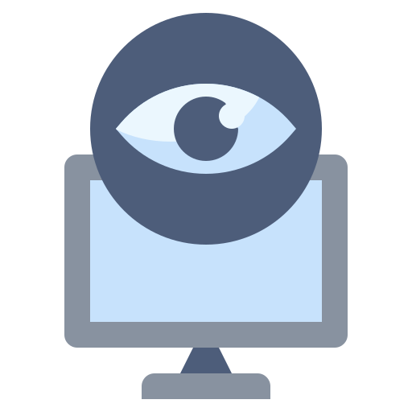
Social Media Risks
Bad actors may use their connections with you to gather information such as, common answers to security challenge questions which may be used to carry out attacks into your associated work systems. This can lead to gaining unauthorized access to sensitive information.
Risk: Retrieve your personal information from social media to steal your identity, and potentially commit fraud.
Outcome: Attempt to compromise your computer via a malicious link embedded in an email or contained in a chat.
Notes:
Bad actors may use their connections with you to gather information such as, common answers to security challenge questions which may be used to carry out attacks into your associated work systems. This can lead to gaining unauthorized access to sensitive information.
Risk: Retrieve your personal information from social media to steal your identity, and potentially commit fraud.
Outcome: Attempt to compromise your computer via a malicious link embedded in an email or contained in a chat.

Slide 11
Social Media Best Practices
Privacy
Keep social media accounts “private,” but also regularly check your settings to ensure it stays that way.
Always assume that everything that you post on the internet will, at some point, become public information.
Posting
Never post or say anything online that you wouldn’t want your family, your boss, future employers, or others to find out.
Exercise caution when posting information about yourself, your job, and your contacts on social media, as it could draw unwanted attention from criminals.
Don’t post your birth date, your address, or phone number on a social network unless you use privacy settings to restrict it to approved contacts.
Network
Be selective about who you accept as a friend on a social network and avoid accepting an invitation from an unknown third party.
Share personal information only with people you know.
Notes:
If possible, validate invitation requests through other means before accepting them.
Use caution when you click links that you receive in messages from your friends on your social media or web-based email site. You should click on a link if, and only if, you’re absolutely certain you know the sender and trust them. A genuine friend could have had their account compromised or someone may have set up an account in their name with the intention of gathering information on you and others you know. If you hover your mouse over a link, but don’t click it, the target of the link will display. This target is where the link is really taking you, regardless of what the text in the link says.
Don’t post your birth date, your address, or phone number on a social network unless you use privacy settings to restrict it to approved contacts.
Refrain from posting ED business or ED sensitive information in personal emails or on external social media outlets such as websites, Facebook pages, blogs, and tweets.
Always assume that everything that you post on the internet will, at some point, become public information. The rules and settings employed by the service provider now might change in the future, or someone might quote you.
When a friend or family member shares a social media quiz or game with you, your best course of action may be to simply ignore it. If you feel you must respond, think about what information is requested. If it is something you might use to respond to a security question, don’t post it.
Keep social media accounts “private,” but also regularly check your settings to ensure it stays that way.
Be wary of hijacked or bogus social media accounts. In some cases, genuine accounts are hacked, malware posts phony ads to their account, then tags their friends in the post. Since the posts appear in a trusted friend’s feed, users are often tricked into clicking which in turn compromises their own account.
Use the built-in reporting and blocking tools on a social media site if you believe you have encountered a bad actor.
Consider whether you need to limit the number of social media tools and accounts you use, or whether you should even use social media at all.
Notify EDSOC at (202) 245-6550 or EDSOC@ed.gov as soon as possible and without unreasonable delay if you believe you have fallen victim to a social media scam.

Slide 12
Avoid a Social Engineering Attack
DO
DON’T
Be suspicious of unsolicited phone calls, visits, or email messages from people asking about employees, computer systems, or internal information
Try to verify the identity of any unknown person who claims to be from a legitimate organization
Remember legitimate personnel will NEVER ask you for your password
Give your passwords to anyone
Enter your credentials into a website accessed by clicking a link in an email message
Allow an unknown individual remote access to your computer in response to an unsolicited telephone call or onscreen pop-up message
Notes:
The following are ways to avoid a social engineering attack:
Do…
Be suspicious of unsolicited phone calls, visits, or email messages from people asking about employees, computer systems, or internal information
Try to verify the identity of any unknown person who claims to be from a legitimate organization. If you receive an unsolicited email from a financial institution such as your bank, paypal, or even amazon asking you to call a number or click on a link from an email, the best thing you can do is look up that phone number or directly type that link into a browser that way you can confirm that you are using the correct one and not one that was maliciously sent to you trying to steal information or install malware onto your computer.
Remember legitimate personnel will NEVER ask you for your password –This includes the MSIX help desk. The Help Desk will NEVER ask you for your password so please do not send it to them or any other MSIX User administrator.
Don’t
Give your passwords to anyone
Enter your credentials into a website accessed by clicking a link in an email message
Allow an unknown individual remote access to your computer in response to an unsolicited telephone call or onscreen pop-up message

Slide 13
Browser in the Browser (BitB) Attacks
BitB attacks are false pop-up browser windows attempting to phish for credentials individuals use to sign into other accounts or websites.
Information is accessible to the hackers behind these attacks once the credentials are made available to them.
Hacked information could lead to fraud, identity theft, and may compromise the Department’s information and systems.
Best Practices
Do not click on links in unsolicited email messages, social media posts, texts, etc.
Keep your usernames, passwords, and security questions, and answers private.
Never enter your login credentials or other sensitive information in an unverified site.
Leverage phishing-resistant multi-factor authentication (MFA) on all accounts, including personal ones.
Notes:
With BitB attacks you cannot move the window or close out of the window once its been hacked in.
(BitB) attack can be exploited to simulate a browser window within the browser in order to spoof a legitimate domain, thereby making it possible to stage convincing phishing attacks.

Slide 14
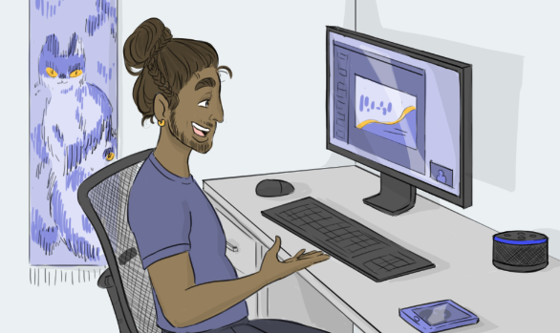
The Internet of Things (IoT)
IoT is a term used to refer to the many physical devices that are connected to the internet, all collecting and sharing data.
Examples: Smart TVs, Thermostats, Digital Assistants like Siri on iPhones and iPads as well as smart speakers such as Amazon Echo and Google Home.
Tip: These devices are constantly listening for commands so if you choose to use digital assistants, be sure to turn them off before participating in meetings.
Notes:
The Internet of Things or IoT is a term used to refer to the many physical devices that are connected to the internet, all collecting and sharing data. Examples include: Smart TVs, Thermostats, Digital Assistants like Siri on iPhones and iPads as well as smart speakers such as Amazon Echo and Google Home.
These devices are configured to constantly listen for commands. Before you use these devices, be mindful of the third-party that may also be listening.
Best practices for IoT devices include:
Replace default account names and passwords
Keep software up to date
Connect to other devices carefully
Check which permissions will be granted to mobile apps
Consider creating a separate home wireless network for IoT devices
Stay up to date on the devices you have in your home
Disable any digital assistants when participating in meetings

Slide 15
Understanding PII, SPII, and PHI
PII
SPII
PHI
Personally Identifiable Information
Any information about an individual that can be used to distinguish or trace an individual's identity alone or when combined with other information linked or linkable to the specific individual.
Sensitive Personally Identifiable Information
PII is considered SPII if its improper release could result in harm, embarrassment, inconvenience, or unfairness to the individual whose name or identity is linked to the information.
Protected Health Information
PHI is any personal health information that can potentially identify an individual, that was created, used, or disclosed while providing healthcare services, whether it was a diagnosis or treatment.
Note: MSIX does contain PII but not SPII or PHI. Please do not input a child’s SPII or PHI into MSIX via file submission or using the correspondence feature.
Notes:
While individual data elements alone in MSIX are PII and not SPII, the whole student record can cause embarrassment, inconvenience, or personal harm. Particularly since MSIX contains records for Minors, extra caution should be exercised. Always password protect or encrypt data exported or screen captured from MSIX.
It is the responsibility of every MSIX user to protect the information maintained in MSIX.
When we say protect the information, this covers not just what’s on the screen, but also downloaded files, screenshots, emails, attachments, printed records, etc.
PII and SPII should only be shared with those with a specific need. They may be parents, students, counselors, registrars, etc. but make sure the information they receive is pertinent and the correct information for the specific request each time. Ask if the information they are seeking is the right information for the right person at the right time.
Please be aware that MSIX is permitted to store PII but SPII such as social security numbers or PHI such as health conditions are not permitted to be stored in MSIX. Please do not input this kind of data into MSIX either via comment in a file submission or via the correspondence feature on move notices or data requests.
Sensitive information should only be discussed in private, controlled areas and be aware of your surroundings and the people around you
Take care when reading or viewing sensitive information outside of the office. Unauthorized individuals may be able to reach or view the information as well
Be discreet when retrieving messages from smartphones and other media. Don’t include sensitive information in voicemail messages
Do not share sensitive information with anyone else unless he or she has a work-related need to know

Slide 16
Understanding PII in MSIX
What PII is in MSIX?
The most frequent occurrence on PII infringements are unencrypted emails to the MSIX Help Desk that include PII.
Examples of a set of information that would constitute PII includes:
Student’s Name
Parent’s Name
Combination of Sex, Birth Date, or Grade Level and other identifying information such as State ID or First Name
While an individual data element may not be considered PII, combination of data elements can be!

Slide 17
Sharing PII
Stop and think:
Before sharing PII/SPII, ask yourself who you are sending it to and whether they “need to know” the information.
To prevent accidentally sending information to the wrong person, address your message carefully. Make sure you select the correct recipient.
Follow your State laws to ensure you are using approved transmission methods and required protections (e.g., encryption).
Never download or store PII on personally-owned equipment.
Do not upload PII to an unauthorized online storage site (e.g., Dropbox, wikis, etc.).
PII should never be accessed from public computers or kiosks found in hotel business centers or airports.
TIP! Do not send PII to the Help Desk without first speaking with a Help Desk representative.
Notes:
Did you know common PII incidents for MSIX involved PII sent via unsecured email to the Help Desk.
Emailing sensitive information should only be done after you stop and think about some of these key points.
What information should be shared? Who is the recipient? Do they have a ‘need to know’ for the specific information?
Ensure the email is going to the right person, and now a whole group of people. Are they inside your organization? Are they external partners?
Did you spell the email address correctly?
If PII needs to be shared, follow your State laws for approved transmission methods. This could include password protection or encrypting the attachment before sending it out.
Email is generally not a safe communication method. It can be easily intercepted without your knowledge.
Encryption tools available to each SEA/LEA differ. Each MSIX User must consult their local IT support team and SEA/LEA tools and policies for specific methods to encrypt and protect PII/SPII.
Here’s another TIP: The US Dept of ED does not routinely request PII from MSIX users. If the Department needs to review your data, we will provide a secure means to do so. This also goes for the MSIX Help Desk. Please do not send PII to the Help Desk. If they need access to data containing PII, they will work with you to send it in a secure manner.

Slide 18
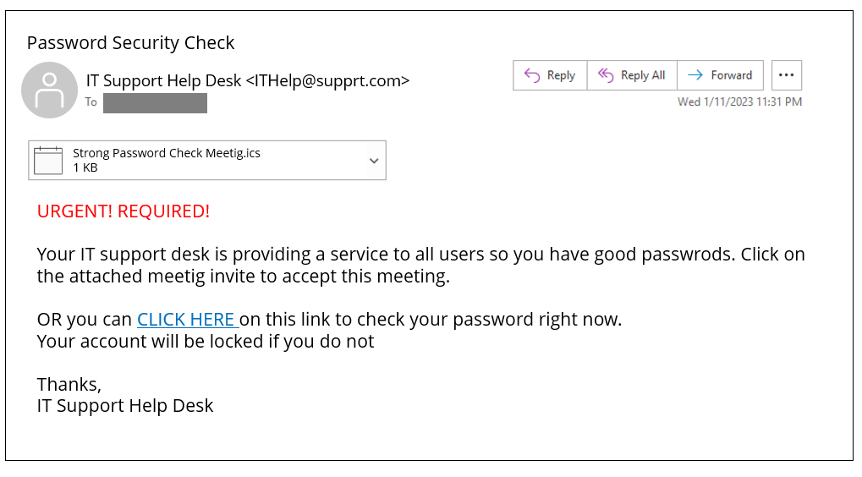
Is this a phishy email, why or why not?
Notes:
BING… you have just received an email from the IT Support Help Desk. After taking a further look you start to notice something phishy. In the chat, please identify the indicators that this email is not legitimate.

Slide 19
Example Email
Address doesn’t match name AND spelling error
Suspicious calendar invitation
Poor grammar and misspellings
False sense of urgency
Threat of account lock-out encourages action
Link goes to suspicious website
Notes:
To start, this email is coming from someone who is not in your contact list and their email address doesn’t match the senders name. Also the word support is misspelled in the domain.
Reading on, there is a strong sense of urgency presented in this email by beginning with “Urgent! Required!”
You continue to notice additional grammar and spelling mistakes in the body of the email like “passwrds, meetig”. The email asks you to click on an attached calendar invite that is .ics
When mousing over the “CLICK HERE” link, the URL for the website seems suspicious
The email ends with a threat of account-lock out
Did you catch all of the red flags?

Slide 20
Email Security Best Practices
Do not open unexpected attachments even if you know the sender
Do not click on suspicious links within emails
Install and update anti-virus software on all devices
Learn how to recognize phishing
Messages that contain threats to shutdown accounts or devices
Requests for personal information (passwords or Social Security Numbers)
Words like “Urgent”
Forged email addresses
Poor writing or bad grammar
Don’t give your email address to sites you don’t trust
Report suspicious emails to your IT Department
Notes:
Do not open unexpected attachments even if you know the sender – if you weren’t expecting an attachment or link from the sender, use a new email or call them to confirm if the attachment or link is legitimate.
Do not click on suspicious links within emails – An example is if you receive an email from your bank telling you that your account has been frozen and to click a link to resolve the issue. You can manually type in the name of your bank or do a google search to visit the legitimate link to confirm if there are any actions that you need to take. Often, the links in these types of emails are malicious.
Install and update anti-virus software on all devices
Learn how to recognize phishing
Don’t give your email address to sites you don’t trust
Report suspicious emails to your IT Department

Slide 21
Malware and Ransomware Attacks
All ransomware is malware, but not all malware is ransomware.
Reason: Deny victims access to their files and demand a ransom in exchange of restoring the access.
How to Prevent Ransomware Attacks?
Use caution with links and when entering website addresses. Pay close attention to the website addresses you click on, as well those you enter yourself.
Open email attachments with caution. Be wary of opening email attachments, even from senders you think you know, particularly compressed zip files.
Verify email senders. Contact sender directly to verify email legitimacy.
Inform yourself. Be informed about recent cybersecurity threats and be updated on ransomware techniques.
Notes:
Attackers use it to demand money from home users, businesses, financial institutions, government agencies, academic institutions, and other organizations, always within a limited timeframe. The
federal government does not support paying ransomware demands. Paying the ransom does not guarantee anything, only that the attackers receive either the victim’s money or banking information. Attackers may demand additional payments, delete a victim’s data, and refuse to decrypt the data or restore access to the system. Note that decrypting files does not mean the malware infection itself has been removed.
Ransomware spreads to connected systems, including shared storage drives and other accessible computers. Department employees and contractors have a role in helping prevent a ransomware attack from impacting operations.

Slide 22
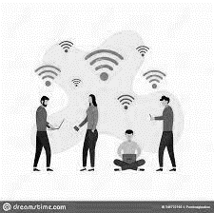
Wireless Networks: Best Practices
HOME
PUBLIC
Keep it Secure
Secure your Wi-Fi network and your digital devices by changing the factory-set default password and username.
Understand the Security Features
Do not use Wired Equivalent Privacy (WEP), which can be hacked in minutes.
Hide the Identity
Turn off the identifier-broadcasting feature of your router. Create a guest wireless network just for your laptop.
Connect to VPN
Connect immediately after logging into your laptop
Use Caution
Be wary of connecting to any network that is identified as "Free Wi-Fi.“
Use Hotspot
Another safer option for accessing the internet is to use your phone's hotspot.
Notes:
HOME
Consider your Wi-Fi router the "front door" to your home network and configure it to lock out intruders. Secure your Wi-Fi network and your digital devices by changing the factory-set default password and username. Select a password that is as long as possible and unique to your router. Keep your router software up to date.
Learn about the security features available with your router and enable firewall services when available. The firewall service will provide a barrier between your Wi-Fi network and the internet, protecting your data and network from unsolicited connections or connection attempts. Configure your router to use strong encryption provided by Wi-Fi Protected Access 3 (WPA3) or at minimum protections provided by WPA2. Do not use Wired Equivalent Privacy (WEP), which can be hacked in minutes .
Consider hiding the identity of your wireless network by turning off the identifier-broadcasting feature of your router. Create a guest wireless network just for your ED laptop and other GFES. Isolating your ED GFES equipment helps protect it from personal devices and all IoT devices on your home network which may provide points of entry for cybercriminals.
PUBLIC
Use Caution: Coffee shops, airports, hotels, and other public places are increasingly providing Wi-Fi. Do not assume they are secure. Avoid connecting to unfamiliar public wireless networks, especially if they don't require a password. Be wary of connecting to any network that is identified as "Free Wi-Fi.“
Connect to VPN: If you must use a public Wi-Fi, and have access to your agency’s VPN, ensure it is connected as soon as possible and limit your activity to web browsing. Avoid accessing any services that require entering credentials (e.g., username and password) or personal information.
Use Hotspot: Another safer option for accessing the internet is to use your phone's hotspot (e.g., mobile Wi-Fi, 4G or 5G services).

Slide 23
Annual Required Trainings
In New York, security training is required for all staff on an annual basis. Staff are trained on the Three “C”s of Security
Secure Conduct: Thinking secure when interacting with student data
Secure Computers: Ensuring all devices accessing student data are properly secured
Secure Communications: Utilizing secure methods to connect and send data over the internet

Slide 24
Secure Conduct
In New York, staff are trained on how to think secure when using any technology. Some techniques we emphasize are:
Considering FERPA whenever student data is requested
Spotting a phishing scam via emails and phone calls
Noticing attempts at social engineering
Never sharing account credentials with anyone else
Using Multi-Factor Authentication (MFA) whenever possible

Slide 25
Secure Computers
In New York, work devices that may access student data are configured to be as secure as possible
Full device encryption safeguards data on the computer
Antivirus protects against malicious programs
Secure cloud storage platforms prevent data loss

Slide 26
Secure Communications
In New York, all communications are required to be done through secure channels
VPNs are required for public Wi-Fi, and mobile hotspots are encouraged instead when possible
Student data may never be sent as plaintext over email and instead must always be encrypted or sent through a more secure platform
Staff are trained on using separation of mediums when sharing encryption keys, so that an encrypted file and its password are never both be sent over email

Slide 27
Principle of Least Privilege
This is the principle of granting the least amount of access necessary to perform one’s job duties. Following the Principle of Least Privilege better safeguards the system data against possible compromise.
In New York, student data is only
granted to the employees who
work with those students

Slide 28
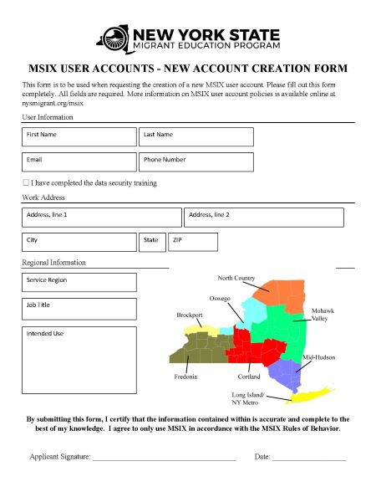
Annual MSIX Account Applications
In New York, access to MSIX must be reapplied for annually using a prepared form. This helps ensure that no disused account gets overlooked and that only the individuals still requiring access to MSIX can continue to do so.
Completion of our annual security training is
required for approval.

Slide 29
Password Managers & Passphrases
In New York, the usage of password management software and strong passphrases is encouraged
Passphrases
A phrase or short sentence used in place of a password that is usually easier for the user to remember and more difficult for an attacker to guess
Password Managers
A program that generates and stores passwords in a secure vault

Slide 30
Software Evaluation
Many software options exist to solve unique problems or to offer special functions, sometimes for free. It is important to evaluate requests to use software like this to make sure it won’t compromise a secure system.
Considerations to make
Who makes this software?
What data will it have access to?
Does the maker have incentives for you to use it?
If any of these questions can’t be answered, then the software might not be appropriate to use on a secure device.

Slide 31
MSIX Account Management

Slide 32
MSIX Password Policy
Between 12 and 20 characters.
Include at least one character from each of the four main character classes:
Uppercase letters [A-Z]
Lowercase letters [a-z]
Non-alphanumeric special characters [!,@,#, etc.]
Numbers [0-9]
Users may not re-use any of their previous 24 passwords.
Passwords must be changed after 90 days of use.
Accounts will be locked after three (3) consecutive login attempts
Notes:
The MSIX password requirements are as follows:
your password length must be between 12 and 20 characters
passwords must include at least one character from each of the four main character classes including uppercase letters, lowercase letters, special characters, and numbers.
you may not re-use any of your previous 24 passwords.
Passwords must be changed every 90 days
Accounts will be locked after 3 consecutive login attempts.
This password policy is a requirement of the Department of Education. All Department of Education information systems using passwords are required to comply with this password policy.
A tip for users who choose to take action to change their password at the 15-day or 3-day expiration notice: uses can still use their current/active password to sign in and then reset their own password on the My Account Page within the MSIX application. This will allow the user an opportunity to review and/or update their Challenge Questions prior to requesting their own password reset.
Due to the continuing threat against Federal computer systems and the sophistication with which hackers and cybercriminals are operating, Multi-Factor Authentication may soon become a requirement for the MSIX system. Like what you may have seen implemented with your financial institutions and other websites you interact with daily, MFA will involve you entering your MSIX username and password along with a one-time code received via an app or text message. Any changes to authentication will be socialized by OME before implementation occurs.

Slide 33
MSIX Multi-Factor Authentication
In January 2022, the Office of Management and Budget (OMB) released Memorandum M-22-09, which sets forth a zero-trust architecture (ZTA) strategy, requiring all federal agencies to meet specific cybersecurity standards. Implementation of MFA will strengthen defenses against increasingly sophisticated and persistent cyber threat campaigns, thereby protecting student data.
Upon MSIX login, existing users are prompted to enter a 6-digit code from their configured MFA device. When logging into MSIX for the first time, new users will need to follow the steps displayed in MSIX to configure an MFA device.
Thank you for your patience and cooperation with the MFA transition. We appreciate your time and energy in helping keep student records safe!
123456
Notes:
In January 2022, the Office of Management and Budget (OMB) released Memorandum M-22-09, which sets forth a zero-trust architecture (ZTA) strategy, requiring all federal agencies to meet specific cybersecurity standards. Implementation of MFA will strengthen defenses against increasingly sophisticated and persistent cyber threat campaigns, thereby protecting student data.
Upon MSIX login, existing users are prompted to enter a 6 digit code from their configured MFA device. When logging into MSIX for the first time, new users will need to follow the steps displayed in MSIX to configure an MFA device.
Thank you for your patience and cooperation with the MFA transition. We appreciate your time and energy in helping keep student records safe!
We also appreciate the feedback provided in the MFA Survey. The team is currently analyzing the results of the survey.

Slide 34
Accessing MSIX
New users work with their User Administrator to complete the User Access Application, Cybersecurity Training, and acknowledge the MSIX Rules of Behavior to obtain access to MSIX.
Status | Time Frame/Conditions | Password Reset
Active | Day 1 – 90 days after account activation or password reset. | Initiate Password Reset using “Forgot Your Password?” on the MSIX Login Page. Answer Challenge Questions to obtain a One-Time Password (OTP) via email. Use the OTP to login to MSIX and reset your password.
Locked | Incorrect username/password combination entered 3 times. | Initiate Password Reset using “Forgot Your Password?” on the MSIX Login Page. Answer Challenge Questions to obtain a One-Time Password (OTP) via email. Use the OTP to login to MSIX and reset your password.
Expired | 91 days – 120 days after account activation or password reset. | Initiate Password Reset using “Forgot Your Password?” on the MSIX Login Page. Answer Challenge Questions to obtain a One-Time Password (OTP) via email. Use the OTP to login to MSIX and reset your password.
Disabled | 121 days after account activation or password reset or manually disabled at any time. | Contact User Administrator.
Deactivated | 1 year after account disablement or manually deactivated at any time. This is a permanent action. | Contact User Administrator to complete your State’s account application process to re-establish access.
Notes:
To gain access to MSIX, potential users must work with their State or Regional User Administrators to complete their State’s MSIX account application process which includes completing a user access application, completing basic cybersecurity training, and acknowledging the MSIX rules of behavior.
Before jumping into the account statuses, remember that passwords expire every 90 days and that you must reset your password prior to the 90 days to maintain access to MSIX!
Let’s review the list of potential MSIX account statuses.
First, you can have an Active account, which means you maintain normal access to MSIX and, if you have set your challenge questions, you can manage your own password. Your account is in an active status for the first 90 days after it has been activated or after you reset your password. If you continue to reset your password within 90 days, your account with remain in an Active status.
Your account can also be Locked, which happens when you enter your MSIX username and password combination incorrectly three times. If you have set challenge questions to your account, you will now be able to use the self-managed password feature to set a new password on your own when your account is locked.
Your account expires if you have not reset your password within 90 days. When your account is expired, if you have your challenge questions set, you can reset your password on your own and regain access to MSIX. The statuses of locked and expired can only set by the system based on either too many invalid login attempts or password age. MSIX User Admins cannot manually set an MSIX account to either locked or expired. The next two statuses we will talk about, disabled and deactivated, may either be set by the MSIX system or manually by a user administrator.
As some of you might remember, we implemented automatic account disabling and deactivation in March of 2019. A month after your account expires, if you haven’t taken action to reset your password, your account will become disabled, and you will not be able to self-manage your account. This means that you will have to reach out to your MSIX User Administrator to request a password reset.
If your account has been disabled for a year, MSIX will automatically deactivate your account. If this happens to your account and you need to access MSIX again, you will need to contact your MSIX User Administrator to complete your State’s account request process.
As a reminder to MSIX User Administrators, the automatic disabling and deactivation of MSIX user accounts is a failsafe. Please continue to manually disable and/or deactivate accounts in your State in a timely manner.
A couple of other tips for using the self-service password management feature:
You cannot use this feature until you have set challenge questions on your account.
When using the self-service password feature, if you type your username incorrectly you may see generic challenge questions and not the ones you had set to your page. If this is the case, please go back and check that you entered your username correctly. As a reminder, your username is NOT your email address.
If you typed your username correctly, but answered you challenge questions incorrectly, you will receive an email to the email address registered with your MSIX account letting you know that this has happened.
The Help Desk cannot reset passwords. You must contact your State or Regional user admin to reset your password if you are not able to complete the self-managed process.

Slide 35
User Administrator Responsibilities
Reset passwords for disabled accounts.
Initiating a password reset for an active, locked, or expired account will give the user an opportunity to reset their challenge questions.
Reset MFA for users who no longer have access to their authenticator application.
Create new accounts
New users will receive two emails: one with new username and a second with a one-time password.
After logging in using the one-time password, new users will be required to set up their challenge questions and set their password.
Add or Change User Roles for existing accounts
Contact a User Administrator in your Region or State to discuss your need for additional functionality.
Disable or Deactivate accounts for MSIX users who no longer have a need to access the system.
TIP! Use the Account List Report to review user accounts within your State.
Notes:
As a User Administrator, it is important to understand your responsibility to keep MSIX safe.
Reset passwords for disabled accounts.
Initiating a password reset for an active, locked, or expired account will give the user an opportunity to reset their challenge questions.
Reset MFA for users who no longer have access to their authenticator application.
Create new accounts
New users will receive two emails: one with new username and a second with a one-time password.
After logging in using the one-time password, new users will be required to set up their challenge questions and set their password.
Add or Change User Roles for existing accounts
Contact a User Administrator in your Region or State to discuss your need for additional functionality.
Disable or Deactivate accounts for MSIX users who no longer have a need to access the system.

Slide 36
MSIX Account Maintenance Tips
MSIX automatically sends an email notice 15 days before a password expires, another notice three days before password expiration, and when the password has expired.
If your password has not expired and you want to change it, log in to MSIX and navigate to the My Account page. Check the box for “Reset my password” and select SUBMIT at the bottom of the page.
Review your Challenge Questions and answers on the My Account periodically in case you get locked out and need to use the “Forgot Your Password?” link on the MSIX sign in page to regain access.
Reset your password before you leave if you plan to be away for an extended period of time, like a summer break.
Notes:
A tip for users who choose to take action to change their password at the 15-day or 3-day expiration notice: uses can still use their current/active password to sign in and then reset their own password on the My Account Page within the MSIX application. This will allow the user an opportunity to review and/or update their Challenge Questions prior to requesting their own password reset.

Slide 37
Thank You!
February 23, 2023

