Slide 1
A Focus on Youth Suicide Awareness and Prevention
Georgia Department of Education
Suicide Prevention Advisory Panel

Slide 2


Thank you to our sponsors!
NAMI Georgia
Technical College System of Georgia
  Albany Technical College, Central Georgia Technical College, North Georgia Technical College, Northwestern Technical College, and Coastal Pines Technical College.

Slide 3
Georgia Student Health Survey 2.0
(GSHS 2.0)

Slide 4
Georgia Student Health Survey 2.0
Georgia is one of the first states with a defined method in the collection and analysis of school climate and student health data through the implementation of the Georgia Student Health Survey 2.0.
The GSHS 2.0 is an anonymous, statewide survey instrument developed by the Georgia Department of Education (GaDOE) in collaboration with the Georgia Department of Public Health, Georgia State University and the University of Connecticut. The GSHS 2.0 identifies safety and health issues that can have a negative impact on student achievement and school climate.

Slide 5
GSHS 2.0 is administered annually from October – March.
2011-2012: 350,000+ students took the Survey
2012-2013: 657,000+ students took the Survey
2013-2014: 895,000+ students took the Survey
      2014-2015: 1,097,870 students took the Survey
      2015-2016: 1,135,150 students took the Survey
      2016-2017: Over 1.2 million students took the Survey
      2017-2018: Over 1.2 million students took the Survey

Slide 6
Did You Know?
All Georgia public schools with grades 3-12 must participate in the survey.
Schools must give parents the opportunity to review the survey and opt out if desired.
Student survey responses are anonymous and self-reported.
GaDOE has internal control measures in place to ensure the integrity of the survey responses.
Schools use survey data to guide school prevention and intervention programs.
Student survey data is FERPA protected and GaDOE will not make personally identifiable, student-level data available to any person or entity outside the GaDOE.
The GSHS 2.0 is not a screening tool!

Slide 7
Student survey results are available at the school, district and state levels.
Each school and school district that participates in the Survey receives a comprehensive summary report that allows school administrators and other staff members to compare outcomes and plan prevention and intervention strategies and programs.
  Survey results are available on the GaDOE webpage.
  Raw survey data (for student, personnel and parent surveys) are available to school district personnel on the GaDOE portal.

Slide 8
2017-2018 Student Survey Results
*Statewide results - 674,354 students (grades 6-12)
12% (78,969) students have seriously considered attempting suicide in the past 12 months.
Most common reasons given by students for seriously considering attempting suicide:
  Other (most common answer)
  Family reasons
  Being bullied
  Problems with peers or friends
  Because of the demands of school work
  I do not feel safe at school

Slide 9
New responses for 2018-2019
Self Harm / Suicidal Ideation Questions
I have not….
Demands of school work
Problems with peers or friends
Family reasons
Being bullied
Social Media
School grades or performance
School discipline or punishment
Argument or breakup with a partner/girlfriend/boyfriend
Dating violence
Drugs or alcohol
Other
Students may now choose all responses that apply to them.

Slide 10
2017-2018 Student Survey Results
*Statewide results - 674,354 students (grades 6-12)
6% (37,508 students) have attempted suicide in the past 12 months.
Most common reasons given by students for attempting suicide:
  Other (most common answer)
  Being bullied
  Family reasons
  Problems with peers or friends
  Because of the demands of school work
  I do not feel safe at school

Slide 14
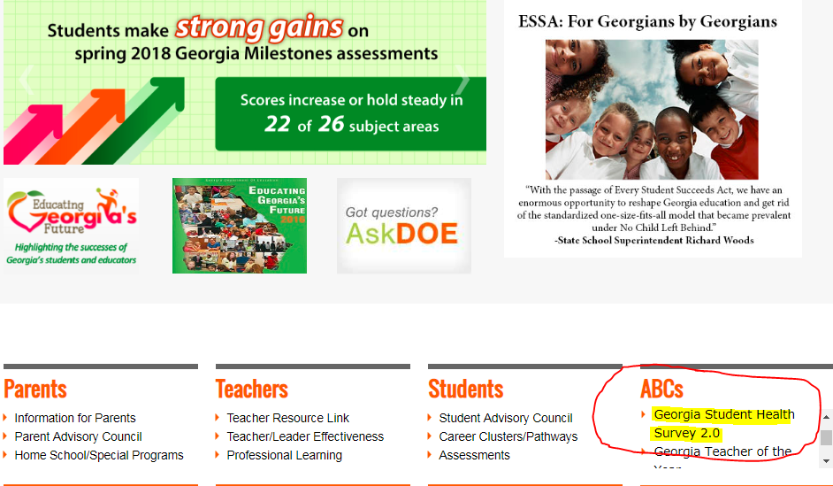

Slide 15
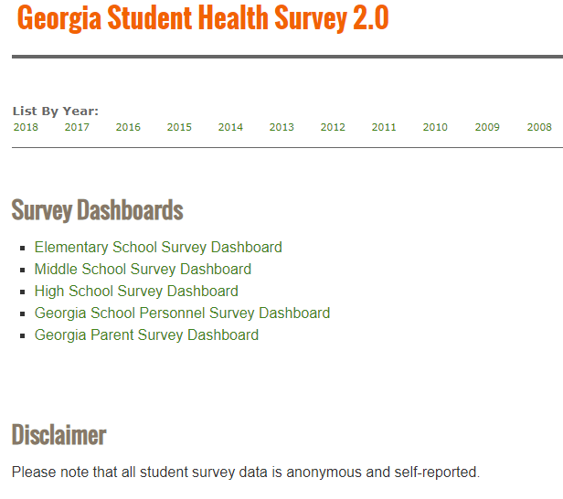

Slide 16
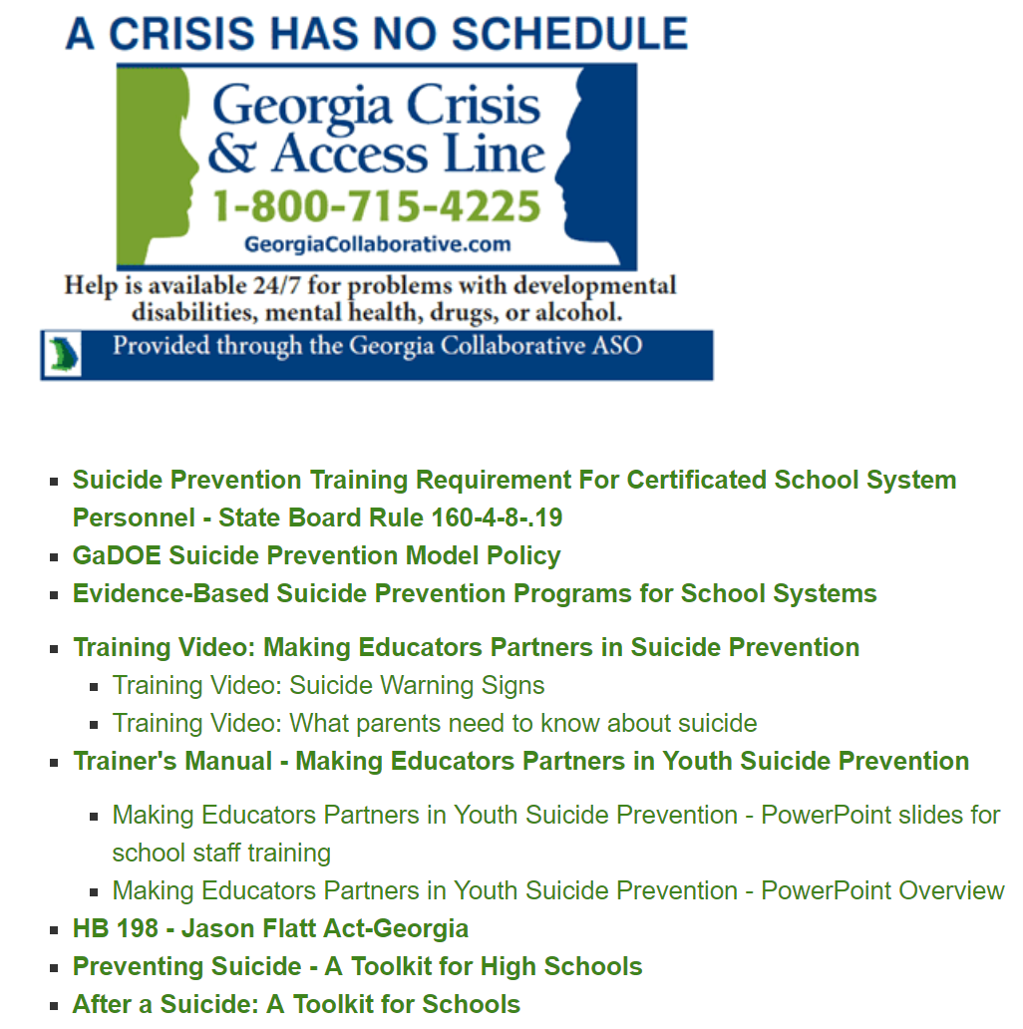
Suicide Prevention Resources

Slide 17

@gadoesafeschool

Slide 18
QUESTIONS??
Cheryl Benefield: cbenefield@doe.k12.ga.us
Jeff Hodges: jhodges@doe.k12.ga.us

